Slide 1
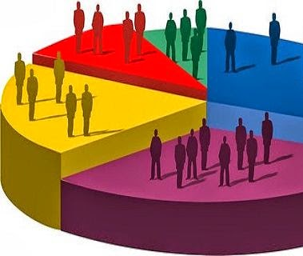

United States Census

Slide 2

Team Members:
Name | Student Id | Role
Bhavya Pichipati | 200501920 | Developer
Nihitha Patcha | 200503298 | Data Analyst
Sindhu Chakravaram | 200507049 | Business Analyst

Slide 3
Project Summary
Developed a Web Application for US Census showcasing population numbers which fetches data every 24 hours from https://datausa.io/about/api/
Use of Python for Back-End Developing and JavaScript and CSS for Front-End Developing.
Mongo Client used for MongoDB live database.
Used Flask as the web framework.

Slide 4
Steps followed to create a web application
Using https://datausa.io/about/api/ data which deals with US census.
Retrieved data is then stored in MongoDB.
The data stored is then used to analyze and create visualizations using GoogleCharts
A pseudo code is implemented in python to fetch data every 24 hours and store in database
Tried to host Web application on Heroku to be made available for everyone.
Nav bar is implemented for easier navigation and select different graphs.

Slide 5
Tools Used:
Python and Flask - To fetch data from API
MongoDB - To store the data fetched from API
Google Charts - To display visualizations of the data and do analysis
Heroku - To deploy the website on live server

Slide 6
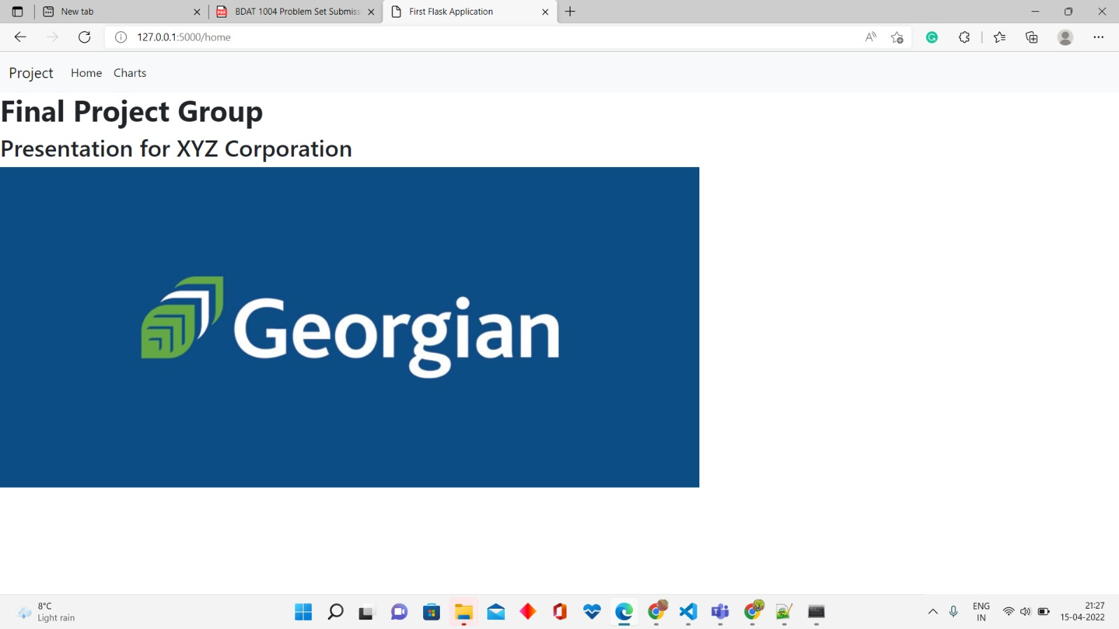
Live Link for our Project

Slide 7
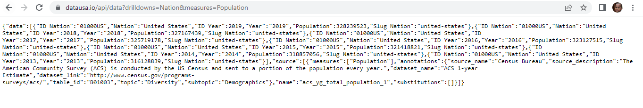
Data From API

Slide 8
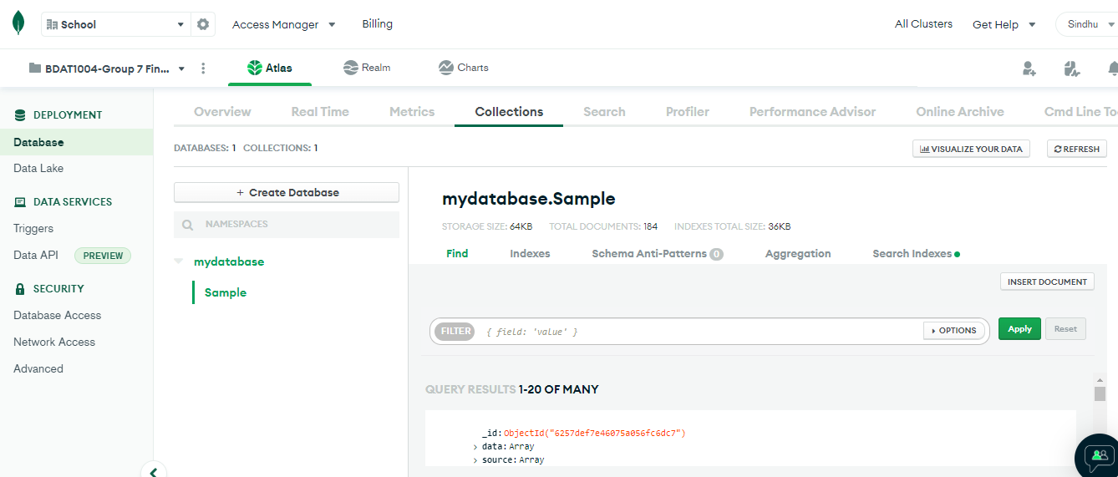
MongoDB Atlas
https://cloud.mongodb.com/v2/6253e12a1352237deade66a1#metrics/replicaSet/625521098638743470939b50/explorer/mydatabase/Sample/find

Slide 9
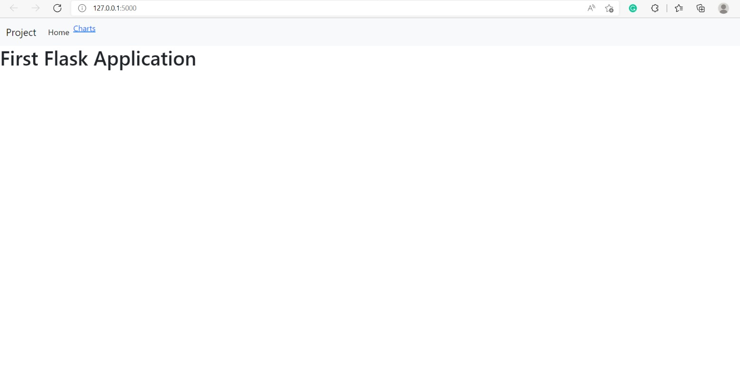
Flask Web App(Local host)

Slide 10
Flask Web App Home Page(Local host)

Slide 11
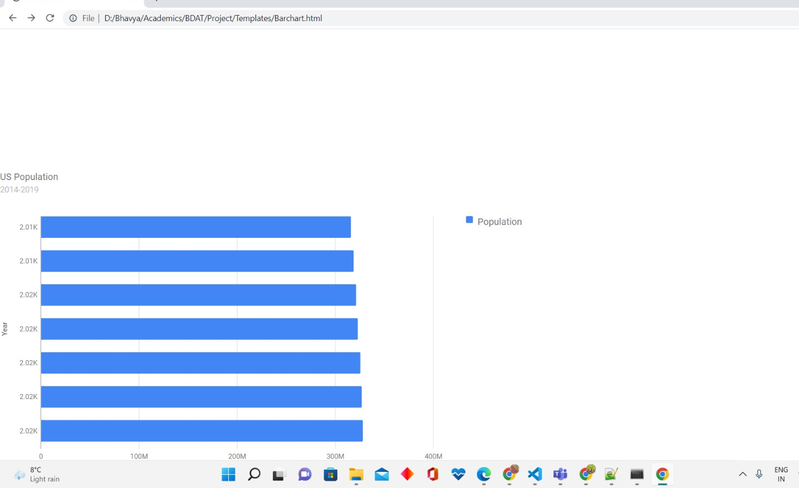
Bar Chart to compare population over years

Slide 12
Fit Gap Analysis
The ideal web application must be able to
Get a range of items
Get item by ID
Class should be able to use a URL to access the API and test
which could not be achieved.

Slide 13
Thank you!

