Slide 1
Identifying Ai Generated Text
Using Chat GPT-4
Presented by:
Nick Kai

Slide 2
01
The Problem
Students are becoming over-reliant on AI

Slide 3
89% of College Students Admit to Using Chat GPT for Homework
26%
48%
53%
Cheating
Tests
Essays
26% of educators K-12 have caught a student cheating
48% of students report using Chat GPT for an at home test or quiz
53% of students report having Chat GPT write one of their essays

Slide 4

90% of Students say they prefer Chat-GPT over a Human Tutor

Slide 5
Detecting Ai Generated Essays
Using a Machine Learning Model

Slide 6
How can we differentiate
We can train a model to recognize patterns in AI generated essays and analyze variables:
Word choice
Sentence complexity
Perplexity

Slide 7
62%
Accuracy
With a limited sample size of training data

Slide 8
Next Steps Using Chat GPT
We can generate even more data

Slide 9
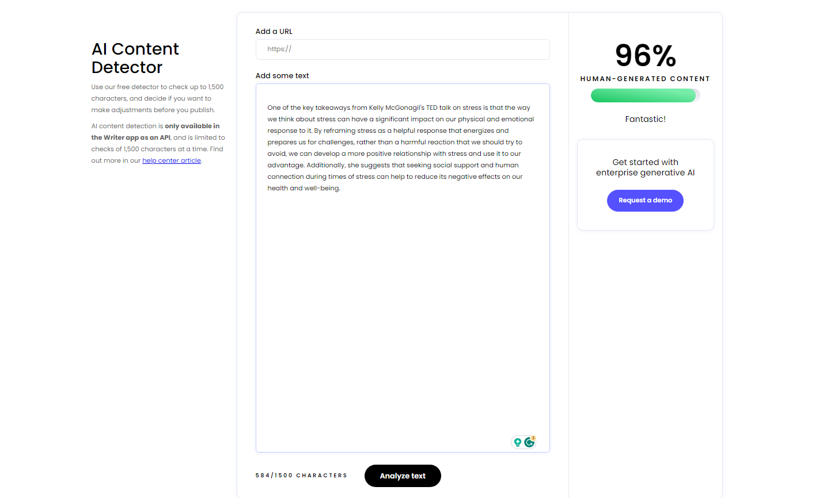
Web-App
After Increasing the Accuracy creating a tool so that anyone can calculate the probability of an essay being written by AI

Slide 10
Thanks!
Do you have any questions?
nhknicholas@gmail.com
Linkedin.com/nihkai
Please keep this slide for attribution

