Slide 1
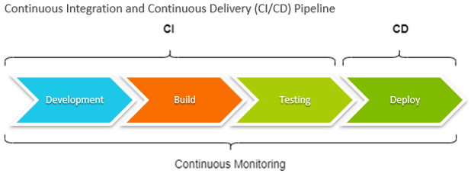
Udapeople
BENEFITS OF CI/CD
IN THIS PROPOSAL
* What is CI/CD * Our Current State and value drive with CI/CD * Risks/ challenges

Slide 2
What is ci/cd
CONTINUOUS INTEGREATION
A practice to streamline all codes written by developers into one.
CONTINUIOUS DELIVERY
A practice where a team working on a project produce and release product value in short cycles
CONTINUOUS DEPLOYMENYT
This is a way in which value is delivered to clients frequently but in an automated fashion. This eliminates any human intervention and things get done faster

Slide 3
OUR CURRENT STATE
Too much manual process which results in delays of value to the production environment.
Clients complaints about poor quality in our software because we have little time to deploy all features
The team is not able to spot errors quickly before they go into production.

Slide 4
Value drive with ci/cd
Infrastructure and manual task will be automated. This will help reduce costs associated with errors and delays
Automated Smoke tests and Rollbacks will protect revenue due to reduction in downtimes in deployment as a result of crashes.
CI/CD will provide a faster feedback cycle from consumers since they will be involved in the cycle from the beginning.
Delivering values in short cycles will boost consumer confidence and this will create revenue

Slide 5
Risks/challenges
There is cost in upskilling the team
The process will require some experiments and will lead to some infrastructure cost
In the short term, there will be challenges but in the long run, the business processes will be significantly improved.

