Slide 1
MICROPROCESSORS
GROUP 2

Slide 2
GROUP MEMBERS
Adolta Andrews Junior, 7310123
Adwapa Rolly Afia Boakye, 7310923
Adomah Chrisford, 7310223
Afful Kelvin Kwaw, 7311123
Adiase Noelle Selorm, 7310023
Akowuah Christian Sarpong, 7312523
Agyemang Rennie Yeboaa, 7311823
Baffour Adu Kwadwo, 7310523
Boadu Darius Sefa, 1786122

Slide 3
TABLE OF CONTENTS
Problem Statement
Methodology
Demonstration
Conclusion

Slide 4
PROBLEM STATEMENT
PIPE LEAKAGE:
Pipe leakage has to do with the escape of water from pipes, joints or fixtures due to corrosion, high pressure or freezing.
The effects of pipe leakage include mold and fungus growth, pest attraction, and if left untreated, high financial cost from increased water bill and pipe fixing system.

Slide 5
METHODOLOGY
The system adopts the function of a flow sensor, microcontroller, buzzer and LED.
The flow sensor detects water movement, it generates electrical pulses proportional to the flow rate.
The microcontroller processes the signal. If the flow is normal as detected by the sensor the system runs as expected. However, if the flow detected is not normal an LED installed will light up and a buzzer will blare.

Slide 6
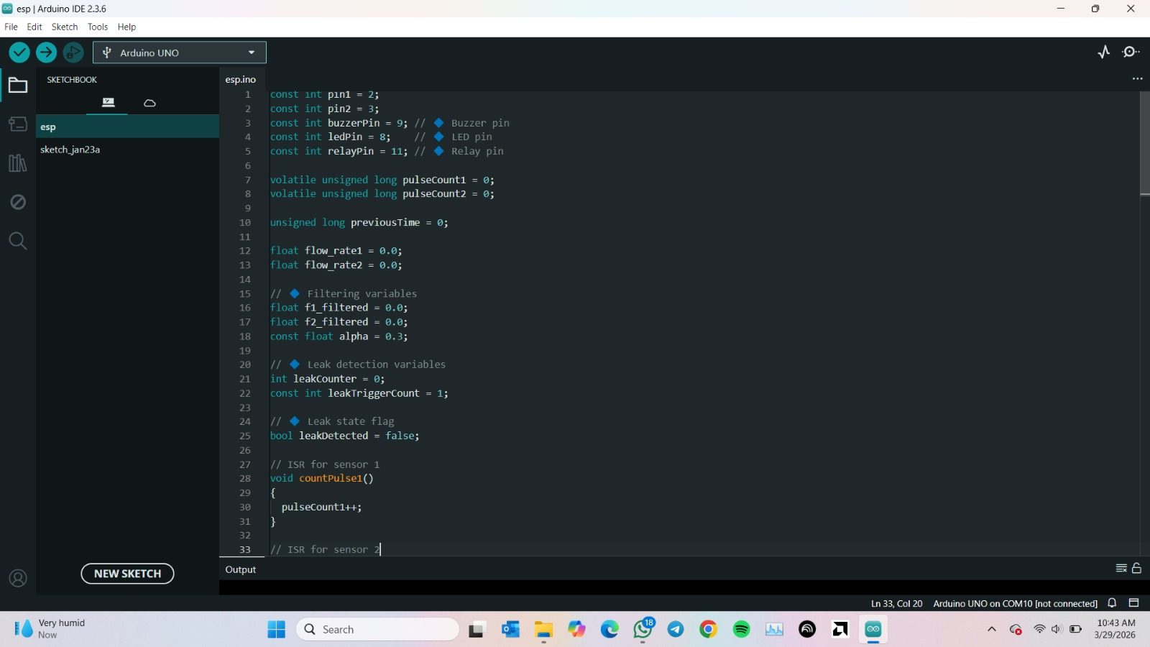
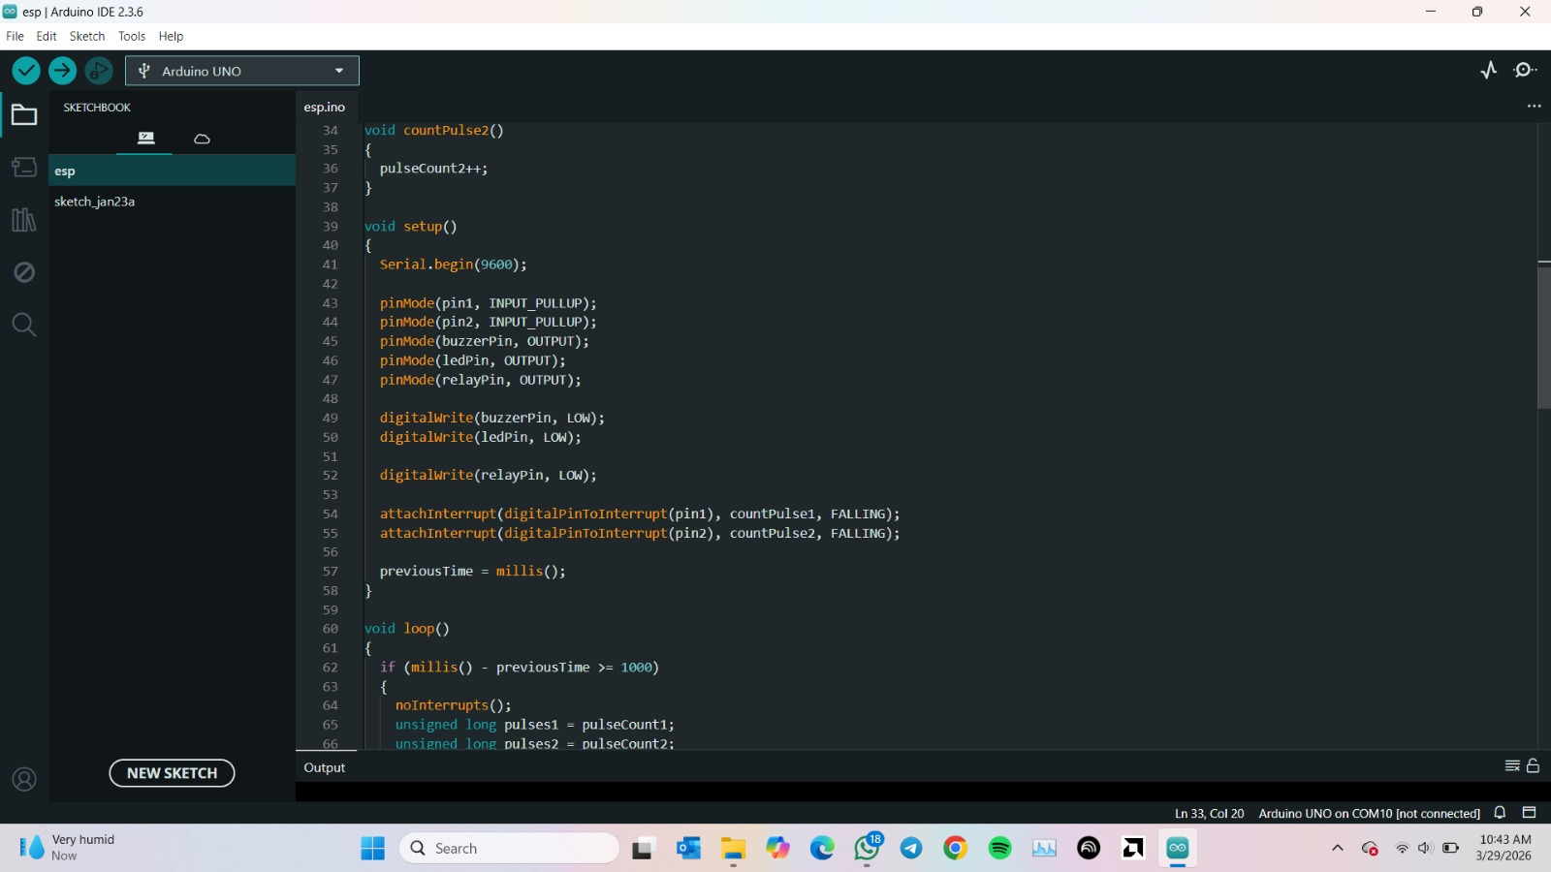
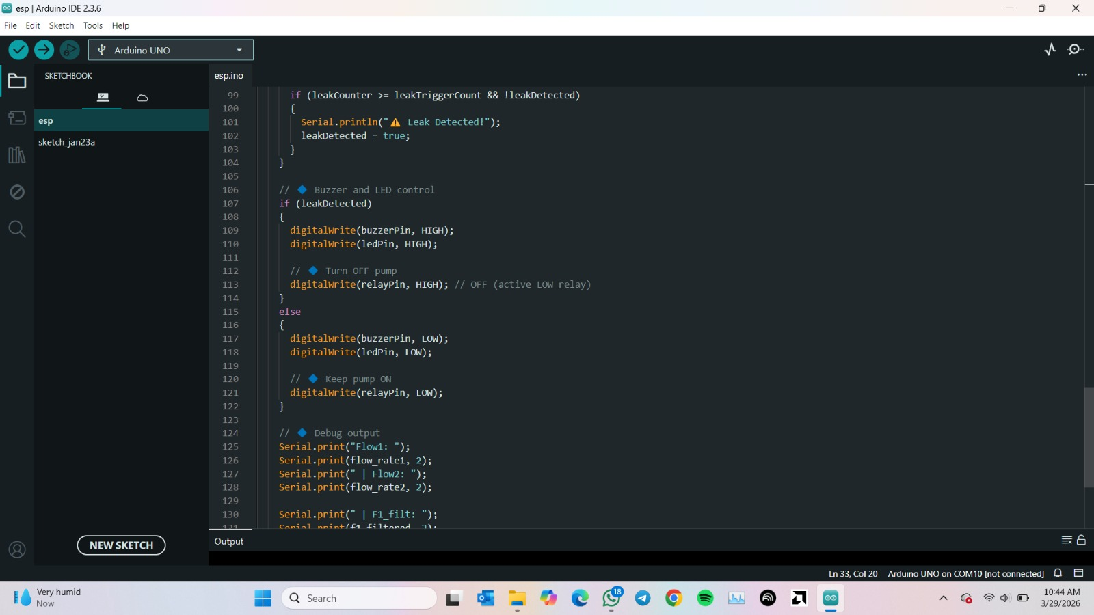
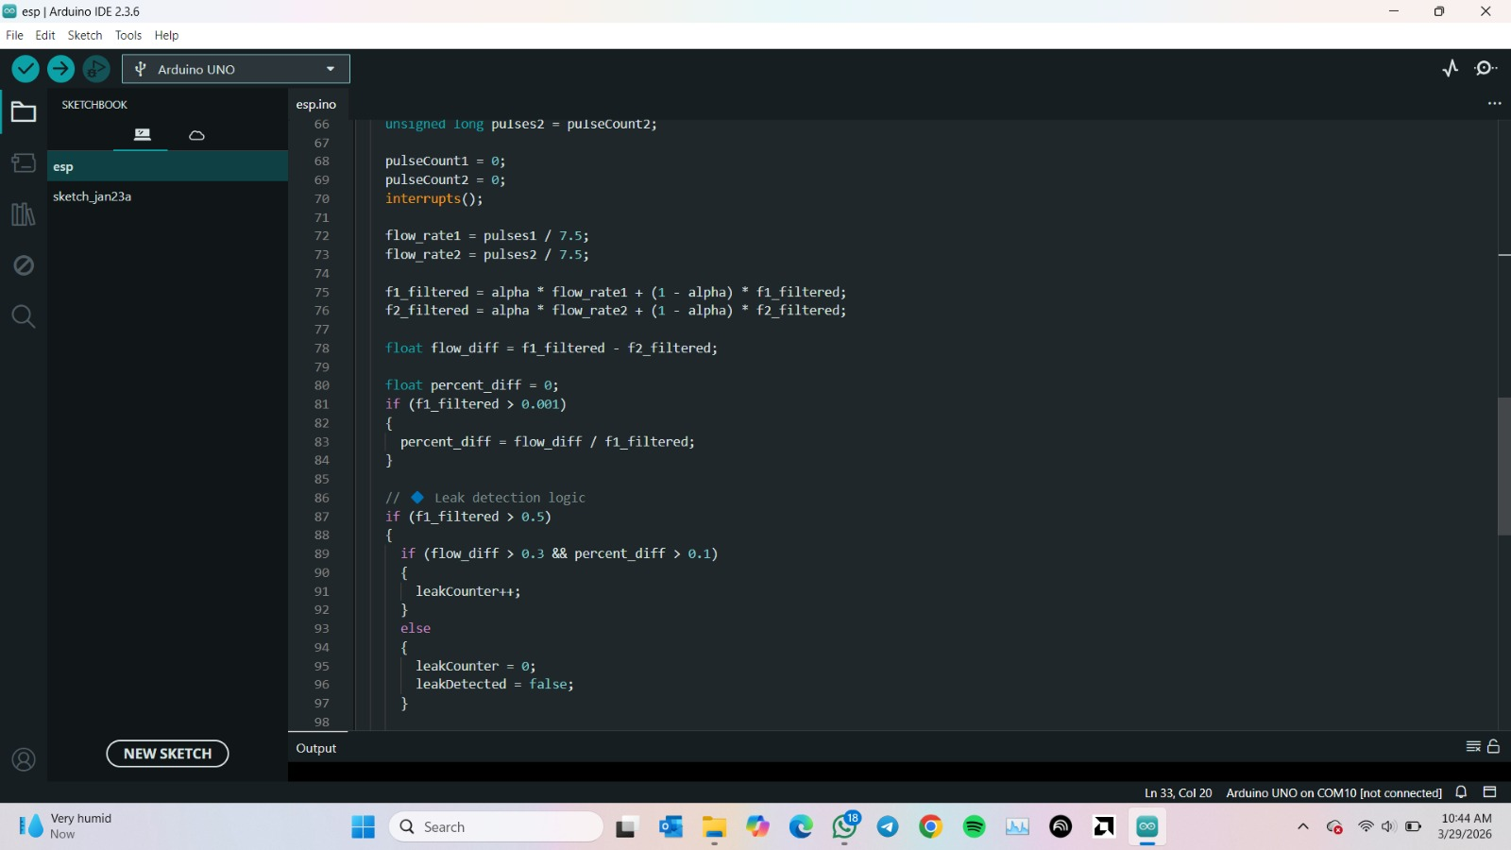
CODE

Slide 7
CODE
In the code above, the sysem pumps water from a source through the flow sensors and the pipe.
The system compares the inlet and oule water flow rates and if a difference of more or less than 0.3 is detected which is the threshold, a leak is identified and an alarm is activated, a Light Emitting Diode lights up and the system is shut down automatically.

Slide 8
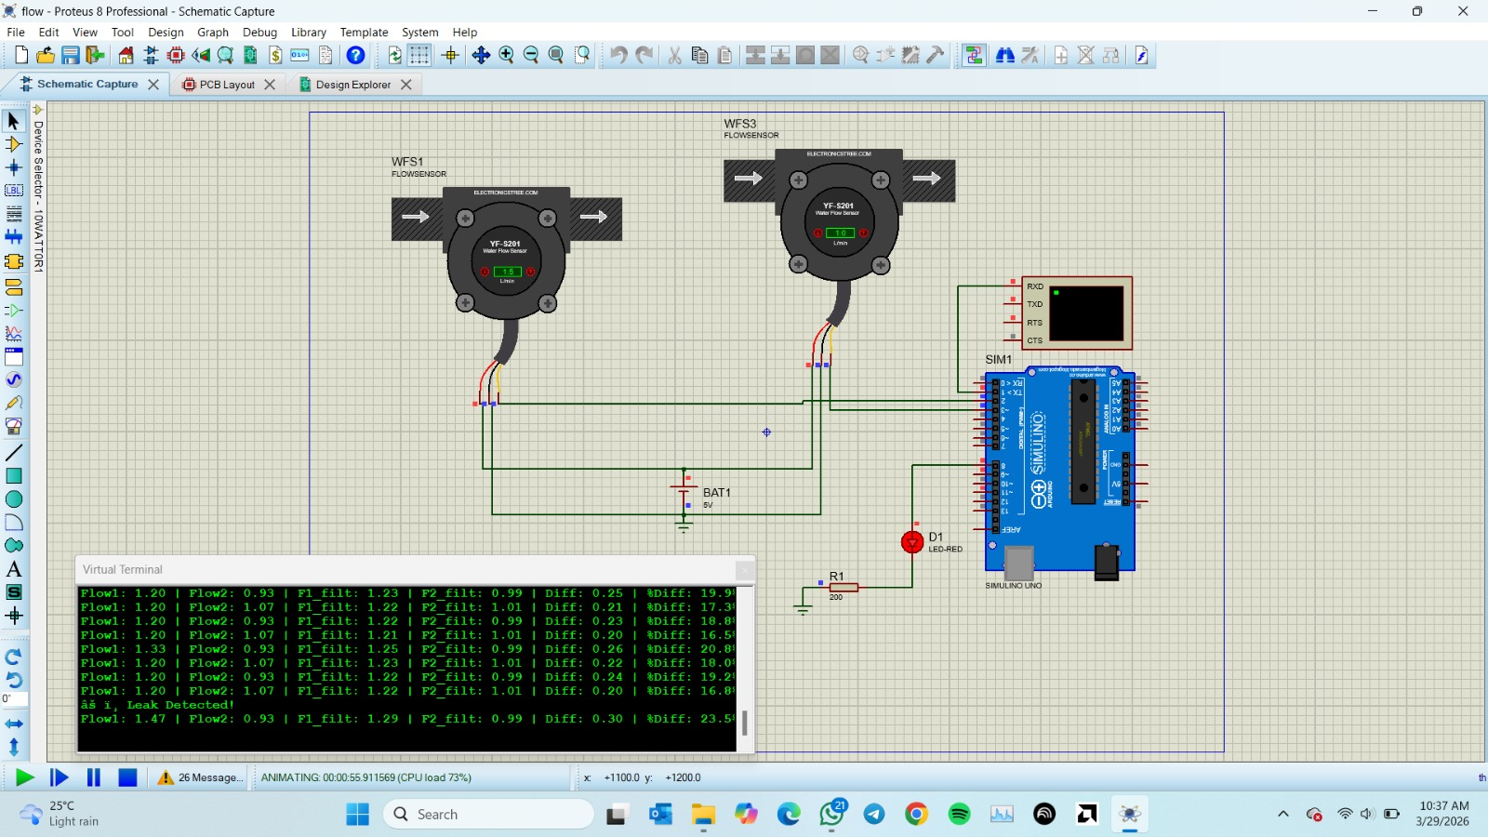
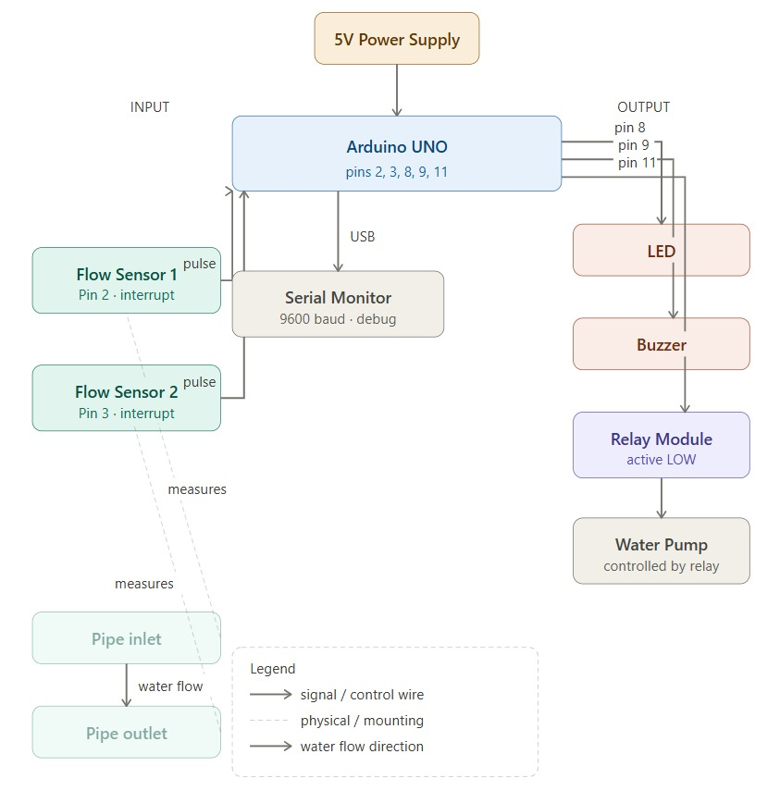
SCHEMATIC

Slide 9
SCHEMATIC
The schematic displays a visual representation of the physical project showing clearly the flow sensors and how they are to be connected, the pump, the relay, the microprocessor connection and the expected output.
It illustrates how the buzzer and LED function in the detection of a leakage in the system.

Slide 10

DEMONSTRATION

Slide 11
DEMONSTRATION
After the simulation has been run it is observed that the LED turns on when a leak is detected.
Key takeaways from the system is, the system reliably detects sustained flow differences, minimizes false alarm as it is activated only after constant leakage detection and automatically responds to leakage conditions

Slide 12
CONCLUSION
After running the code, the leakage was successfully detected making the alarm go off and the LED light up.
A challenge encountered is that the flow sensor became unresponsive during the execution of the code. An improvement we made to the system to counter this challenge was to check jumper cable connections and strengthen them.

Slide 14
THANK YOU.

