Slide 1
MICROPROCESSORS PROJECT PRESENTATION
TOPIC: SMART HAND SANITIZER DISPENSER
Presented By: Electrical Group 7
Supervised By: Ing. Dr. Eliel Keelson

Slide 2
ELECTRICAL GROUP 7 MEMBERS
1. Stephen Tufuor Amponsah - 7314723
2. Allen Amoako-Ansong -7314323
3. Benjamin Amfo-Swanzy -7313323
4. Melody N. E. Annan -7315023
5. Nancy Ode Boakye -7320523
6. Ama Agyeiwaa Antwi -7315123
7. Ebenezer Arthur Ayirebi -7316023
8. Jason Safro-Adu Amankwah -7313123
9. Kwaku Agyekum Ampofo -7314623

Slide 3
TABLE OF CONTENTS
Project statement
Methodology
Demonstration/ Simulation
Conclusion

Slide 4
PROBLEM STATEMENT
Maintaining proper hand hygiene is important for preventing the spread of germs and infections. Conventional sanitizer bottles require physical contact, which can lead to contamination when used by many people.
There is also the problem of sanitizer wastage due to a more than necessary amount of pumping by users.
To solve this problem, our project proposes a touch-free smart hand sanitizer dispenser. The system detects a hand and automatically dispenses sanitizer once; it only dispenses again after the hand is removed and brought back.

Slide 5
METHODOLOGY
The project was simulated online using Tinkercad. This was the approach taken. We used;
an HC-SR04 ultrasonic sensor to detect the presence of a hand by measuring distance.
an Arduino Uno to process the measured distance(signal).
a DC motor, representing a pump, to simulate sanitizer dispensing.
an LED to turn ON to indicate sanitizer dispensing.
To prevent repeated dispensing, we used a Boolean operation.
We also made sure the system resets only after the hand is removed.

Slide 6
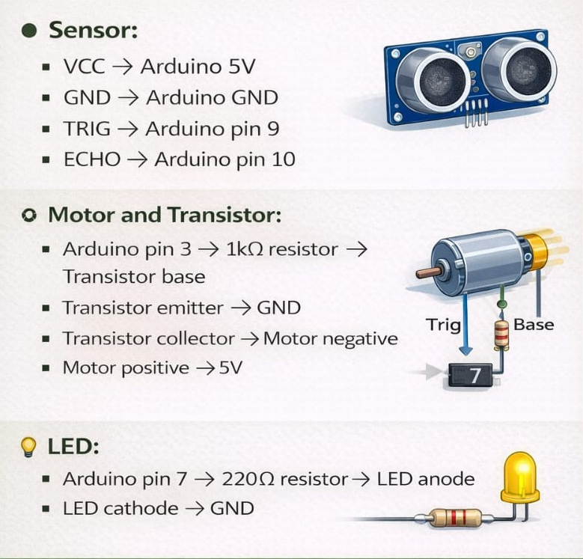
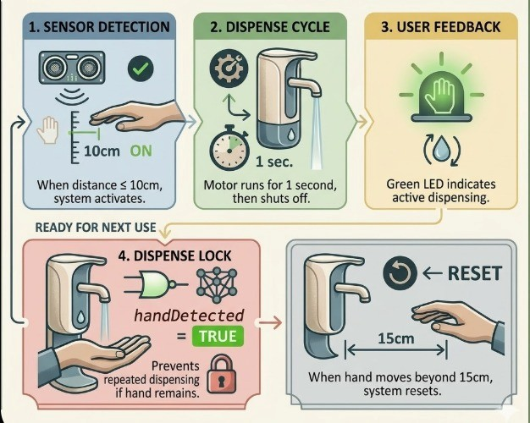
METHODOLOGY
SCHEMATIC OVERVIEW:
CODE OVERVIEW
FALSE

Slide 7
DEMONSTRATION/SIMULATION
During the Tinkercad simulation;
The motor and LED remained OFF when no hand was present.
The motor turned ON for one second and the LED lit up when a hand entered the detection range.
The system did not dispense again while the hand remained under the dispenser.
The system reset when the hand was moved more than 15cm away.
The system re-activated when the hand returned into the detection range.
This showcases the system’s functionality.

Slide 8
DEMONSTRATION/SIMULATION
Link to simulation: https://www.tinkercad.com/things/jikvkJAkMv4-micro-p/editel?returnTo=%2Fdashboard%2Fdesigns%2Fcircuits&sharecode=5k_P179p3gQLKnhql0zgd_3UnKqTfd9jk76eKHS9WJY
Key Takeaways From Simulation:
The system achieved touch-free operation.
The sensor successfully detected hand presence.
The motor effectively simulated sanitizer dispensing.
The LED provided a clear visual indication during operation.
The control logic prevented sanitizer wastage by avoiding repeated dispensing.

Slide 9
CONCLUSION
-The smart hand sanitizer dispenser was successfully designed and simulated using Tinkercad.
-The project demonstrated how an Arduino Uno, an ultrasonic sensor, motor and LED can be combined to create a functional touch-free sanitizing system.
-Challenges encountered:
Preventing repeated dispensing while the hand remained in place(solved using control logic)
Ensuring stable motor control (solved using an NPN transistor and a diode)

Slide 10
CONCLUSION
-Possible improvements:
Use of real liquid pump in hardware implementation
Addition of buzzer or LCD display
Battery-powered portable design
END OF PRESENTATION

Slide 11
THANK YOU

