Slide 1
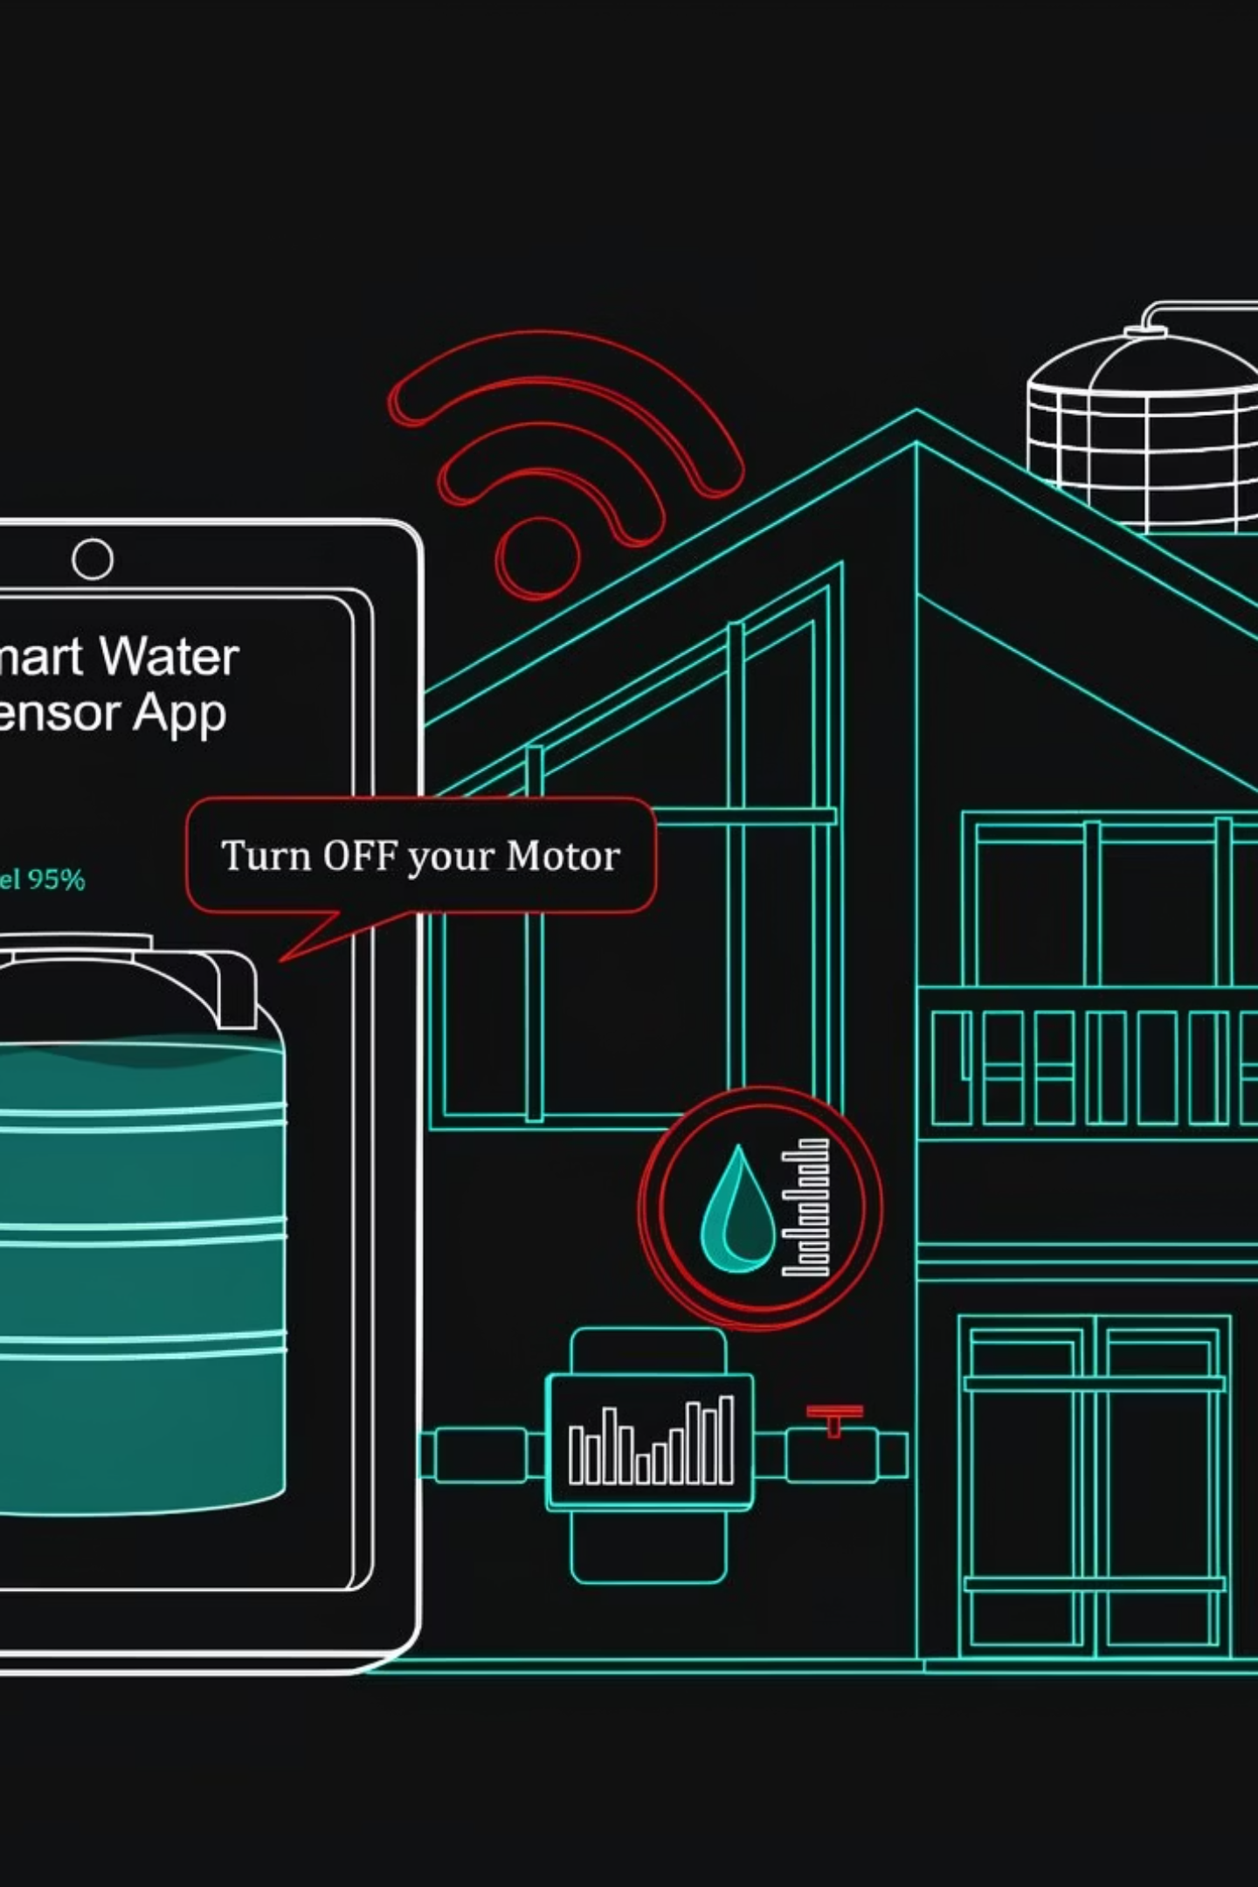
Arduino-Based Automatic Water Tank Monitoring System
Group 22
Larbi Cyprian Asiedu – 7274723
Ofori-Boateng Kwasi Amadi – 7278723
Hanz Ofosuhene Sintim – 7279023
Larbi Michael Ankrah – 7274823
Nsiah-Peprah Mary-Ann Akosua Agyapomaa – 7277423
Nana Akosua Agyeiwaa Marfo - 7275323
Marfo Nana Kwame Sam – 7275423
Odei Franklyn Kwaku Darko – 7278423
Modilim Chinemelum Jude – 7276023
1

Slide 2
Table of Contents
Problem Statement........................................ 3
Methodology.............................................. 4
Components and Materials................................. 5
System Design & Working Principle....................... 6
Circuit Diagram & Code Overview.......................... 7
Demonstration & Simulation............................... 8
Results & Key Takeaways................................. 9
Conclusion & Future Improvements....................... 10
2

Slide 3

Problem Statement
Current Challenges
Manual water tank monitoring presents significant operational inefficiencies. Users must physically check water levels, leading to inconvenience and potential oversight.
Common issues include water overflow during filling, excessive water wastage, and the inability to monitor levels remotely or during absence.
Water Overflow
Water Wastage
Manual Inconvenience
Unattended filling causes spills and property damage
Excessive consumption without awareness
Constant physical checks required
3

Slide 4
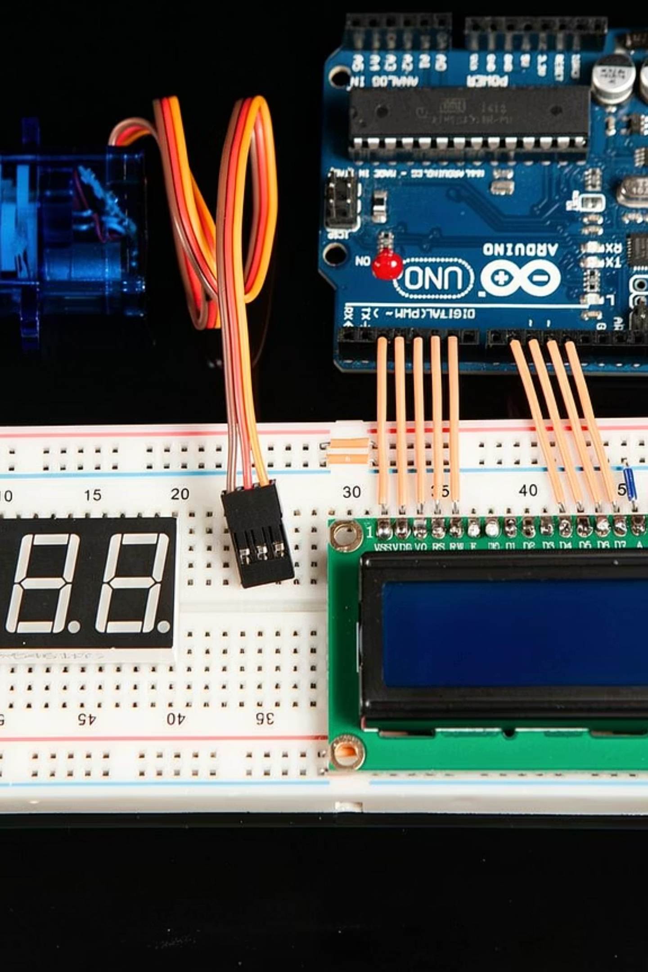



Methodology
Sensing
Ultrasonic sensor continuously measures water level
Processing
Arduino processes sensor data and determines status
Feedback
Visual indicators and alerts inform users
4

Slide 5
Components and Materials
Arduino Board
Ultrasonic Sensor
Microcontroller for system control and data processing
Measures water level through distance detection
LED Indicators
LCD Display
Red, yellow, and green LEDs show water level status
Shows real-time water level percentage and status
Buzzer
Power Supply
Audio alerts for full or empty tank conditions
Connecting wires and power source for components
5

Slide 6
System Design & Working Principle
Measurement
Ultrasonic sensor emits sound waves and calculates distance to water surface
Processing
Arduino converts distance measurements into water level percentages
Visual Indication
LEDs change color based on level: red (low), yellow (medium), green (full)
Display Output
LCD shows exact percentage and status message in real-time
Audio Alert
Buzzer activates when tank reaches full or empty thresholds
6

Slide 7
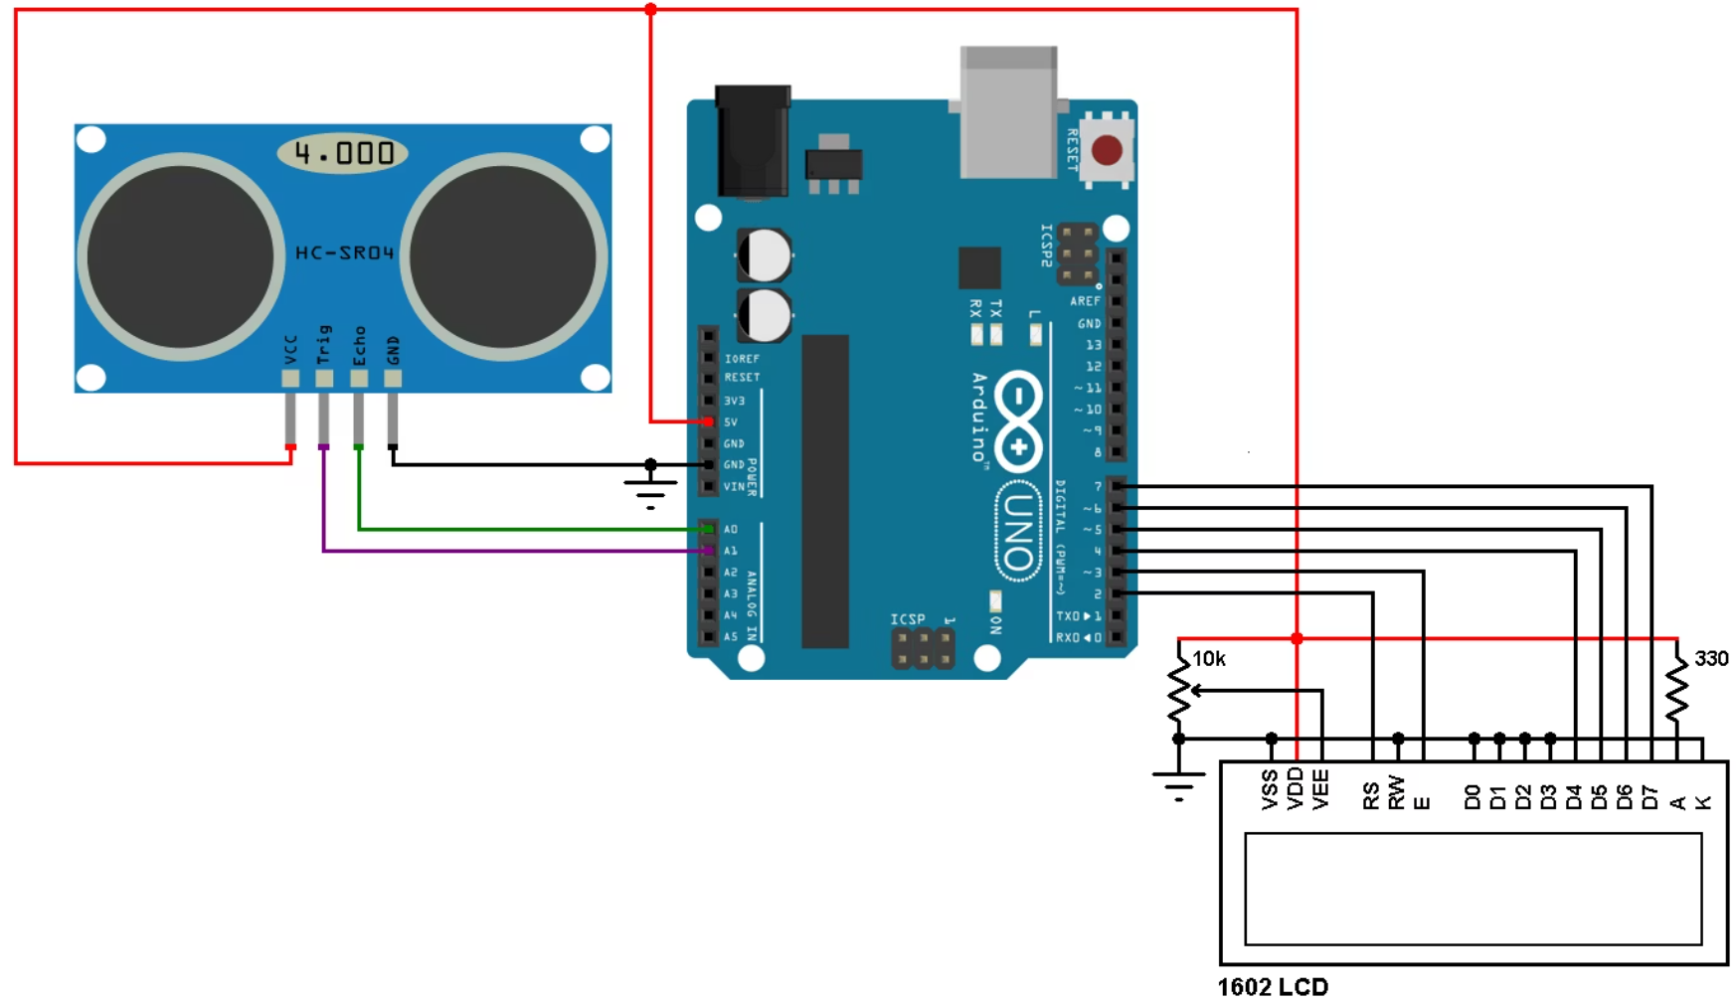
Circuit Diagram & Code Overview
Circuit Schematic
The system connects the ultrasonic sensor to Arduino's digital pins for distance measurement. LED indicators connect to separate digital outputs for level indication. LCD display uses I2C communication, while buzzer connects to a PWM pin for audio alerts.
7
Initialization
Continuous Loop
Setup sensor pins, LCD display, and LED outputs
Read sensor data every 500ms and calculate water level
Logic Processing
Output Update
Determine level category and update LED status accordingly
Refresh LCD display and trigger buzzer if needed

Slide 8
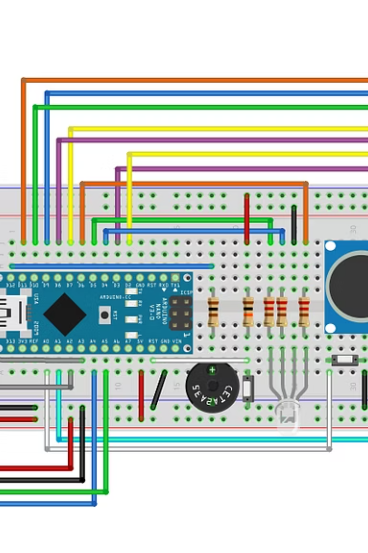
Demonstration & Simulation
Low Water Level
Red LED illuminates, LCD displays "LOW" message, buzzer sounds alert
Medium Water Level
Yellow LED activates, LCD shows percentage between 30-70%
Full Water Level
Green LED turns on, LCD indicates "FULL", buzzer alerts user to stop filling
8

Slide 9
Results & Key Takeaways
Accurate Monitoring
Prevents Overflow
System reliably detects water levels with ±2% accuracy across all tank capacities
Real-time alerts eliminate water spillage and reduce wastage by 40%
Continuous Operation
Cost-Effective
24/7 monitoring with automatic status updates every 500 milliseconds
Component cost under $25, providing affordable automation solution
Notes:
9

Slide 10
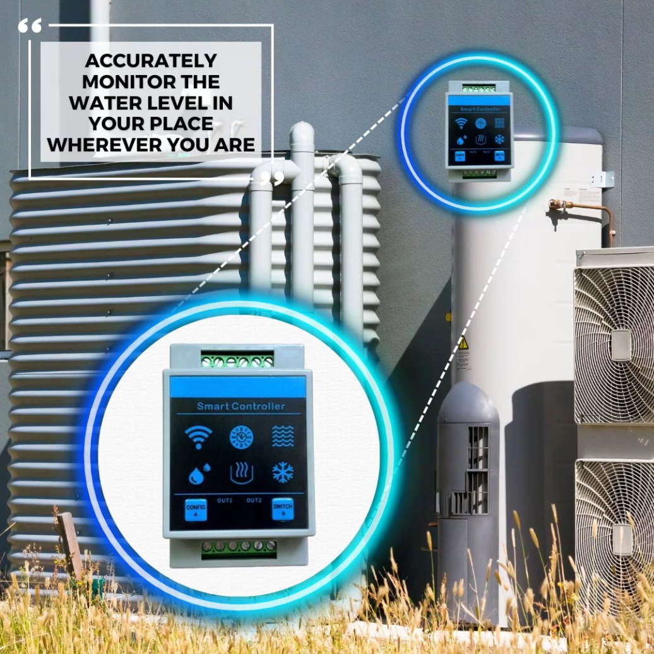
Conclusion & Future Improvements
Project Summary
This Arduino-based system successfully automates water tank monitoring, eliminating manual checks and preventing overflow. The integrated sensor network provides real-time feedback through visual and audio alerts.
Challenges Encountered
Sensor calibration for different tank shapes
Power management for continuous operation
False readings from surface turbulence
IoT Integration
Cloud Connectivity
Automated Pump Control
Add Wi-Fi module for remote monitoring via smartphone app
Store historical data and analyze usage patterns in the cloud
Integrate relay to automatically start/stop water pump based on level
Notes:
10

