Slide 1
COE 381- MICROPROCESSORS
PROJECT TOPIC:
GAS LEAKAGE DETECTOR
Presented By:
GROUP 20, ELECTRICAL AND ELECTRONIC ENGINEERING

Slide 2
GROUP MEMBERS
MONDJRO CHRISTIAN – 7329723
OSEI AFRIFA ANDY – 7333223
TETEKPOR PETROVA DZIDEDI – 7336223
NYUMUYO OSBORNE – 7331123
ANGEL ASEDA PINTO – 7334523
NORBI HELINA ASANTEWAA – 7330523
OPOKU RANDY AGYEMANG – 7332823
ALHASSAN MOHAMMED – 7329623
OWUSU ABENA ACHIAA CLENDA - 7333723

Slide 3
TABLE OF CONTENTS
Problem Statement
Methodology
Conclusion

Slide 4

PROBLEM STATEMENT
Among the gas leakage detectors, our project is specified mainly on Smoke detectors.
Smoke detectors are life-saving safety device that addresses critical issues with fire by early detection of fires before they become large and uncontrollable.

Slide 5
PROBLEM STATEMENT
Fire, which can begin from faulty wiring, smoking materials or electrical faults, produces smoke and toxic gases long before flame or fire becomes intense.
Most fire deaths are caused by smoke inhalation and not burns. Smoke contains carbon monoxide and other toxic gases that can disorient people within minutes if not noticed on time.
Without a detector, occupants may not notice the fire until it has spread to block escape paths, filling rooms with dense smokes.

Slide 6
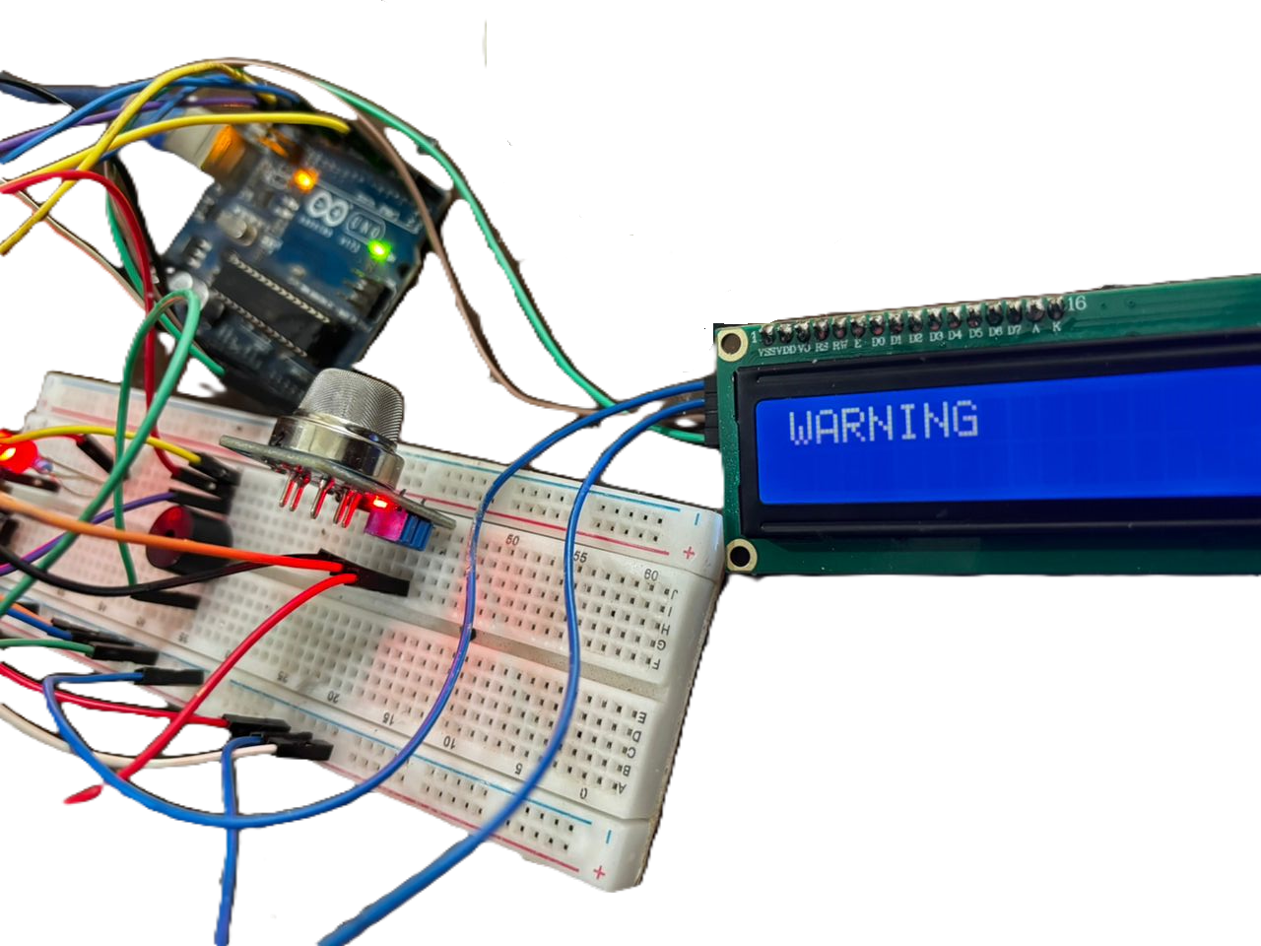
METHODOLOGY
COMPONENTS USED
Arduino Uno
Breadboard
MQ-2 sensor
Buzzer
Push button
Resistors(220 ohms)
LCD
Jumper wires
Red LED

Slide 7
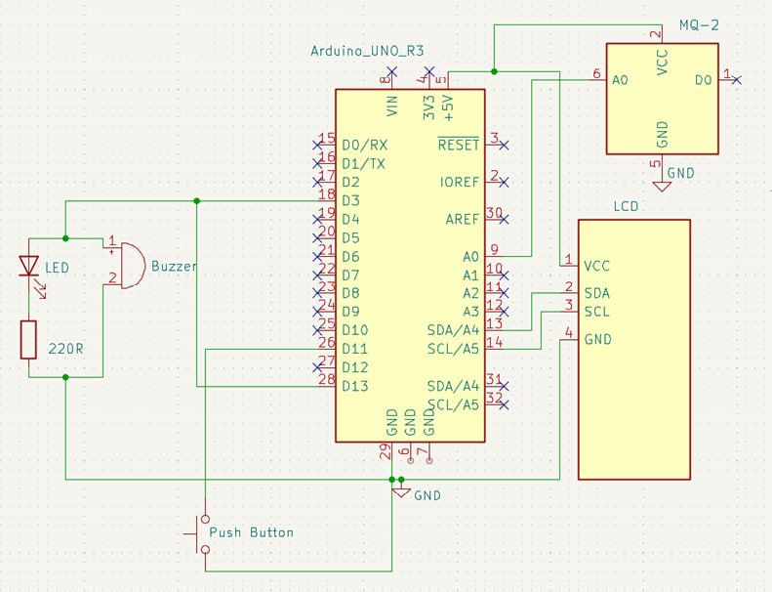
METHODOLOGY: DESIGN OF SCHEMATIC
Tinkercad was used to design and test the gas leakage detector before building.

Slide 8
METHODOLOGY
WHY THE GAS LEAKAGE DETECTOR MATTERS
The smoke detector sensor senses the smoke at certain concentrations and triggers the buzzer and the red LED which will make noise to draw attention .
The smoke detectors continuously monitor the air for particles of combustion(smoke). When smoke reaches a dangerous level, the alarm sounds loudly, giving people precious extra minutes to alert others to attempt to extinguish a small fire or escape.
Early warnings dramatically increases survival rates and reduces property damage.

Slide 9
CONCLUSION
Smoke detectors protect against the hidden dangers of fire and smoke inhalation, while the gas leakage detectors protect against invisible toxic or explosive gas accumulation.
Installing, maintaining and testing them regularly is one of the simplest and most effective ways to prevent accidents and tragedy in any living or working space.

Slide 10
THANK YOU

