Slide 1
GROUP 9
Azasu Angelo – 7319123
Amidu Najlaau Abdul – 7313523
Asare Crystal – 7316923
Anuklu Wilson – 7315523
Hamdan Ngmeninbin Banda – 7319923
Appiah Christian Senior – 7315623
Asante Yaw Gyamfi – 7316823
Appiah Julian – 7315723
Amoah Baidoo Daniel - 7314023

Slide 2
TABLE OF CONTENTS
• Problem Statement
• Methodology - Components Used, approach taken, Code and Schematics.
• Simulation/Demonstration - Output and key takeaways
• Conclusion – Findings, challenges encountered and possible improvements.

Slide 3
PROBLEM STATEMENT
Traditional taps present significant challenges regarding cross-contamination through physical contact, leading to the spread of pathogens.
These system often result in unnecessary water wastage due to leaving taps running and can be difficult to operate for individuals with limited physical mobility.
There is a need for a contactless, automated solution that ensures hygiene, minimizes water loss and provides ease of use.

Slide 4
METHODOLOGY
COMPONENTS USED;
SDPT Relay and 2N2222 Transistor
Breadboard
Ultrasonic Sensor
RGB LED
Resistors (220Ω and 10k)
Arduino UNO
Pump

Slide 5
METHODOLOGY
The system uses an Arduino Uno as the central controller. It employs an HC–SR04 Ultrasonic Sensor to detect a container’s presence by measuring the time it takes for sound waves to bounce back.
If an object is detected within a set threshold ie. 10cm, the Arduino triggers a 5V relay.
The relay completes the circuit for a mini submersible pump, which draws water from a reservoir and dispenses it through a sprout.

Slide 6
METHODOLOGY
Code Walkthrough
The code was written in c++.
It consists of 3 parts, namely;
The global variables
The setup function
The loop function

Slide 7
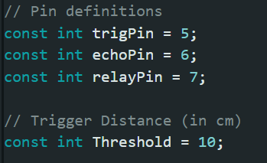
METHODOLOGY
Global variables definitions
PIN DEFINITIONS
trigPin sends the pulse
echoPin receives the bounce from the sensor
relayPin switches the pump by controlling the
relay
CONSTANTS
Threshold is used to limit the sensor range to
10cm

Slide 8
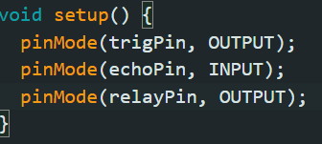
METHODOLOGY
The Setup Function
This function runs once at setup and returns
nothing.
It configures the board.
The pinMode function is used to indicate
which pins are used to send or receive signals. It accepts two arguments, the pin number(an int) and an integer constant(INPUT, OUTPUT or INPUT_PULLUP). Here trigPin and relayPin are sending signals hence OUTPUT and trigPin is receiving hence INPUT.

Slide 9
METHODOLOGY
Loop Function
This function runs non-stop.
In this project the functions called in the loop function are;
digitalWrite: a two-argument function that is used to set a target pin as HIGH or LOW. It takes the pin number as one argument and HIGH or LOW as the other .
delayMicroseconds(x): a single argument function that pauses execution for x microseconds.
If and else statements for making conditional statements.
delay(x): similar to delayMicroseconds except that it does so in x milliseconds.
pulseIn: a two-argument function that measures how long a pulse lasts on a pin. It returns the duration in microseconds

Slide 10
METHODOLOGY
Loop Function
Every cycle of loop function performs this sequence:
Ultrasonic distance sensing
Checks if an object is within 0 and 10cm
Turns the pump on or off through the relay
Waits for 2s
Starts over again

Slide 11
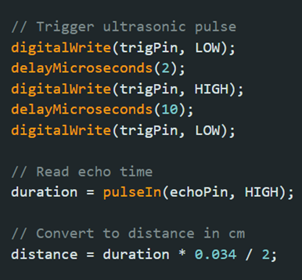
METHODOLOGY
Ultrasonic Distance Sensing
here ultrasonic pulse is fired through trigPin. The
echo is measured and the signal received through
echoPin. The distance is then calculated in cm.

Slide 12
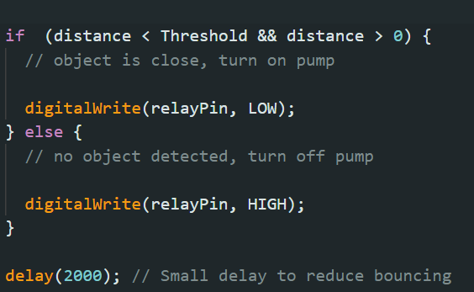
METHODOLOGY
Relay And Pump Control Logic
The condition in parenthesis is checked and
evaluated as true or false
If true; the relay is set to low and the pump is on
as the relay is normally closed.
If false; the relay is set to high via the relayPin
and the pump is off.

Slide 13
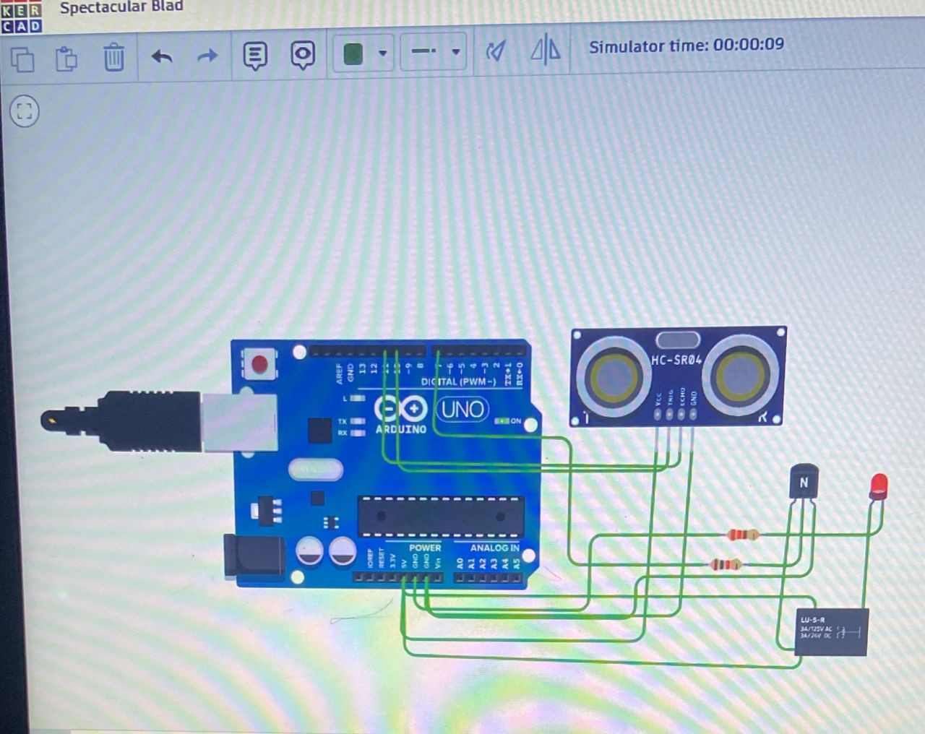
METHODOLOGY
SCHEMATIC DIAGRAM

Slide 14
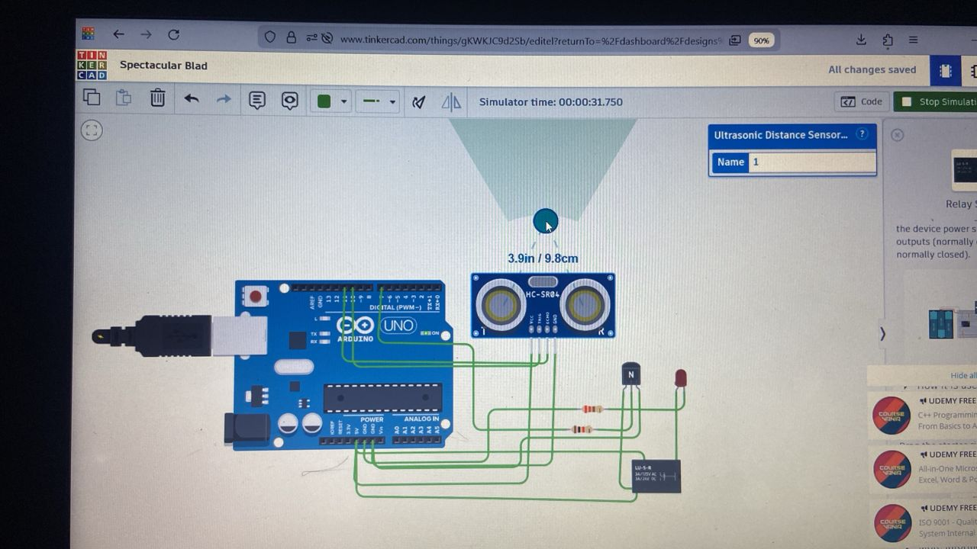
METHODOLOGY
SCHEMATIC DIAGRAM

Slide 15
DEMONSTRATION / SIMULATION
OUTPUT AND KEY TAKEAWAYS
The HC-SR04 ultrasonic sensor sends a pulse and receives an echo, providing a continuous stream of distance data to the Arduino.
The Arduino calculates the distance. In our simulation, we set a threshold of 10cm.
When distance < 10cm, the Arduino sends a Digital LOW/HIGH signal to the Relay.
The Relay closes the high-voltage circuit, allowing the DC Water Pump to activate and dispense liquid.

Slide 16
DEMONSTRATION / SIMULATION
KEY TAKEAWAYS
The simulation confirmed that the ultrasonic sensor can distinguish between a container and background noise with high accuracy.
The use of a relay proved necessary to handle the current spikes from the pump without crashing the microcontroller.
The "Touchless" logic was validated, showing that the system responds only to the presence of an object, fulfilling the hygiene objective.

Slide 17
CONCLUSION
Findings
The sensor–actuator loop successfully automated water delivery with a response time of less than 1 second, effectively eliminating physical contact.
The Ultrasonic sensor provided reliable detection within a 2cm to 10cm range, ensuring the pump only activated when a container was properly positioned.
Automated shut-off immediately followed container removal, confirming a significant reduction in potential water wastage compared to manual taps.

Slide 18
CONCLUSION
CHALLENGES ENCOUNTERED
Ambient noise or reflections from nearby surfaces occasionally caused 'ghost triggering,' which required fine-tuning the code's distance threshold.
The water pump creates an inductive load that initially caused the arduino to reset; this was resolved by using a relay module to isolate the high-current pump circuit from the microcontroller.
Ensuring the electronic housing was properly sealed while maintaining a clear 'line of sight' for the ultrasonic sensor was a key mechanical hurdle.

Slide 19
CONCLUSION
POSSIBLE IMPROVEMENTS
Incorporating a small solar panel and rechargeable lithium-ion battery to make the unit fully self-sustaining and portable.
Adding a potentiometer to allow users to manually adjust the pump speed and pressure based on their needs.
Adding a second sensor or a float switch to the reservoir to trigger an LED or buzzer when the water level is low.

