Slide 1
MICROPROCESSORS PRESENTATION (GROUP 14) TOPIC: Emergency Alert System for Patients
GROUP MEMBERS
Deveer Benedict Nii - 7322323
Cornan John - 7321223
Boateng Lord Nkansah - 7320823
Manteaw Emmanuel - 7328823
Ofosu Maame Akua Henewaa - 7332023
Cudjoe Hermone - 7321423
Buabin Michael - 7321023
Issah Touffic - 7326223
Maisie Pius Kweku Emmanuel - 7328723

Slide 2
TABLE OF CONTENT
Introduction
Problem Statement
Methodology
Components used and their Functions
Code Overview
Circuit Schematic
Demonstration
Future Roadmap: Scalability & Innovation
Conclusion

Slide 3
INTRODUCTION
In critical clinical environments, every second counts. Our project replaces outdated alert protocols with a high-reliability, priority-based Emergency System. By utilizing optimized C++ programming on an Arduino-based architecture, we’ve engineered a solution that captures, buffers, and displays multiple patient needs in a real-time status queue ensuring no distress signal is ever overlooked.

Slide 4
PROBLEM STATEMENT
The Critical Gap: Conventional patient-response protocols are often cost-prohibitive or lack a structured prioritization matrix for concurrent emergencies.
The Risk: Delayed response times for immobile patients in distress can lead to preventable complications.
Our Objective: To design and build a low-cost, high-reliability Arduino-based system that:
Identifies specific patient locations instantly.
Synthesizes multiple alerts into a manageable status queue.
Provides multi-sensory feedback (Visual + Auditory) for medical staff.

Slide 5
METHODOLOGY
Identify the problem
Design the system
Build and wire the system
Write the code
Test the system

Slide 6
Components used and their Functions
Adruino Uno Mini
Push button
Potentiometer
Piezo buzzer
LCD 16x2 (12c) display
Reset button
Light Emitting Diode(LED)
Resistor (220Ω)
Breadboard
Male and Female jumpers

Slide 7
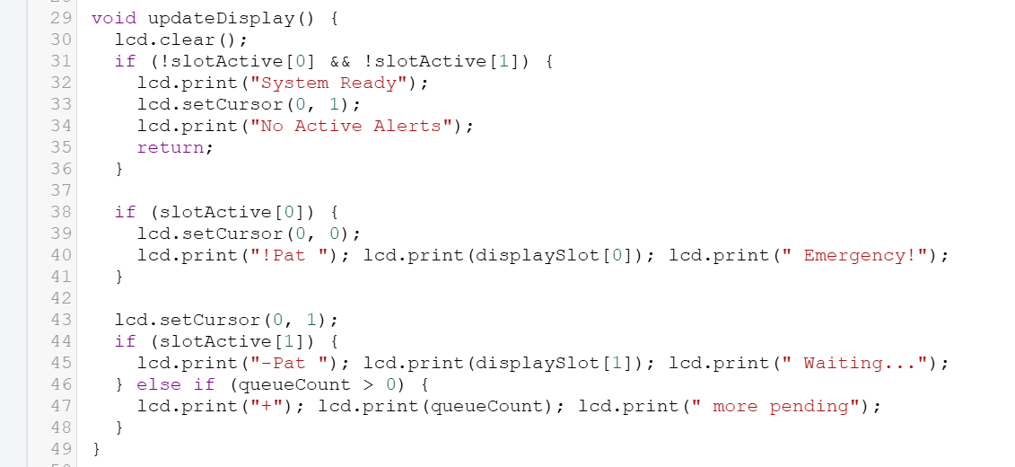
CODE OVERVIEW
This Arduino-based system manages patient calls in a hospital using a digital queue displayed on a two-row LCD. The addAlert() function will be called whenever a button connected to pin 12 or 13 is pressed, which will register the patient and sound a buzzer connected to pin 2 for 3 seconds and light an LED connected to pin A0. The promoteFromQueue() function will hold extra patient information in a waiting list and move them to the display as soon as a slot is available, as the LCD display will only show two patients at a time.
Pressing the reset button connected to pin 5 will invoke the dismissAlert() function, clearing the top priority alert and shifting all the remaining queue upwards. To decongest the system, the checkExpiry() function will automatically remove the alert that has not been acknowledged in more than two minutes. The LED will stay on as long as the alert is active and will switch off only when the queue is empty.

Slide 8
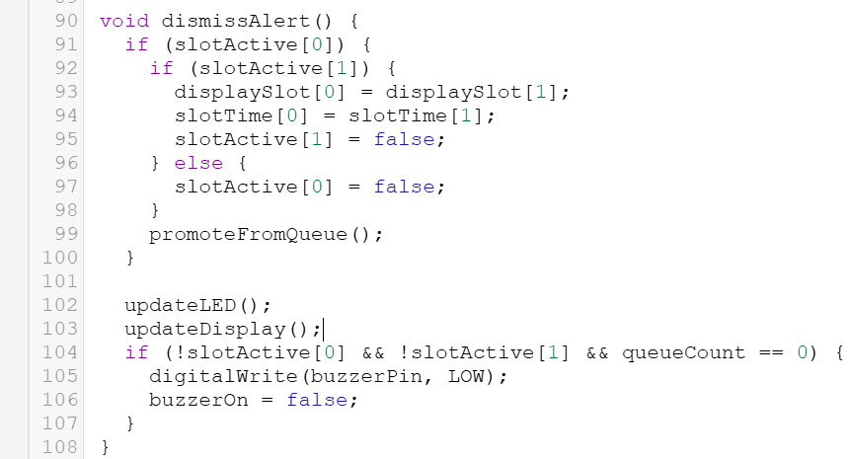
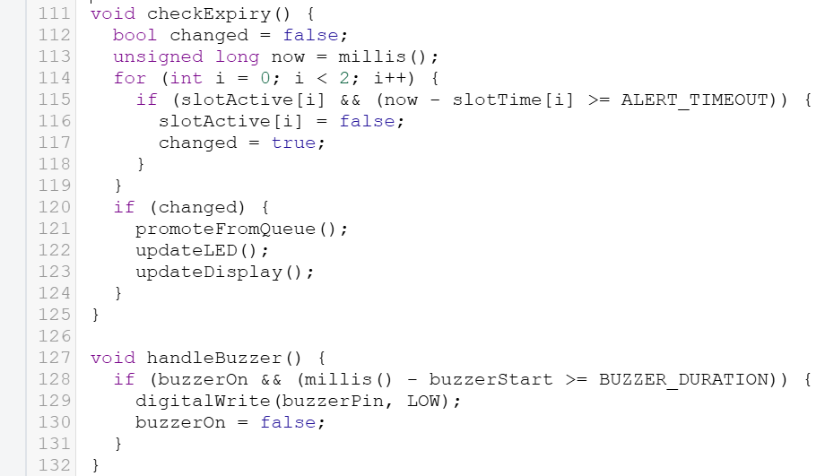
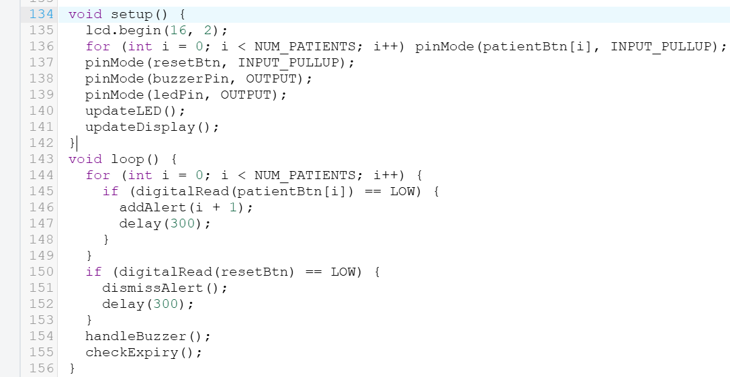
All of this runs inside the loop() function which acts as the heartbeat of the program, constantly checking buttons, managing alerts and keeping the display up to date, making sure the system is always ready to respond the moment a patient needs help

Slide 9
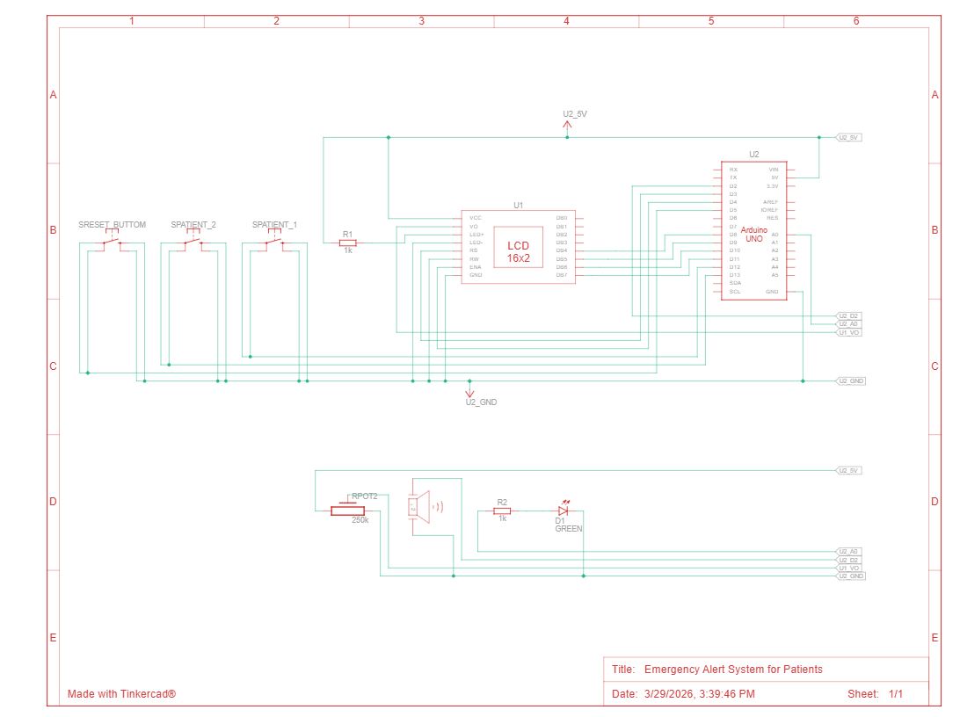
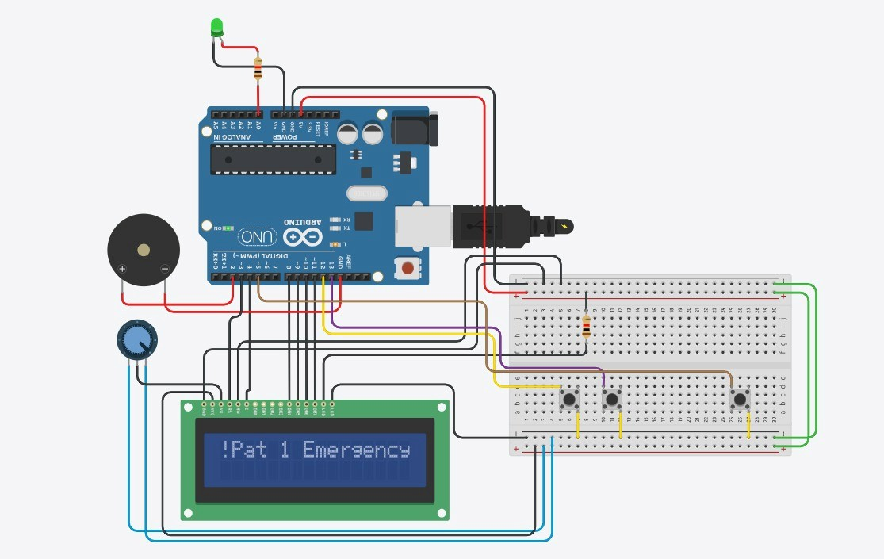
Circuit Schematic

Slide 10
Demonstration
The System Demonstration and Hardware Integration project entails creating a patient alert system, which has various states and hardware. The states in the patient alert system are System Ready, Single Patient Alert, Stacked Alerts, and System Reset.
In the System Ready state, the system is initialized, and the LCD shows "System Ready." The LED and buzzer are not activated. However, when a patient sends an alert, for example, "Patient 1," the system moves to the Single Patient Alert state, where the LCD shows an emergency message, the LED is activated, and the buzzer beeps for 5 seconds. When another patient, for example, "Patient 2," sends an alert, the system moves to the Stacked Alerts state, where priority is managed on the LCD and the buzzer is re-triggered.
In terms of hardware, the patient alert system has an Arduino Uno microcontroller, a 16x2 LCD display, a potentiometer for LCD contrast, a piezo buzzer, and a status LED. Three tactile switches are used for user input for "Patient 1 Call," "Patient 2 Call," and "System Reset." The patient alert system has pull-down resistors for logic transition stability and current-limiting resistors for the LED.
In terms of programming, the patient alert system is programmed in C++ and is implemented in the Arduino Framework, using the LiquidCrystal library. The patient alert system is validated through two stages: Tinkercad digital simulation and prototyping.

Slide 11
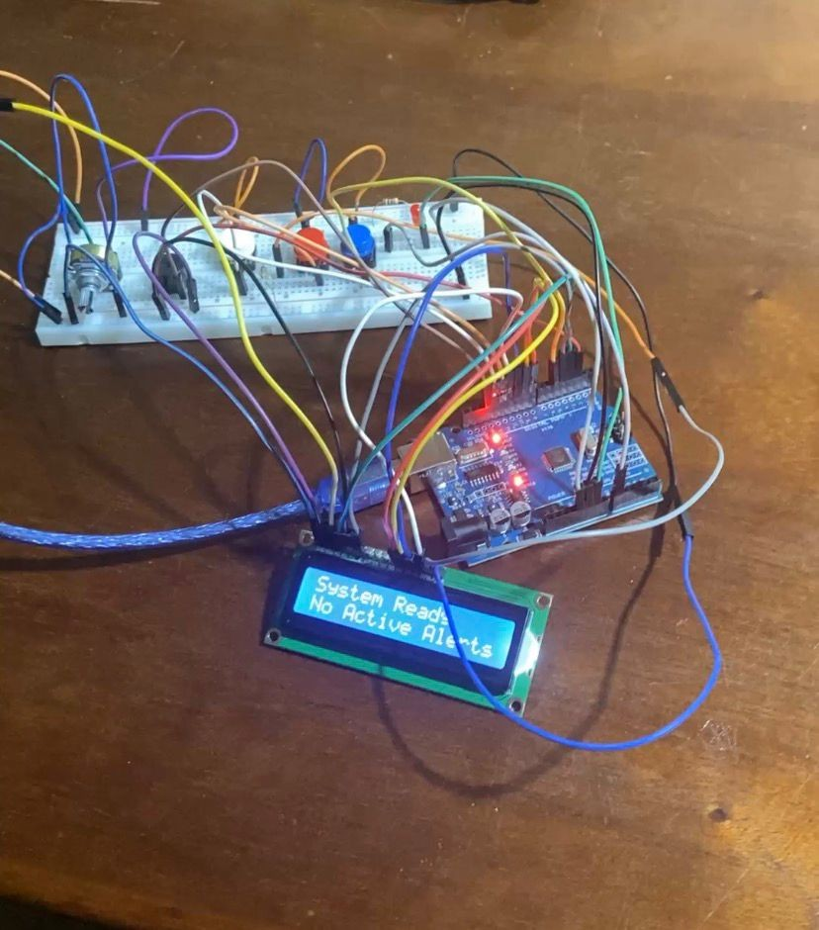
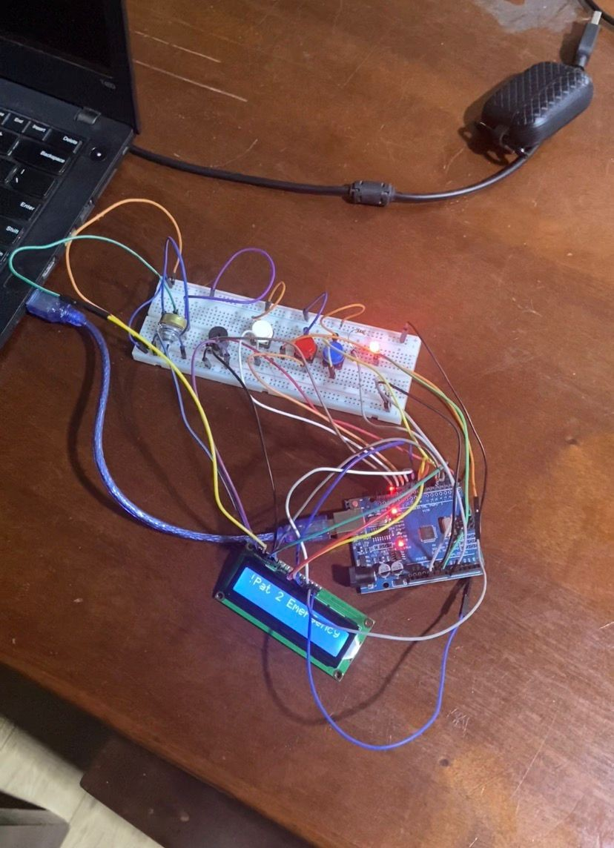
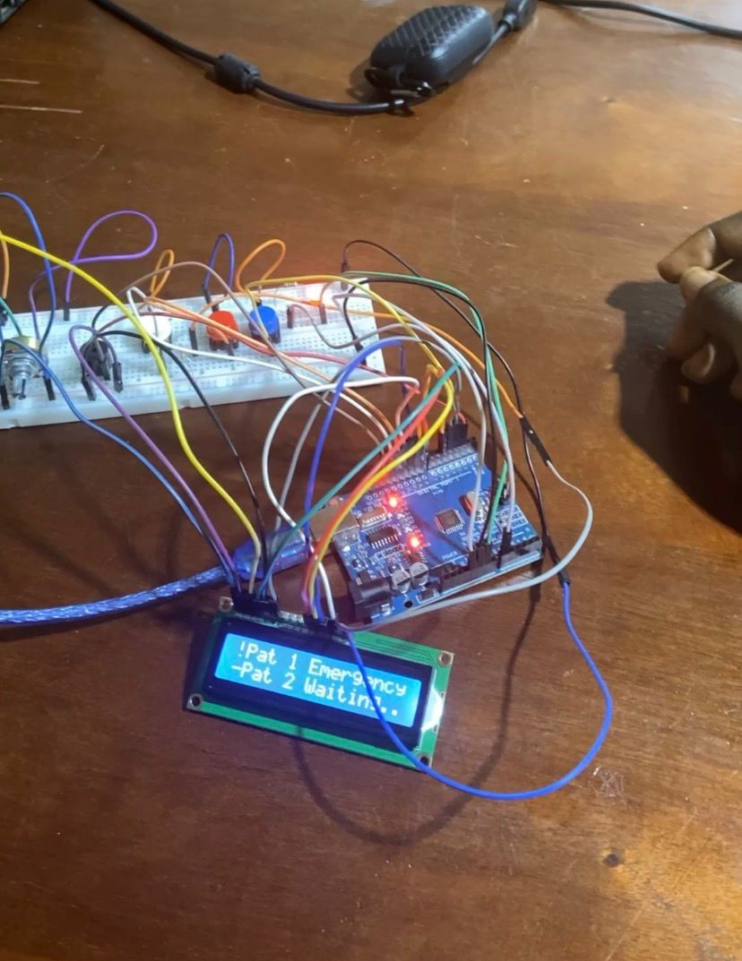

Slide 12
Future Roadmap: Scalability & Innovation
1. Hybrid Wireless Connectivity
IoT (Wi-Fi): This will allow campus-wide monitoring, where the server can monitor alerts from different wards or buildings without distance constraints.
Bluetooth (BLE): This will allow for low power, high-speed communication for instant "Room-to-Reception" alerts over shorter distances.
2. Infrastructure Optimization
Cost Reduction: This will eliminate the need for costly cabling, which would have meant significant labor costs for routing the wires through the hospital walls.
Seamless Maintenance: Moving over to "Plug-and-Play" wireless nodes will reduce system down time during maintenance or upgrade activities.
3. Human Machine Interface (HMI) Evolution
Capacitive Touch: This will replace traditional buttons with touch-sensitive pads, which will reduce wear and tear on the system.
Clinical Hygiene: Touch-sensitive surfaces are easier to sanitize, which will directly contribute to hospital hygiene, infection control, and sterilization.

Slide 13
Conclusion
In conclusion, our Emergency Alert System effectively illustrates the possibilities of focused Electrical Engineering and Embedded Programming to bridge critical gaps in the field of healthcare communications. Through optimizing our code with C++ and developing a sophisticated Priority Logic, we have created a system that is both reliable and scalable. We firmly believe that with the integration of the IoT and Touch Interface enhancements we have proposed, this system has the potential to become a cost-effective, life-saving standard for modern medical wards. Thank you for your time. I’m now open to any technical questions.

Slide 14
THANK YOU

