Slide 1

SMART DOOR LOCK SECURITY SYSTEM
GROUP 26-MEMBERS
PERCY KOGME SOYERE - 7336123
KIMOKSUA GILBERT TAMIRKA-1854522
EUGENE NTIM- 7330723
DOROTHY NKUM- 7330423
MINTAH JAPHET FOSU- 7329523
DUBIK NAANGBONG- 7130221
AYINE-TORA ANDY- 1849022
SAEED SANI MUJAHID- 7335223
REUBEN MWINZIE NINNONI- 3007220

Slide 2

TABLE OF CONTENTS
PROBLEM STATEMENT
METHODOLOGY
DEMONSTRATION/SIMULATION
SUMMARY AND CONCLUSION

Slide 3
PROBLEM STATEMENT
Many offices use manual locks and basic security methods that are easy to bypass. Physical keys can be lost, stolen, duplicated, or used by unauthorized persons.
In some offices, there is no smart verification systems to control who has access. Traditional locking systems do not provide interactive access control such as password authentication, alarm system when an incorrect access attempt is made, and this creates a security risk for office equipment, important files, and confidential information.
As such, it becomes important to build a microprocessor based password controlled office security system that can improve access control and provide alert functions all to improve protection in offices

Slide 4
METHODOLOGY
Problem identification: Evaluated the weakness of traditional manual lock systems in offices.
System design: Designed a password based office security system
Component selection: Arduino Uno,keypad,LCD,servo motor,and a buzzer
Circuit Design: Designed and connected all the circuit components as shown the schematic(figure )
Programming: The arduino was programmed to check the password entered as shown in the code provided
Testing: Tested the system to verify that it operates well under conditions of both wrong and write passwords.

Slide 5
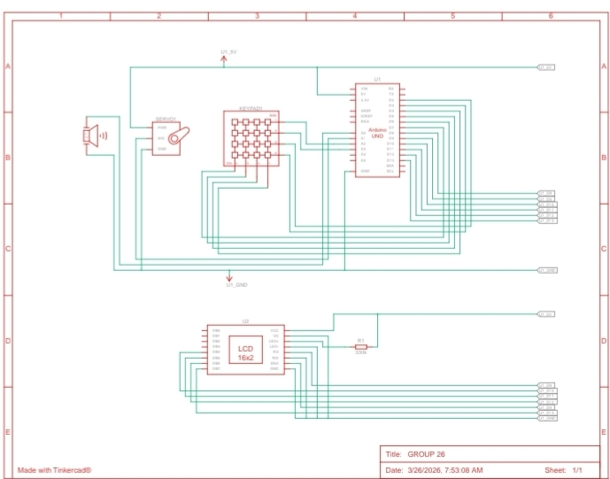

Slide 6
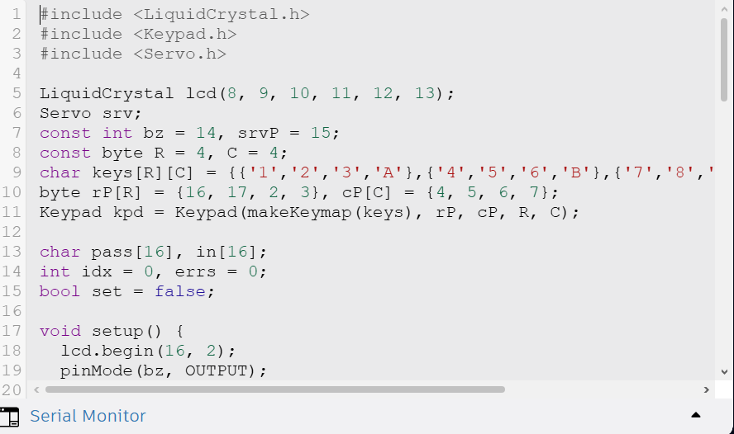

Slide 7
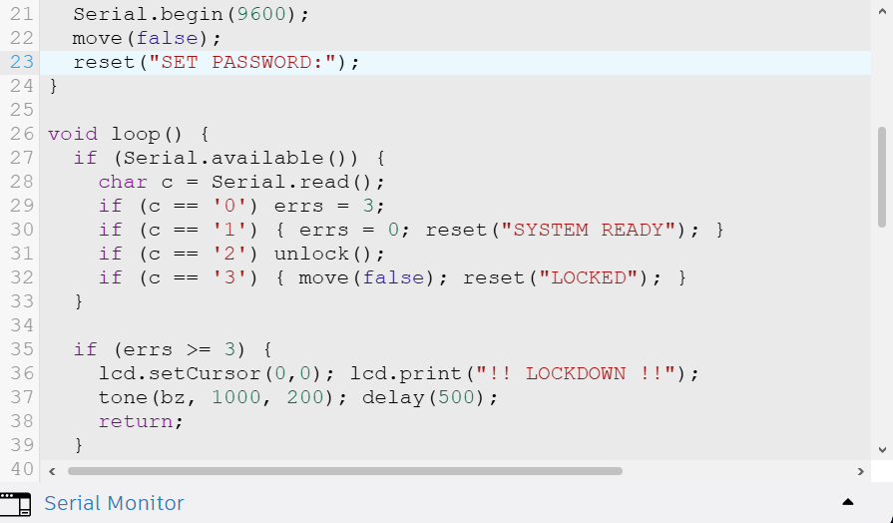

Slide 8
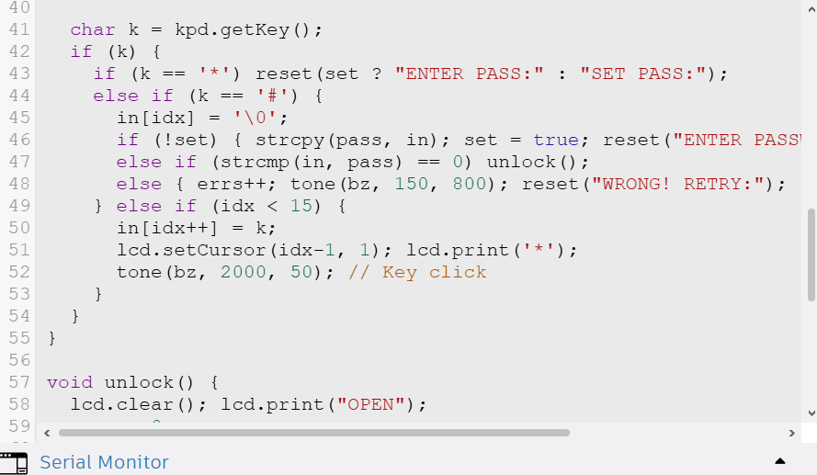

Slide 9
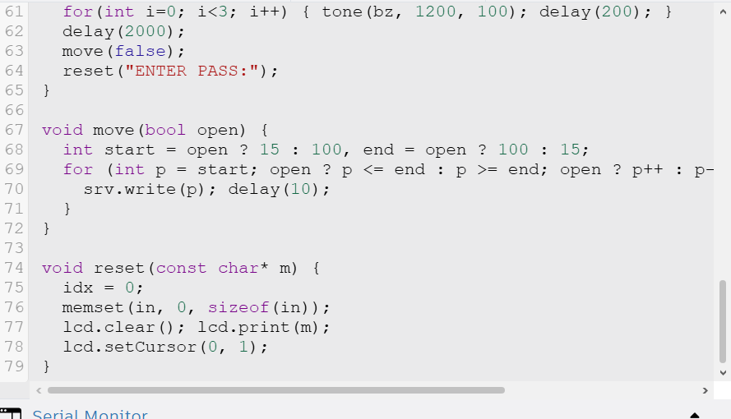

Slide 10
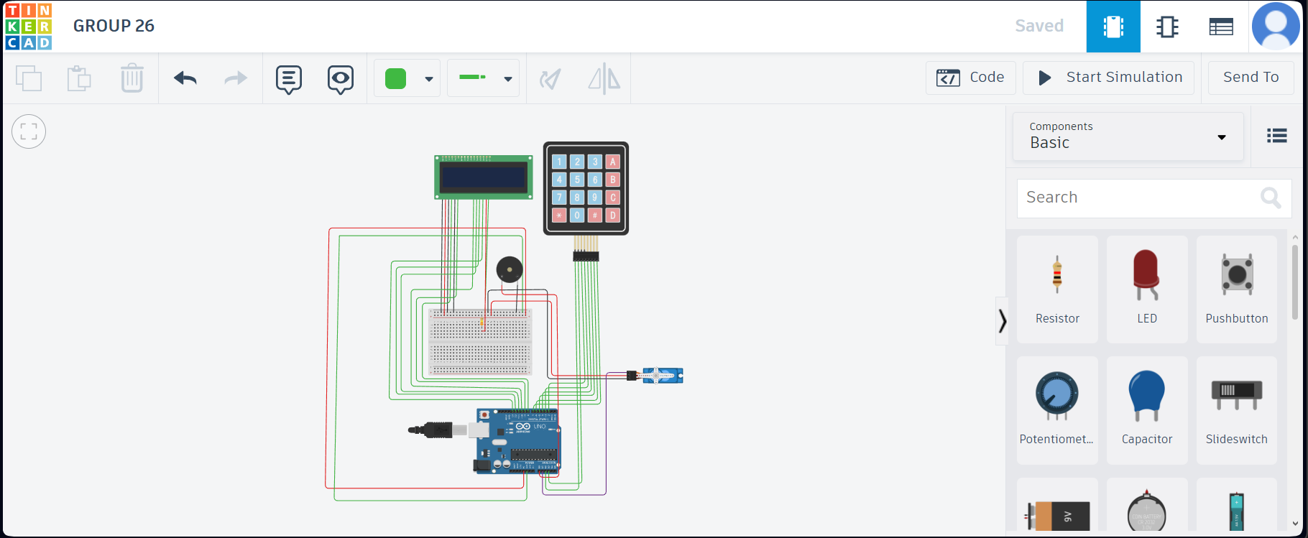
DEMONSTATION/SIMULATION
CLICK HERE

Slide 11
Summary
• This project developed a microprocessor-based office security system using Arduino Uno, keypad, LCD, servo motor, and buzzer.
• The system authenticates users through password entry, displays system messages, unlocks for authorized access, and activates an alert for repeated wrong attempts.
Conclusion
• The project provides a simple but effective improvement over traditional office locking systems.
• It enhances office security through controlled access, better monitoring, and alarm response.

Slide 12


