Slide 1


QA Basics: Exam Preparation
SoftUni Team
Technical Trainers
Software University
http://softuni.bg

Slide 2
Table of Contents
Sample Exam Questions
QA Engineer Profession Explained
What Does a QA Engineer Do?
Job Description
Roles and Duties
The QA Curriculum @ SoftUni
Q&A Session

Slide 3
You Have Questions?
sli.do #QA-Basics

Slide 4

Sample Exam Questions

Slide 5
Question 1
A test scenario contains multiple:
Test drivers
Test cycles
Test cases
Test controls
Hint: Quality Assurance Intro lecture

Slide 6
Question 2
The following statement can be applied to which test level: "Testing must confirm that components collaborate correctly"?
Integration testing
Acceptance testing
Non-functional testing
Functional testing
Hint: Components collaborate

Slide 7
Question 3
Software testing is NOT a way:
To evaluate the features of the software item
To find all the bugs
To verify specified requirements
To reduce the risk of software failure
Hint: Seven testing principles

Slide 8
Question 4
Software testing process includes:
Test design
Test planning
Test reporting
Test execution
Choose the correct order, that these are performed.
2, 3, 1, 4
2, 1, 4, 3
1, 3, 4, 2
2, 3, 4, 1
Hint: Quality Assurance Intro lecture

Slide 9
Question 5
Which of the following list contains only non-functional tests:
Security testing, reliability testing, performance testing
Testing various configurations, beta testing, unit testing
Stress testing, component testing, portability testing
System testing, performance testing, alpha testing
Hint: Test Levels and Test Types lecture

Slide 10
Question 6
One of the fields on a form contains a text box which accepts numeric values in the range of 18 to 25. Which test will be negative?
19
21
25
17
Hint: Unit testing

Slide 11
Question 7
Which of the following requirements is testable:
The safety-critical parts of the system shall contain 0 faults
The system shall be built to be very fast
The system shall be user friendly
The response time shall be less than one second for the specified load
Hint: What could cause defects?

Slide 12
Question 8
Software testing activities should start:
When the requirements have been officially signed
As soon as the code is written
Before the debugging stage
As soon as possible in the development life cycle
Hint: Software Testing Process

Slide 13
Question 9
A bug tracking system:
is of limited value
should be used only by the test team
is a valuable source of project information during testing
only records defects
Hint: Bugs and Bug Tracking lecture

Slide 14
Question 10
Why should expected results be defined before execution?
To reduce the possibility of incorrect results
To assist in automation
To improve system efficiency
To improve design of the software
Hint: Bugs and Bug Tracking lecture

Slide 15

QA Engineer Profession Explained

Slide 16
What Does a QA Engineer Do?
A QA engineer monitors every phase of the software development process, including:
design
development
testing
debugging
delivery
Maintains the quality standards of the software at every stage and ensure the final product meets the requirements.
Defines the tests to verify that the software does not have any technical shortcomings.

Slide 17
QA Tasks
Here is a list of typical tasks of a QA specialist:
Checking if the product complies with the requirements
Assessing risks
Planning ideas to improve product quality
Designing tests
Executing manual an automation tests
Analyzing the test results

Slide 18
QA Roles
There are four main QA roles:
Test Analyst - engaged in static testing of requirements and checks them for completeness and consistency.
Test Designer - creates a set of tests based on requirements and plans configurations that are necessary for testing.
Test Executor performs pre-planned tests, describes and documents the found errors, and steps for reproducing (or fixing) them.
Test Manager - plans and monitors work related to testing such as deadlines, schedule, controlling requirements to tests, setting tasks, communicating with stakeholders.

Slide 19
A workday of a QA Engineer
A typical workday of a QA specialist consists of several duties. Here are some of them:
Writing test cases, running tests, documenting errors (depending on the phase of the project)
Checking the bug tracking system for the fixed errors
Conducting meetups
Learning the requirements and their clarification with the customer
Communicating with developers
Writing test documentation

Slide 20
Skills and personal qualities
QAs should:
Have a broad IT knowledge and be eager to learn new things
Be able to communicate (the quality of communication in the development team directly affects the quality of the software)
Be attentive to details, be diligent, responsible, and persistent
Possess analytical skills, be able to model and work with abstractions
Have a critical mindset aimed to find errors

Slide 21
The career prospects of QA specialists
The main areas for professional development in the QA career:
Explore new areas and grow as a QA: junior QA -> middle QA -> senior QA -> QA team lead -> QA-manager -> Head of QA department.
If you are interested in automation and want to know what a QA automation engineer does, there’s an option to master automated testing and move along this direction. It requires deeper technical knowledge.
Upgrade your qualification to a Business Analyst or a developer.
Having gained enough experience, you can grow into a Project Manager, then into a Senior Project Manager

Slide 22

The QA Curriculum and Opportunities
Become a QA Automation Engineer and Start a Job

Slide 23
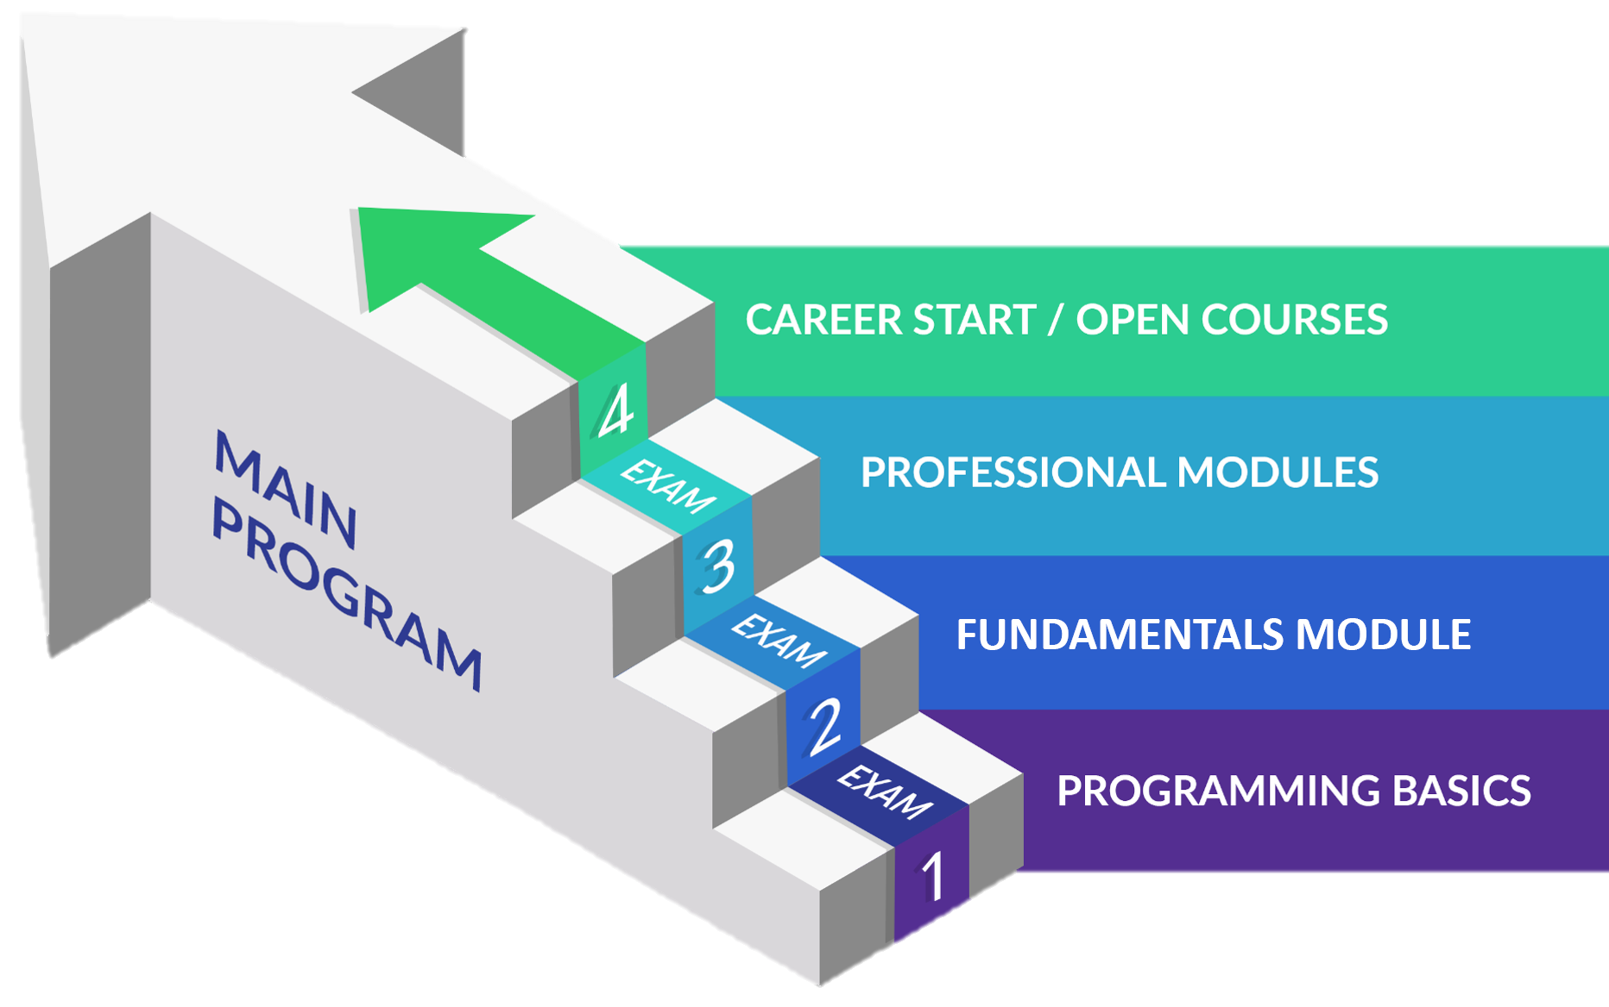
QA Engineering: Educational Program

Slide 24
Curriculum
Entry Module
QA Basics
1 month
Fundamentals Module
QA Fundamentals
4 months
Professional Modules
Programming for QA
Back-End Test Automation
Front-End Test Automation
12 months
https://softuni.bg/qa/curriculum

Slide 25

SoftUni Partners
Tech Companies, Who Support SoftUni

Slide 26














SoftUni Diamond Partners

Slide 27

Educational Partners

Slide 28
Coca-Cola HBC – Bulgaria
Coca‑Cola HBC is one of the world's largest bottlers of brands from the Coca‑Cola company
CCHBC started operations in Bulgaria in 1992 and since then, is one of the biggest contributors to the local economy
Global company with over 36 thousand engaged people
CCHBC serves more than 715 million consumers across a broad geographic footprint of 29 countries on 3 continents
https://bg.coca-colahellenic.com

Slide 29

Ambitioned
Offering digital transformation by delivering high-quality software solutions
Expertise in eLearning development
Business analysis, architecture, development, support, cloud deployment, integration, scalability, security, and more
Building an infrastructure for data aggregation, analysis, and reporting
Core expertise in .NET technologies
https://ambitioned.com/

Slide 30

CreateX
Site design
Website optimization – SEO
Online advertising – PPC
Social media marketing
Copywriting
Creative concept and design
https://createx.bg/

Slide 31
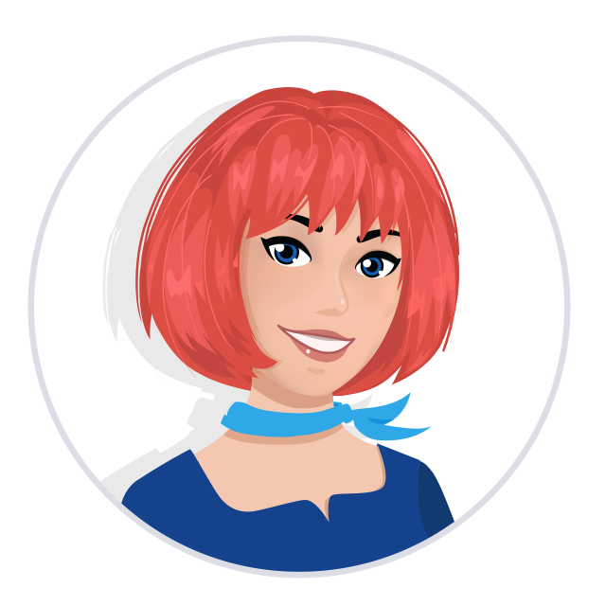
Postbank
One of the top banking institutions in Bulgaria
Employer of the year for 2017
Member of the Eurobank Group with € 58 billion of assets
Serious investments in digitization
The first bank credit botchat – EVA
https://www.facebook.com/evapostbank
https://www.postbank.bg/Za-nas/Careers

Slide 32
SuperHosting
The largest hosting company in Bulgaria
Hosting & Domains
WordPress Hosting
VPS Servers
SSL Certificates
E-Commerce
Top-quality support
Top-qualified team
Offering a complete solution
Leading technical equipment
https://www.superhosting.bg/

Slide 33
SmartIT
Established in 2005
Developing their own Fintech software tools
Technological hub of MFG with a focus to establish a new generation platform Smart Check
Using C#, .Net Core, Web API, RabbitMQ, Microservices, Docker, Kubernetes, Polymer, React, JS, JQuery, MS SQL, MongoDB, etc
Looking for Devs & QAs
https://www.smartit.bg

Slide 34
Draft Kings
US-based award-winning tech company
Has a team of over 3900 talented engineers across the globe
Works with innovative technologies to deliver high-quality sports entertainment products to their clients
DraftKings has more than 1000 employees in Bulgaria, with offices in Sofia and Plovdiv
https://careers.draftkings.com/jobs/

Slide 35

Indeavr
Business and technology services company
Business application development
Cloud engineering services
Collaboration services
Looking for junior .NET Developers
https://www.indeavr.com/en/careers

Slide 36



Software Group
Integration solutions for financial institutions
Provide digital transformation
https://www.softwaregroup.com/
Discovering Potential
Driving Innovation
Unlocking Opportunities

Slide 37

Schwarz IT
Digital heartbeat of the leading global retail group Schwarz
The group brings together Lidl and Kaufland retail chains, the recycling company Pre Zero, and the manufacturing company Schwarz Production
500,000 employees worldwide & over 12,900 stores in more than 30 countries
Provision of IT infrastructure, platforms, and business applications
Long-term commitment to support education and invest in the development of business and IT professionals
https://it.schwarz/en/it-hubs/bulgaria

Slide 38

PokerStars
Product company home of PokerStars, PokerStars Casino and PokerStars Sport
Part of the International division of Flutter Entertainment Plc., a global sports betting and gaming operator
Global engineering team, industry-leading products - innovative Sportsbook platform, a renown poker site, and the world's fastest-growing casino
Java, JS, React, Kubernetes, AWS, and many more
https://pokerstarscareers.com/

Slide 39

PharVision Capital
Founded in 2020 in Chicago
Provide superior uncorrelated investments returns using statistics and AI/ML methods
Sources un/structured datasets, sound economic and financial principles, and advanced ML techniques to capture in the equity markets
https://www.pharvision.ai/

Slide 40

Bosch.IO
Bosch.IO drives the digital and AIoT business of Bosch Group
Five countries and 900 associates, more than 200 of whom are working in the Bulgarian office
Languages and frameworks: Java, Spring Boot, Go, TypeScript; Mobile: iOS & Android; Cloud Platforms: Azure & Azure DevOps, AWS
Looking for software engineer / architect, cloud engineer, UX/UI designer, project manager, product / business owner
https://bosch.io/

Slide 41
DXC Technology
A Fortune 500 global IT services leader
Provides services for business process outsourcing, analytics and engineering, applications, security, cloud, IT outsourcing, and modern workplace
DXC has strong values, and fosters a culture of inclusion, belonging, and corporate citizenship
DXC is a virtual-first company, we put the employee experience first with a modern workplace and allow them to work from the comfort of their home
https://dxc.com/us/en

Slide 42

Q & A Session

Slide 43

Summary
…
…
…
Exam preparation: Solving sample questions
QA profession: What does a QA engineer do?
QA curriculum: Your QA path
Our partners: Opportunities
Q & A Session: Your questions answered

Slide 44
Questions?
Notes:
44

Slide 45

SoftUni Diamond Partners

Slide 46
Educational Partners

Slide 47

License
This course (slides, examples, demos, exercises, homework, documents, videos and other assets) is copyrighted content
Unauthorized copy, reproduction or use is illegal
© SoftUni – https://about.softuni.bg/
© Software University – https://softuni.bg
Notes:
47

Slide 48
Trainings @ Software University (SoftUni)
Software University – High-Quality Education, Profession and Job for Software Developers
softuni.bg, about.softuni.bg
Software University Foundation
softuni.foundation
Software University @ Facebook
facebook.com/SoftwareUniversity
Software University Forums
forum.softuni.bg
Notes:
48

