Slide 1
CMAD Design Review Blogging Site
GuruVinayak P
Nijamuddin Sipai

Slide 2
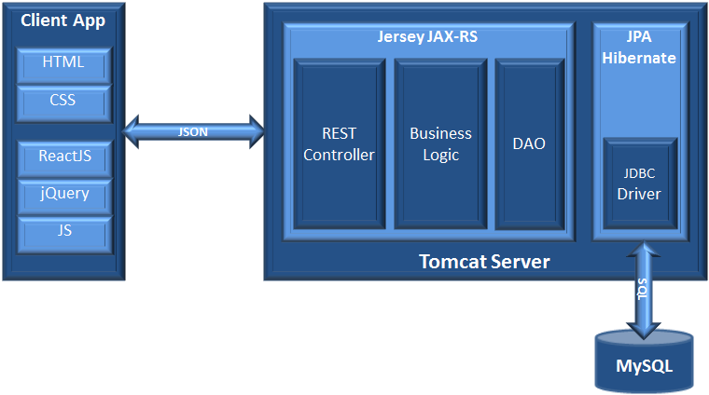
High Level Architecture

Slide 3
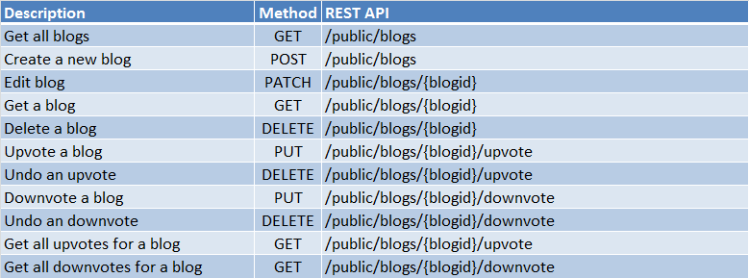
REST Documentation

Slide 4
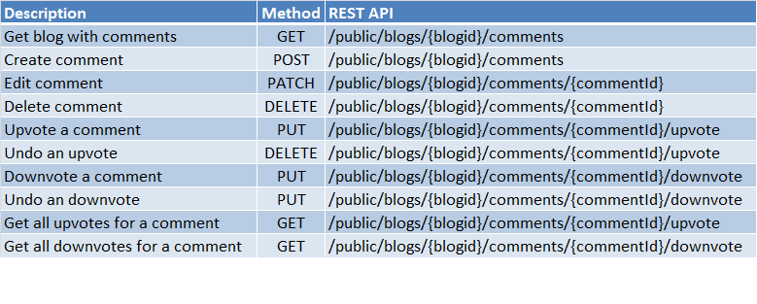
REST Documentation

Slide 5
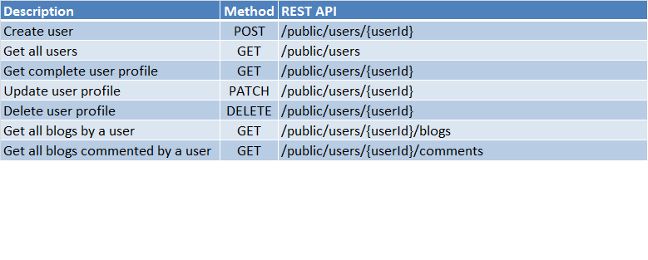
REST Documentation

Slide 6
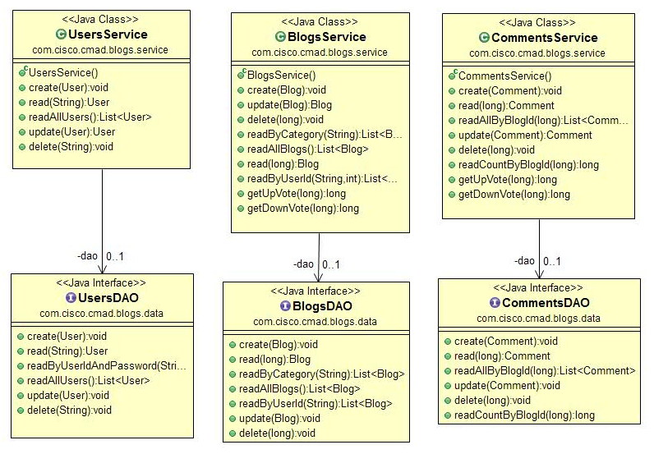
Class Design

Slide 7
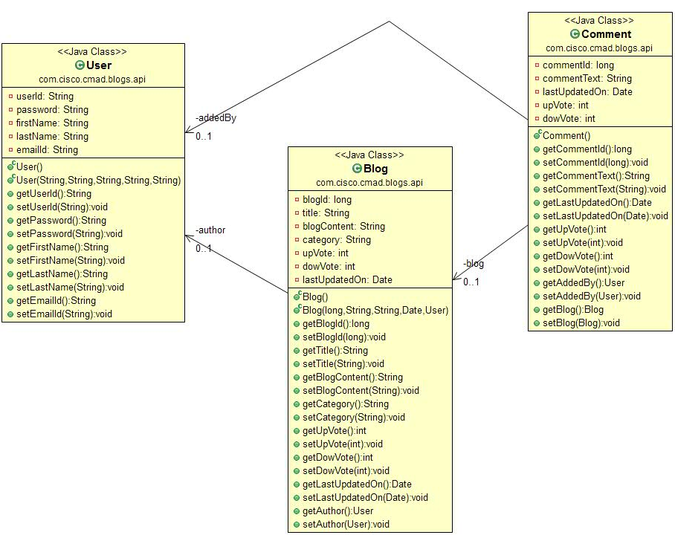
Class Design (contd.)

Slide 8
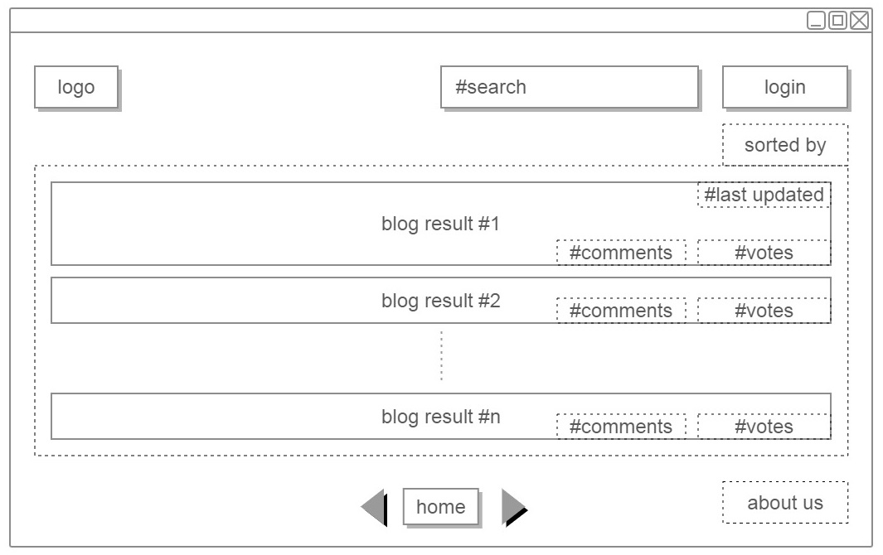
UI flow (home)

Slide 9
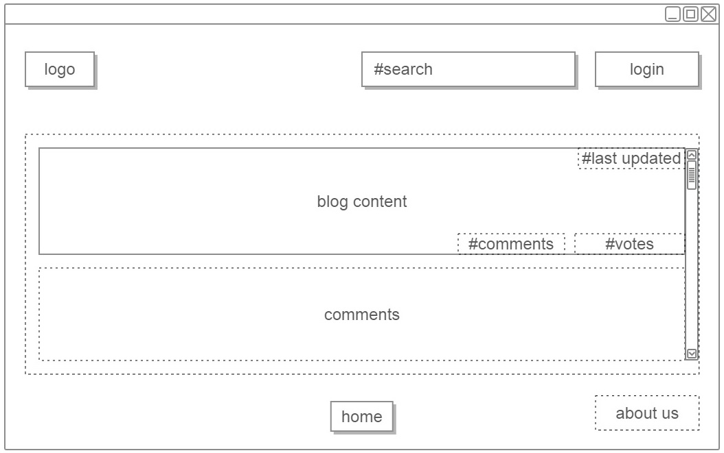
UI flow (load a blog)

Slide 10
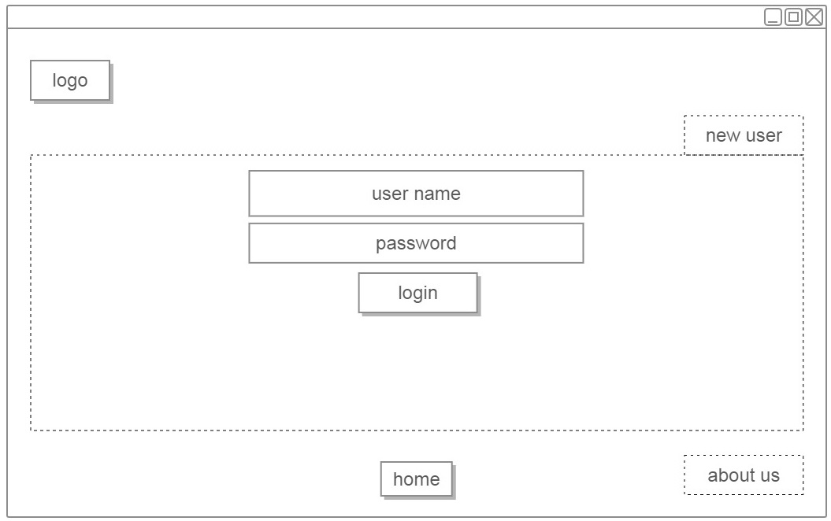
UI flow (login)

Slide 11
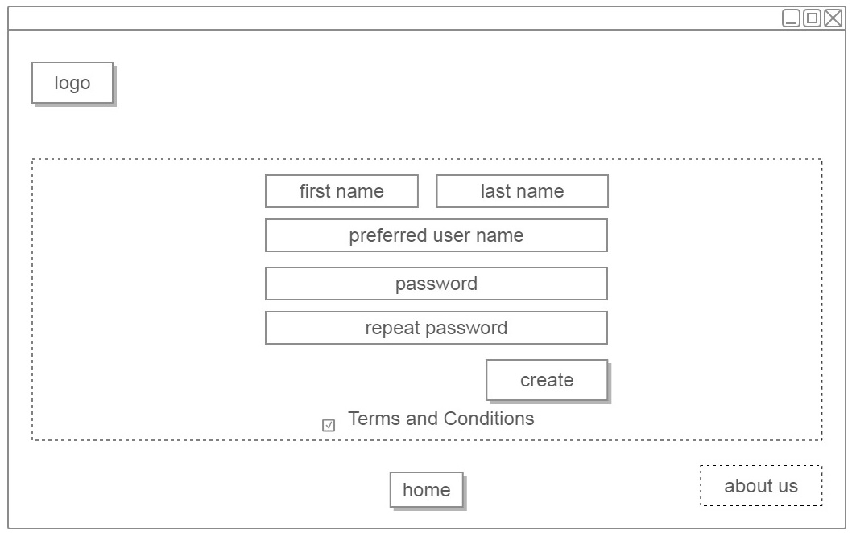
UI flow (create user)

Slide 12
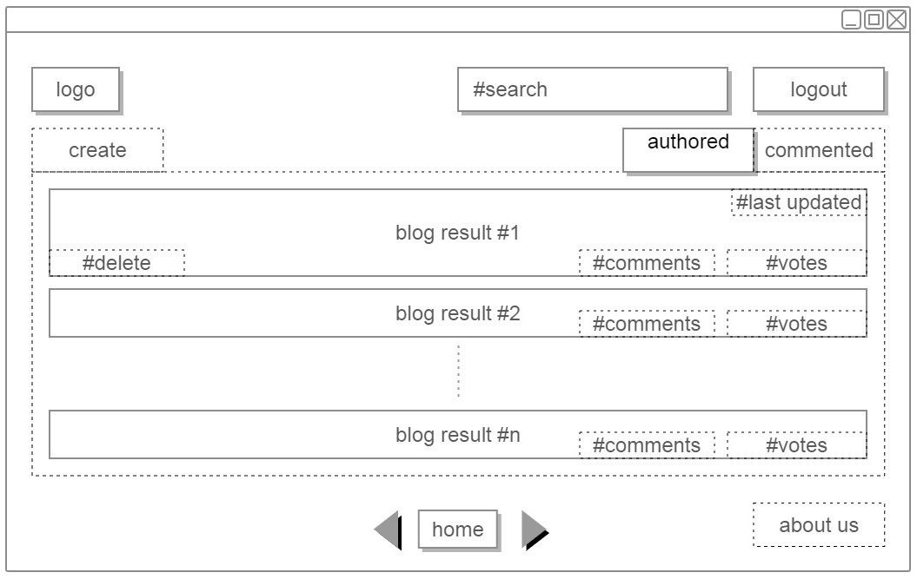
UI flow (authored blogs)

Slide 13
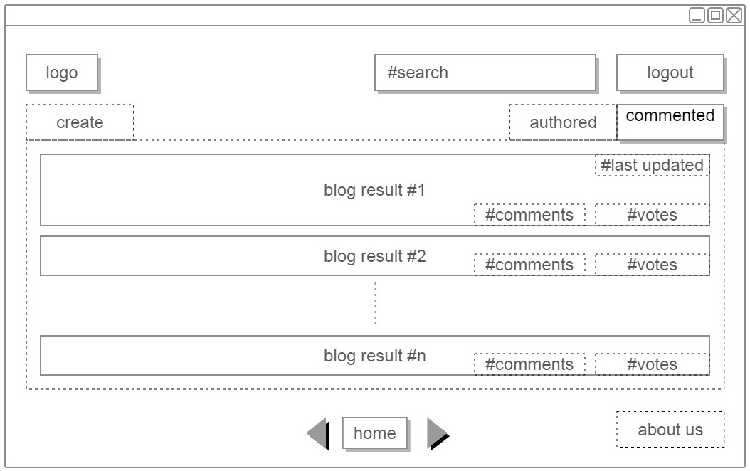
UI flow (commented blogs)

Slide 14
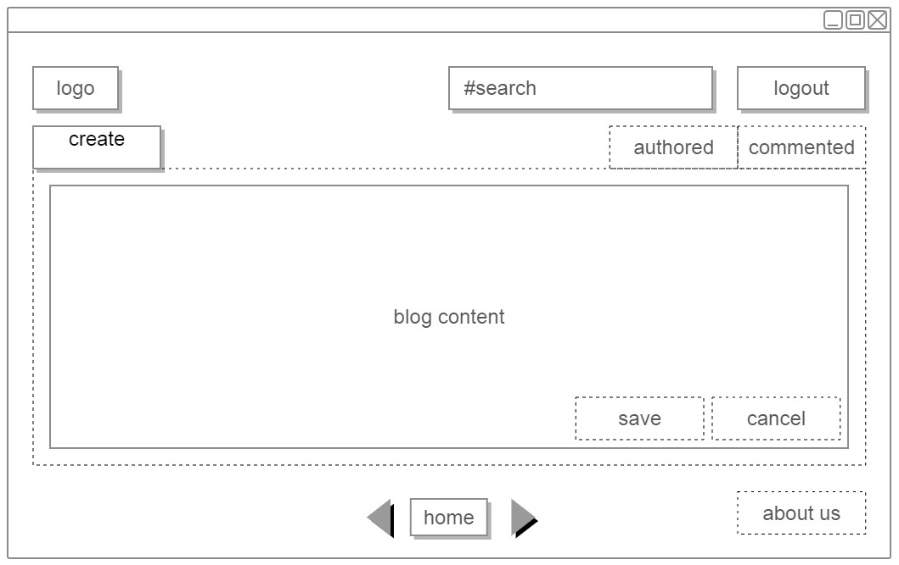
UI flow (create blog)

Slide 15
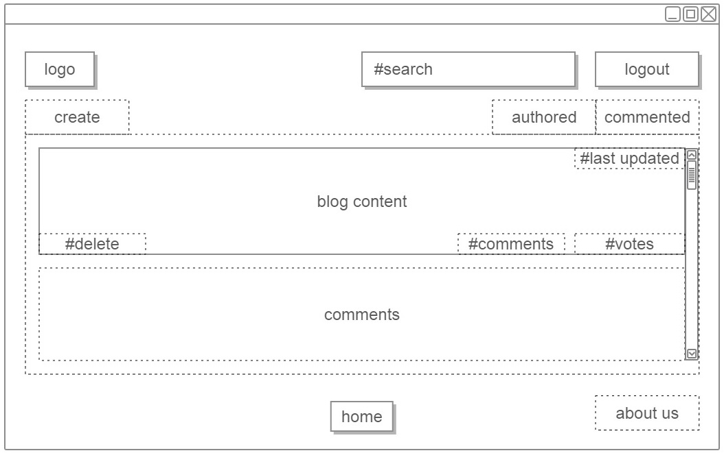
UI flow (blog saved)

Slide 16
Thank you

Slide 17
High Level Architecture
Client App
Tomcat Server
Jersey JAX-RS
JPA Hibernate
HTML
REST
Controller
Business Logic
DAO
CSS
JSON
ReactJS
JDBC Driver
jQuery
JS
SQL
MySQL

