Slide 1
🌾 Agriculture
Data Analysis🌾
Presented by:
Nijas

Slide 2
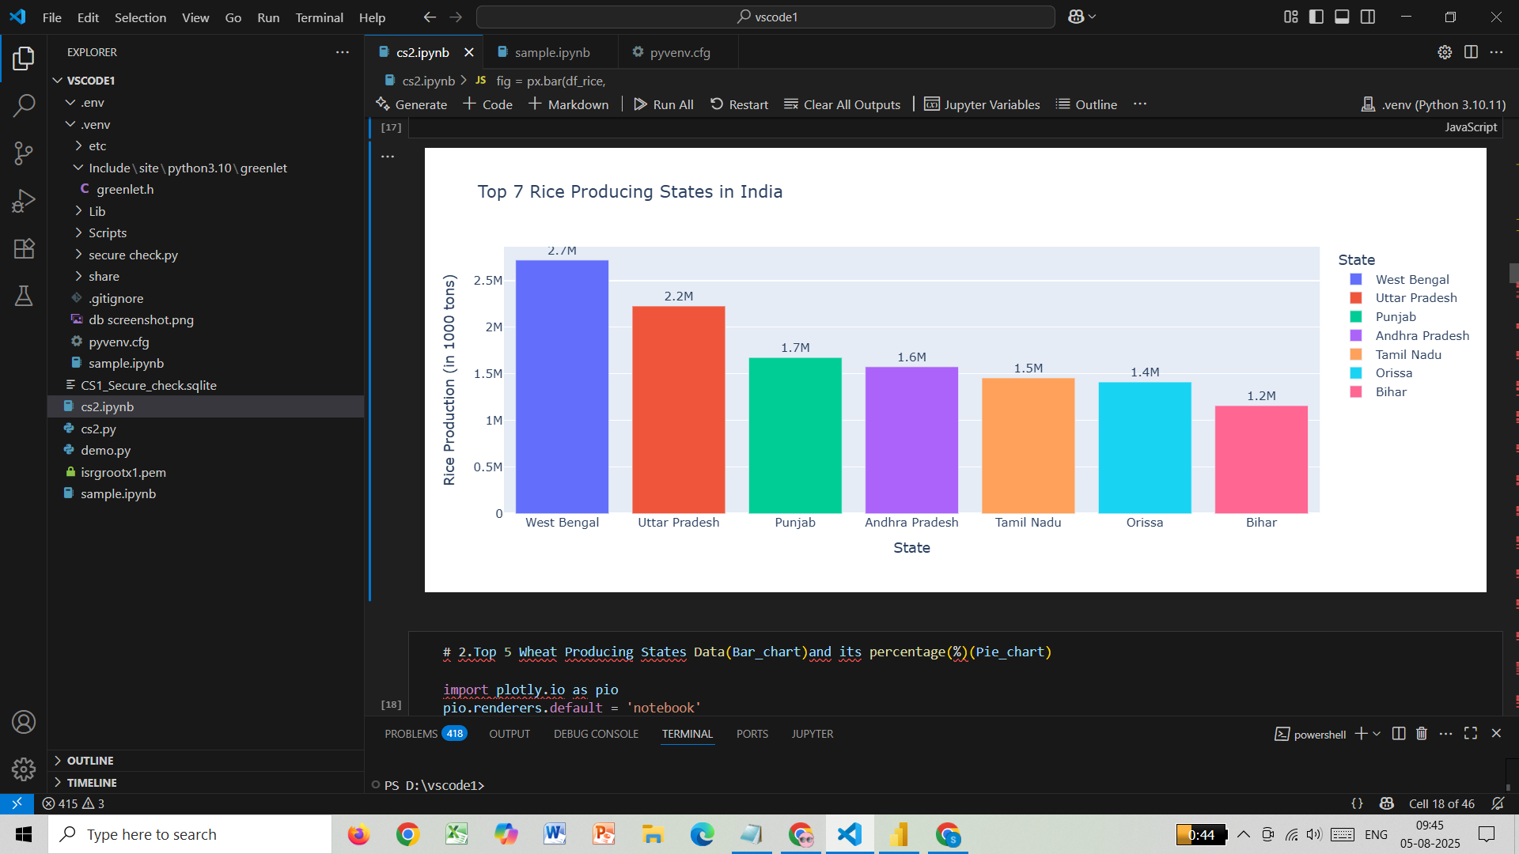
🌾 Top 7 Rice Producing States in India
West Bengal grows the most rice, followed by Uttar Pradesh and Punjab These 7 states help feed a large part of the country.
Insights:
➤ Helps the government focus on supporting key rice-producing regions

Slide 3
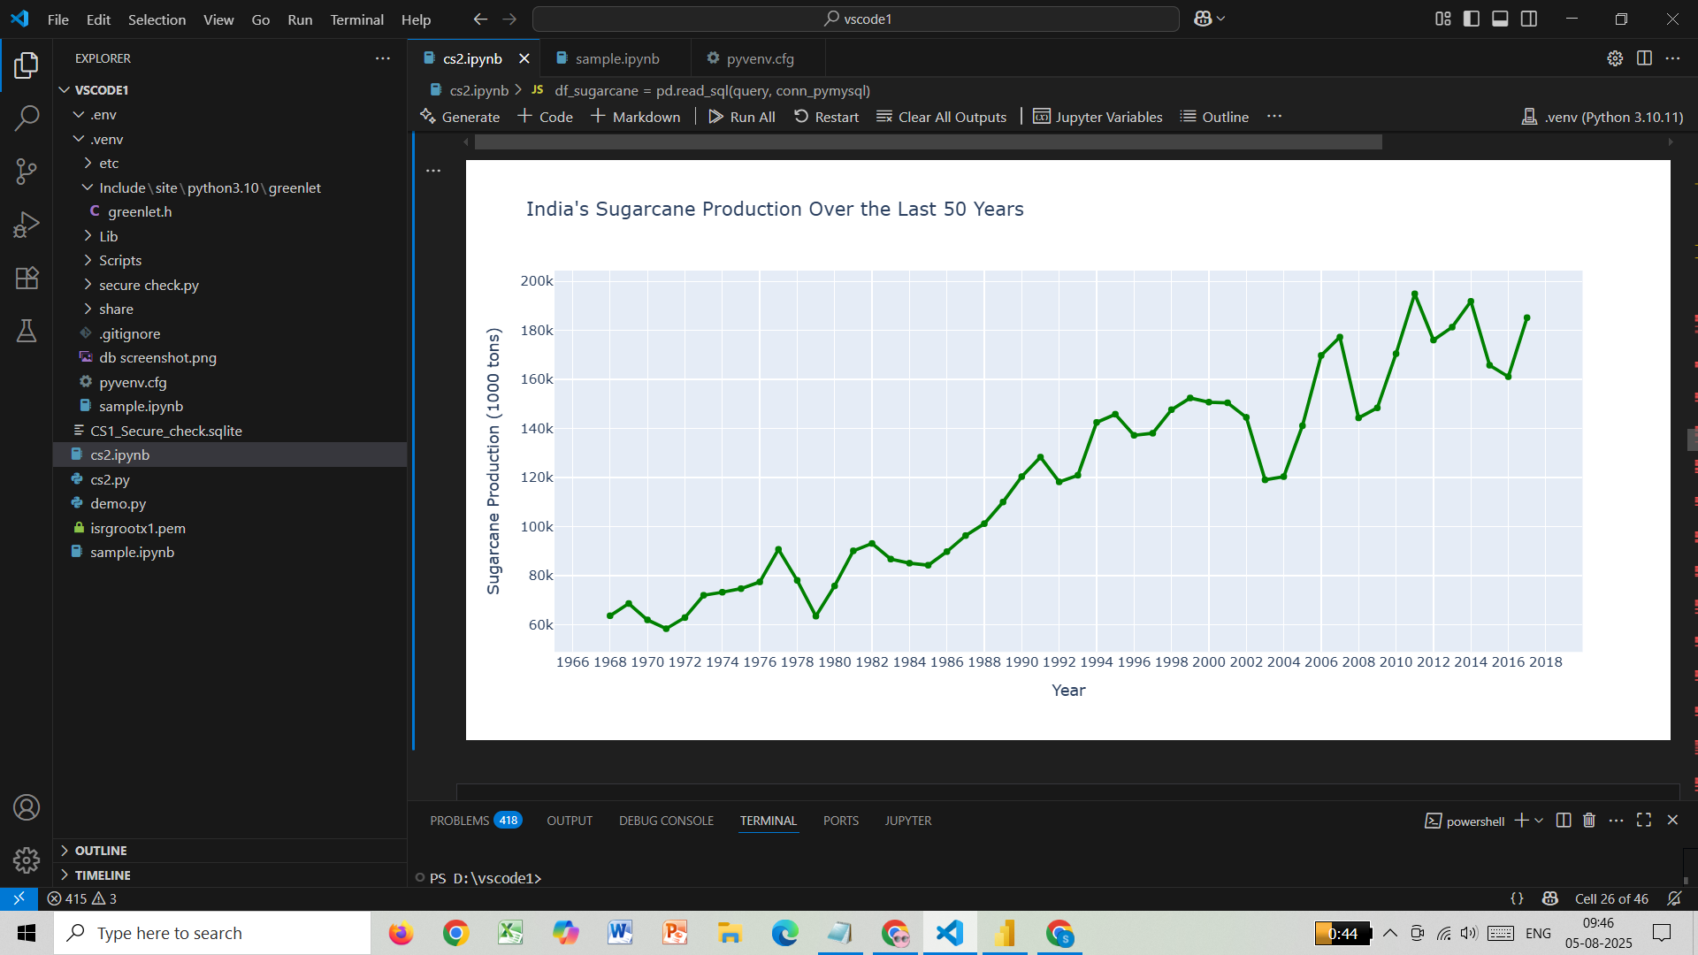
🍬 Sugarcane Production Over 50 Years
Sugarcane farming has increased steadily since 1966. Some ups and downs in recent years may be due to weather or rules.
Insights:
➤ Useful for predicting future supply and planning for sugar industries.

Slide 4
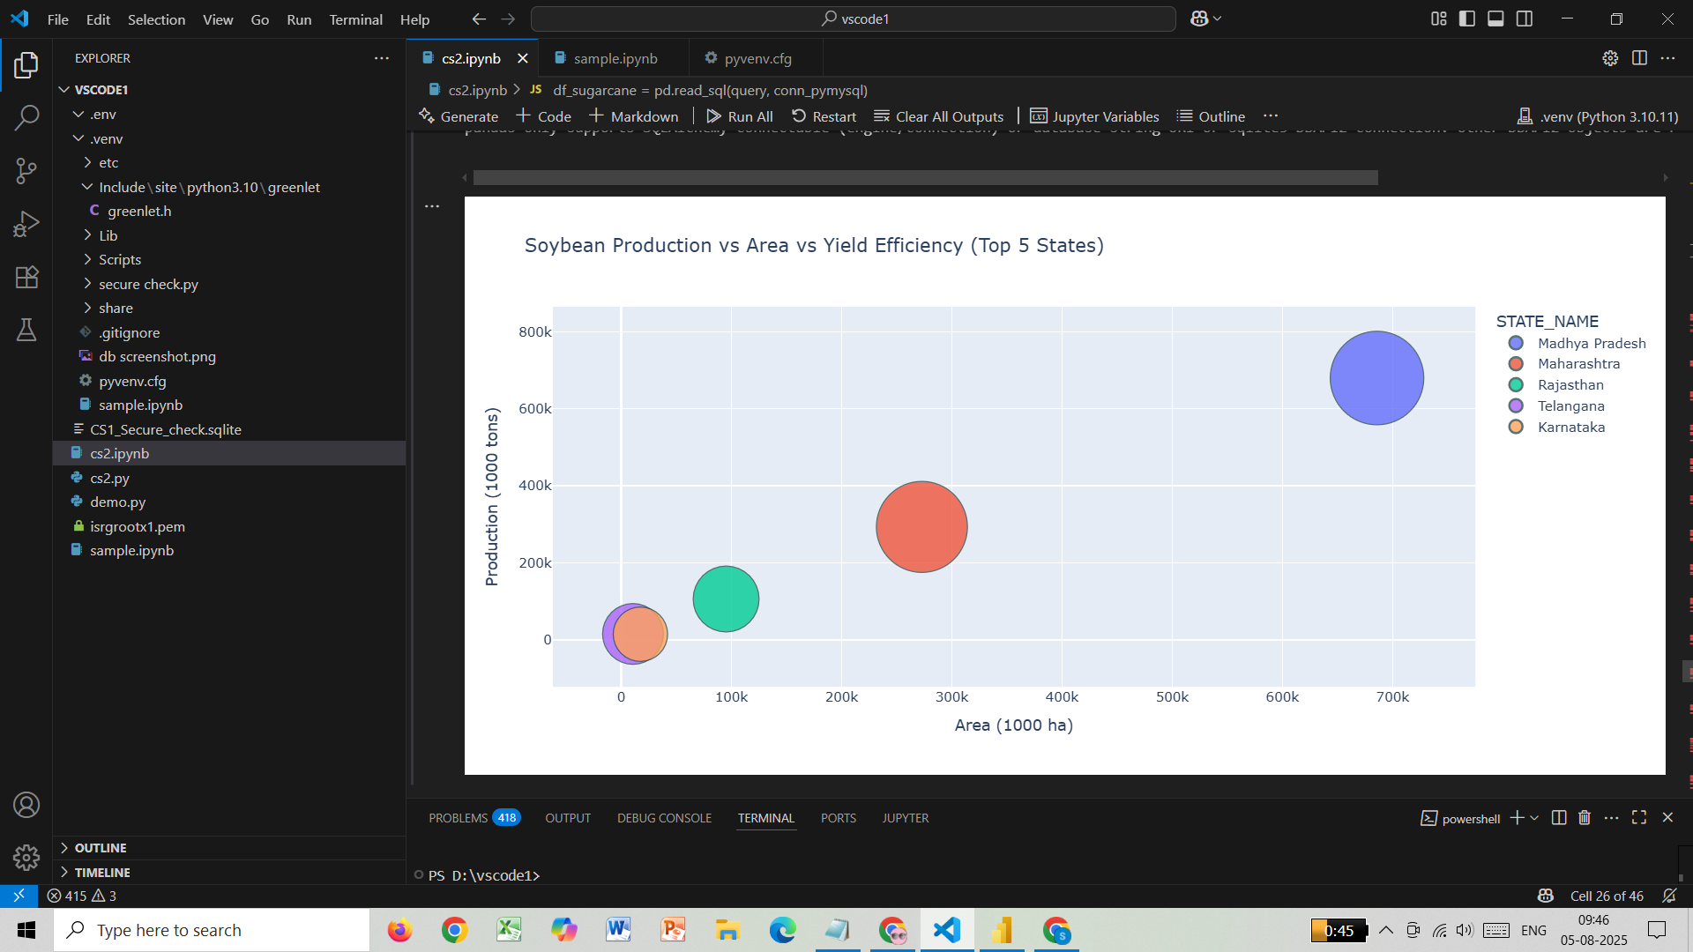
🌱 Soybean – Area vs Production
Madhya Pradesh grows the most soybeans using large land areas. Bubble size shows which states use land most efficiently.
Insights:
➤ Helps farmers and policymakers understand which states grow soybeans efficiently.

Slide 5
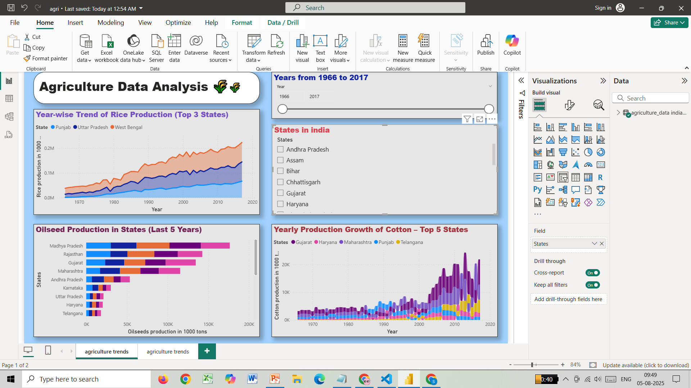
📈 Rice Trend (Power BI – Top 3 States)
Rice production increased steadily in Punjab, UP, and West Bengal These states grow more because of good soil and water.
Insights:
➤ Helps track consistent growth and plan irrigation or storage facilities.

Slide 6
🛢 Oilseed Production in Last 5 Years (Power BI)
MP, Rajasthan, and Gujarat are top oilseed producers. Farmers are growing more oilseeds for better income.
Insights:
➤ Guides investment in states showing rising oilseed trends.

Slide 7
👕 Cotton Production Growth (Power BI)
Cotton farming grew fast after 2000, especially in Maharashtra. Better seeds and tools helped increase production.
Insights:
➤ Supports textile industries in planning based on raw cotton availability.

