Slide 1


Zignuts Technolab
DEVANG PATEL INSTITUTE OF ADVANCE TECHNOLOGY AND RESEARCH
External Guide
Internal Guide
Prepared By
Mr. Pruthvi Darji (Mentor)
Prof. Priyanka Padhiyar
Dhara Thakkar(D21DCS153)

Slide 2

Company Profile
DETAILS
Industry Name | Zignuts Technolab
Industry Number | 9925800950
Guide Email ID | pruthvid@zignuts.com
Industry Address | A-409, Siddhraj Zori,, S. G. Road, Near Sargasan Circle, Gandhinagar, Gujarat 382421
Website | https://www.zignuts.com/

Slide 3
Introduction of Internship
As a full-stack web developer intern, I bring a solid understanding of JavaScript and Node.js to the table. I'm eager to get started with both front-end and back-end development since I want to learn and progress. I'm prepared to add significant value to the team and broaden my experience because I have a strong desire to succeed and a passion for technology.

Slide 4
Internship Activity
Week-1
Start Working on given learning path.
Practiced HTML,CSS, Bootstrap etc.
Learn concepts of React.js .
Week-2
Start Learning REST-Api with node.js
Learn Node.js and Express.
Currently Working on assignment Car-rental system.

Slide 5

Implementation Screenshots
1 Main page of car-rental system

Slide 6
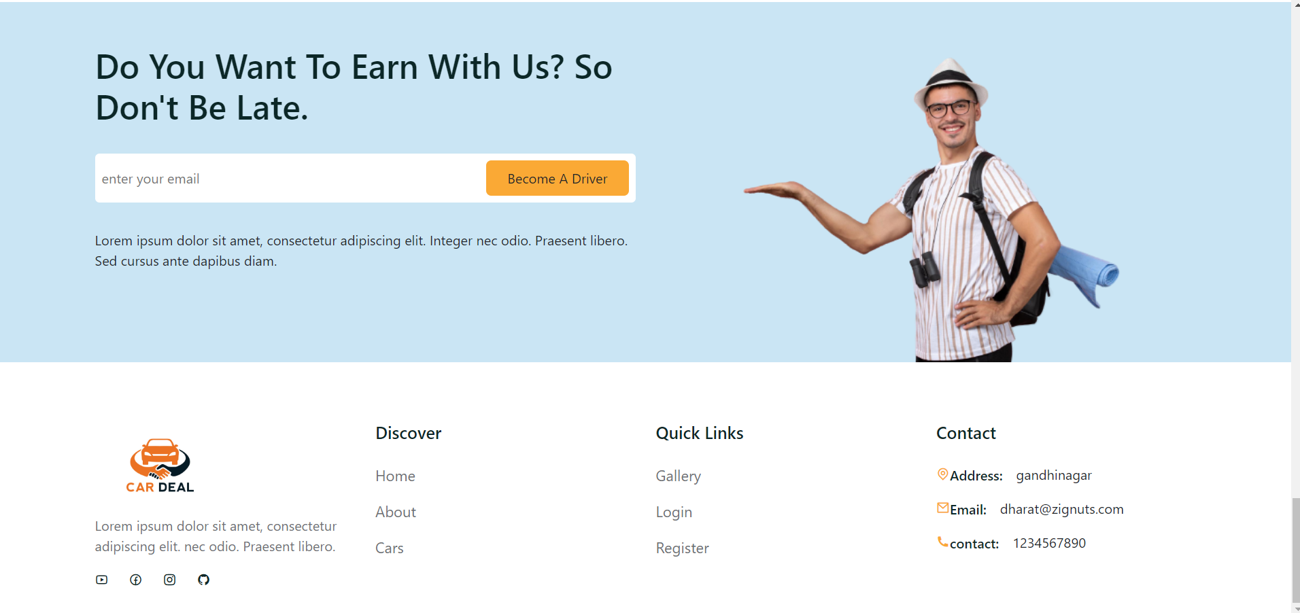
Implementation Screenshots
2.Driver and Footer page

Slide 7
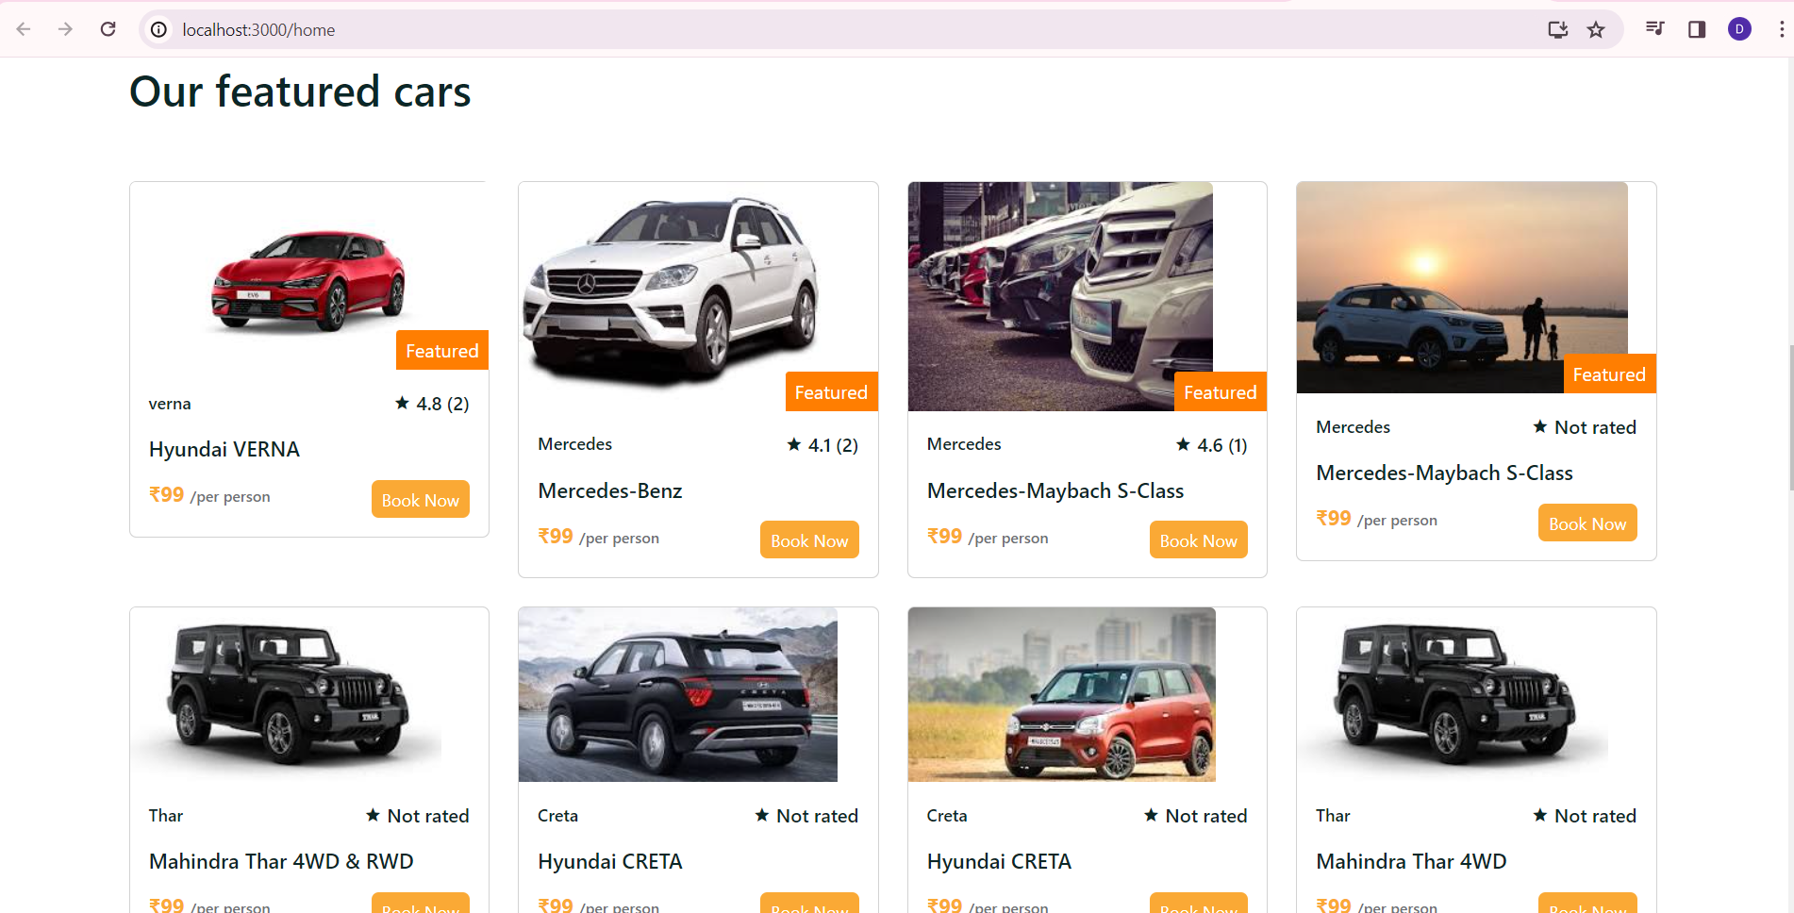
Implementation Screenshots
3. Cars page

Slide 8
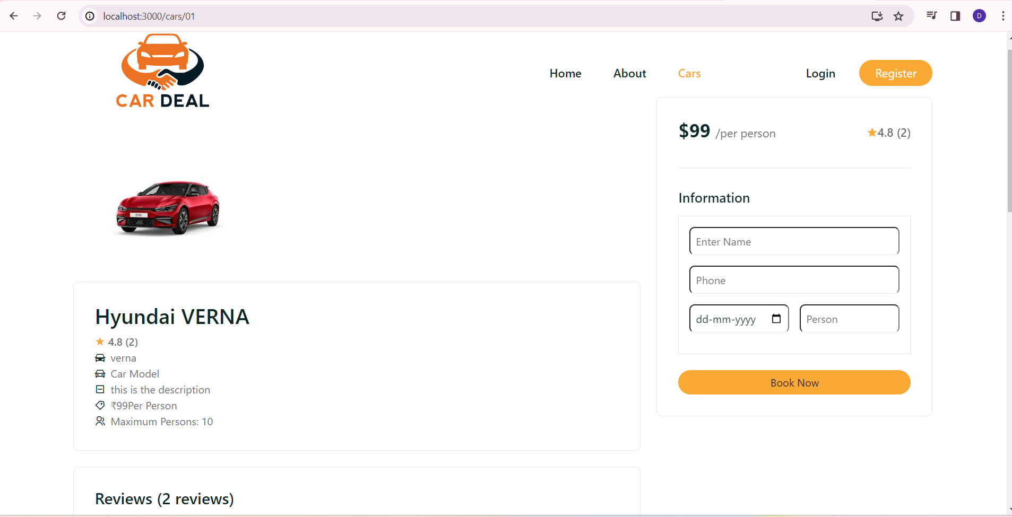
Implementation Screenshots
3.1 Book now page of car

Slide 9
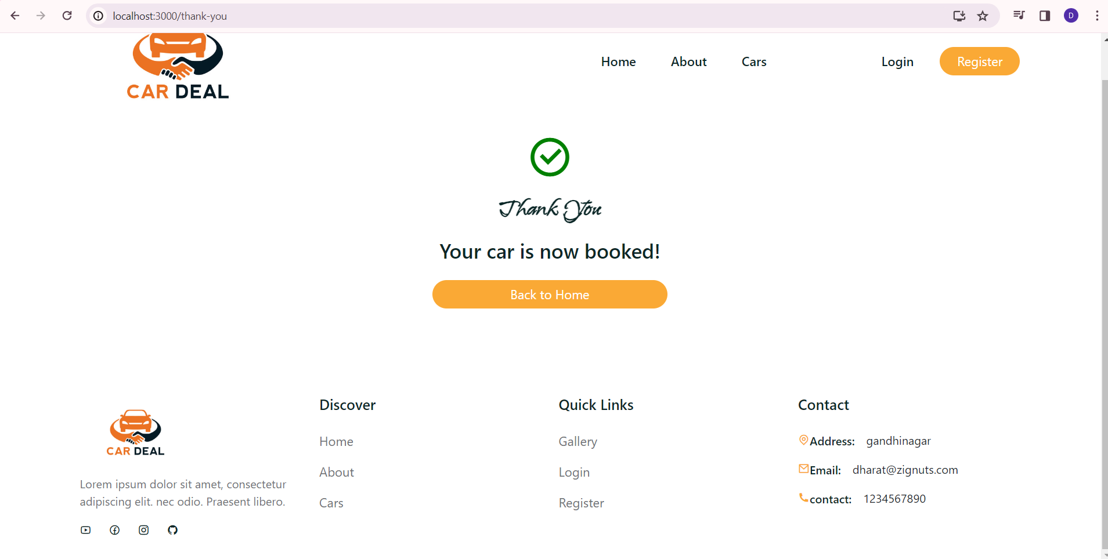
Implementation Screenshots
3.2 Thank-you page after booking

Slide 10
THANK YOU

