Slide 1
Skip-Thought Vectors
NNFL Term Project 2019-20
Anwesh Bhattacharya 2016B5A70590P
Ajinkya Vyas 2016A3PS0246P
Nikhil Khandelwal 2016A3PS0192P

Slide 2
OVerview
Introduction
Skip-Thoughts
Experiments
Results

Slide 3
Introduction
Unsupervised Sentence Encoder Framework
Train an encoder-decoder model that tries to reconstruct the surrounding sentences of an encoded image
Sentences that share semantic and syntactic properties are thus mapped to similar vector representations
Vocabulary expansion
Evaluate our vectors with linear models on 2 tasks : Paraphrase detection, Opinion Polarity Classification

Slide 4
Introduction
Learn high-quality sentence vectors without a particlar supervised task in mind
Encode a sentence to predict the sentences around it
Encoder as a generic feature extractor for arbitrary tasks
Learning a mapping that transfers word representations from one model to another
Sentence to vector representation

Slide 5
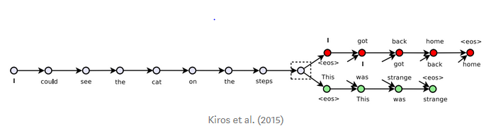
Given a 3-tuple of sentences, the middle sentence is encoded and the model tries to reconstruct the previous sentence and the next sentence

Slide 6
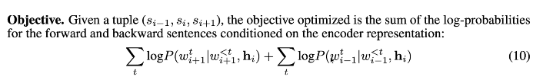

Slide 7
Experiments
Model is trained on Book Corpus
UniSkip → Unidirectional encoder with 2400 dimensions
BiSkip → Bidirectional model with forward and backward encoders of 1200 dimensional each
CombineSkip → 4800 dimensions by combining 2400 uniskip + 2400 biskip
Mini-batch size 128
Adam optimizer

Slide 8
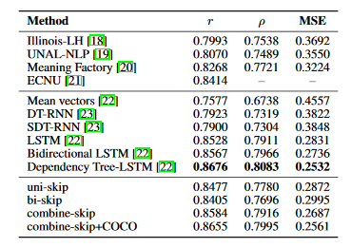
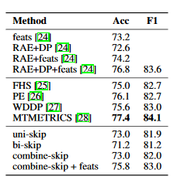
Experiment 1 -
SemEval 2014 Task1 : Semantic Relatedness SICK dataset
Similarity score is used to find if 2 sentences are similar. Score is between 1 to 5. The dataset comes with a predefined split of 4500 training pairs, 500 development pairs and 4927 testing pairs.

Slide 9
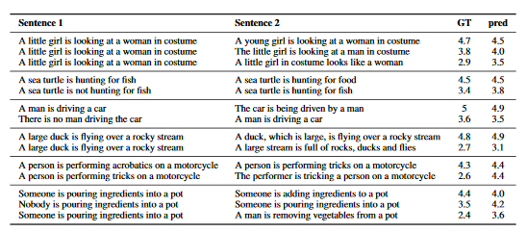
Experiment 2 - SEMANTIC RELATEDNESS
Giventwo sentences, our goal is to produce a score of how semantically related these sentences are, basedon human generated scores. Each score is the average of 10 different human annotators. Scorestake values between 1 and 5. A score of 1 indicates that the sentence pair is not at all related, whilea score of 5 indicates they are highly related.

Slide 10
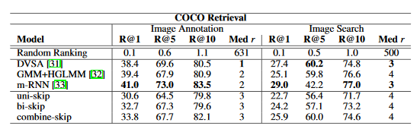
Experiment 3 - Paraphrase Detection
Paraphrase detection on the Microsoft Research Paraphrase Corpus
On this task, two sentences are given and one must predict whether or not they are paraphrases. The training set consists of 4076 sentence pairs (2753 of which are positive) and the test has 1725 pairs (1147 are positive)

Slide 11
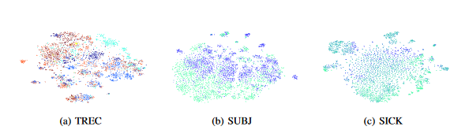
Experiment 4 - IMAGE-SENTENCE RANKING
Each image is annotated with 5 captions, each from different annotators.
For image annotation, an image is presented and sentences are ranked based on how well they describe the query image.

Slide 12
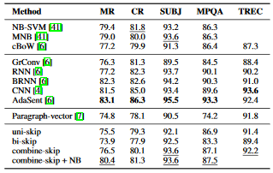
Experiment 5 - CLASSIFICATION BENCHMARKS
Movie review sentiment(MR), customer product reviews(CR), subjectivity/objectivity classification(SUBJ), opinion polarity (MPQA) and question-type classification(TREC)

Slide 13
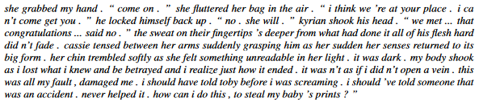
Experiment 6 - VISUALIZING SKIP-THOUGHTS & GENERATING STORIES
Each point represents a sentence pair, computed using the concatenation of component-wise and absolute difference of features.
Remarkably, sentence pairs that are similar to each other are embedded next to other similar pairs. Even without the use of relatedness labels, skip-thought vectors learn to accurately capture this property.

