Slide 1
Dealing with performance analysis in C/C++
Denis Bakhvalov
embo++, March 2018
Notes:
Hi, my name is Denis and I’m working at Intel in C/C++ Compiler team. On a daily basis I’m doing a lot of profiling of different benchmarks and analyzing performance and today I want to share with you some of the techniques that I use.

Slide 2
Legal Disclaimer & Optimization Notice
INFORMATION IN THIS DOCUMENT IS PROVIDED “AS IS”. NO LICENSE, EXPRESS OR IMPLIED, BY ESTOPPEL OR OTHERWISE, TO ANY INTELLECTUAL PROPERTY RIGHTS IS GRANTED BY THIS DOCUMENT. INTEL ASSUMES NO LIABILITY WHATSOEVER AND INTEL DISCLAIMS ANY EXPRESS OR IMPLIED WARRANTY, RELATING TO THIS INFORMATION INCLUDING LIABILITY OR WARRANTIES RELATING TO FITNESS FOR A PARTICULAR PURPOSE, MERCHANTABILITY, OR INFRINGEMENT OF ANY PATENT, COPYRIGHT OR OTHER INTELLECTUAL PROPERTY RIGHT.
Software and workloads used in performance tests may have been optimized for performance only on Intel microprocessors. Performance tests, such as SYSmark and MobileMark, are measured using specific computer systems, components, software, operations and functions. Any change to any of those factors may cause the results to vary. You should consult other information and performance tests to assist you in fully evaluating your contemplated purchases, including the performance of that product when combined with other products. For more complete information visit www.intel.com/benchmarks.
Copyright © 2018, Intel Corporation. All rights reserved. Intel, Pentium, Xeon, Xeon Phi, Core, VTune, Cilk, and the Intel logo are trademarks of Intel Corporation in the U.S. and other countries.
Optimization Notice
Intel’s compilers may or may not optimize to the same degree for non-Intel microprocessors for optimizations that are not unique to Intel microprocessors. These optimizations include SSE2, SSE3, and SSSE3 instruction sets and other optimizations. Intel does not guarantee the availability, functionality, or effectiveness of any optimization on microprocessors not manufactured by Intel. Microprocessor-dependent optimizations in this product are intended for use with Intel microprocessors. Certain optimizations not specific to Intel microarchitecture are reserved for Intel microprocessors. Please refer to the applicable product User and Reference Guides for more information regarding the specific instruction sets covered by this notice. Notice revision #20110804
2
Notes:
So, this is the disclaimer slide, they asked me to put in my presentation, so here it is.

Slide 3
Overview
How we do performance analysis
How you can do it
What you need to be aware of
Notes:
So in this talk I will start with some specifics of our work, then
I will show how you can use it in the development of your application and finally I will walk you through some dark corners of performance analysis.

Slide 4
Performance analysis that we do
Notes:
Now, before we dig into the cases and examples, let me tell you specifics about my work

Slide 5
Performance analysis that we do
Performance analysis of | Code of the benchmark | Code of the compiler
Applications | changing | fixed
Notes:
Usually we as a C++ developers have our application and hopefully some form of CI contiguous integration which includes nightly build and performance tracking. Meaning that whenever someone will implement some slow piece of code, she or he will receive notification next morning saying “Hey! There was a performance drop after the your commit”. So, the code of the benchmark is changing but usually we are not switching to another compiler, or using different compiler options.

Slide 6
Performance analysis that we do
Performance analysis of | Code of the benchmark | Code of the compiler
Applications | changing | fixed
Compiler | fixed | changing
Notes:
However, I have an opposite reality: I have a set of benchmarks with fixed sources (they are not changing) but each day I have a brand new built from sources compiler. Our automatic tracking system builds, say a new clang compiler, from the latest revision and uses it to compile the benchmark and runs it. So, this is basically how we track performance of the code generated by the compiler.
The bottom line here is that application developers will try to change the code of the application to improve the performance, but we will try improve the compiler to make it generate optimal code.

Slide 7
Performance analysis that we do
before
after
Compiler dd/mm/yyyy
performance gap
Compiler dd+1/mm/yyyy
Notes:
The new version of clang might generate different assembly code than it generated yesterday, for the same sources, causing performance gain or regression.
And whenever we see a performance regression we should analyze it and hopefully fix it in the compiler.
In my team we work with all the major compilers. However, I’m mostly working with clang compiler nowadays.

Slide 8
What tools do I use?
perf, Intel® VTune™ Amplifier
binutils (objdump, nm, etc.)
Notes:
Before going to the examples I want to briefly say about the tools that I’m using. It happens to be not that much, so there is nothing that stops you from starting performance analysis of your application right now. I just profile application using perf or Intel Vtune and use good old binutils.
Perf is an open source SW and very powerful tool, but sometimes when I need more detailed analysis I use Intel Vtune.
This talk is NOT about:
How to use profiling tools – there is plenty of good articles and tutorials how to do that.
How to use better algorithms - the benchmarks that I’m working with are already highly optimized and contain no obvious performance problems, like for example, traversing matrix by columns, which is not cache friendly and so on. Remember, we will talk about 5-15% difference in performance, not the orders of magnitude.

Slide 9
Compiler options
You might want to use at least those:
-O2/O3
-march=<architecture>
Notes:
Now, I’m still surprised how many people don’t know that they can significantly improve performance of their application just by using better compiler options.
You can simply use higher optimization level or specify that you want compiler to generated code for particular architecture. This –march option can be used for crosscompiling but now compiler will fully leverage all the capabilities of a particular CPU architecture.

Slide 10
Compiler options
You might want to use at least those:
-O2/O3
-march=<architecture>
For coremark-pro suite:
‘-O3 -march=skylake’ is +9% better than ‘-O2’
Notes:
For example, coremark-pro benchmark suite compiled ‘-O3 –march=skylake’ is +9% better than ‘-O2’ on Skylake platform

Slide 11
Case 1
Execution slows down by 15%.
Benchmark: EEMBC (networking/routelookup)
Notes:
Ok, so let me show you an example of performance regression in compiler. I specifically don’t want to name the compiler on which that regression happened in order not to make a bad impression on this compiler.
This happened on of the benchmarks from EEMBC suite.
So, I measured the performance for binaries compiled with yesterday’s and today’s compiler and found that execution slowed down by 15%.
As a first step I found the hottest place in the benchmark.
In this benchmark it is the only hot place, so lets jump directly into it.

Slide 12
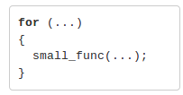
Performance degraded (1)
Notes:
And here it is. I stripped everything out that is not relevant for this case. There is a loop with a function call inside.

Slide 13
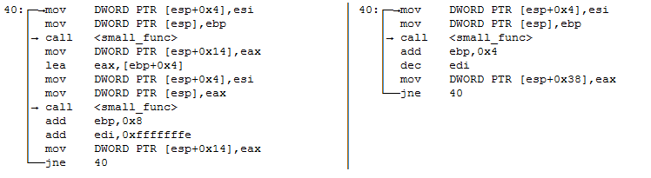
Performance degraded (1)
before (fast)
after (slow)
Notes:
And here is the assembly that is associated with it.
Those two assembly codes were generated by different versions of the same compiler. For example, lhs was generated by the yesterday’s version of compiler X and rhs by today’s version.
I hope everyone is comfortable with the x86 assembly, but you don’t need to fully understand all the code, otherwise I will walk you through the code line by line.
Also you can spot the backwards jump which essentially forms the loop.
The number of iterations is pretty big, say 100 000 times.

Slide 14
Performance degraded (1)
before (fast)
after (slow)
performance
-15%
Notes:
So, measurements tell us that rhs has 15% bigger execution time.
Can anyone guess what can be the reason for this?

Slide 15
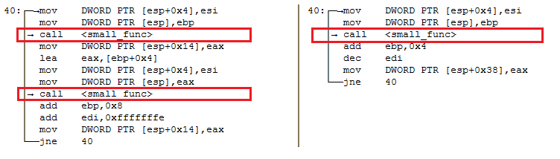
Performance degraded (1)
before (fast)
after (slow)
performance
-15%
Notes:
Yeah, so this optimization that was performed yesterday and was NOT performed today is called loop unrolling.
We have 2 function calls per iteration on the lhs and only 1 on the rhs. That means that we are doing twice as much jumps in the slow case.
Notice that I specifically renamed the function to small_func, so the overhead of jumps is significant in comparison with the amount of work that is done by small_func.
I consider this a difference that can be spotted pretty quickly.

Slide 16
Case 2
Execution slows down by 10%.
Benchmark: EEMBC (coremark-pro/loops-all-mid-10k-sp)
Notes:
The second case.
Again happened on a real benchmark.
Now we have 10% regression.
In this benchmark there is more than one hotspot, so I compared all of them and found the one which was different.

Slide 17
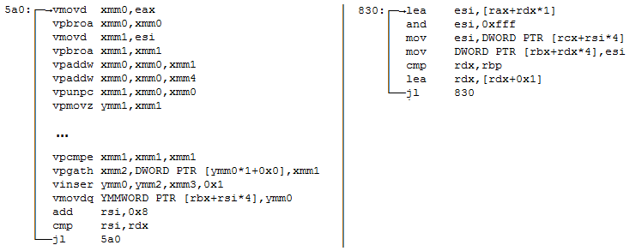
Performance degraded (2)
before (fast)
after (slow)
performance
-10%
Notes:
So, here it is. I’m not showing the source code because it’s rather big, but here is the assembly and again a loop with a backwards jump.
Rhs is 10% slower overall.
Can anyone guess what’s the reason?
Yes, this optimization is called vectorization.
Notice that there is scalar code on the right. The code operates on the scalar registers like esi, rdx, rax.
But on the left we have vector code operation on vector registers xmm, ymm, etc.
And it is usually better, because it utilizes the HW SIMD features.
Yesterday compiler was able to vectorize the loop, but today it fail to do so.
So we saw two examples when the problem can be seen directly by looking at the assembly, but sometimes you can have the case when there is the code on both sides that differs a little bit, but you can’t really understand what is the difference on the high level.

Slide 18
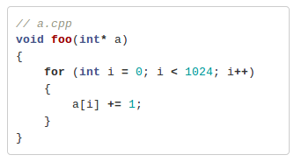
Compiler Opt Reports
Notes:
And in order to do that compiler can emit optimization reports. So it will tell what optimizations it did just recently for your source code.
So if we have a simple function like that…

Slide 19
Compiler Opt Reports
$ clang++ a.cpp -O2 -Rpass=.
<source>:4:5: remark: unrolled loop by a factor of 2 with a breakout at trip 0 [-Rpass=loop-unroll]
for( int i = 0; i < 1024; i++ )
^
<source>:4:5: remark: vectorized loop (vectorization width: 8, interleaved count: 1) [-Rpass=loop-vectorize]
for( int i = 0; i < 1024; i++ )
^
Notes:
And we use clang…
We can emit optimization reports by specifying –Rpass to the compiler options.
And it will tell us that first it unrolled the loop by a factor of 2 and then it vectorized this loop.
This functionality is integrated into every decent C/C++ compiler.

Slide 20
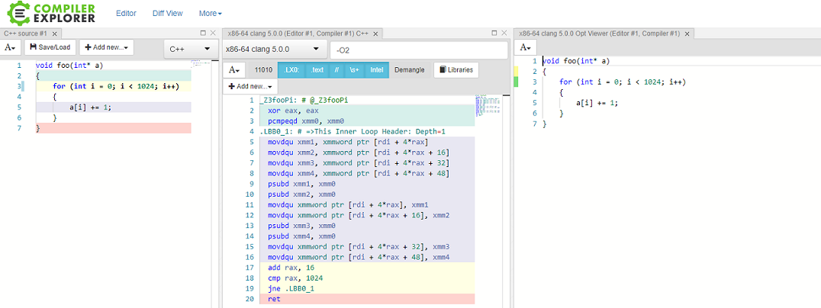
Opt Reports in compiler explorer
Notes:
The good news are that now the same functionality is integrated into compiler explorer.

Slide 21
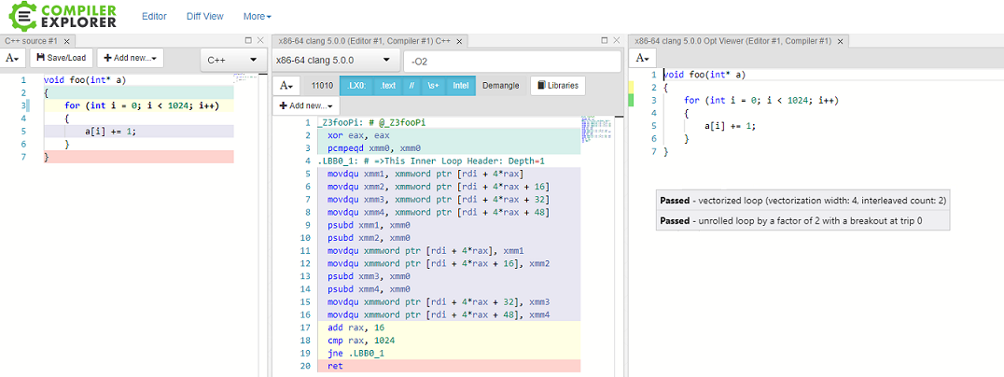
Opt Reports in compiler explorer
Notes:
You can hover your mouth over this green bar and it will basically show you the same information as we saw on the previous slide.
*** Maybe skip this:
Notice, that it was generated by Opt Viewer which is the llvm-tool.
So, if you afraid to upload your proprietary code into the compiler explorer or your code is to big to be uploaded, you can you this tool – it will generate html report for you.

Slide 22
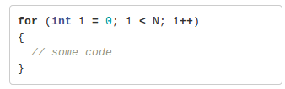
Using optimization reports
$ clang++ -Rpass=. –Rpass-analyses=.
<source>:4:5: remark: loop not vectorized
<source>:4:5: remark: the cost-model indicates that vectorization is not beneficial
Notes:
Now, how you can use optimization reports to improve the performance of your application.
So, imagine you have a code like that and this hot loop was not vectorized because compiler decided that it is not beneficial to do so. You found this from opt reports.

Slide 23
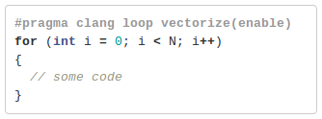
Using optimization reports
$ clang++ -Rpass=. –Rpass-analyses=.
<source>:4:5: remark: loop not vectorized
<source>:4:5: remark: the cost-model indicates that vectorization is not beneficial
$ clang++ -Rpass=. –Rpass-analyses=.
<source>:5:5: remark: vectorized loop…
Notes:
You can try to override it’s behavior by using special pragma.
So this pragma tells that if the compiler can prove that it is legal to do the vectorization here, it should do that even the cost model tells the opposite.
And compiler did what we requsted.
But, please, don’t insert the pragma’s all over the place – always measure the impact of it!

Slide 24
Finding optimization opportunities
Notes:
So let me now summarize it in how you can find optimization opportunities.

Slide 25
Finding optimization opportunities
Measure the baseline
Notes:
Of you measure the baseline. This is the first step you should do.

Slide 26
Finding optimization opportunities
Measure the baseline
Identify the hotspots
Notes:
Then you run it under profiler and identify the hot places in your benchmark. There is no need to optimize cold path.

Slide 27
Finding optimization opportunities
Measure the baseline
Identify the hotspots
Do analysis of the hotspots:
Check optimization reports for the hot places
Look at generated assembly of the hotspots
Collect hardware events and performance counters
Notes:
And then first
1. You can check optimization reports for those hotspots, i.e. what optimization were performed and what were missed. Maybe compiler was not able to make some important optimization, but you can slightly change the code, so compiler will be able to do it.
2. If the optimization reports doesn’t bring any value to the table you can look at the assembly code using your eyes, to gather some information about it. In particular look at what instructions are particularly hot. You can find interesting anomalies there.
3. If that also doesn’t give any clue you can collect general information about your benchmark. You can collect hardware events and performance counters. By hardware events I mean, for example, branch-misspredict or L1 data cache-miss.
I will have few examples on collecting performance counters, so I’ll show it a little bit later.

Slide 28
Tricky cases
Notes:
Now, there are situations when you made some change in your sources and there is drop in performance.
You checked the optimization reports – it’s the same, compared assembly – it looks also similar, and you have no idea what can cause performance swing.

Slide 29
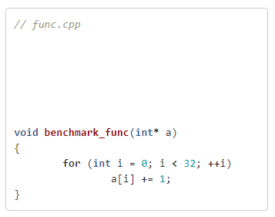
Code placement
Notes:
One such example is code placement or code alignment.
Let me ask you a question: how hard it is to measure a throughput of a function like that?
Well, who knows? ☺
But let’s say we measured some number.
*** Maybe skip this:
Well, it is a really simple code which iterates over an array of integers and incrementing each element.

Slide 30
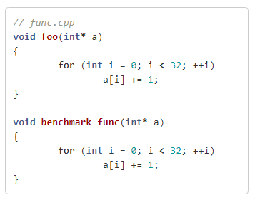
Code placement
Notes:
What will happen if I will insert some dummy function right before the function we want to benchmark?
Let’s measure!

Slide 31
Code placement
Throughput
+15%
Notes:
So I did the measurements and found that inserting dummy function gives +15% in performance.
Again, notice that it doesn’t mean that you need to insert dummy functions before your hot functions. ☺
There is no way how foo can influence the performance unless…
There is something more interesting that we need to know about.

Slide 32
Code placement
 | Throughput, GB/s
Baseline | 28.7
+ foo() | 33.0 (+15%)
Notes:
So, here are the numbers. “Baseline” is the single function and ‘+foo’ is the case where I added dummy foo function.

Slide 33
Code placement
$ perf stat -e r53019c -- …
 | Throughput, GB/s | IDQ_UOPS_NOT_DELIVERED.CORE
Baseline | 28.7 | <later>
+ foo() | 33.0 (+15%) | <later>
Notes:
I ran those cases under profiler and collected performance counter “IDQ_UOPS_NOT_DELIVERED.CORE”.
Here is how you can collect it using perf. You just say “perf stat -e” and then what goes after ‘r’ is the hexadecimal code this counter.
To understand the meaning of this counter we need to know some details of Intel CPUs.

Slide 34
Understanding IDQ_UOPS_NOT_DELIVERED.CORE
dec rdi
jnz .loop
Port 0
uops
Port 1
decoders
scheduler
…
Port 7
Notes:
We fetch assembly instruction and feed it into the decoders. Decoders decode assembly instruction into the sequence of so-called “uops”. It can be one or many uops depending on the instruction.
Then scheduler sends them into the back-end.
But because we have multiple execution units we can execute multiple uops in parallel.
For Skylake CPU we can schedule 4 uops in one cycle. And if, let’s say, we deliver only 1 uop this counter will be increased by 3 (it’s basically 4 – 1 is 3).
If we deliver 4 uops in one cycle it will not be increased.
So it measures how many slots for issuing new uop were missed.
So, the lower the better.

Slide 35
Code placement
$ perf stat -e r53019c -- …
 | Throughput, GB/s | IDQ_UOPS_NOT_DELIVERED.CORE
Baseline | 28.7 | 34 * 10⁹
+ foo() | 33.0 (+15%) | 30 * 10⁹
Notes:
And indeed we see that we are now better feeding instructions to the back-end.

Slide 36
Code placement
$ perf stat -e r53019c -- …
 | Throughput, GB/s | IDQ_UOPS_NOT_DELIVERED.CORE
Baseline | 28.7 | 34 * 10⁹
+ foo() | 33.0 (+15%) | 30 * 10⁹
32B function alignment * | 38.0 (+32%) | 24 * 10⁹
32B basic blocks alignment ** | 42.4 (+48%) | 17 * 10⁹
* -mllvm -align-all-functions=5
** -mllvm -align-all-blocks=5
Notes:
To make it even more fun I did 2 more experiments where I aligned the function at the 32B boundary and all the basic blocks inside the function.
For those who don’t know basic block is sequence of assembly instructions with single entry and single exit.
Now, we know that the only moving part is the placement of our function inside the binary. Right? Everything else stays the same.
In order to understand how code placement can affect performance let’s compare the two last cases: alignment of the function and alignment of the basic blocks inside the function.

Slide 37
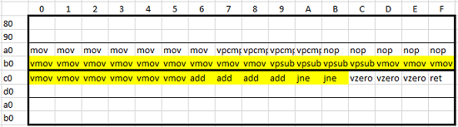
Code placement
Function aligned at 32B boundary
Notes:
So here is the complete assembly code the function. Again it’s not important what are the instructions exactly.
The code for the loop which turns out to be hot is highlighted in yellow.

Slide 38
Code placement
cache line
Function aligned at 32B boundary
Notes:
And the thick box represent one cache line in instruction cache.
So, notice that in this case the hot path occupies 2 cache lines.

Slide 39
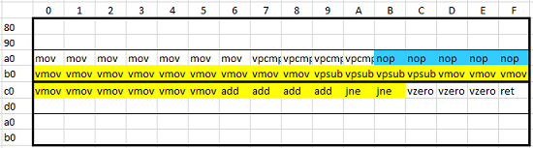
Code placement
cache line
Function aligned at 32B boundary
Notes:
Notice that compiler already inserted 5 nops before the loop. So now the loop is aligned at the 16B boundary.

Slide 40
Code placement
cache line
Function aligned at 32B boundary
Loop aligned at 32B boundary
Notes:
So when we align all the basic blocks at the 32B boundary we essentially shift the loop down by 16B. Loop is also a basic block, so we shift it.

Slide 41
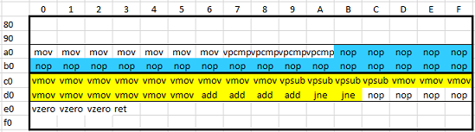
Code placement
cache line
Function aligned at 32B boundary
Loop aligned at 32B boundary
Notes:
Notice that now there are even more nops added, but now hot loop is aligned at the beginning of the cache line, which is very good for performance, because now we only need to read one cache line instead of two.
This is not the end of the story, other placements might behave in a different way.

Slide 42
Code placement
Additional resources
My blog post: “Code alignment issues” (https://dendibakh.github.io/blog/2018/01/18/Code_alignment_issues)
2016 LLVM Developers’ Meeting: Z. Ansari "Causes of Performance Instability due to Code Placement in IA“
Mytkowicz, T., Diwan, A., Hauswirth, M., Sweeney, P.: Producing Wrong Data Without Doing Anything Obviously Wrong! In: Proc. of Int’l Conf. on Architectural Support for Programming Languages and Operating System, March, 2009, pp. 265-276. ACM, Washington (2009)
Notes:
I discuss exactly those 4 cases in the article on my blog with much more details, so I definitely encourage you to visit it.
Also there is the whole presentation about code alignment made by my colleague Zia Ansari on one of the LLVM developers meeting.
And this great paper. It shows that even the order of linking object files may affect performance in such a way that even -O2 may be better than -O3.
Also I specifically want to point out that those issues goes away with the number of hotspots in the benchmark. Because it’s unlikely that all those hotspots will have bad placement in the binary.
*** Look at the clock
Any questions to this before we go further?

Slide 43
One more tricky case
Notes:
And I have another tricky case.
Let me tell you a story.

Slide 44

Instruction fusion
before (fused)
after (unfused)
Notes:
One day I was analyzing performance regression. And there was difference in assembly similar to this spread all over the hot place.
So, there were many patterns like that.

Slide 45
Instruction fusion
before (fused)
after (unfused)
~5%
performance gap
Notes:
And there was 5% gap in performance. Rhs performed 5% worse than the lhs.
Note that those assembly sequences are doing the same job. It is essentially a RMW operation, but fused on the lhs and more explicit on the rhs. On the right we are loading the value from the memory into edx, incrementing it and then writing it back.
On the left we are doing it in one instruction.
Also I noticed ~50% more executed instructions in the case on the right.
And I decided: “Well usually, the more instruction you execute, the more execution time you get”, so I decided that I know the source of the problem.
The other day after consulting with my colleagues I came back to that case and did more experiments.

Slide 46
Instruction fusion
before (fused)
after (unfused)
 | INSTRUCTIONS_RETIRED | UOPS_RETIRED.ALL | CYCLES/ ITERATION
Fused | 1 | 3 | 1
Unfused | 3 | 3 | 1
Notes:
I put those instruction sequences into the tight loop and run 1000 iterations.
I used uarch_bench tool, which super awesome – you can download it and start stressing your CPU.
INSTRUCTIONS_RETIRED counter simply counts assembly instructions, so no surprise that we see 1 for the fused and 3 for the unfused case.
But UOPS_RETIRED.ALL counts micro-ops which turns out to be the same. Meaning that basically it is the same amount of work that was executed by the back-end.
And this actually explains why both cases execute at the same amount of cycles per iteration.

Slide 47
Instruction fusion
before (fused)
after (unfused)
performance on par
(in equal conditions)
Notes:
Performance of those assembly sequences is on par with the caveat that we were not hit by some micro architectural issue that we discussed earlier.
So, the root cause of the original regression was again code alignment.
The bottom line here is that even number of retired instructions sometimes can be a bad proxy for making conclusions about performance.

Slide 48
Know your hardware!
Notes:
Spend some time on learning how your HW works.

Slide 49
You can find me
My blog: dendibakh.github.io
Twitter: @dendibakh
Notes:
I have more interesting cases on my blog, so go check it.

Slide 50
Thank you!

