Slide 1

OPTIMIZING SUPPLY CHAIN AND SALES PERFORMANCE
Nikhilesh Dhavale
Aditya Karande

Slide 2
DATASET & GITHUB
DataCo SMART SUPPLY CHAIN FOR BIG DATA ANALYSIS
6102-sp-25-Dhavale-Karande

Slide 3

INTRODUCTION
Timely deliveries are critical for customer satisfaction and revenue.
Supply chain delays impact cost, efficiency, and brand reputation.
Goal: Apply statistical analysis and machine learning to identify patterns linked to late deliveries..
Develop predictive models to determine whether an order will be late or on-time.

Slide 4
DATASET OVERVIEW
Source: DataCo Supply Chain dataset.
Records: 180,519
Columns: 51
Data categories: Customer details, Product details, Order and shipping details, Geographic markets & regions.
Target variable: Late_delivery_risk (0 = on-time, 1 = late).
Target Variable Distribution: Binary variable with ~55% late and ~45% on-time orders, No major class imbalance,.

Slide 5
OBJECTIVE
To Predict whether an order will result in a late delivery or an on-time delivery using customer, product, and shipping features?
Measurable: Evaluate with accuracy, precision, recall, ROC-AUC.
Achievable: Large dataset (180k+ rows) with rich shipping details.
Relevant: Helps improve delivery commitments and logistics planning.

Slide 6
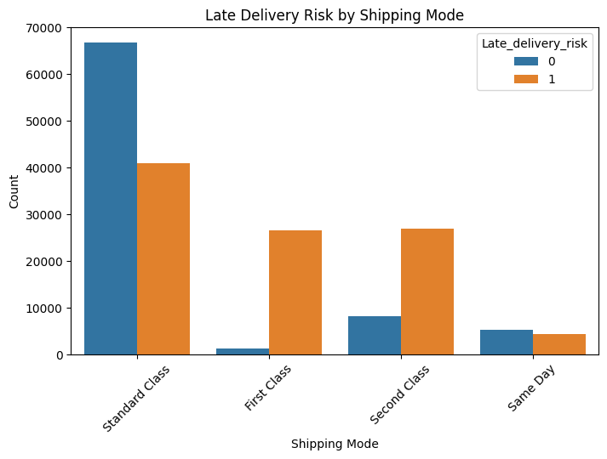
EXPLORATORY DATA ANALYSIS
Shipping Mode vs Late Delivery Risk:
Standard Class shows the highest late-delivery rate.
First Class and Second Class also show a large proportion of late deliveries.
Same Day shipping is the most reliable, with very few late deliveries.
Shipping mode is a strong operational factor in delivery performance.

Slide 7
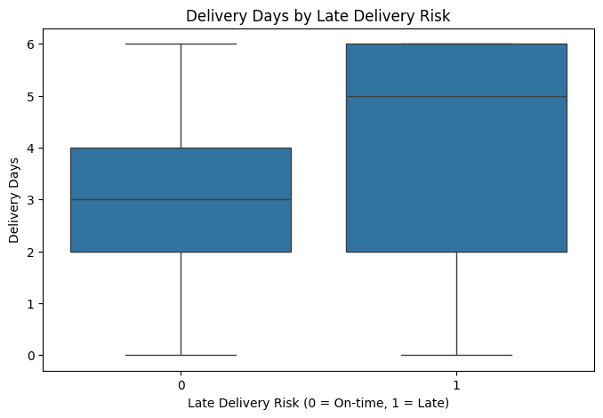
EXPLORATORY DATA ANALYSIS
Delivery Days Comparison:
Late deliveries have noticeably higher delivery-day values.
On-time orders cluster around lower delivery days with a tighter spread.
Late orders show both higher median and wider variability in delivery duration.
Indicates that total delivery time is a strong driver of late delivery risk.

Slide 8
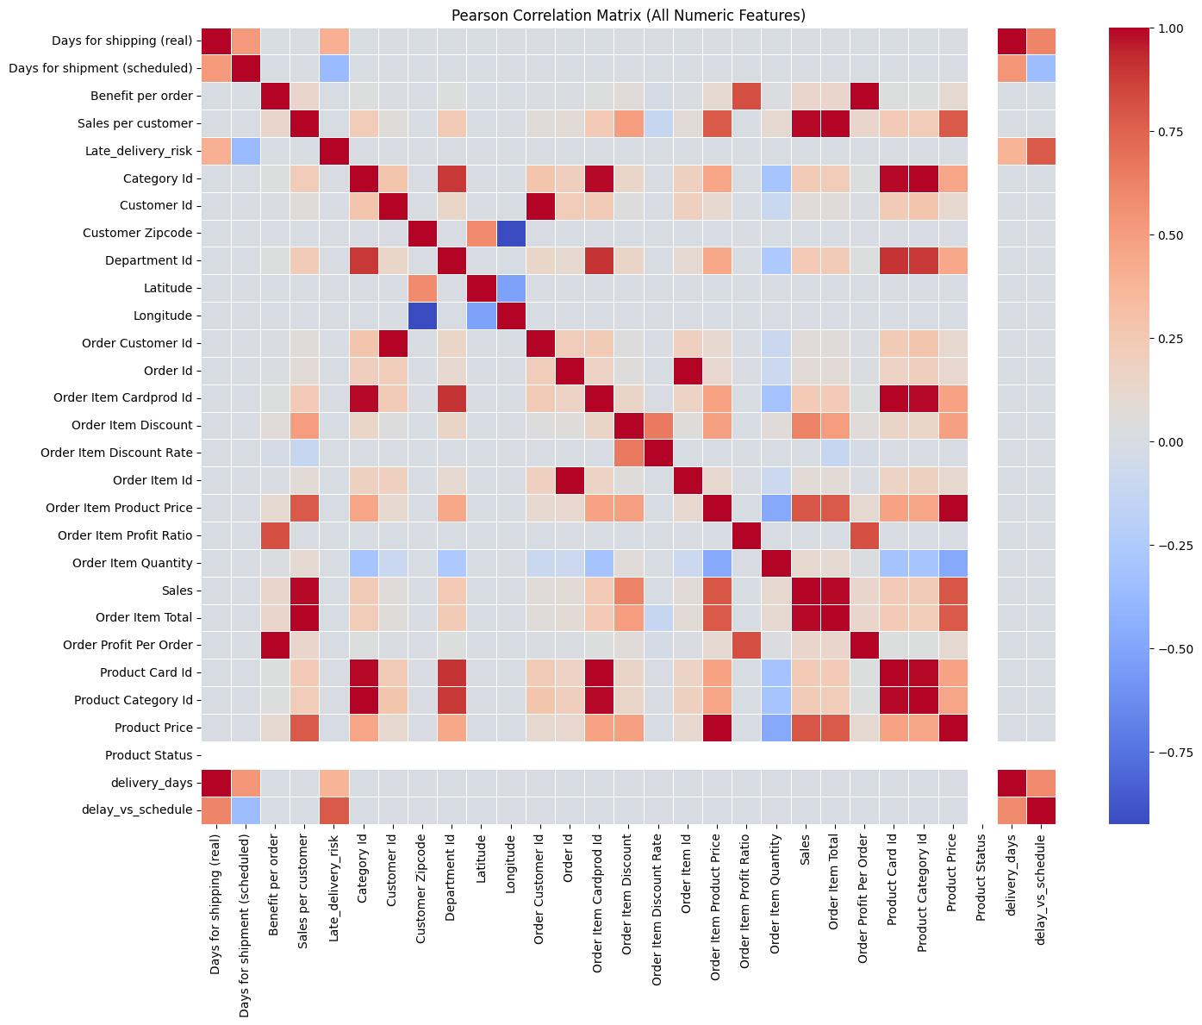
EXPLORATORY DATA ANALYSIS
Correlation Heatmap:
Strong correlations among shipping-related variables: delivery_days, delay_vs_schedule, Days for shipping (real).
Customer and product variables show weak association.
Confirms importance of operational timing for predictive modeling.

Slide 9
HYPOTHESIS TESTING
t-Test: Delivery Days (Late vs On-Time):
Late orders have significantly higher delivery days than on-time orders.
Result: p < 0.05 → strong evidence of difference.
Interpretation: Shipping duration strongly affects late delivery risk.

Slide 10
HYPOTHESIS TESTING
Chi-Square Test: Shipping Mode vs Late Delivery Risk:
Shipping mode and late delivery risk are statistically associated.
Result: p < 0.05 → dependency confirmed.
Interpretation: Shipping mode impacts whether an order arrives late.

Slide 11
HYPOTHESIS TESTING
ANOVA: Delivery Time Across Shipping Modes:
Shipping mode and late delivery risk are statistically associated.
Result: p < 0.05 → dependency confirmed.
Interpretation: Shipping mode impacts whether an order arrives late.

Slide 12
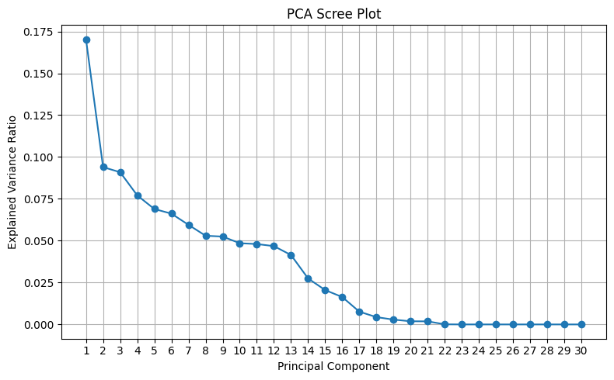
PRINCIPAL COMPONENT ANALYSIS (PCA)
Principal Component | Top Contributing Features
PC1 | Sales, Product Price, Order Item Total
PC2 | Profit Ratio, Benefit per Order, Discount Rate
PC3 | Delivery Days, Delay vs Schedule, Days for Shipping (Real)

Slide 13
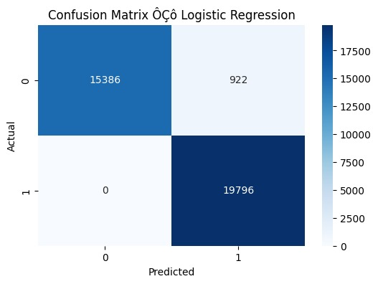
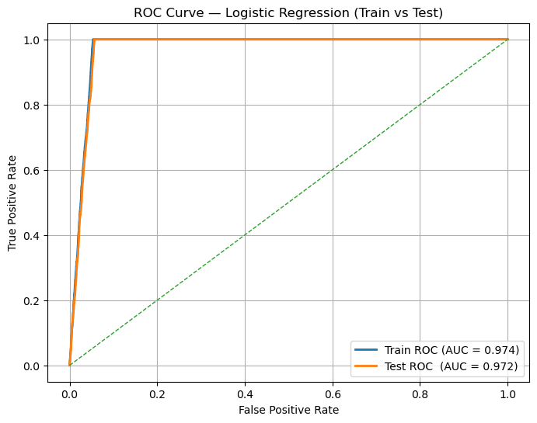
LOGISTIC REGRESSION
Accuracy: 97.44%
ROC–AUC : 0.972
F1 Score: High for both classes
Recall : 1.00, almost all late deliveries correctly identified.
Model correctly identifies 19,796 late deliveries showing very high true positive performance.
Model predicts 0 false negatives and 922 false positives.

Slide 14
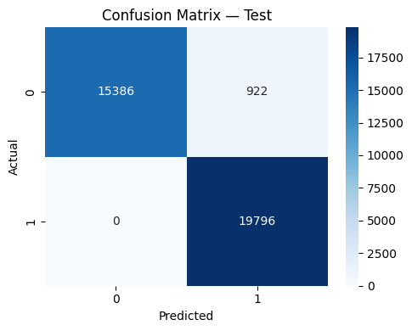
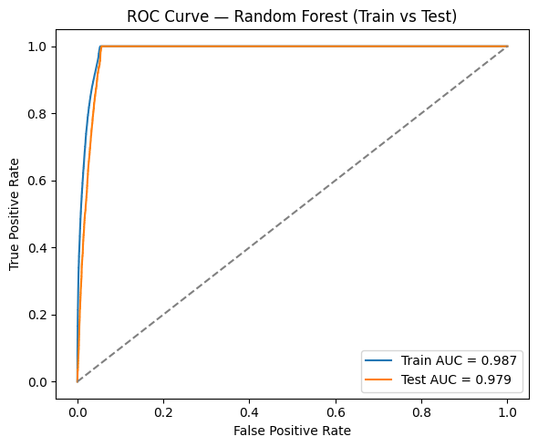
RANDOM FOREST CLASSIFIER
Accuracy: 97.46%
ROC–AUC : 0.979
F1 Score: High for both classes
Recall : 1.00, almost all late deliveries correctly identified.
Model correctly identifies 19,796 late deliveries showing very high true positive performance.
Model predicts 0 false negatives and 922 false positives.

Slide 15
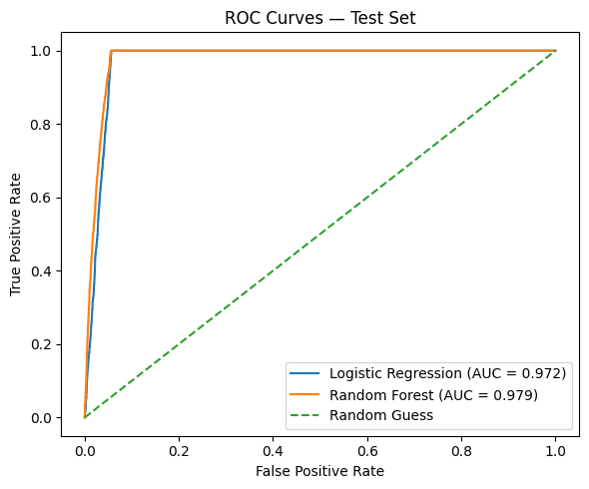
MODEL COMPARISION
Logistic Regression
Accuracy: 97.44%
ROC–AUC: 0.972
Recall (Late deliveries): 1.00
Model is simple, interpretable, and fast.
Random Forest
Accuracy: 97.46%
ROC–AUC: 0.979
Recall (Late deliveries): 1.00
Captures nonlinear patterns and interactions better.

Slide 16
CONCLUSION
Late delivery risk is highly predictable using operational features.
Logistic Regression and Random Forest achieved >97% accuracy.
Consistent findings across EDA, statistical testing, PCA, and modeling.
Provides actionable insights to improve delivery reliability.

Slide 17


