Slide 1
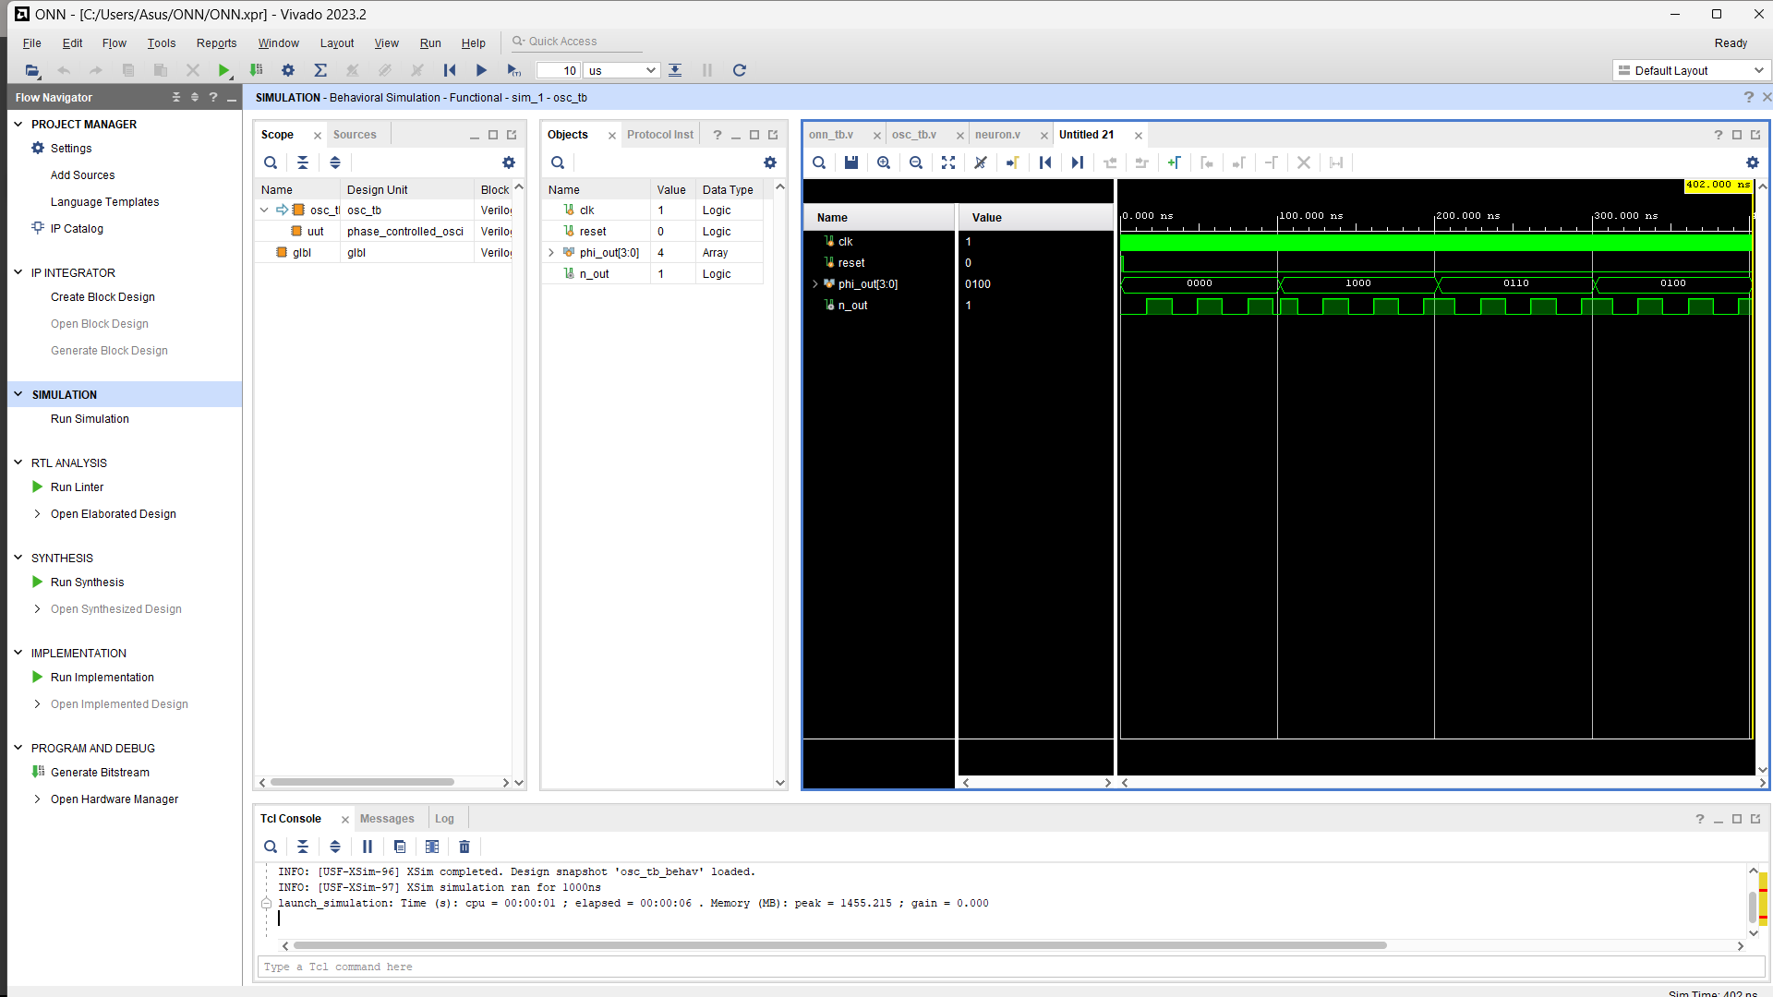
Phase controlled oscillator

Slide 2
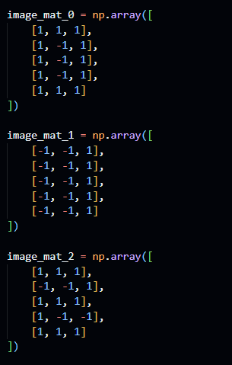
5x3 Onn
Standard representation 0,1,2

Slide 3
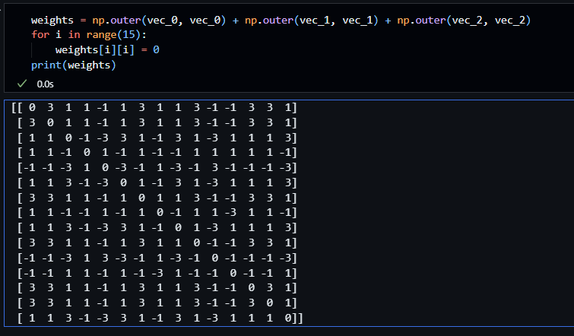
Weights (5x3)– Hebbian learning

Slide 4
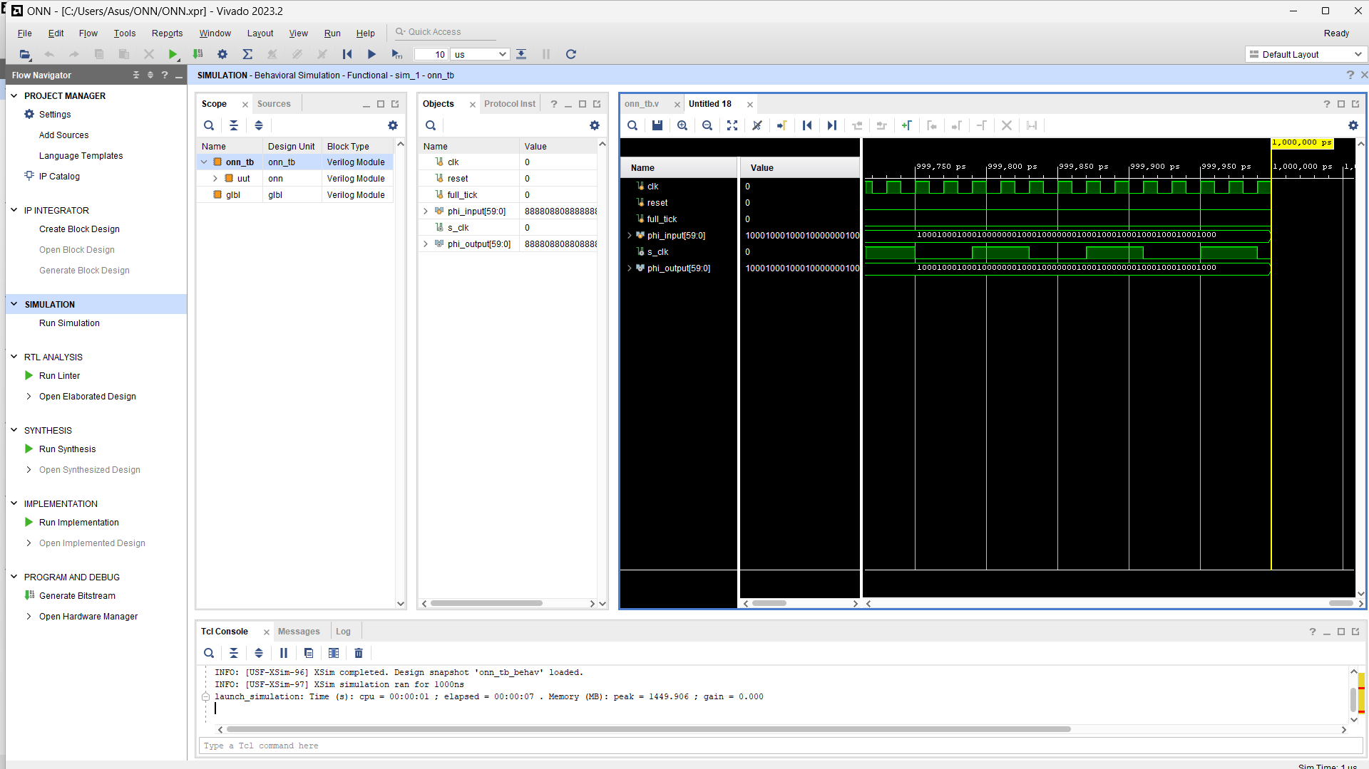
Corrupted “0” —> “0”

Slide 5
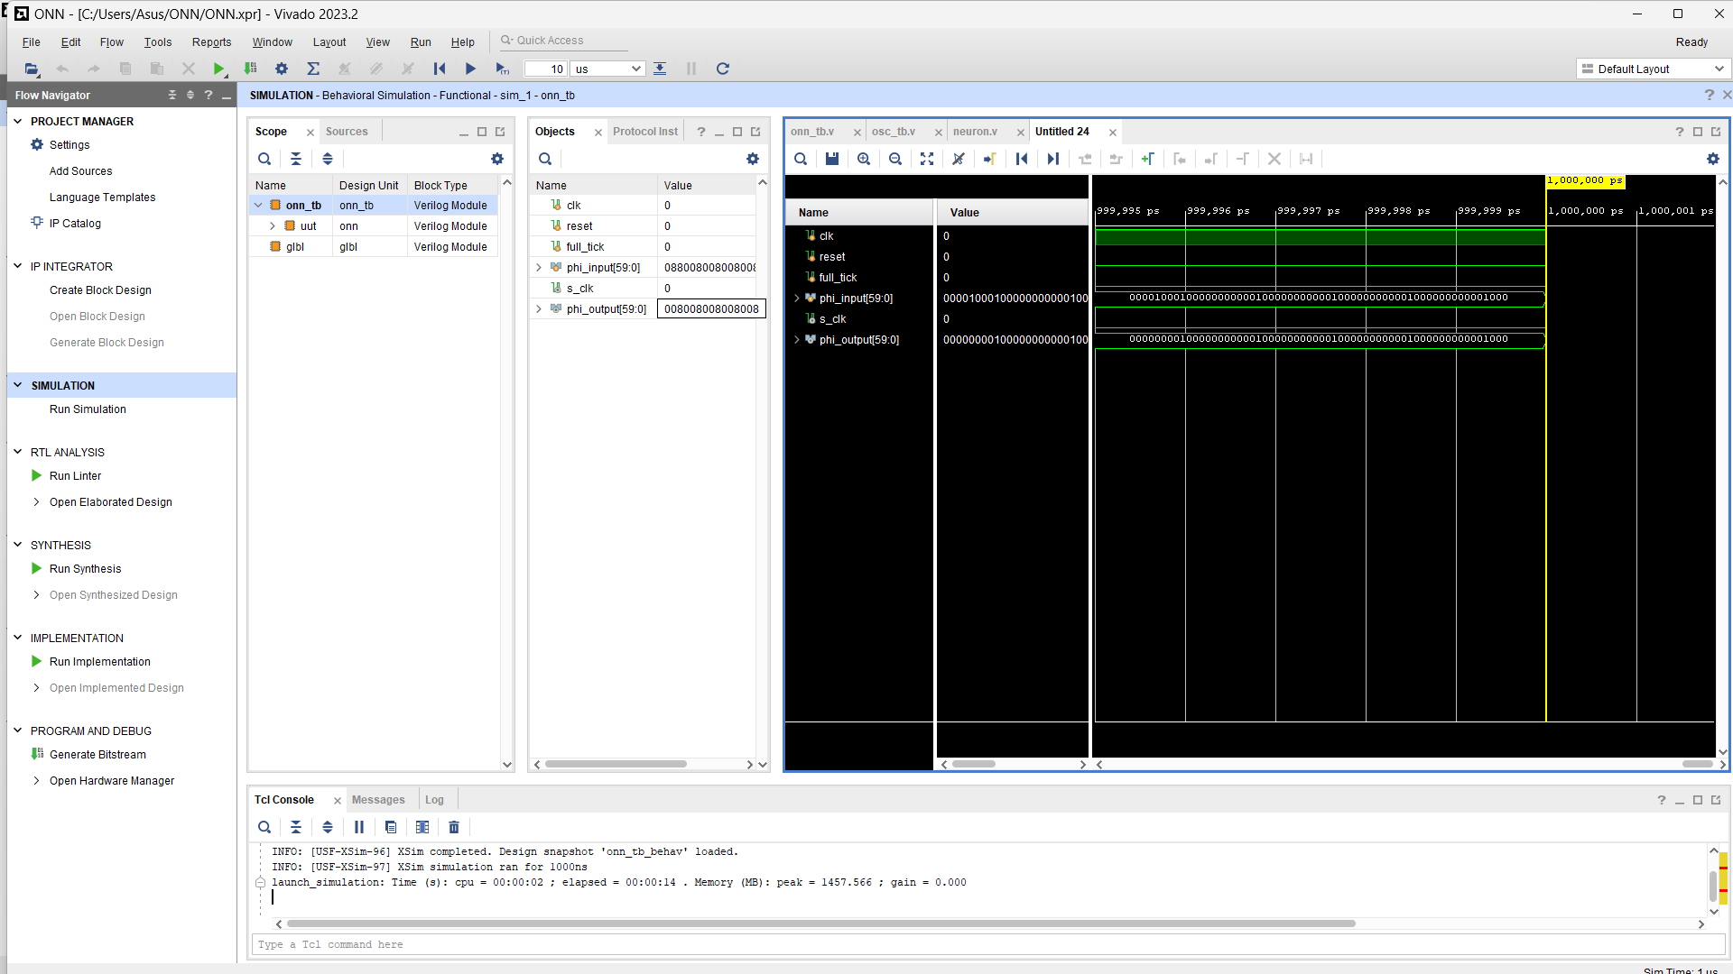
Corrupted “1”—> “1”

Slide 6
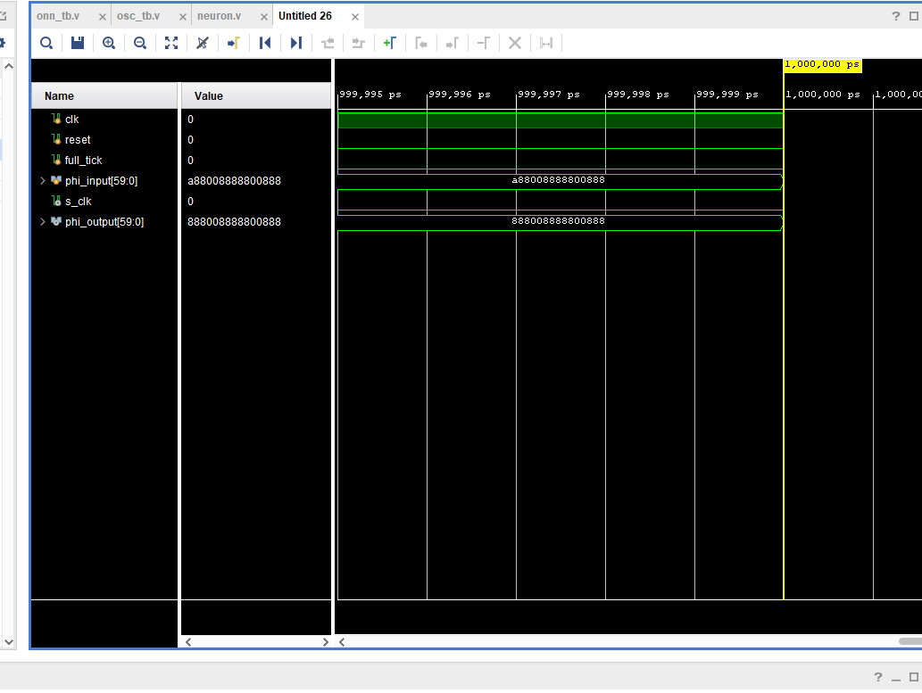
Corrupted “2”—> “2”
a88
008
888
800
888 —>
888
008
888
800
888

Slide 7
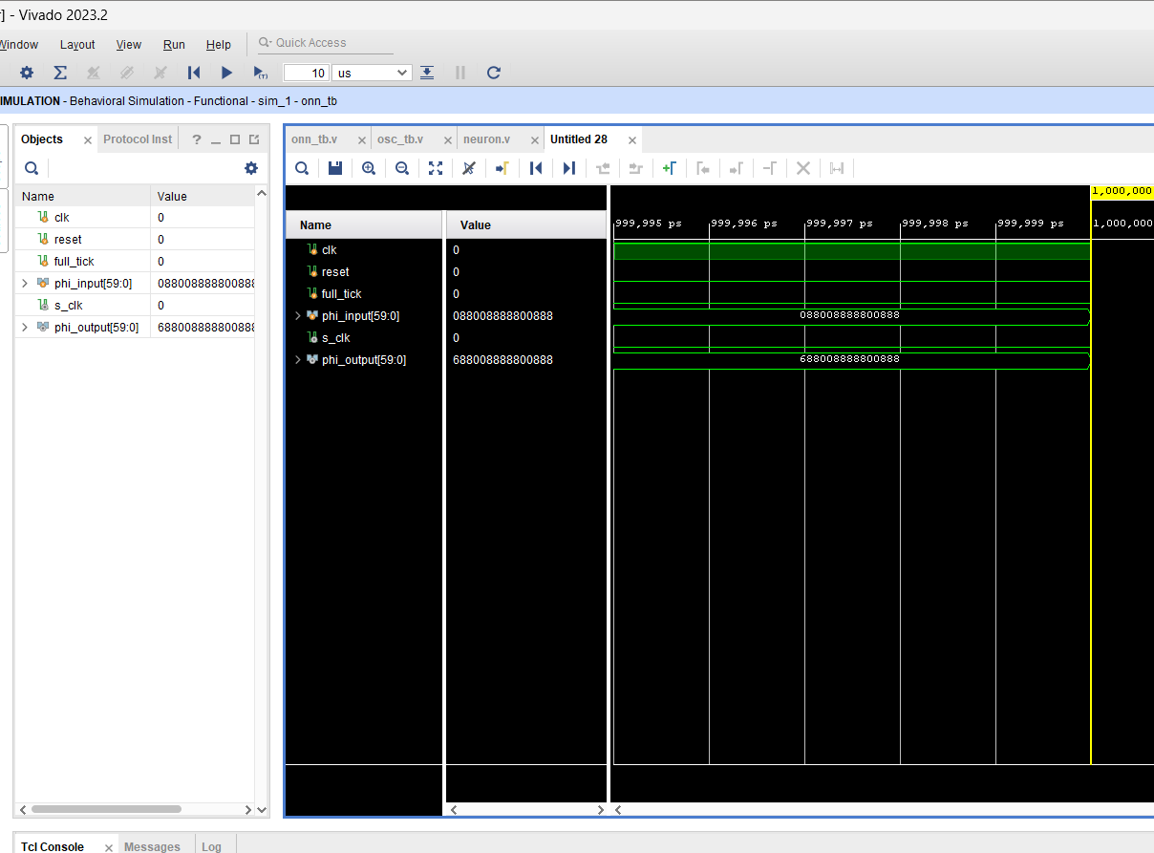
Corrupted “2”—> “2”
088
008
888
800
888
—> 688
008
888
800
888
error

Slide 8
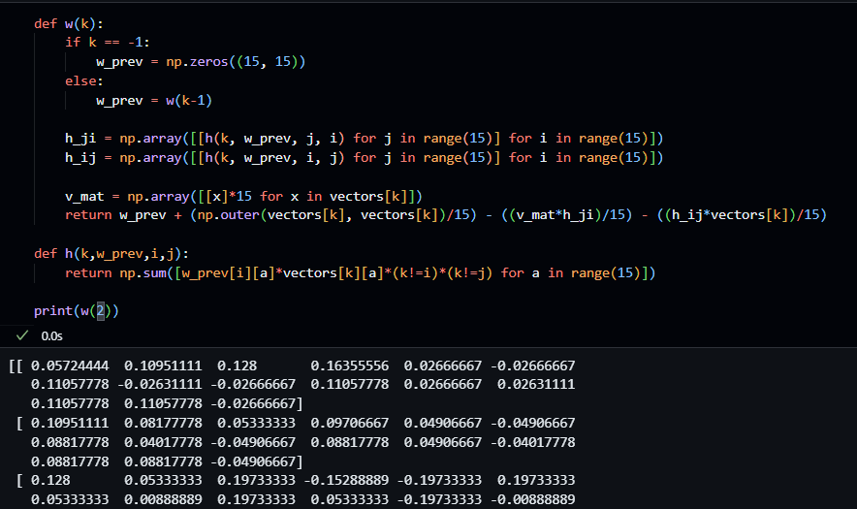
Weights (5x3) -storkey learning

Slide 9
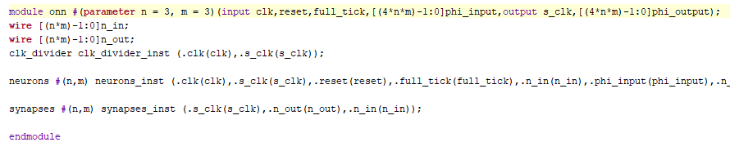
Parameterized for Onn size (n x m)

Slide 10
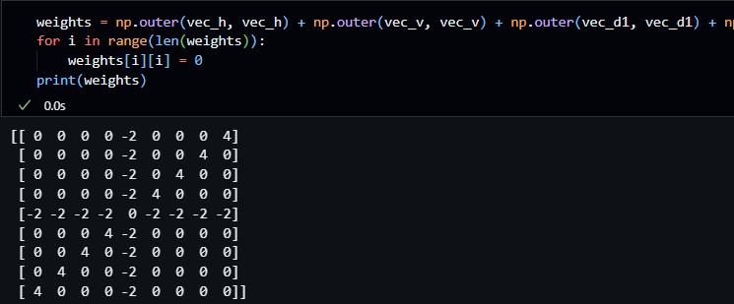
Edge detection - layer 1
Weights (3x3) - hebbian learning

Slide 11
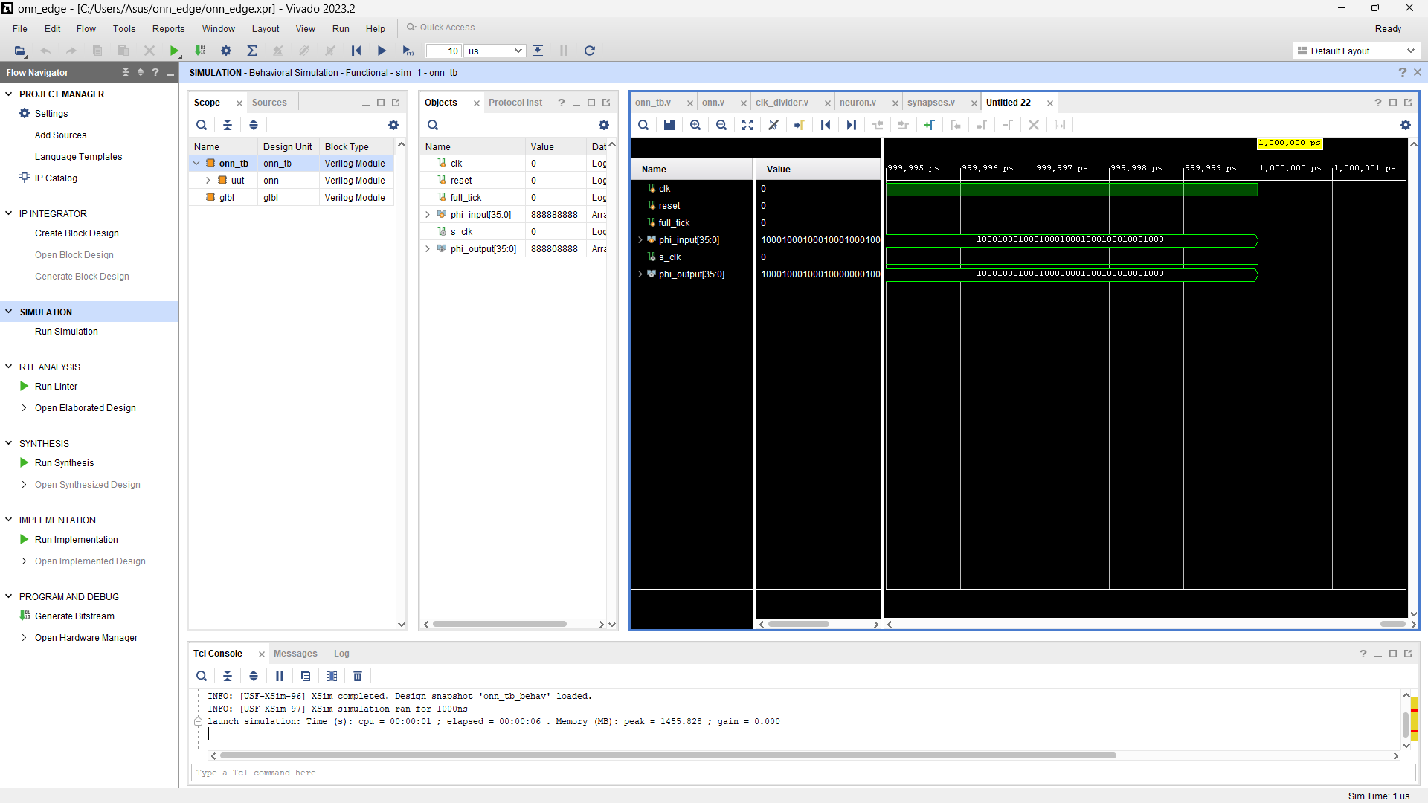


Edge detection - layer 1

