Slide 1

Finding similar neighborhoods in three Indian cities
Niket V Patil

Slide 2
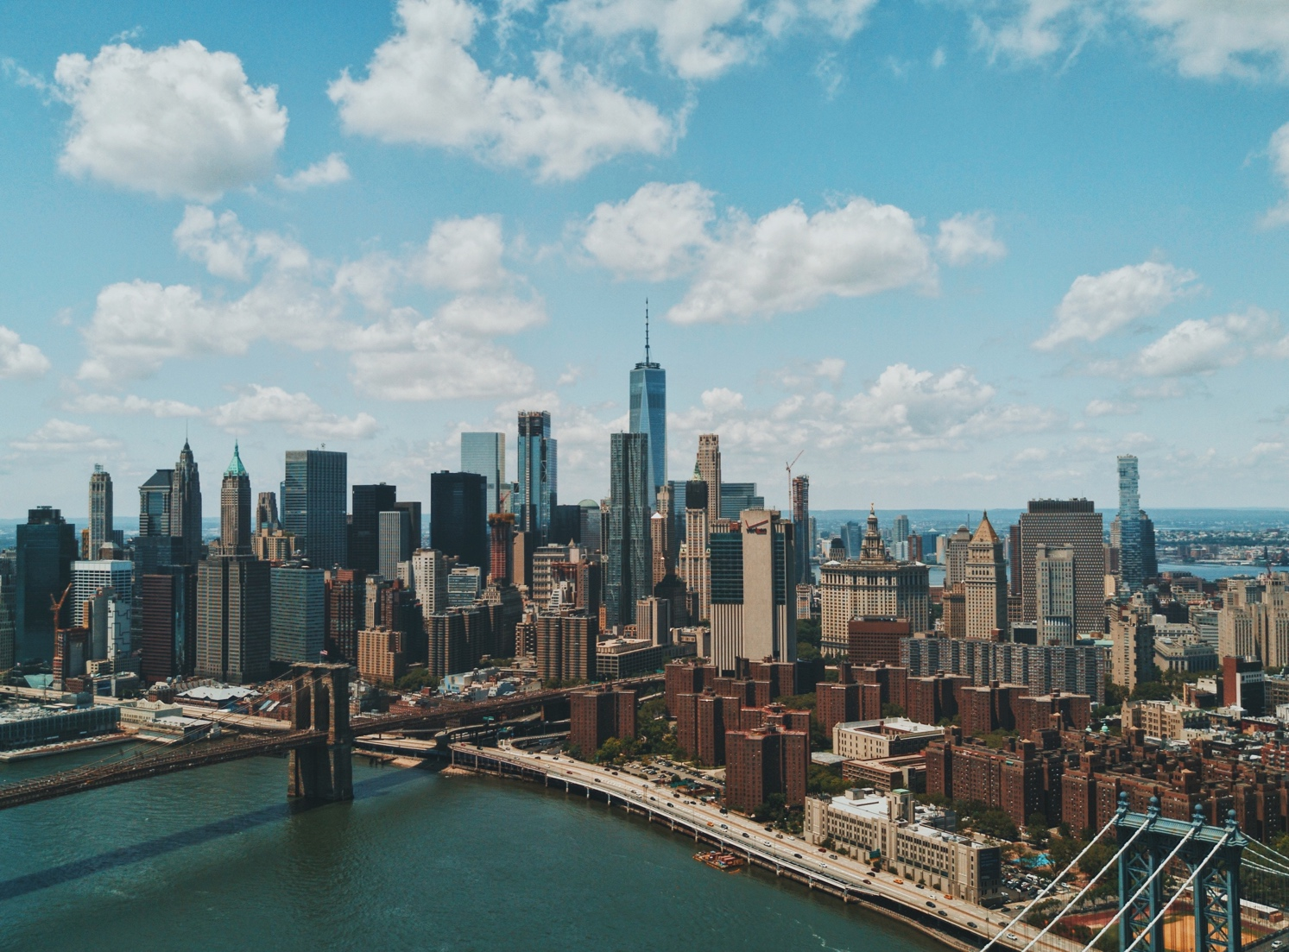
Business Problem
In last decade, cities in India have developed at astonishing rate. With developing cities House pricing also goes up. If a resident in one city wants to relocate to different city or neighborhood, which city/neighborhood should he choose that is most similar to his current neighborhood. This project will try to answer this question. We will base our similarity on a kind of Blueprint for neighborhoods based on popular venues such as Restaurants, Malls, Natural Areas, Tourist Destinations etc.

Slide 3

DAta
Our Data comes from
Wikipedia, List of Areas in Mumbai, Chennai & Bengluru
Mapquest API for location data
Foursquare API for top venues & categories in each Neighborhoods

Slide 4
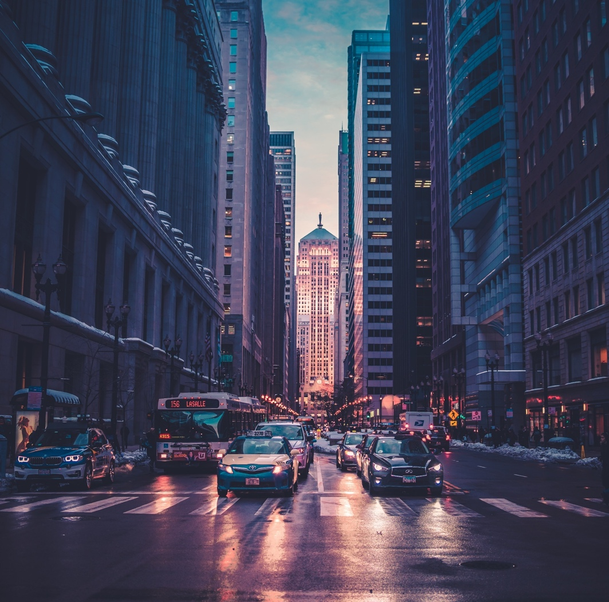


Methodology
Data Preparation
Clustering
Top five venue categories for each area’s vector profile for clustering using k-means clustering algorithm.
K-means clustering algorithm to identify patterns in data.
Cluster separation is best at six clusters.

Slide 5


Results & conclusion
333 Neighborhoods in Mumbai, Chennai & Bengluru.
2682 total venues in all neighborhoods.
Next steps in the process might be to supplement the data used to cluster cities with additional sources, such as the average home price, population size & crime rate.
Result/discussion
Clusters:
Two big clusters and four small clusters.
Indian Restaurant Area, Developed Urban Area, Old/Small Area, Shopping Area were some of the Interesting clusters
Conclusion

Slide 6
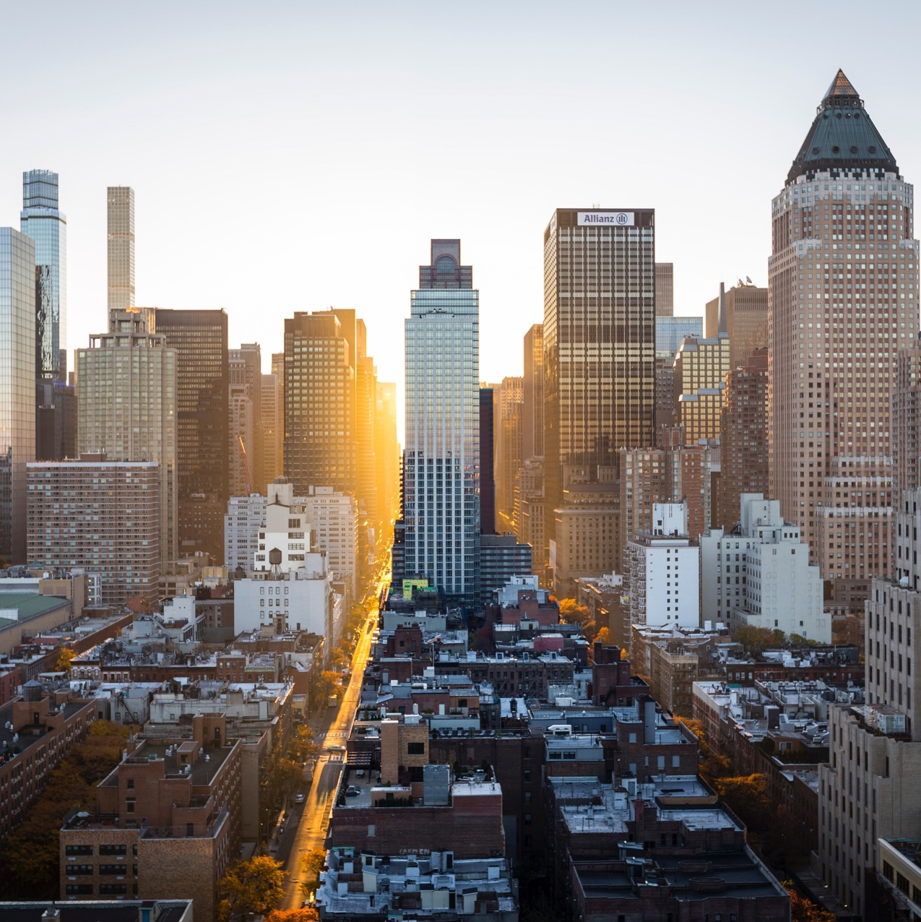
Thank you!

