Slide 1
Heena agrawal

Slide 2
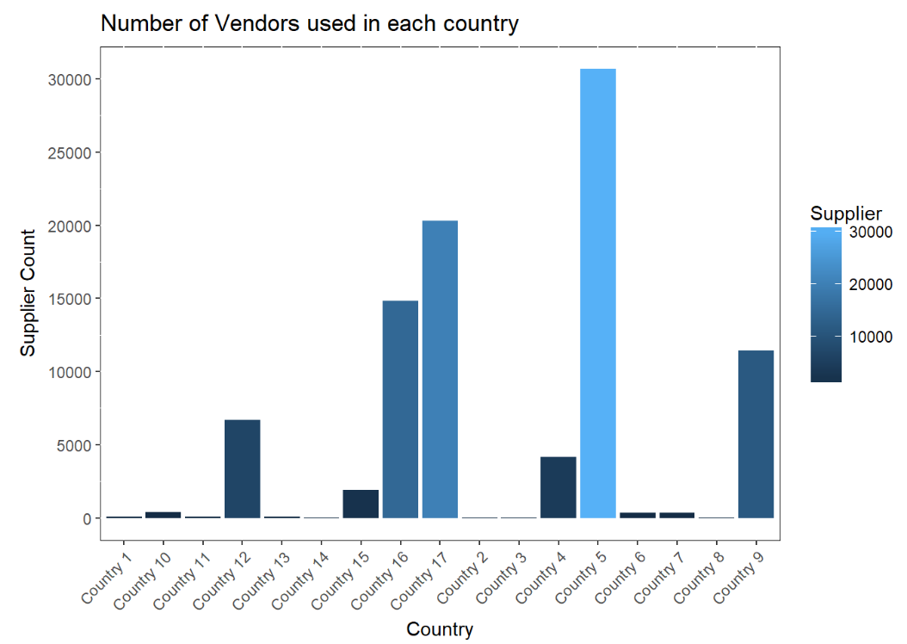
Number of Vendors used in each country
There are 45 Vendors in
Suppliers and there are 17 Countries.
The maximum number of Vendor count is in Country 5 .

Slide 3
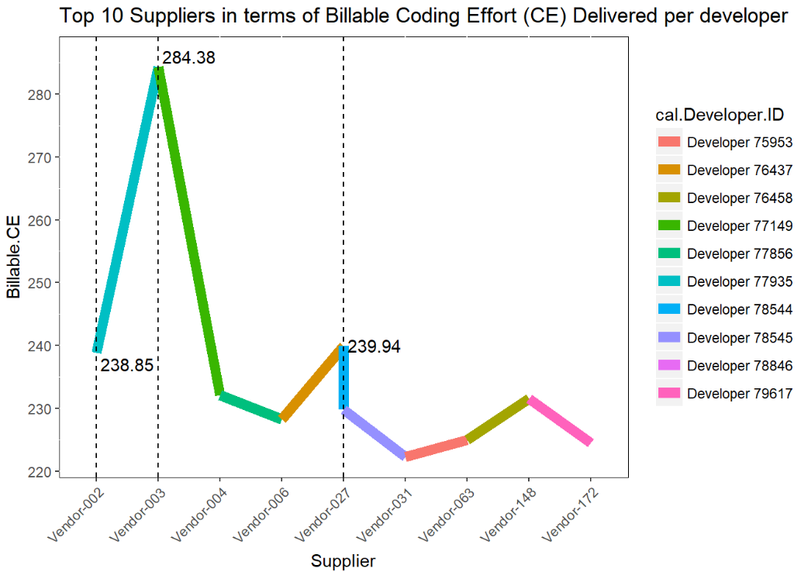
Top Suppliers in terms of Billable Coding Effort (CE) Delivered per developer
Supplier Developer.ID Billable.CE
Vendor-003 77149 284.38
Vendor-027 78544 239.94
Vendor-002 77935 238.85

Slide 4
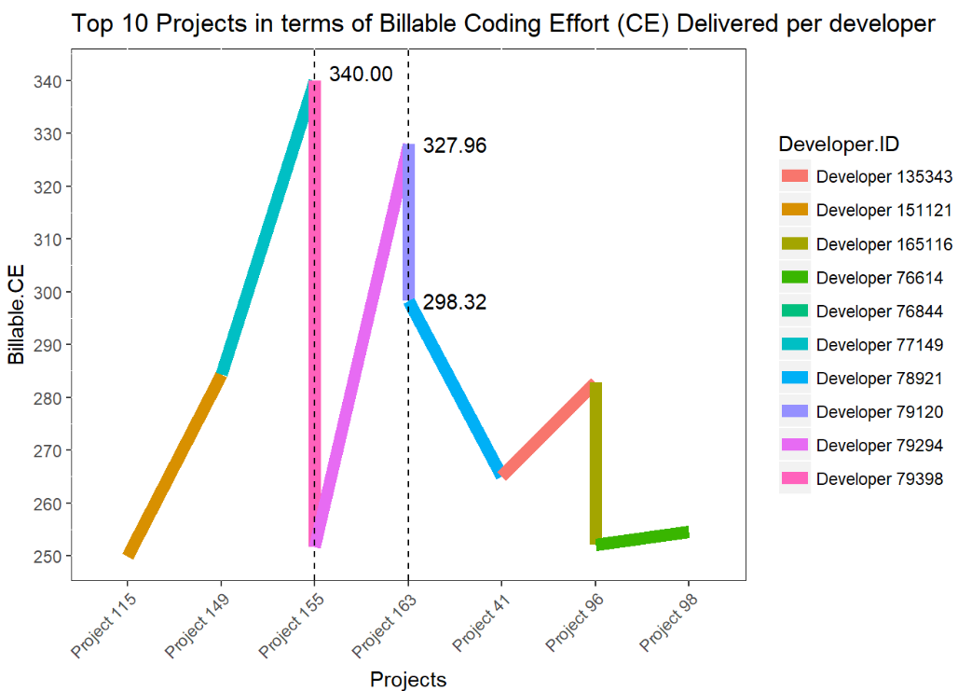
Project with a maximum number of Billable CE hours per day delivered per developer
Project 155
Developer 79398
Billable CE 340.00

Slide 5
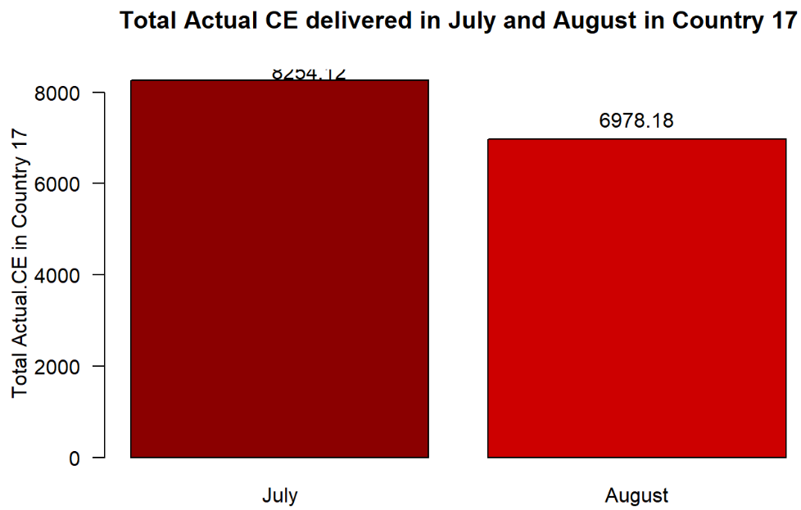
total Actual CE delivered between July and August in Country 17
The difference in total Actual CE
between July and August in
Country 17 is 1275.94.
Actual CE for July was 8254.12
Actual CE for August was 6978.18

Slide 6
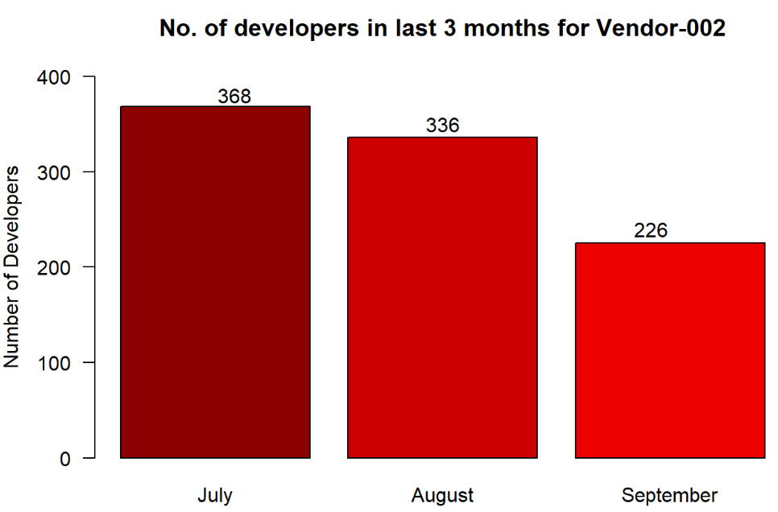
total number of developers in each one of the last 3 months for Vendor-002
Total number of developers in
each one of the last 3 months
for Vendor-002 in :
July : 368
August : 336
September : 226

Slide 7
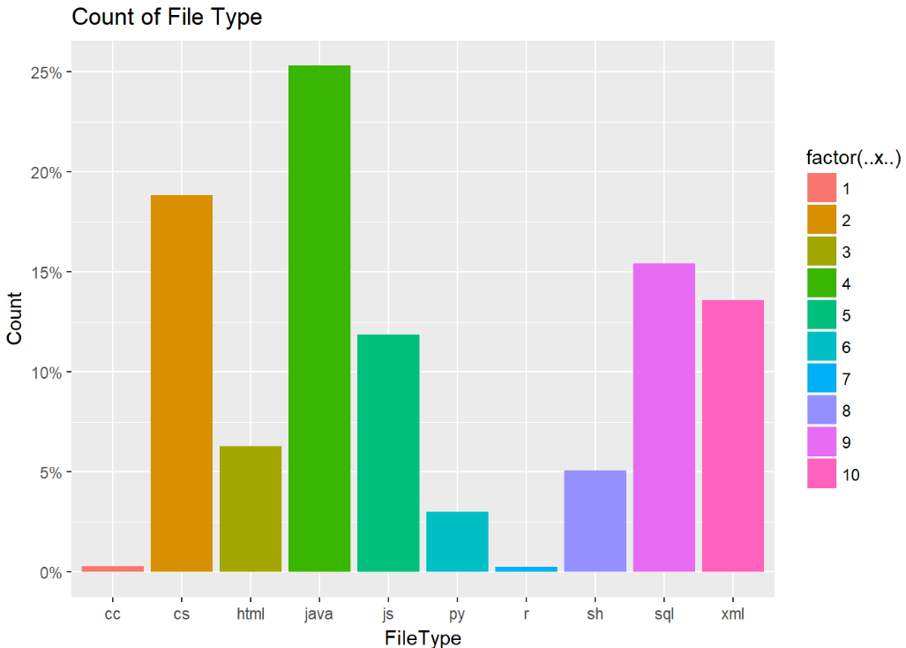
Percentage of the total projects working with Different Files
We can see that maximum
Number of file type was
Java type with 25.30933 %
Projects in it.

Slide 8
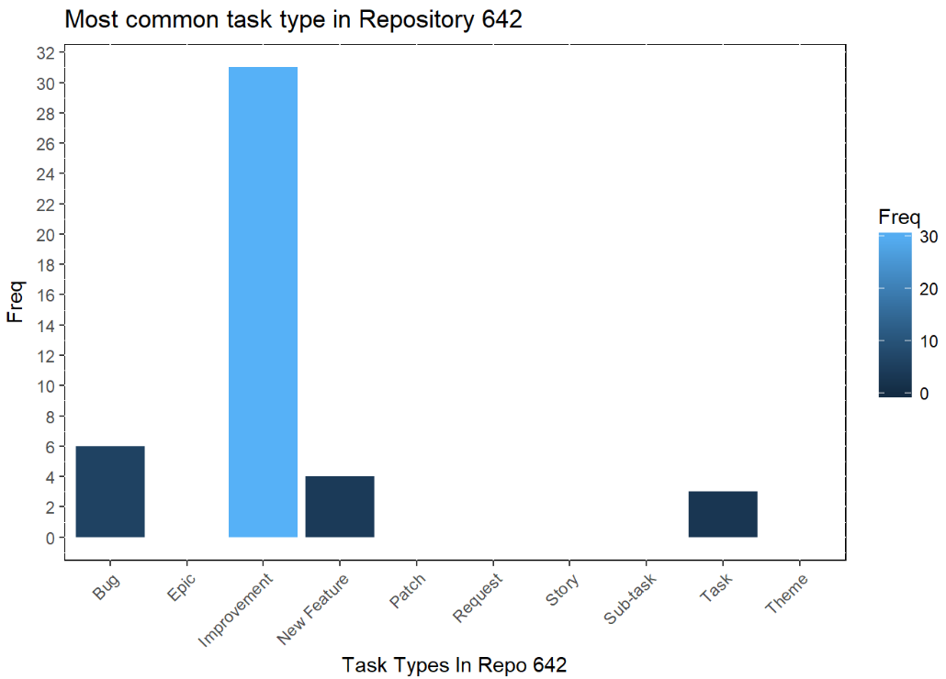
most common task type in Repository 642
The most common Task
Type in Repository 642
is Improvement
with frequency of 31.

Slide 9
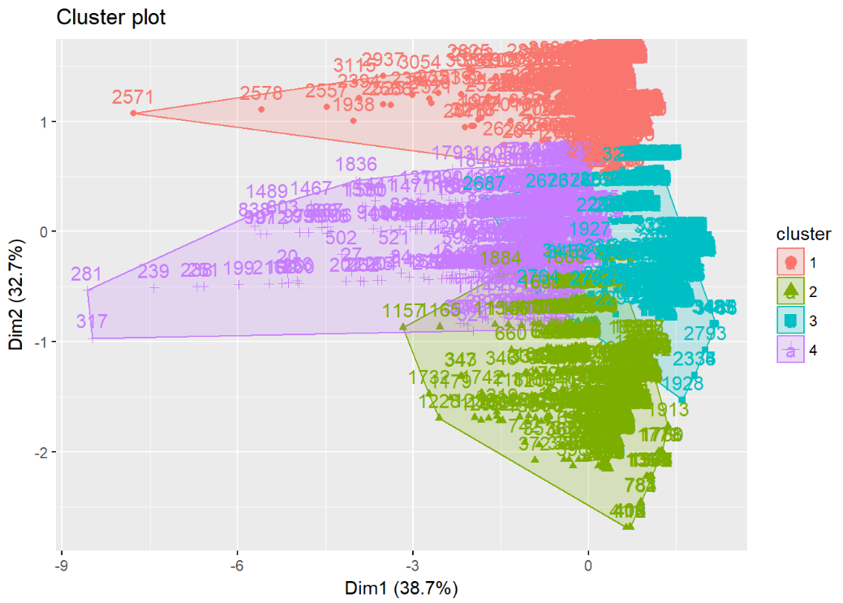
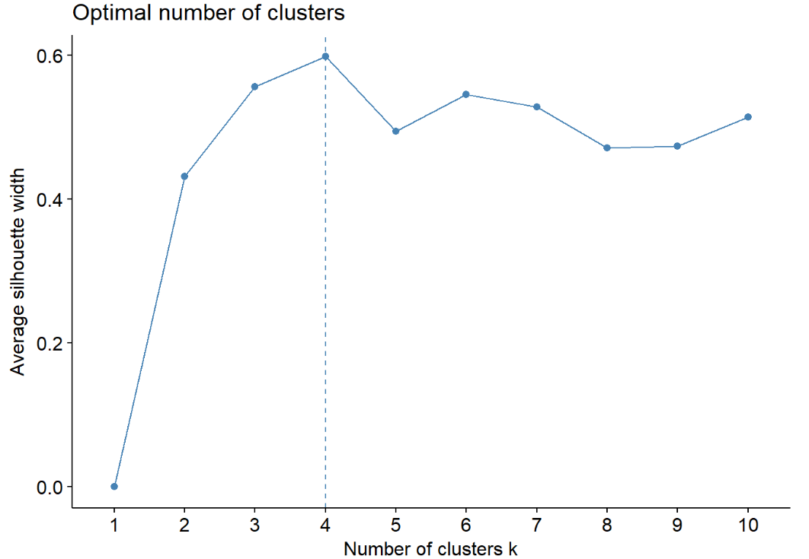
Clustering
Silhouette Method showing
4 clusters to be considered.
After using Kmeans Clustering
we can conclude that Developers
can be divided in 4 clusters
According to Number of Days,
File Types and Their Repository.

Slide 10
Thank you

