Slide 1
Back-End Requirements
Posal Website
11/6/17

Slide 2
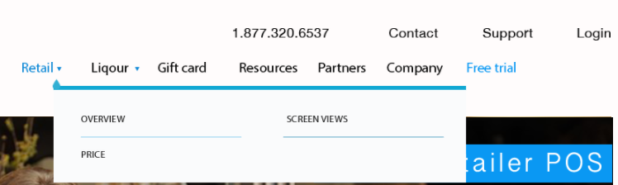
Header
Highlight links when hovered
Dropdown tab for Retail, Liquor with highlighted hover links

Slide 3
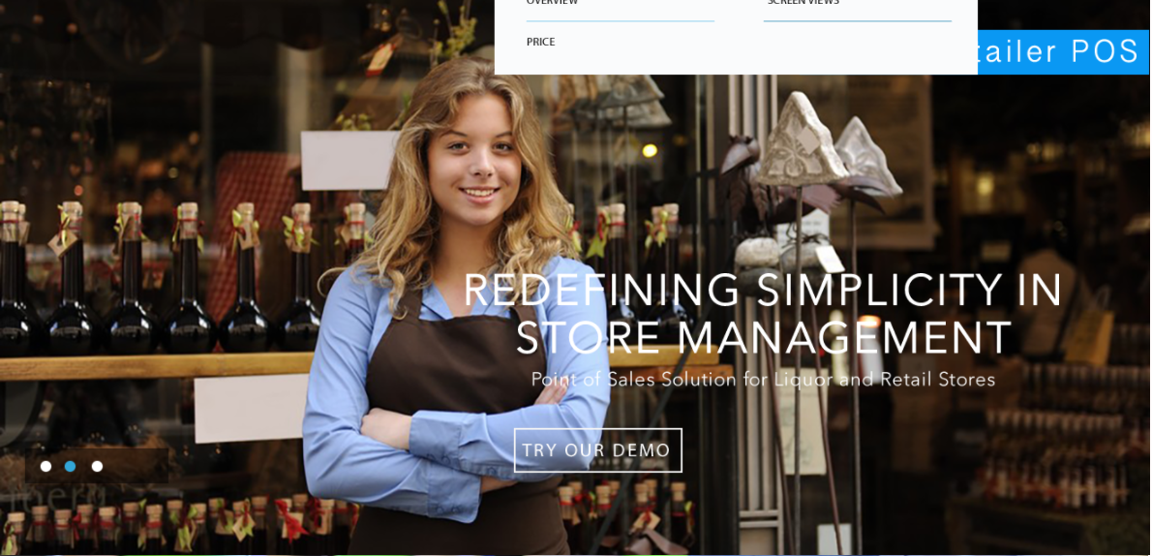
Landing Page (Carousal)
3-Image Carousal with clickable button transitions
Highlighted hover button: “TRY OUR DEMO”

Slide 4
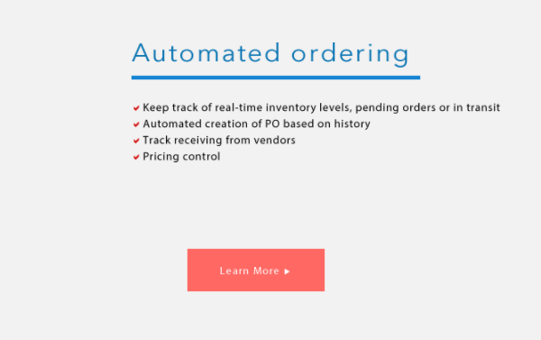
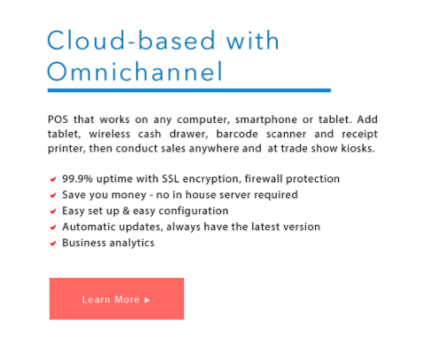
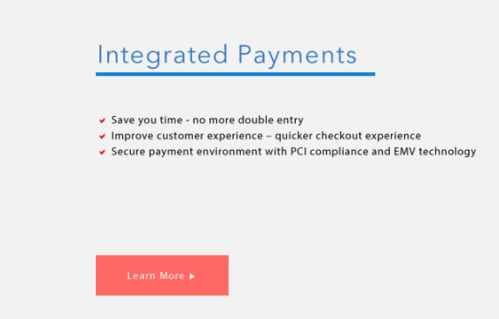
Landing Page (Body)
- Highlighted Hover buttons: “Learn More”

Slide 5
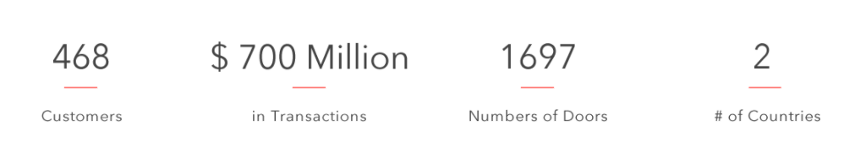

Landing Page (Body)
- Animated Numbers from queried from Database
- Highlighted hover button

Slide 6
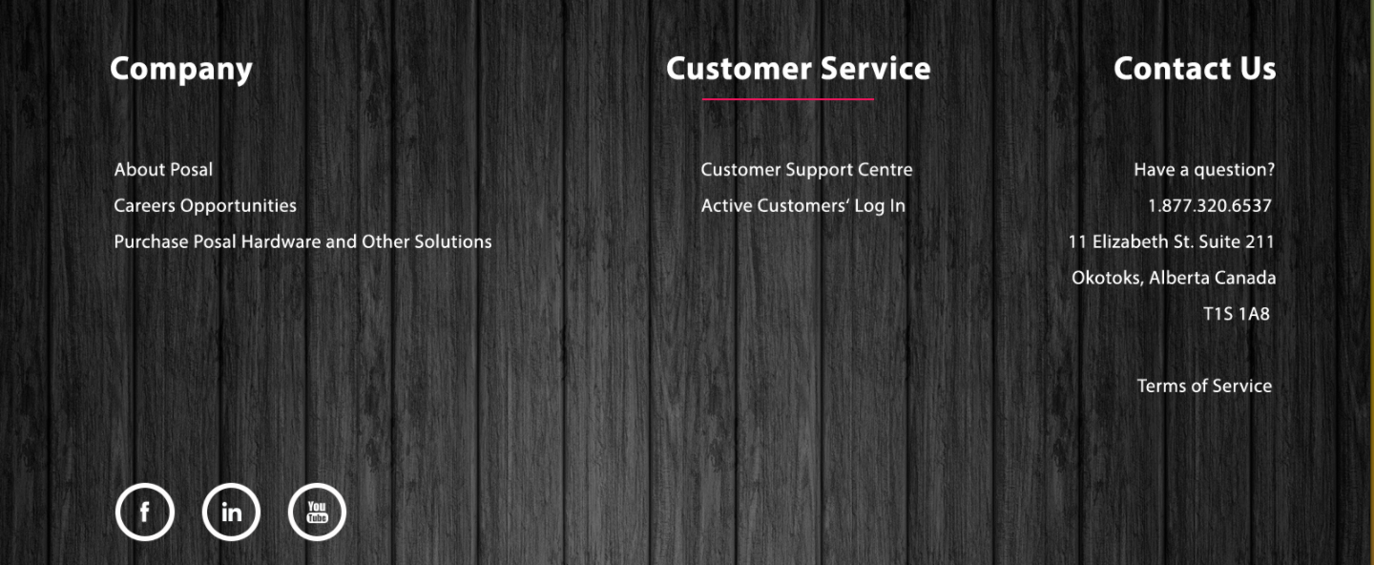
Footer
Underlined hover links
Highlighted hover social media buttons

