Slide 1
Coursework «Reinforcement learning for resource allocation tasks in the cloud»
Faculty of
Computer Science
Software
Engineering
Moscow
2022
Peganov Nikita Sergeevich
204 group

Slide 2

List of contents
Software
Engineering
Coursework «Reinforcement learning for resource allocation tasks in the cloud»
List of
contents
3. Introduction to the topic
4. The purpose of the course work
5. The importance of the topic
6. Practical value of the work
7. Description of methods for solving the problem
8. Description of the experiment
9. Results of the experiment
10. Further work plan
11. Conclusion of the presentation

Slide 3
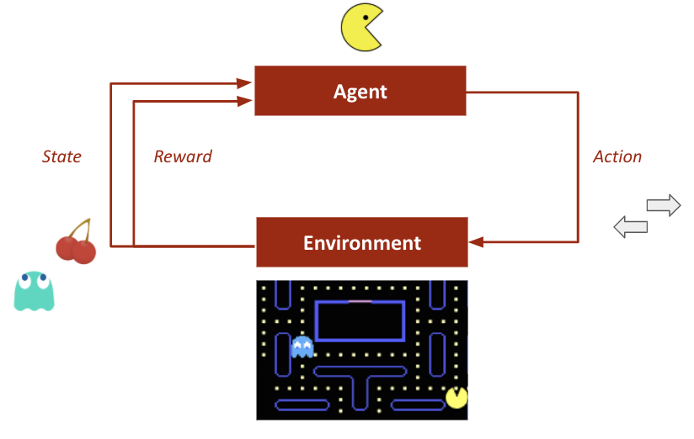
Introduction to the topic
Software
Engineering
Coursework «Reinforcement learning for resource allocation tasks in the cloud»
Introduction
to the topic
Reinforcement learning (RL) is an area of machine learning connected with how intelligent agents ought to take actions in an environment in order to maximize the notion of cumulative reward.
Cloud computing is the on-demand availability of computer system resources, especially data storage (cloud storage) and computing power, without direct active management by the user.
Tetris (Russian: Тéтрис) is a puzzle video game created by Soviet software engineer Alexey Pajitnov in 1984.

Slide 4

The purpose of the course work
Software
Engineering
Coursework «Reinforcement learning for resource allocation tasks in the cloud»
The purpose of
the course work
Finding the effectiveness of reinforcement learning in the tasks of resource allocation in the cloud.
My own purpose: Learn more about neural networks, learn how to use them.

Slide 5
Software
Engineering
Coursework «Reinforcement learning for resource allocation tasks in the cloud»
The importance
of the topic
The importance
of the topic
Amazon, Google, Huawei and other major information companies are engaged in cloud computing¹.
In 2020, the global cloud computing market is estimated at $289.25 billion².
The distribution of cloud resources is one of the most important tasks of cloud computing.
¹ https://www.computerweekly.com/feature/A-history-of-cloud-computing https://www.sdxcentral.com/articles/news/can-huawei-reinvent-itself-as-a-cloud-leader/2021/04/
² https://www.businesswire.com/news/home/20210824005585/en/Global-Cloud-Computing-Market-2020-to-2026---by-Service-Deployment-Application-Type-End-user-and-Region---ResearchAndMarkets.com
³ https://www.gartner.com/en/newsroom/press-releases/2022-02-09-gartner-says-more-than-half-of-enterprise-it-spending?utm_source=ixbtcom

Slide 6
Practical value of the work
Software
Engineering
Coursework «Reinforcement learning for resource allocation tasks in the cloud»
Practical value
of the work
Reducing server load
Decreasing server support costs
Lessening production costs while reducing the number of servers
Reducing the carbon footprint of the company
¹ https://www.huawei.com/nl/sustainability/environment-protect/reducing-carbon-emissions

Slide 7
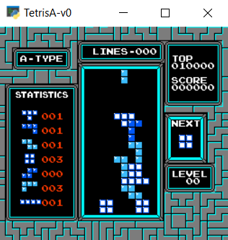
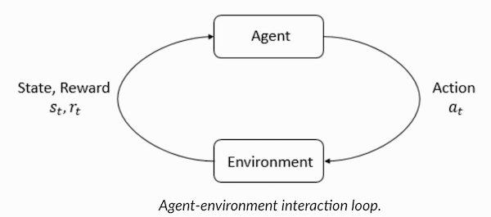
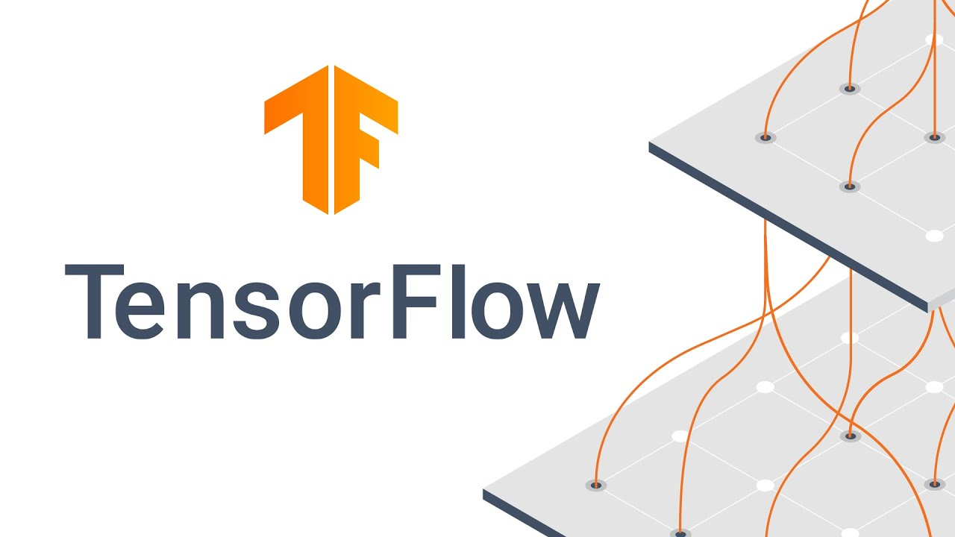
Description of methods for solving the problem
Software
Engineering
Coursework «Reinforcement learning for resource allocation tasks in the cloud»
Description of methods
for solving the problem
Reinforcement Learning
OpenAI Gym
TensorFlow
KerasRL

Slide 8
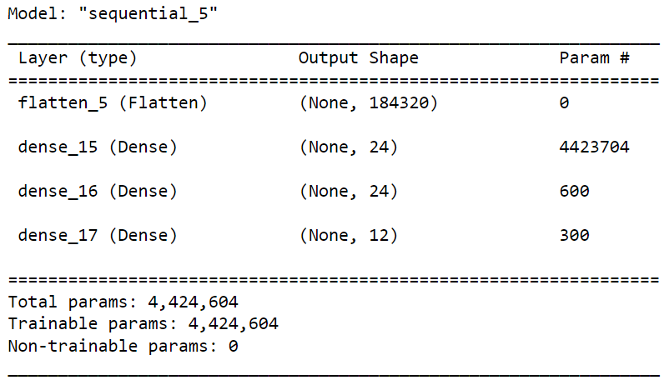
Software
Engineering
Coursework «Reinforcement learning for resource allocation tasks in the cloud»
Description
of the experiment
Description
of the experiment
Made Tetris environment with OpenAI Gym
Created a network model with KerasRL
Set an agent with this model and BoltzmannQPolicy
Launched 50,000 steps for 8 hours

Slide 9
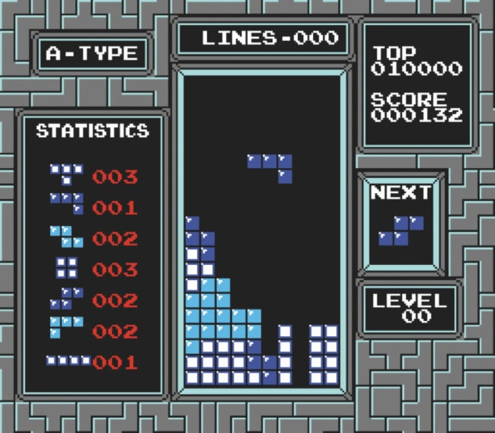
Software
Engineering
Coursework «Reinforcement learning for resource allocation tasks in the cloud»
Results
of the experiment
Results
of the experiment
Average reward: 11.02
Average number of steps before losing: 4260.23
Maximum result: 31

Slide 10

Further work plan
Software
Engineering
Coursework «Reinforcement learning for resource allocation tasks in the cloud»
Further
work plan
Study of materials on the use of RL in cloud tasks, their description in the text of the course work, experiment planning (February)
Implementation of the task in the code (March)
The complexity of the task, for example, changes in environmental conditions (April)
Correction of defects, registration (May)

Slide 11

Conclusion of the presentation
Software
Engineering
Coursework «Reinforcement learning for resource allocation tasks in the cloud»
Conclusion
of the presentation
In this work:
Materials about RL have been studied
For clarity, an automatic Tetris playing is implemented
The ways of using RL in cloud computing are considered
Reinforcement learning is a modern technology that has a lot of unexpected uses.

Slide 12
Software
Engineering
Coursework «Reinforcement learning for resource allocation tasks in the cloud»
Thank you
for your attention
Thank you for your attention!
I’ll be glad to answer your questions.

