Slide 1
A Program for Modeling the Perception of Success Factors of an IT-Project Using Fuzzy Cognitive Maps
HSE University
FCS SE
Project Proposal
Protection
Moscow
2024
The Program Project
Author: Nikita Sergeevich Peganov, BPI204 group
Supervisor: Assoc. Prof., Department of SE, Ph.D. K. Y. Degtyarev
Educational program: “Software Engineering” of the Higher School of Economics

Slide 2
AGENDA
HSE University
FCS SE
Project Proposal
Protection
Moscow
2024
3. Literature Review:
- Review of existing studies on IT project success factors and their modeling techniques.
- Review of studies on the use of FCMs in various fields, especially in IT project management.
4. Research Methods:
- Explanation of the proposed program that uses FCMs to model the perception of success factors in IT projects.
- Description of the cognitive modeling technique used in the program.
5. Anticipated Results:
- Discussion on the expected outcomes of the study, including the program’s potential in accurately modeling and analyzing the success of IT projects.
1. Background:
- Discussion on the complexity of factors contributing to the success of IT projects.
- Introduction to Fuzzy Cognitive Maps (FCMs) and their role in modeling human reasoning and decision-making processes.
2. Problem Statement:
- Identification of the need for a comprehensive understanding of the complex relationships and interdependencies among various factors that contribute to the success of IT projects.
- Discussion on the challenges in accurately modeling and analyzing the success of IT projects.
A fuzzy cognitive map of the UK's digital region, whose economy is based on biotechnology
The functions of belonging to a linguistic variable

Slide 3
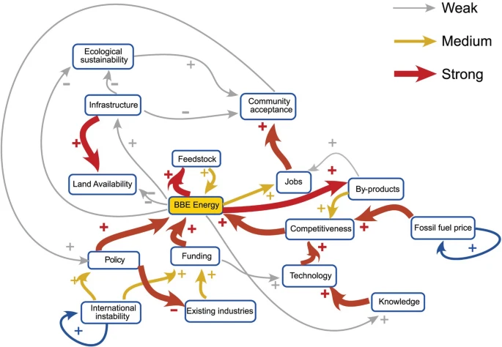
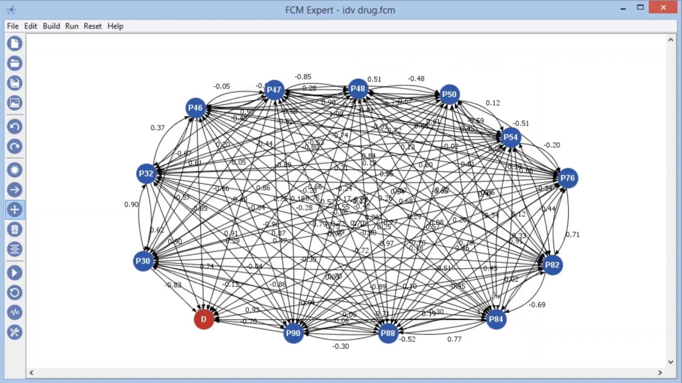
BACKGROUND
HSE University
FCS SE
Project Proposal
Protection
Moscow
2024
Mental Modeler
FSM Expert
A fuzzy cognitive map of the UK's digital region, whose economy is based on biotechnology

Slide 4
PROBLEM STATEMENT
HSE University
FCS SE
Project Proposal
Protection
Moscow
2024
Problem: There are no programs for modeling fuzzy cognitive maps in the Russian-speaking environment yet. Fuzzy cognitive maps are most often used in research work. Main goal: Development of a program for modeling the perception of success factors of an IT-project using fuzzy cognitive maps.
Objectives: 1. Literature review and analysis of existing methods for evaluating the success of IT projects 2. Studying the theory of fuzzy cognitive maps 3. Development of a methodology for modeling the perception of success factors of an IT project 4. Designing a simulation program 5. Implementation of the program 6. Testing and validation 7. Analysis of the results and conclusions 8. Preparation of documentation

Slide 5


RESEARCH METHODS
HSE University
FCS SE
Project Proposal
Protection
Moscow
2024
• Study of the subject area
• Choosing the types of fuzzy sets
• Сhoosing a platform for creating a program
• Сhoosing a programming language and frameworks
• Development of the program architecture
• Analysis of the received program

Slide 6
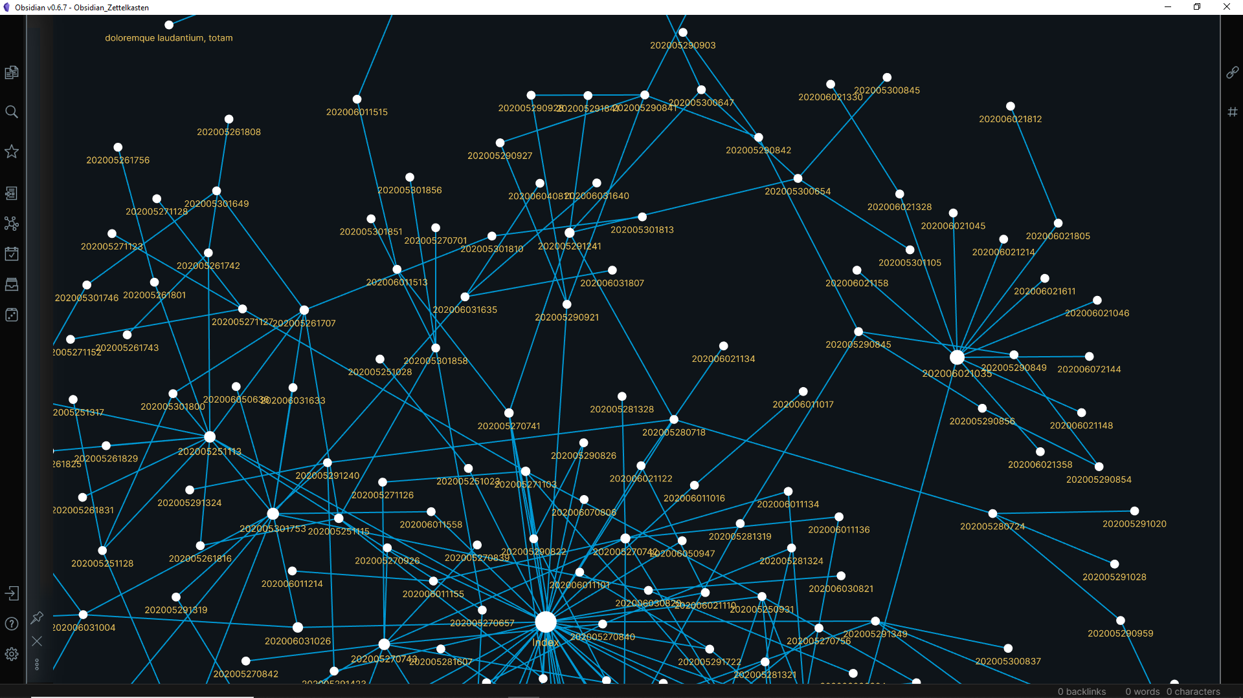
RESULTS ANTICIPATED
HSE University
FCS SE
Project Proposal
Protection
Moscow
2024
1. Technical specification of the program
2. A program for modeling the perception of success factors of an IT project using fuzzy cognitive maps with flexible settings
3. Program documentation (explanatory note, operator's manual)

Slide 7
LITERATURE REVIEW
HSE University
FCS SE
Project Proposal
Protection
Moscow
2024
Authors | Research | Insights
Atasoy, Güzide (2007) | “Using cognitive maps for modeling project success” | balanced perspective provides a more comprehensive understanding of cognitive maps
Bhutani, K., Kumar, M., Garg, G., & Aggarwal, S. (2016) | “Assessing IT-projects success with extended fuzzy cognitive maps & neutrosophic cognitive maps in comparison to fuzzy cognitive maps” | Neutrosophic cognitive maps outperformed fuzzy cognitive maps and improved cognitive maps in assessing the success of the project
Luis Rodriguez-Repiso, Rossitza Setchi, Jose L. Salmeron (2007) | “Modeling IT projects success with Fuzzy Cognitive Maps” | The writers emphasize the significance of Critical Success Factors (CSFs) as the essential prerequisites for a project to be deemed successful
ИТОГО | 75 984 375 | 3 984 759 835

Slide 8
REFERENCES
HSE University
FCS SE
Project Proposal
Protection
Moscow
2024
[1] Barbrook-Johnson, P., Penn, A.S. (2022) Fuzzy Cognitive Mapping. In: Systems Mapping // Сайт doi.org (https://doi.org/10.1007/978-3-031-01919-7_6) Просмотрено: 20.11.2023.
[2] Michael Glykas (2010) Fuzzy cognitive maps. Advances in theory, methodologies, tools and applications // Сайт researchgate.net (https://www.researchgate.net/publication/268170676_Fuzzy_cognitive_maps_Advances_in_theory_methodologies_tools_and_applications) Просмотрено: 20.11.2023
[3] Kosko, B. (1986). Fuzzy Cognitive Maps // International Journal of Man-Machine Studies, Vol. 24, No. 1, 1986, pp. 65-75.
[4] Maikel León, C. R. (2010). Fuzzy Cognitive Maps for Modeling Complex Systems // Сайт researchgate.net (https://www.researchgate.net/publication/220887109_Fuzzy_Cognitive_Maps_for_
Modeling_Complex_Systems) Просмотрено: 20.11.2023
[5] Chrysostomos D. Stylios Voula C. Georgopoulos and Peter P. Groumpos (1997) The use of fuzzy cognitive maps in modelling systems // Conference: 5th IEEE Mediterranean Conference on Control and Systems

Slide 9
Thanks for your attention!

