Slide 1
ResNet Architecture Overview

Slide 2
ResNet
Based on VGG
3x3 convolution filters in all layers
Images randomly cropped to 224 x 224 RGB, then random horizontal shift + random RGB color shift
Preprocessing: subtract the mean RGB value, computed on the training set, from each pixel
Stride of 2

Slide 3
ResNet Layers
Stack of convolutional layers
Followed by 3 Fully-Connected layers.
First two layers are 4096 channels each.
Third layer has 1000-way classification (1 for each class).
Final layer is a soft-max layer
All hidden layers are equipped with rectification ReLU

Slide 4
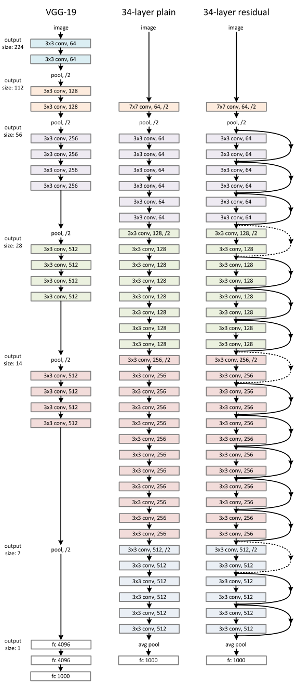
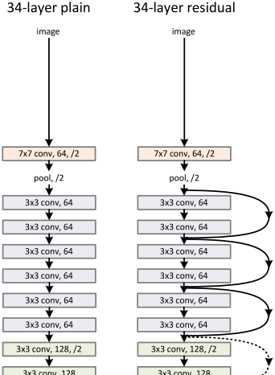
Residual Layers

Slide 5
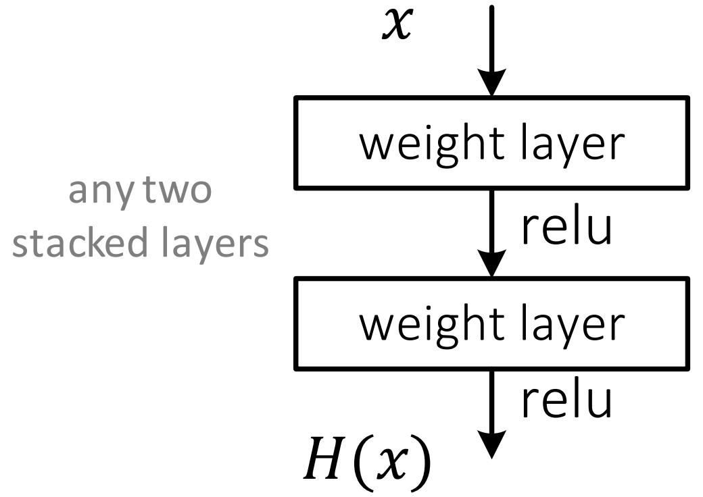
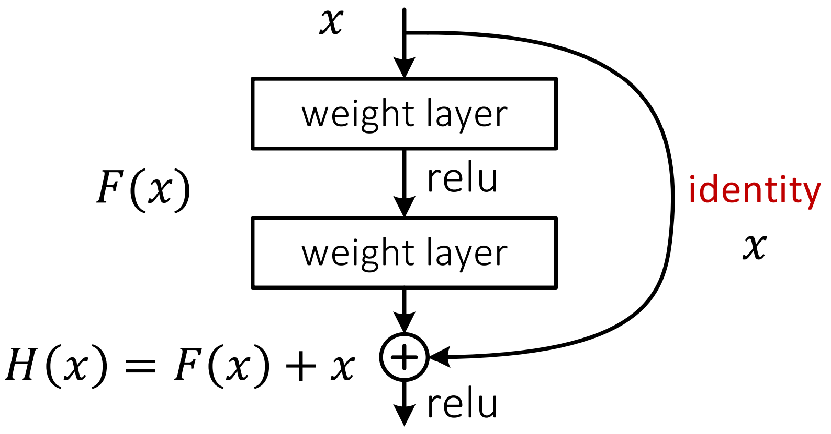
Residual Layers Continued
Plain Layers
Residual Layers
Use Residual functions
Identity is the error difference calculated by the residual function from layers above

Slide 6
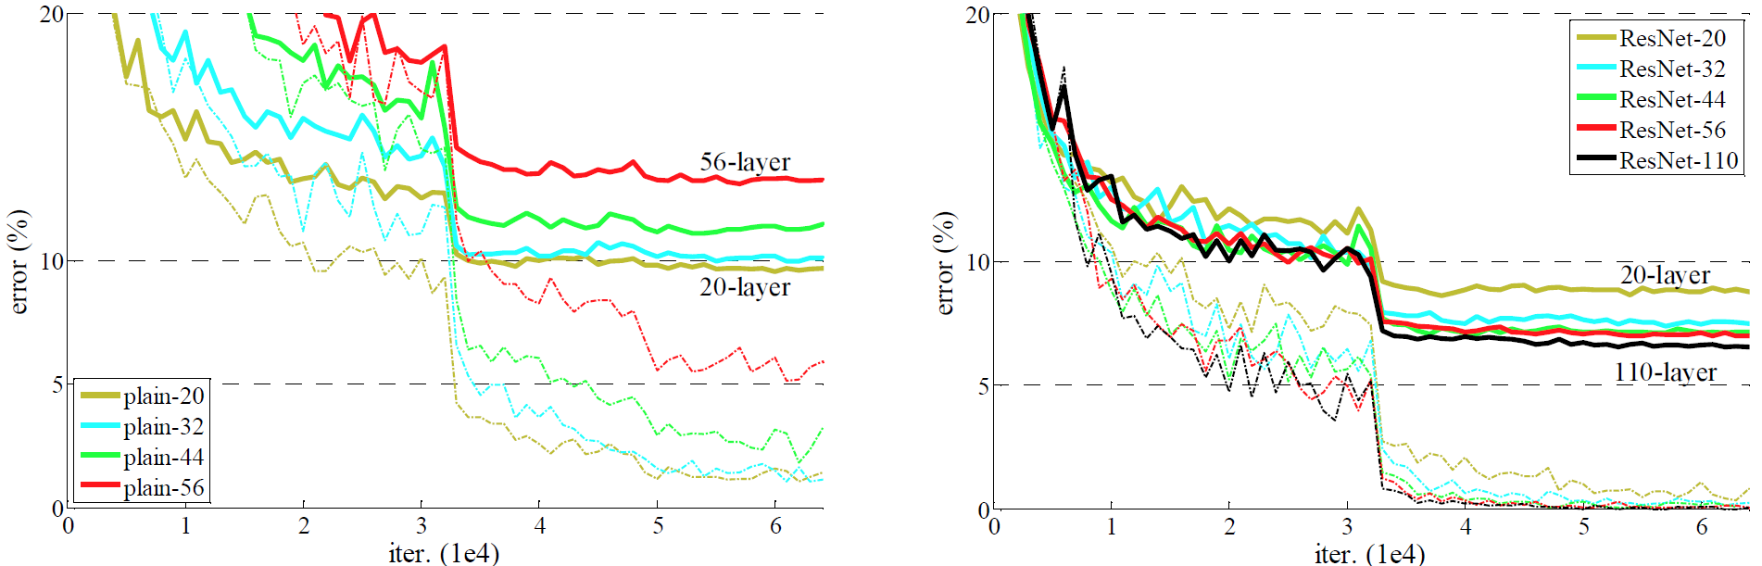
Reason for Use of Residual Layers
Bold – Training Err
Thin – Testing Err
Resnets:
Lower error as depth increases
Generalize better / Less overtraining
Prevent Exploding / Disappearing gradients

Slide 7
Image Rescaling & Cropping
The image is resized with its shorter side randomly sampled in [256; 480] for scale augmentation.
A 224 x 224 crop is randomly sampled from an image or its horizontal flip, with the per-pixel mean subtracted
Average the scores at multiple scales (images are resized such that the shorter side is in {224; 256; 384; 480; 640g}
for S ≫ 224 the crop will correspond to a small part of the image, containing a small object or an object part.
Takeaway: Images are first scaled to 256 x 256 and then augmented using the above procedures

Slide 8
Scale Testing
Preprocess the images by rescaling to 256 x 256
Rescale to 256 shorter edge, then crop to 256 x 256

