Slide 1
ResNet Update

Slide 2
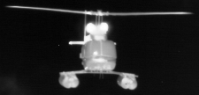
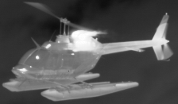
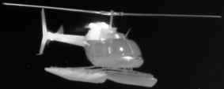
Test Results: 154 Validation Set
FULL SIZED IMAGES (68 Images):
XOR Error Average: 16.29 %
Engineering Unit Error Average: 9.46 %
Confidence Level Average: 85.31 %
XOR P Standard Deviation: 4.87
EU P Standard Deviation: 3.42
Confidence Level Stand Deviation: 4.64
RESIZED IMAGES (256x256) (68 Images):
XOR Error Average: 15.50 %
Engineering Unit Error Average: 6.10 %
Confidence Level Average: 88.42 %
XOR P Standard Deviation: 4.58
EU P Standard Deviation: 3.36
Confidence Level Stand Deviation: 4.16
CROPPED IMAGES (15 Images):
XOR Error Average: 20.60 %
Engineering Unit Error Average: 10.39 %
Confidence Level Average: 83.57 %
XOR P Standard Deviation: 6.22
EU P Standard Deviation: 5.36
Confidence Level Stand Deviation: 6.35

Slide 3
Next Steps
Test and save epoch with minimum error %
Change number of channels for image reader from 3 channels to 1 channel

