Slide 1
Régulon Pho
PhoB
Pst-PhoR
Pi
Pi
Pi
Pi
Pi
PhoB
Pi
Pi
PhoA
Pi
Pi
Pi
PhoD
Pi
Pi
Pi
PhoE
Pi
[...]
Pi

Slide 2
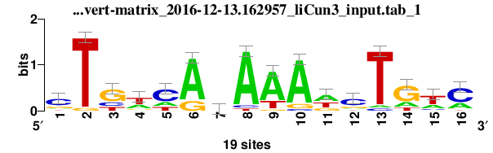
Régulon Pho
PhoB
Pst-PhoR
Pi
Pi
Pi
Pi
Pi
PhoB
Pi
Pi
PhoA
Pi
Pi
Pi
PhoD
Pi
Pi
Pi
PhoE
Pi
[...]
Pi

Slide 3
Régulon Pho
PhoB
Pst-PhoR
PhoB
PhoB
PhoA
PhoD
PhoE
Pi
[...]
Pi

Slide 4
Régulon Pho
Pst-PhoR
PhoB
PhoB
PhoB
PhoA
PhoD
PhoE
Pi
[...]
Pi

Slide 5
Régulon Pho
PhoB
PhoB
Pst-PhoR
PhoB
PhoB
PhoB
PhoB
PhoB
PhoB
PhoB
PhoB
PhoB
PhoB
PhoB
PhoB
PhoB
PhoA
PhoB
PhoB
PhoD
PhoB
PhoB
PhoE
Pi
[...]
Pi

Slide 6
Régulon Pho
PhoB
PhoA
PhoD
PhoE
[...]

Slide 7
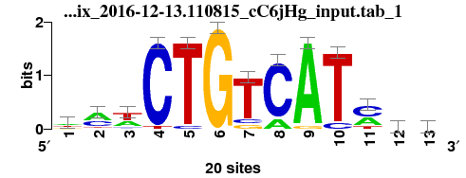
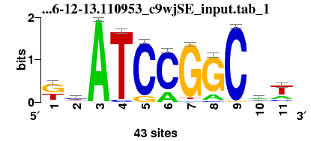
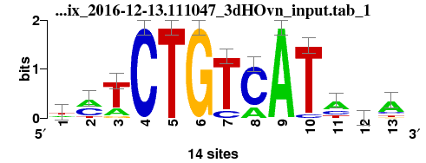
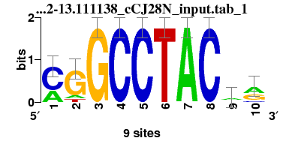
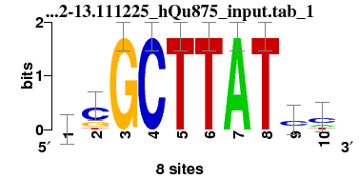
Base de données (86 FT)

Slide 8
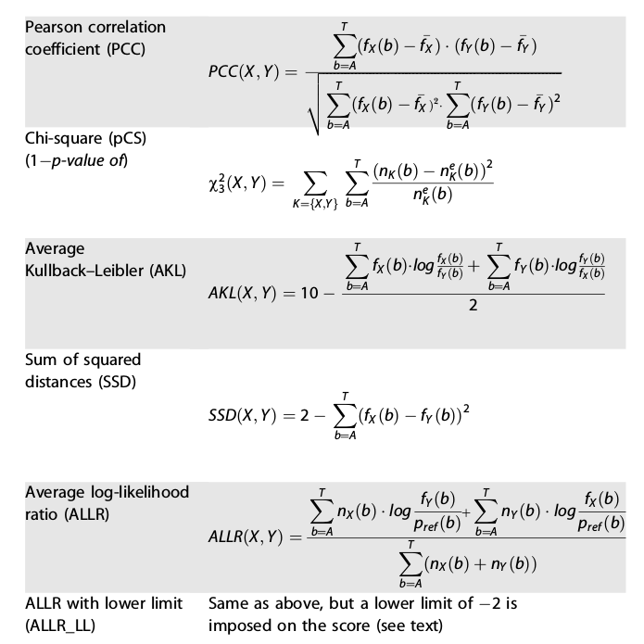
Base de données (86 FT)
- Alignement Local Smith-Waterman
- Plusieurs métriques :

Slide 9
 | PCC | SSD | AKL
 | PhoB SlyA NarP RscB TorR ... | CysB OmpR ArgP CRP ArcA ... | OmpR XylR ArcA Fis PhoP ...
 | SlyA RelBRelE HipB MetR IclR ... | FlhDC CysB AraC HipB Dan ... | PhoP AscG Lrp RcsAB HNS ...
 | PhoB RcsB TorR HNS RelBRelE ... | PhoB CysB OmpR ArgP ArcA ... | OmpR CysB CRP ArcA XylR ...
 | IHF AsnC RstA NarP NanR ... | NanR EvgA NarP ModE NtrC ... | EvgA DeoR NtrC GadW SoxS ...
 | ExuR NanR RelBRelE DgsA HipB ... | Nac ModE ArgP GntR DnaA ... | GntR ModE Fur Nac Fis ...
PhoB : 57/86
PhoB : 42/86
PhoB : 38/86
PhoB : 52/86
PhoB : 27/86
PhoB : 73/86
PhoB : 62/86
PhoB : 38/86
PhoB : 53/86
PhoB : 50/86
PhoB : 57/86
PhoB : 75/86

Slide 10
 | PCC | SSD | AKL
 | PhoB SlyA NarP RscB TorR ... | CysB OmpR ArgP CRP ArcA ... | OmpR XylR ArcA Fis PhoP ...
 | SlyA RelBRelE HipB MetR IclR ... | FlhDC CysB AraC HipB Dan ... | PhoP AscG Lrp RcsAB HNS ...
 | PhoB RcsB TorR HNS RelBRelE ... | PhoB CysB OmpR ArgP ArcA ... | OmpR CysB CRP ArcA XylR ...
 | IHF AsnC RstA NarP NanR ... | NanR EvgA NarP ModE NtrC ... | EvgA DeoR NtrC GadW SoxS ...
 | ExuR NanR RelBRelE DgsA HipB ... | Nac ModE ArgP GntR DnaA ... | GntR ModE Fur Nac Fis ...
PhoB : 57/86
PhoB : 42/86
PhoB : 38/86
PhoB : 52/86
PhoB : 27/86
PhoB : 73/86
PhoB : 62/86
PhoB : 38/86
PhoB : 53/86
PhoB : 50/86
PhoB : 57/86
PhoB : 75/86

