Slide 1
Boxxy
Code exploration and debugging tool

Slide 2
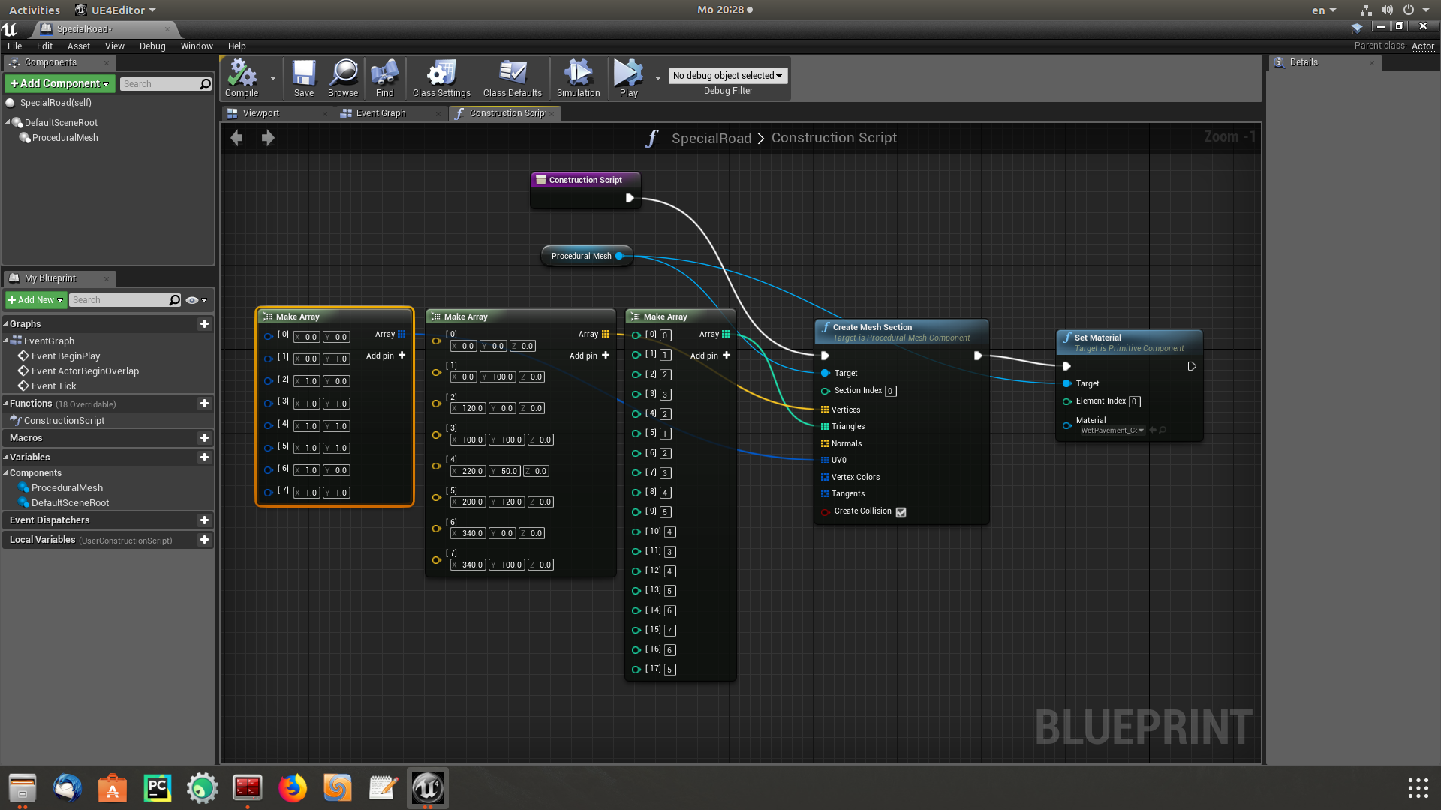

Slide 3
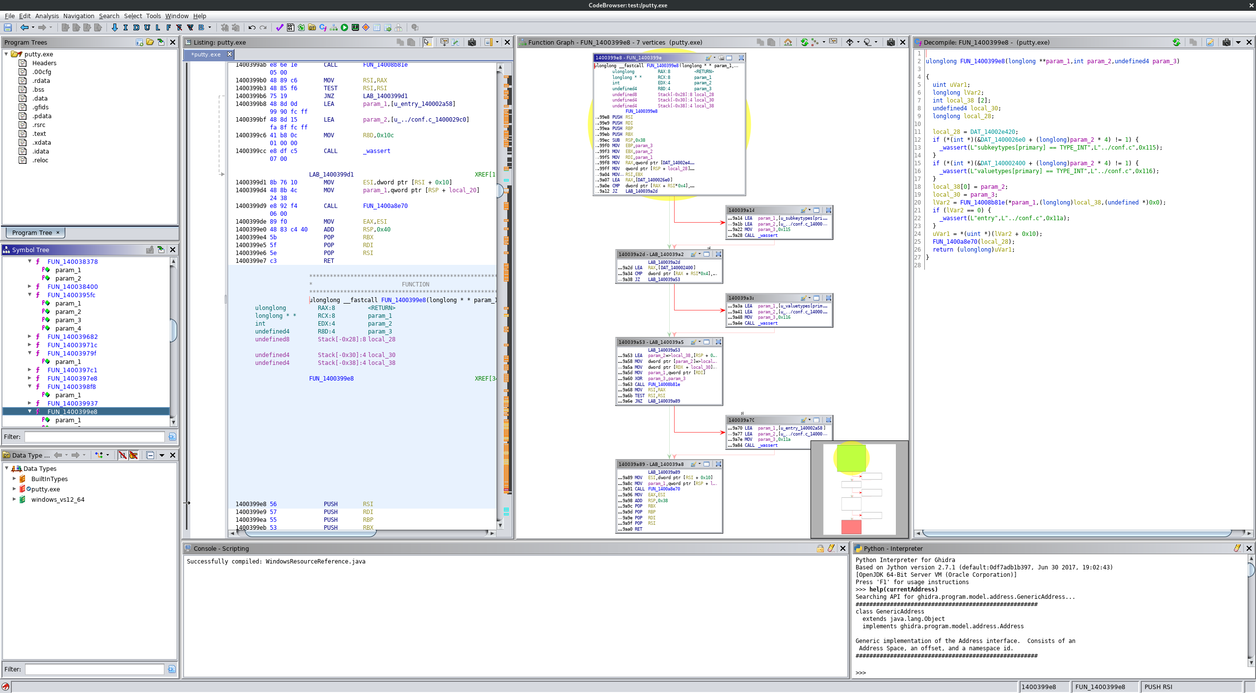

Slide 4
