Slide 1

Dr Mahalingam College of Engineering & Technology
Department of Computer Science and Engineering 19CSPN6601- Innovative and Creative Project
First Review
Title: HEART DISEASE PREDICTION
USING MACHINE LEARNING ALGORITHMS
Team Number: 22BCSA015
Team Member(s): 19BCS089 - G. Shangavie
19BCS093 - R. Nikesh
19BCS107 - V. Veeraraghavan
Faculty Supervisor: K. Prabhu, AP/CSE.
Date: 30/04/2022

Slide 2
Contents
Domain Introduction
Problem description
Objective
Literature Survey
Design (Block Diagram)
Module Description
Screenshots
Hardware /Software Requirements
Reference(s)
Online Course Details
Project Content identified/ Journal Identified

Slide 3
Domain Introduction
Machine learning disease prediction is a system that predicts diseases based on information provided by users using various suitable algorithms. In recent times, Heart Disease prediction is one of the most complicated tasks in the medical field. In the modern era, approximately one person dies per minute due to heart disease. Data science plays a crucial role in processing huge amount of data in the field of healthcare.

Slide 4
Problem Description
As heart disease prediction is a complex task, there is a need to automate the prediction process to avoid risks associated with it and alert the patient well in advance. This Heart Disease Prediction Using Machine Learning is completely done with the help of Machine Learning algorithms and Python Programming language with and also using the dataset that's available previously by the hospitals using that we'll predict the disease.

Slide 5
Problem Description
This model is developed using classification algorithms, as they play important role in prediction. The proposed work predicts the chances of Heart Disease and classifies patient's risk levels by implementing different machine learning techniques such as Logistic Regression, Random Forest, Support vector machine, Gaussian Naïve Bayes, Gradient boosting, K-nearest neighbours, Multinomial Naïve bayes and Decision trees.

Slide 6
Objective
The main objective of this project is to get a better accuracy to detect heart disease using a combination of algorithms in which the target output counts whether a person has heart disease or not. This in turn will help to provide effective treatment to patients and avoid severe consequences.

Slide 7
Literature Survey
Jayshril S. Sonawane et al. [1] proposed prediction of heart disease using multilayer perception neural network(2014). The accuracy by using this technique is 80%. Since the time complexity will be more due to usage of complex Boolean functions while using limited data sets for training, independently trained subnetworks scale quite well.
Ketut Agung Enrico et.al [2] a system was proposed by him for heart disease prediction using KNN algorithm with simplified parameters(2016). The accuracy of this algorithm is 81.85%. Using KNN , with increase of number of parameters the performance decreases and it considers 90% of data for training which is computationally expensive and does nothing during.
M.Akhil jabbar et al [3] studies about heart disease prediction using Lazy Associative classification. The vast amount of space used to store the entire data collection. Since no abstraction is made during the training phases, especially noisy training data increases the case base unnecessarily.

Slide 8
Literature Survey
Jaymin Patel et.al [4] proposed prediction of heart disease using data mining techniques(2015). The accuracy is 56.76%. The drawback of J48 is that the tree increases linearly with large data. LMT is slower and takes long time for implementation and accuracy is low.
Rifki wijaya et al [5] studies about preliminary design of estimating heart disease by using machine learning ANN within one year(2013). The accuracy is 81.85%. To function, the neural network needs to be trained. Big neural networks necessitate a long processing time. Microprocessor design and history necessitate their emulation.
Carlos Ordonez et al [6] proposed association rules to implement this prediction system. The accuracy is 70%. It uses too many parameters from patients record and produce irrelevant rules. So, this technique is computationally expensive and performance is low.

Slide 9
Literature Survey
Jyoti soni et al [7] did evaluation of Weighted Associative Classifier (WAC).The accuracy is 81.51%. All attributes are not equally important in predicting the class mark in the prediction model. As a result, various weights may be allocated to different attributes based on their ability to predict.
Idticeme sedjelmaci et al [8] proposed detection of some heart diseases using fractal dimension and chaos theory(2013). The accuacy of this technique is 80%. Fractal analysis was created to analyse complex irregular objects. The drawbacks of applying Chaos Theory are primarily due to the input parameters chosen. The methods used to compute these parameters are determined by the underlying dynamics of the data as well as the type of analysis being performed, which is usually complex and not always precise.
D.R.Patilet al [9] proposed prediction of heart disease using learning vector quantization algorithm. The accuracy of this algorithm is 85.55%. There is no limit to the number of prototypes that can be used per class; the only requirement is that each class have at least one prototype.

Slide 10
Literature Survey
AH Chen et al. [10] presented a heart disease prediction system that can help doctors predict heart disease status using patient clinical data. The C language is used an artificial neural networks for classification and prediction of heart disease.The C and C# programming languages are used to develop system.The proposed method accuracy is 80%. m.
Anbarasi et al [11] proposed prediction of heart disease with feature subset selection using genetic algorithm(2010). The accuracy is 70%. The language used to specify candidate solution must be robust.
Manpreet Singh et.al [12] proposed cardiovascular disease prediction system based on structural equation modelling (SEM) and Fuzzy cognitive map (FCM) (2016). The accuracy of SEM and FCM 74%. It doesn’t work well with large data and accuracy is low. Kathleen j.

Slide 11
Literature Survey
Miao et al [13] studies about coronary heart disease diagnosis using Deep Neutral Network(2015). The accuracy is 83.67%. It is difficult to be adopted by people who are less experienced. It is difficult to comprehend performance based solely on understanding, and this necessitates the use of classifiers.
Jae Kwon Kim et al [14] proposed neural network based coronary heart disease risk prediction using feature correlation analysis(2017). The accuracy of this is 81.163%. A correlational analysis can only be used when the variables are two measurable on scale. It's difficult to tell which variables cause which effects, and a high correlation between variables can be misleading. Sairabi H.
Mujawar et.al [15] proposed a model for prediction of heart disease using modified K-means and Naïve Bayes(2015). Naïve Bayes assumes that all predictors are independent and it also have zero frequency problem.

Slide 12
Design (Block Diagram)
Data Set
Attribute
Selection
Pre-Processing
Machine Learning Algorithms
( Logistic Regression, KNN, SVM, Naive Bayes, Decision Tree, Random Forest )
Patient Data
Prediction
Camparision
HEART DISEASE PREDICTION USING MACHINE LEARNING

Slide 13
Module Description
Heart disease predicting model is trained by using the Cleveland dataset which takes age, sex, chest pain, resting blood pressure, rest ECG, maximum heart rate, exercise including angina, ST depression, ST slope, number of major blood vessels, types of thalassemia as inputs and produce output stating whether the patient is suffering from heart disease or not. If only a single algorithm is used it cannot Pre-Process data and even it can’t get good accuracy. So it’s better to have a combination of algorithms like “Logistic Regression”, “KNN”, “SVM”, “Naïve Bayes”, “Decision Tree”, and "Random Forest“. A lot of work has been carried out to predict heart disease using the Machine Learning dataset. Different levels of accuracy have been attained using various data mining techniques. This Project “Heart Disease Prediction using Machine Learning algorithms” is implemented using python completely.

Slide 14
Module Description
Modules Identified:-
Patient Data
Data Set
Attribute Selection
Pre-Processing
Machine Learning Algorithms
Logistic Regression
KNN
SVM
Naive Bayes
Decision Tree
Random Forest
Prediction
Comparision

Slide 15
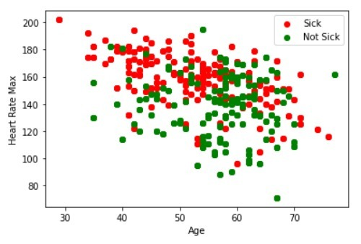
Screenshots:
Plot Graph of the Output.

Slide 16
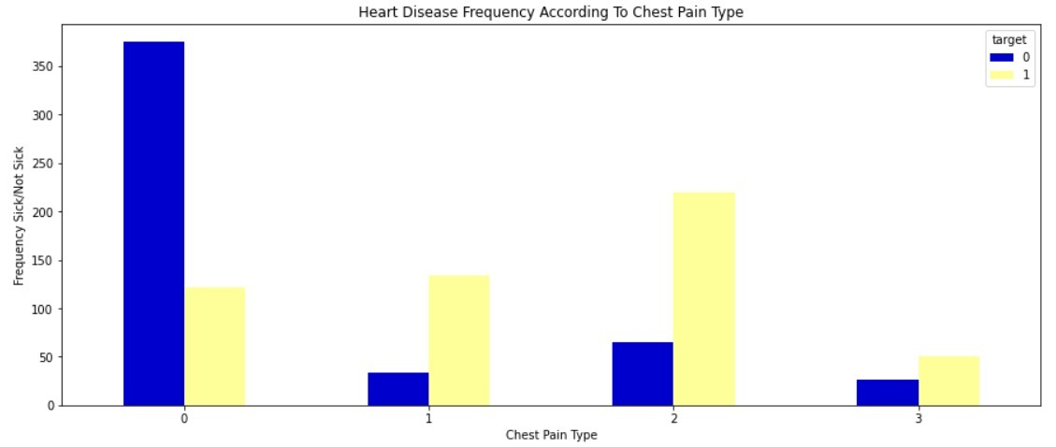
Screenshots:
Heart Disease Frequency According to Chest Pain.

Slide 17
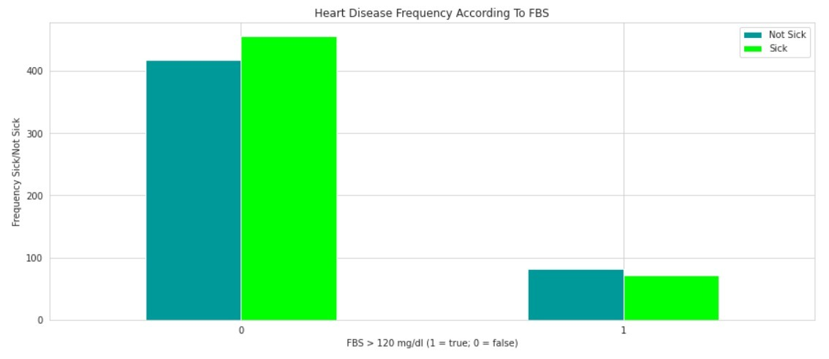
Screenshots:
Heart Disease Frequency According to FBS

Slide 18
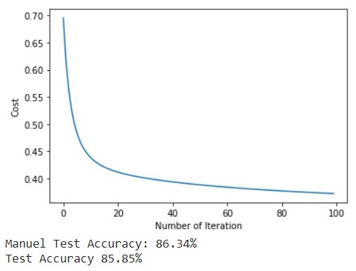
Screenshots:
Accuracy Rate Testing

Slide 19
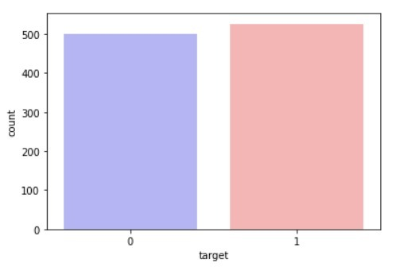
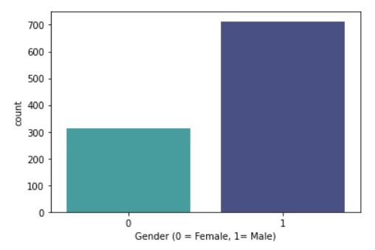
Screenshots:
No.of Patients Affected/Not Affected

Slide 20
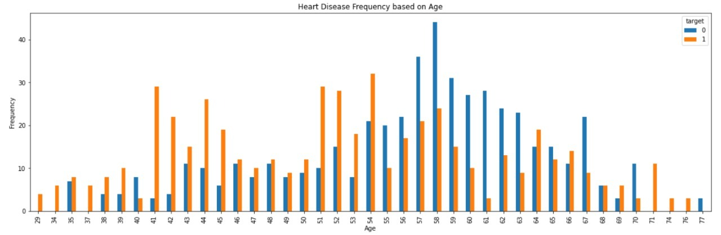
Screenshots:
Heart Disease Frequency based on Age

Slide 21
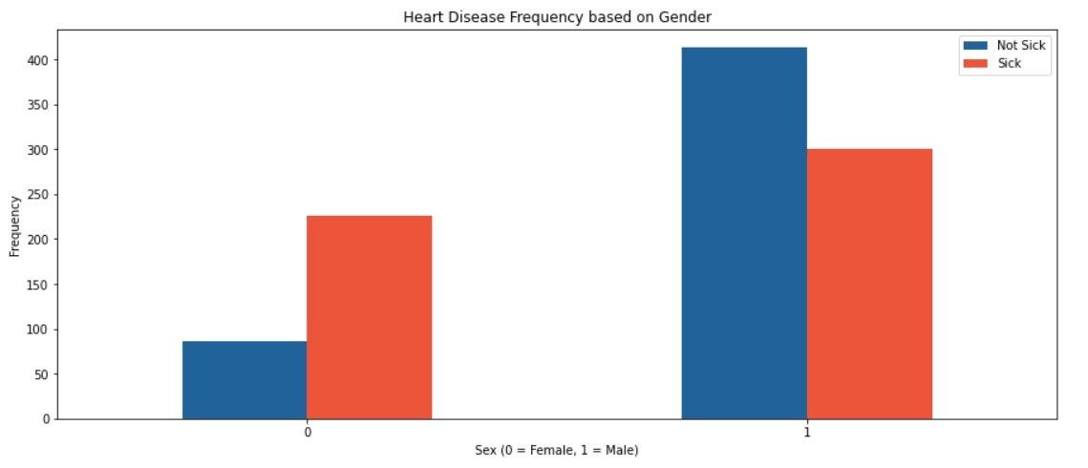
Screenshots:
Heart Disease Frequency based on Gender.

Slide 22
Screenshots:
Heart Disease Frequency According to Chest Pain Type

Slide 23
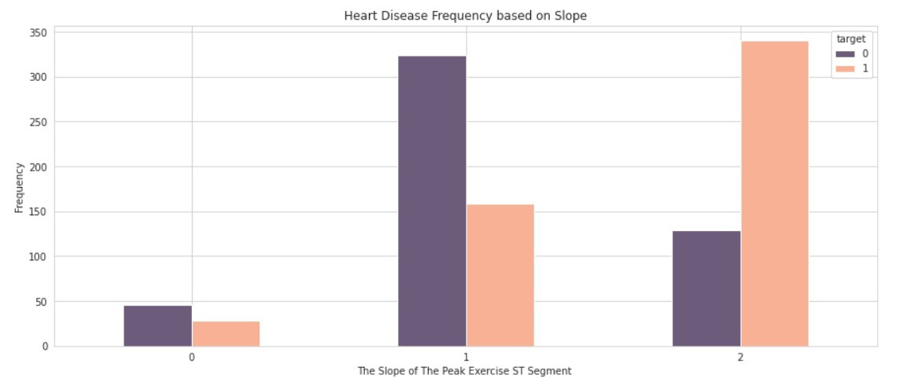
Screenshots:
Heart Disease Frequency based on ST slope

Slide 24
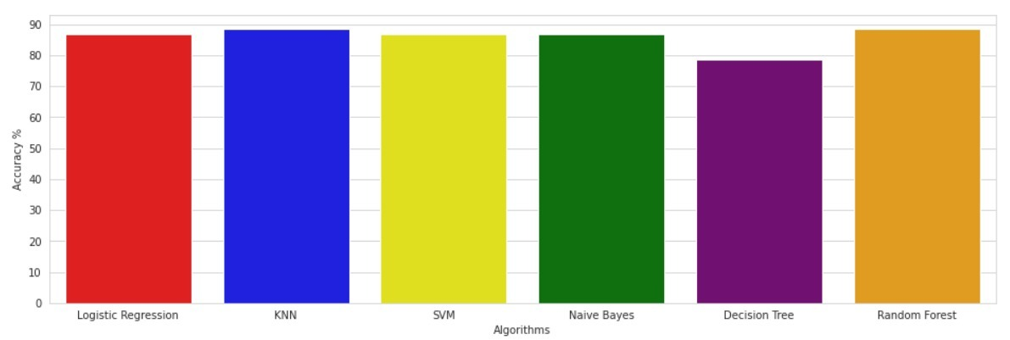
Screenshots:
Bar Graph for Heart Disease Accuracy by various Algorithms

Slide 25
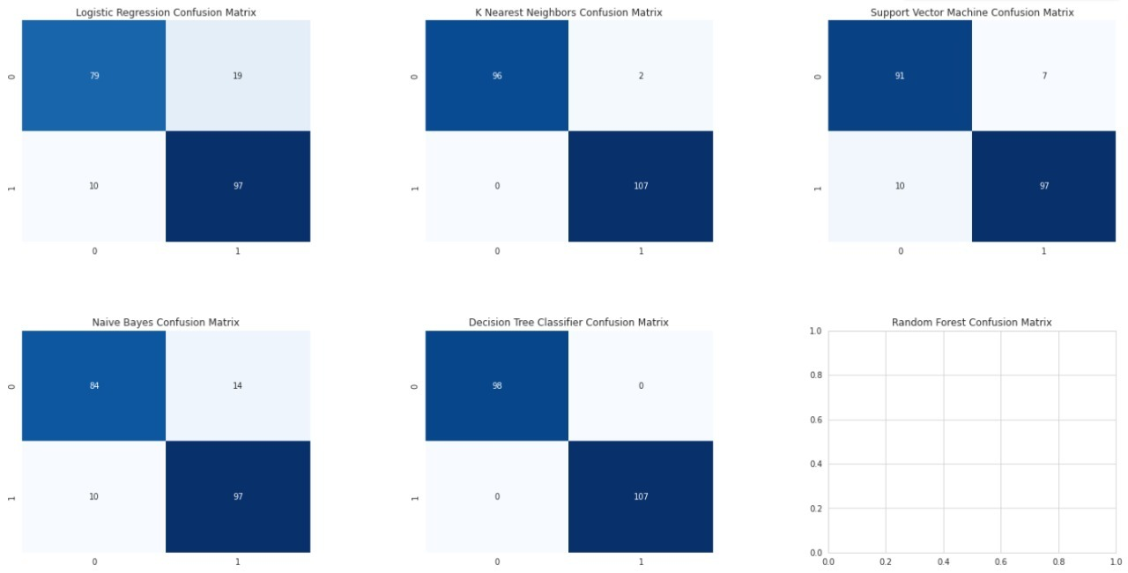
Screenshots:
Confusion Matrix for various Algorithms

Slide 26
Software and Hardware Requirements
Software Requirements – Google Colab
Hardware requirements – Internet Connectivity Intel i5 Processor (min)
RAM – 4 GB (min)

Slide 27
References
[1] Jayshril S. Sonawane, D.R Patil, 2014, “ Prediction Of Heart Disease Using Multilayer Perceptron Neural Network ”, IEEE International Conference on Information Communication and Embedded Systems (ICICES2014).
[2]I Ketut Agung Enriko, Muhammad Suryanegara,Dinda Agnes Gunawan, “ Heart disease prediction system using k-Nearest neighbor algorithm with simplified patient's health parameters”, 2016.
[3] M. Akhil Jabbar; B. L Deekshatulu; Priti Chandra, “ Heart disease prediction using lazy associative classification”, : 2013, IEEE International Mutli-Conference on Automation, Computing, Communication, Control and Compressed Sensing (iMac4s).
[4] Jaymin Patel, Prof. Tejal Upadhyay, and Dr. Samir Patel, Sep 2015-Mar 2016, “Heart Disease Prediction using Machine Learning and Data Mining Technique”, Vol. 7, No.1, pp. 129-137.
[5] Rifki Wijaya, ArySetijadiPrihatmanto, Kuspriyanto, “ Preliminary design of estimation heart disease by using machine learning ANN within one year”, 2013, IEEE Joint International Conference on Rural Information & Communication Technology and Electric-Vehicle Technology (rICT&ICeV-T).

Slide 28
References
[6] Carlos Ordonez,2006, “Association Rule Discovery with the Train and Test Approach for Heart Disease Prediction”, IEEE Transactions on Information Technology in Biomedicine (TITB), pp. 334-343, vol. 10, no. 2.
[7] Jyoti Soni, Uzma Ansari, Dipesh Sharma, and SunitaSoni,June 2011, “Intelligent and Effective Heart Disease Prediction System using Weighted Associative Classifiers”, International Journal on Computer Science and Engineering (IJCSE), Vol. 3, No. 6, pp. 2385-2392.
[8] IbticemeSedielmaci; F. BereksiReguig, “ Detection of some heart diseases using fractal dimension and chaos theory”, 2013, IEEE 8th International Workshop on Systems, Signal Processing and their Applications (WoSSPA).
[9] Jayshril S. Sonawane; D. R. Patil, “ Prediction of Heart Disease Using Learning Vector Quantization Algorithm ”, 2014, IEEE Conference on IT in Business, Industry and Government (CSIBIG).
[10] AH Chen, SY Huang, PS Hong, CH Cheng, and EJ Lin,2011, “HDPS: Heart Disease Prediction System”, Computing in Cardiology, ISSN: 0276-6574, pp.557- 560.

Slide 29
References
[11] Anbarasi Masilamani, ANUPRIYA, N Ch Sriman Narayana Iyenger, “Enhanced Prediction of Heart Disease with Feature Subset Selection using Genetic Algorithm”, October 2010, International Journal of Engineering Science and Technology 2(10).
[12] Manpreet Singh, Levi Monteiro Martins, Patrick Joanis, and Vijay K. Mago,2016, “Building a Cardiovascular Disease Predictive Model using Structural Equation Model & Fuzzy Cognitive Map”, IEEE International Conference on Fuzzy Systems (FUZZ), pp. 1377-1382.
[13] Kathleen H. Miao, Julia H. Miao, “Coronary Heart Disease Diagnosis using Deep Neural Networks ”,(IJACSA)International Journal of Advanced Computer Science and Applications, Vol. 9, No. 10, 2018 .
[14] Jae Kwon Kim and Sanggil, “Neural Network-Based Coronary Heart Disease Risk Prediction Using Feature Correlation Analysis”, 2017.
[15] Sairabi H. Mujawar, and P. R. Devale, October 2015,“Prediction of Heart Disease using Modified k-means and by using Naive Bayes”, International Journal of Innovative Research in Computer and Communication Engineering(An ISO 3297: 2007 Certified Organization) Vol. 3, Issue 10, pp. 10265-10273.

Slide 30
References
[16] B Padmaja, V V Rama Prasad, K V N Sunitha (2016), “TreeNet analysis of human stress behavior using socio-mobile data,” in Journal of Big Data, 3(1), pp. 1-15, 2016, Springer.
[17] B Padmaja, Myneni Madhu Bala, E Krishna Rao Patro (2020), “A Comparison on visual prediction models for MAMO(multi activity multi-object) recognition using Deep Learning,” in Journal of Big Data, 7(24), pp. 1-15, Springer.
[18] B Padmaja, V V Rama Prasad, K V N Sunitha (2020), “ A Novel Random Split Point Procedure using Extremely Randomized Trees Ensemble Method for Human Activity Recognition,” in EAI Endorsed transactions on Pervasive Health and Technology, 6(22), PP. 1-10.
[19] B Padmaja, V V Rama Prasad, K V N Sunitha (2018), “Machine Learning Approach for Stress Detection using Wireless Physical Activity Tracker,” in International Journal of Machine Learning and Computing, 8(1), pp. 33-38.

Slide 31
Online course details
S.No | Course Title with Duration | Platform | Status
19BCS089 | Machine Learning A-Z: Become Kaggle Master | Udemy | 100%
19BCS093 | Complete Machine Learning & Data Science Bootcamp 2022 | Udemy | 100%
19BCS107 | Machine Learning A-Z™: Hands-On Python & R in Data Science | Udemy | 100%

Slide 32

Online course Certification

Slide 33
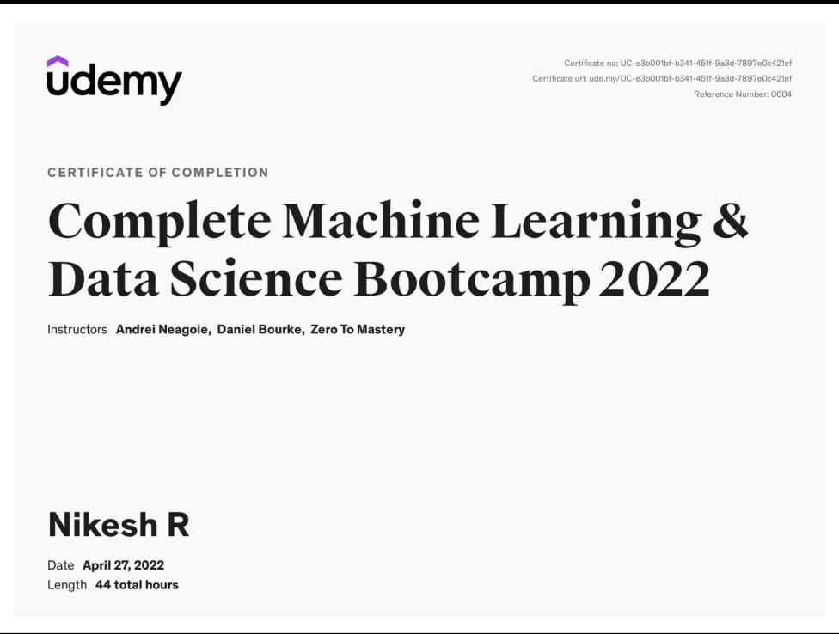
Online course Certification

Slide 34

Online course Certification

Slide 35
Project Content/ Journals Identified
[1] JETIR - Journal of Emerging Technologies and Innovative Research
[2] IJCRT - International Journal of Creative Research Thoughts
[3] IJRAR - International Journal of Research and Analytical Reviews
[4] IJCSPUB - International Journal of Current Science
[5] IJNRD - International Journal of Novel Research and Development

Slide 36
Thank You!

