Slide 1
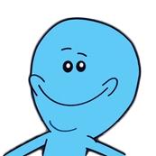
Special Needs
The Meeseeks
Notes:
We are the m
<number>

Slide 2
Problems faced by the Parents and community Members
“When you have a SN child, your child has more appointments than a White House secretary could probably manage” - Meyers , Seth
Events get mixed up
Constant feeling of not-knowing
More time searching for information than comprehending it
Notes:
It took a little product research to realize that parents of SN children are tremendously hard working even if they never show it.
- Constant attempt to find all the events scheduled
- More time trying to remember what is has happened, what is happening and what is going to happen through out your child's life
<number>

Slide 3
Target customer
The community* revolved around a child with special needs:
Parents
Care-takers
School
Medical Officials
Temporary (e.g. Baby-sitters, neighbors)
* This could also include people whom are involved in the lives of SN kids on a regular basis
Notes:
Important to realize that the target customers are the people that are involved in the child’s life. We call these people the community.
- app was meant to help all members of the community
- avoid overlapping planning
<number>

Slide 4
Our Solution
Create a platform that connects all community members
Store and find information easily under one roof
Facilitate planning for a child with special needs
Constant synchronization of information
Notes:
Our goal with this product was to create a platform for all member of a community to interacts.
It is important that the app is able to store and find vital information under one roof,
hence facilitating the planning for parents and community members.
Last but not least, we hope to provide a constant synchronization of
information for all parties involved in the caring of the child.
<number>

Slide 5
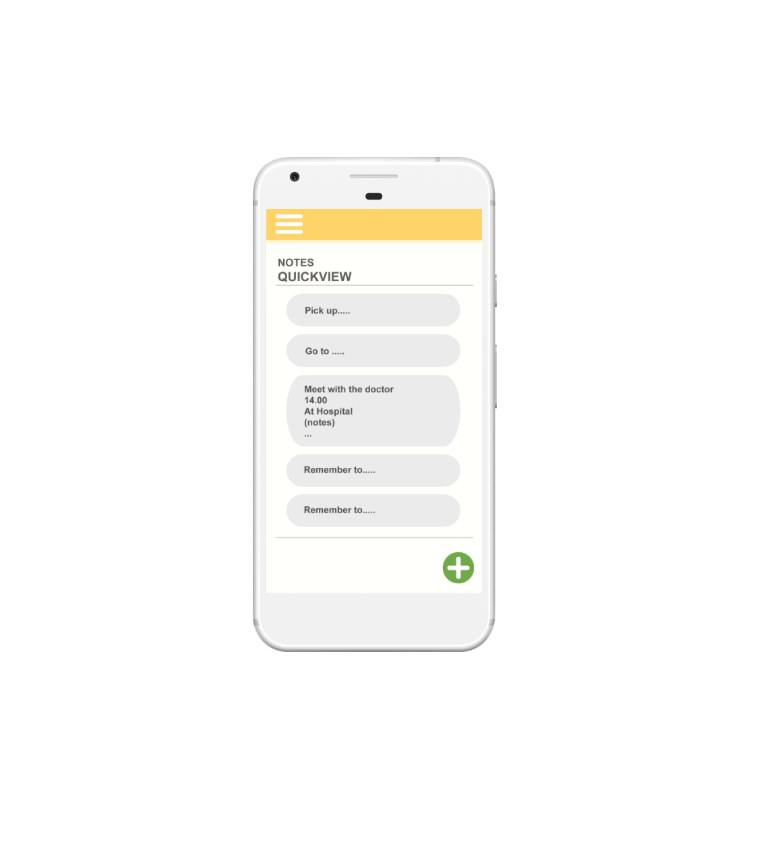
Concept
We envisioned an app with a simple, yet welcoming, interface that made navigation as simple as it had to be, for a difficult task.
Notes:
<number>

