Slide 1
Cold Chain Sensors
Joacim Gerdbo Andrey Prokopiev Adam Wamai Egesa Erdal Bejtula Robert Bärlin

Slide 2
How did we do it?
Gave up
Got inspired
Planned and found scope
Recruiting
Assumed positions
Act as sleeping is bad for you

Slide 3
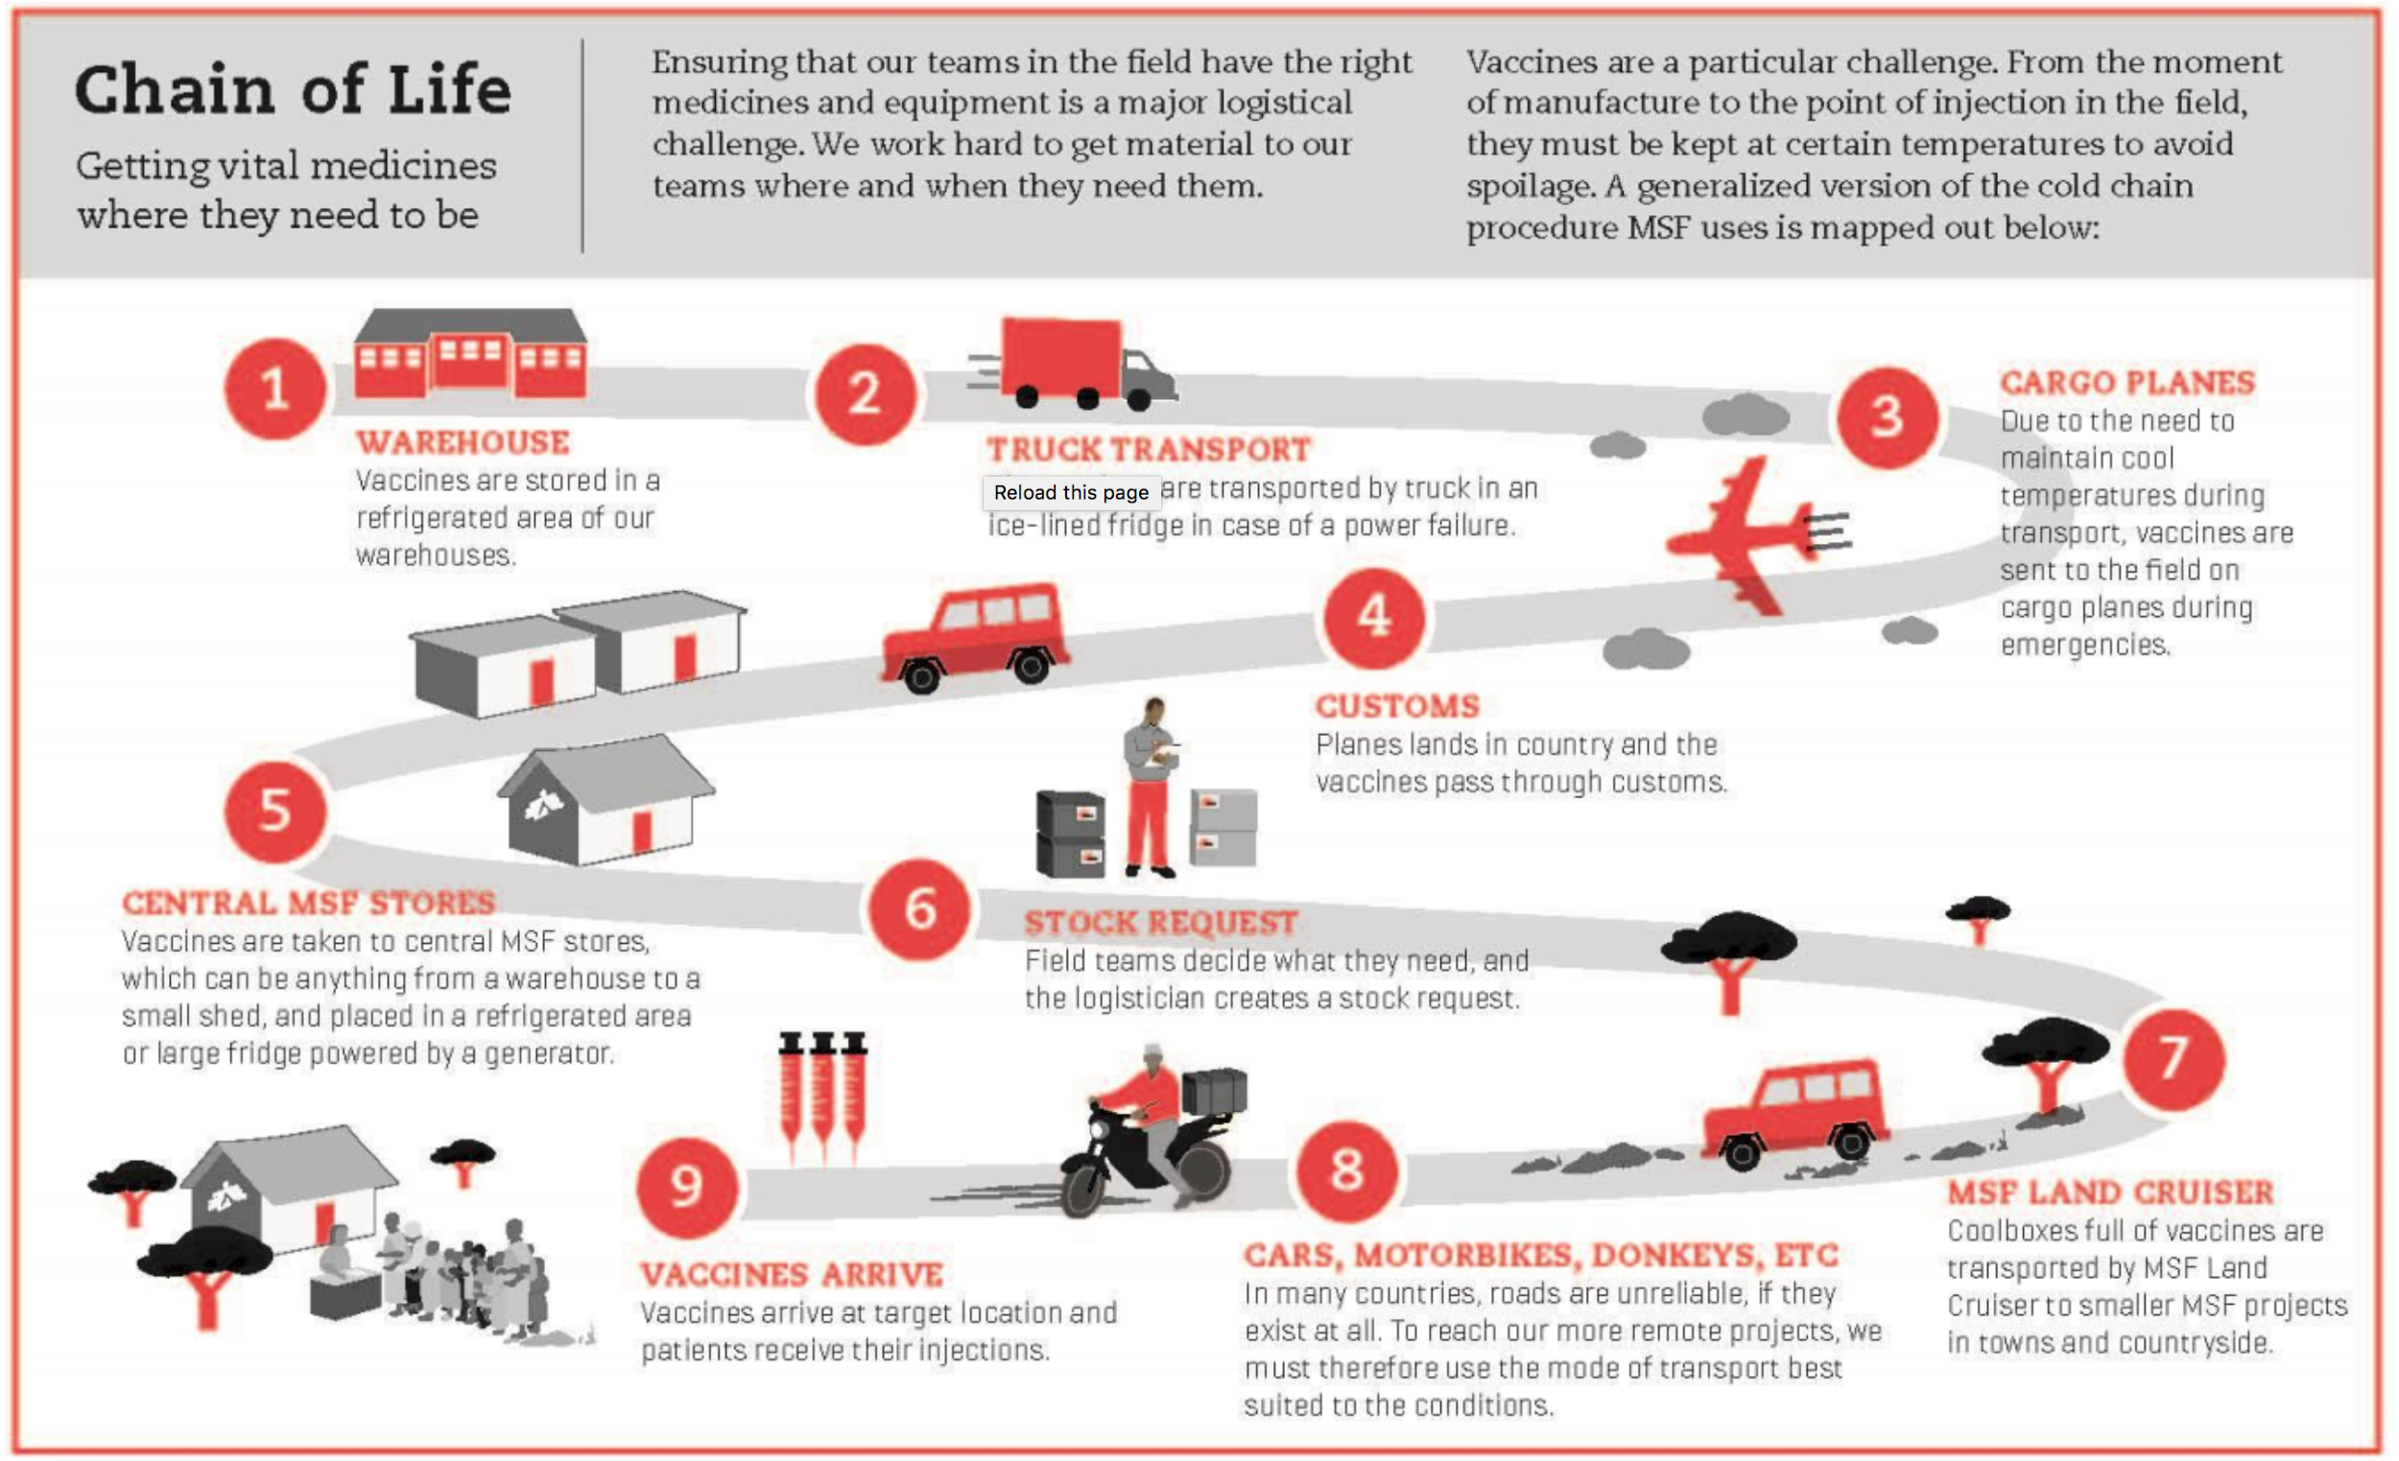
The Cold Chain

Slide 4
Problems
Some medicine needs a cold chain transportation - for example vaccine
Analog-type or no indication of temperature conditions during transportation
High number of spoiled medicine
Packed in large boxes with medicine with different requirements
Unnecessary loss of medicine

Slide 5
Goals of the project
Avoid supplying bad medicine to patients
Increase visability of transportation process
Provide system for early warning
Give a business user posibility to find bottlenecks or problem sites in chain process
Decrease the number of spoiled medicine

Slide 6
What we need
Measure temperature
Collect data
Save data
Display data
Inform users of hazardous levels

Slide 7






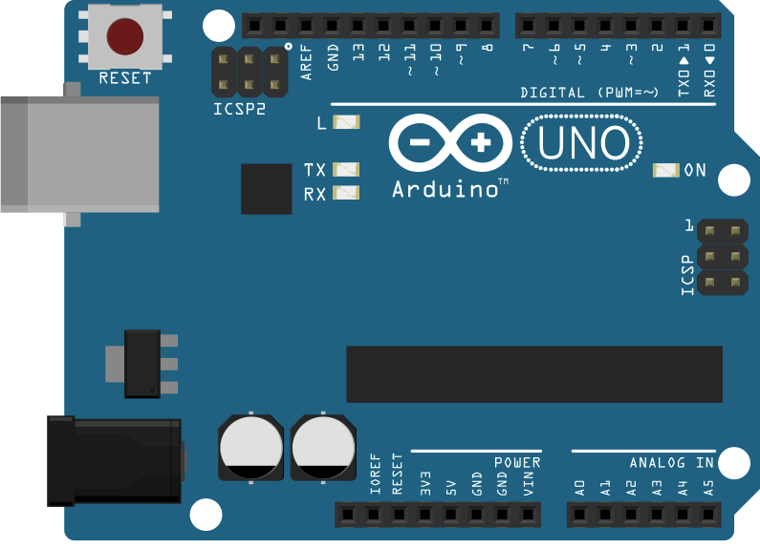












What goes where?
Medicine
Transport
BlueMix
User space
MySQL
Sensor
Graphs
Medicine
Web Client
Web API
Android
CloudantDB
Sensor
Twilio
IoT Foundation

Slide 8
Sensor device - Arduino
What can it do?
Send and receive data via Bluetooth
Read temperature
Change between rule-sets
Change status
Main components
Micro Pro - Arduino
BMP-180 - Sensor
HC-06 - Bluetooth

Slide 9
Gateway- Android
What can it do?
Bluetooth / Wifi / 3G
Communicates with Arduinos
Communicates with Go backend
Communicates with IoT Foundation

Slide 10
Web API - Go
What can it do?
Save sensor data
Compare sensor data to rule-set
Supply an endpoint for “static data”

Slide 11
Databases - MySql / Cloudant
What can it do?
MySql - saves “static” data
Cloudant - saves sensor data
Cloudant - can be an endpoint itself

Slide 12
Web client - Angular
What can it do?
Display medicine costs etc.
Display current temperature readings
Overall dashboard type web app
Notifications
Graphs - using D3

Slide 13
Notification Service - Node-RED / IoT Foundation
What can it do?
Communicating with MQTT
Twitter - Tweet
Twilio - SMS

Slide 14
Sensor device - Arduino
Future improvements?
Have improved communcations
Run effectively on battery
GPS
Local logs

Slide 15
Gateway- Android
Future improvements?
Save local data
Receive configurations
Phone app with user interface

Slide 16
Web based stuff - Web app / API
Future improvements?
Performance improvements
Extend API and Web client integration
Real infrastructure for notifications via sms
and more ...

Slide 17
Stuff we need
Node-RED
Bluemix
Twilio
IoT Foundation
Cloudant
(Hardware)

Slide 18
Team
-----------------------------------------------------
Joacim Gerdbo
Andrey Prokopiev
Adam Wamai Egesa
Erdal Bejtula
Robert Bärlin
Thanks for listening!
https://github.com/SevenStringArgs/ColdChainSensors

