Slide 1
Rymdkraftverk
Axel Ulmestig
Lorentz Lasson
Robert Bärlin
Simon Lagos
Torsten Hansson

Slide 2
Problem
Lack of transparency and feedback

Slide 3
Solution
CharityQ - treating donations as elements in queue
Notes:
Are aware money doesn’t really work that way, but we think the concept is helpful communicate charity spending to donors.

Slide 4
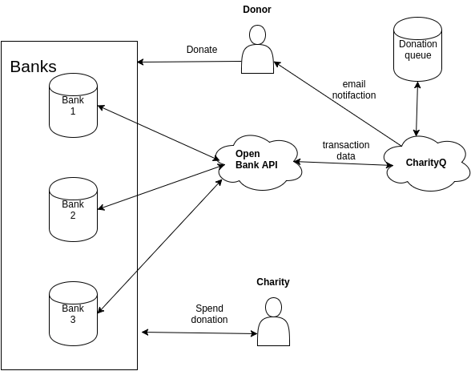
Solution
Notes:
Are aware money doesn’t really work that way, but we think the concept can still be helpful for donors to.

Slide 5
Todo
Login
trace your donations
enable donor based analytics
Notes:
Are aware money doesn’t really work that way, but we think the concept can still be helpful for donors to

