Slide 1
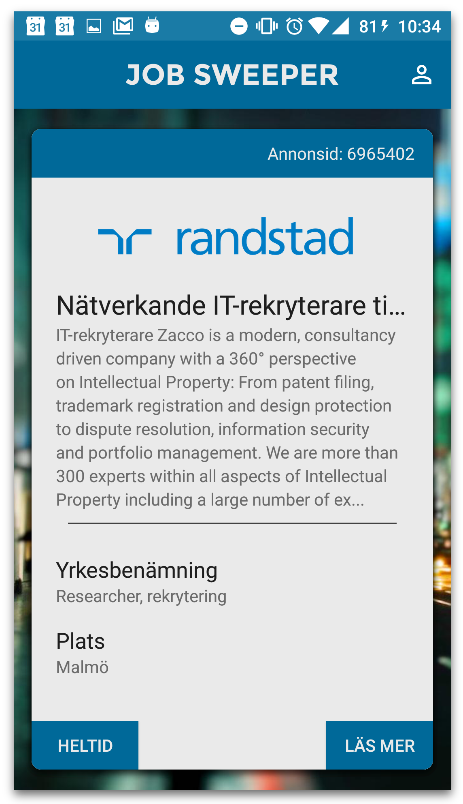

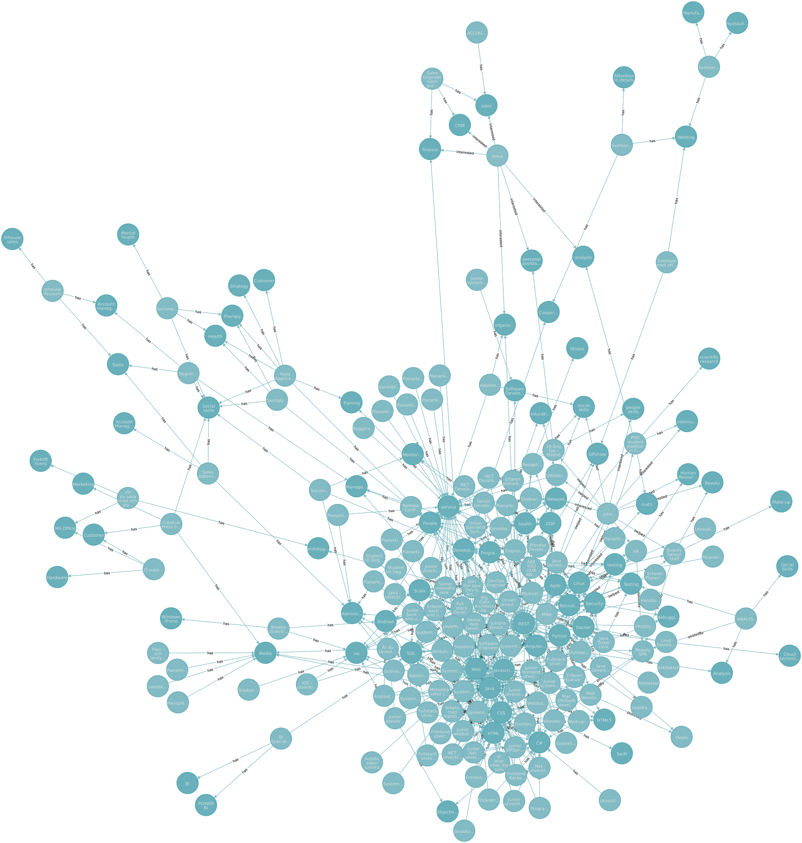
Jobsweeper
Victor
Sebastian
Felix
Carl
David
Adnan
Nick

Slide 2



Problems
Many people need a job
There are many employers that need people
Users are accustomed to getting recommendations, not actively filtering a large amount of data.

Slide 3

needs to be active in searching
investing time without guarantees
employers overwhelmed by applications
employers don’t get any feedback
jobseekers don’t get any answers
hard for AF to follow up on the job searches
users have different interpretation of keywords
Too many irrelevant jobs presented -> the matches are never found

Slide 4

JOB SEEKERS
MATCHES
JOBS AVAILABLE

Slide 5
Proposed Solution
User should put minimum effort into job search
Recommendations delivered to the user
Straightforward and quick application process
Job search centered around skills and competences
Each job has tags that reflect required competences
Each job seeker has a set of tags that represent possessed skills
Notes:
NEW

Slide 6
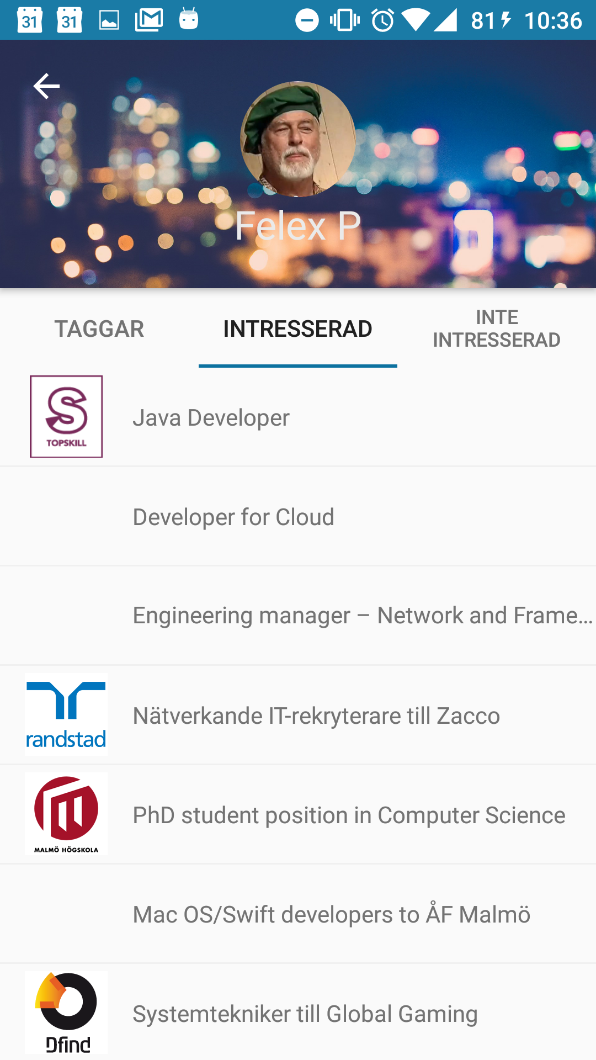
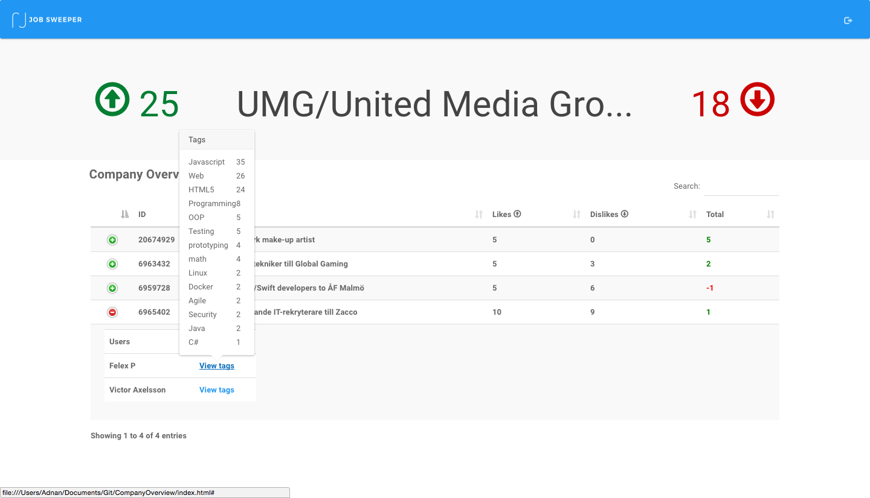
Platforms
App - Jobseekers
Website - Employers

Slide 7
Jobseeker app
Notes:
https://youtu.be/iO3a2xfJy5U
https://drive.google.com/file/d/0Bwq9E888Rq3oNWN5TUtNdEFmWEU/view?usp=sharing

Slide 8
Employer website
Notes:
https://youtu.be/iO3a2xfJy5U
https://drive.google.com/file/d/0Bwq9E888Rq3oNWN5TUtNdEFmWEU/view?usp=sharing

Slide 10

Architecture
Dashboard
(website)
Nodejs
(API)
Services from Arbetsförmedlingen
Recommendation Engine (API)
Android App
Neo4J
Graph DB

Slide 11
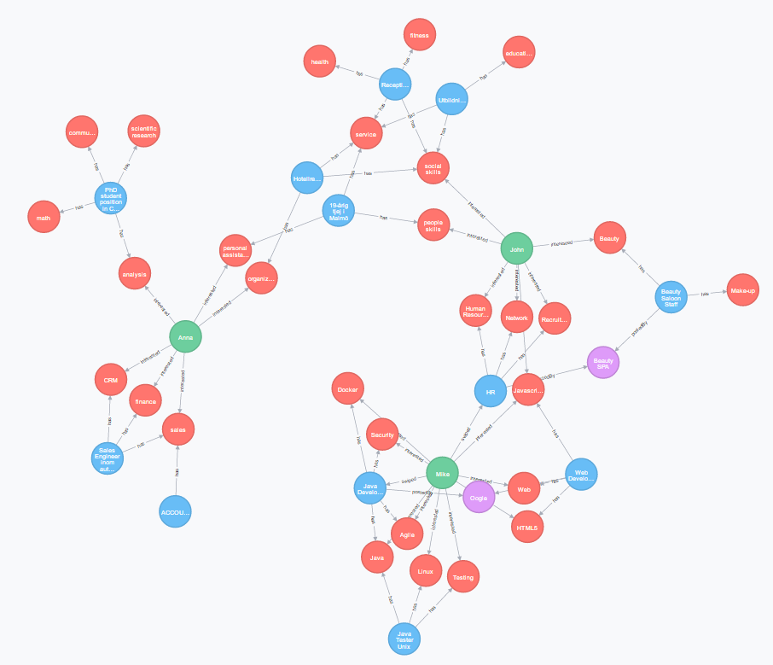
Blue: jobs
Red: tags
Green: users
Violett: employers

Slide 12
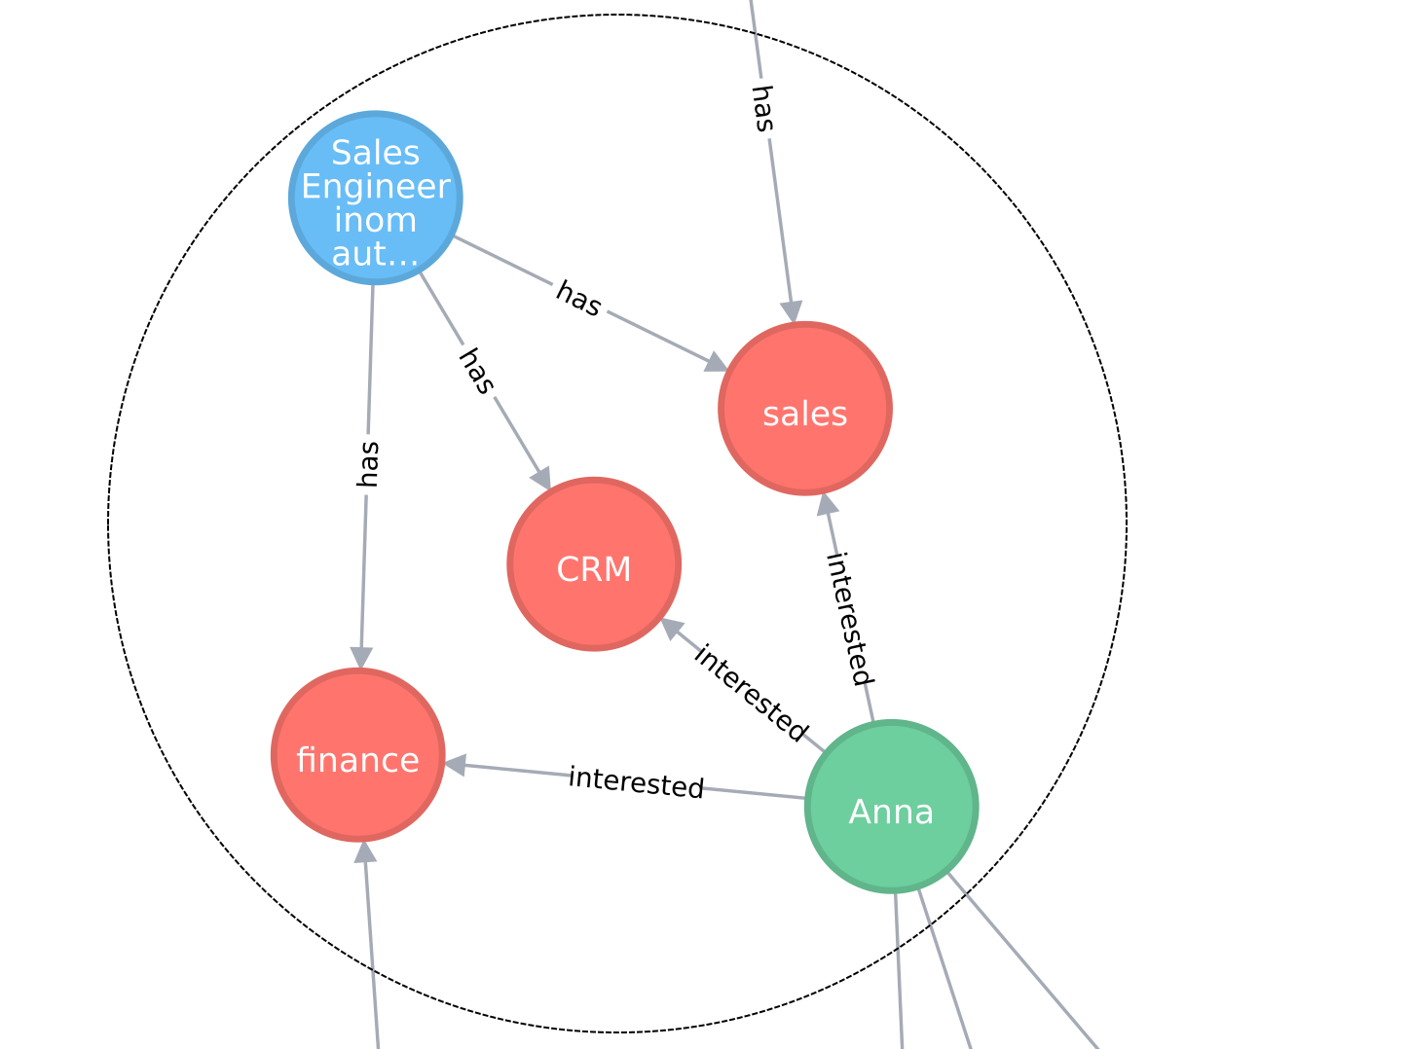

Slide 13
The employer dash board automatically notifies the job seekers about results.
Better startup in order to solve cold start problems for the recommendations.
Use of 1-2-5 year predictions on job market to recommend users jobs with better prospects
Improved recommendation based on qualifications
Using templates for responses from the employers to the ones that didn’t got the a swipe back
Throw random recommendation into the list, making the user thing outside its box
Integration educations, showing that a user might have benefits from taking some certificate or education
Log in with an Arbetsförmedlingen account. AF import data for the user.
Push notification for the users to speed up the process.
Refine tags to include part-time/full-time and location.
Integrate job prognoses and guiding the jobseeker.
Better keywords on the cards. Better job representation.
Integrate 3D visualization about a particular job.

Slide 14
Thanks! Come talk to us afterwards
Notes:
https://youtu.be/iO3a2xfJy5U
https://drive.google.com/file/d/0Bwq9E888Rq3oNWN5TUtNdEFmWEU/view?usp=sharing

