Slide 1
Morphemes Made possible by Huridocs
Johannes, Gabi, Daniel

Slide 2
The Case
Find evidence of structural gender discrimination in court documents from the Pacific.
Notes:
If we automatically could find evidency of structural gender discrimination it would be a really big deal. Then the same methods could be used to go through thousands and millions of documents and be able to put preassure on organizations and institutions where there is room for improvement. This would lead to a more inclusive world where all people are respected.

Slide 3
The Case
Find evidence of structural gender discrimination in court documents from the pacific.
7000 documents
600 from Domestic Violence and Sexual Assault
Semi structured dataset

Slide 4
GO!
Notes:
Aaaand GO!

Slide 5
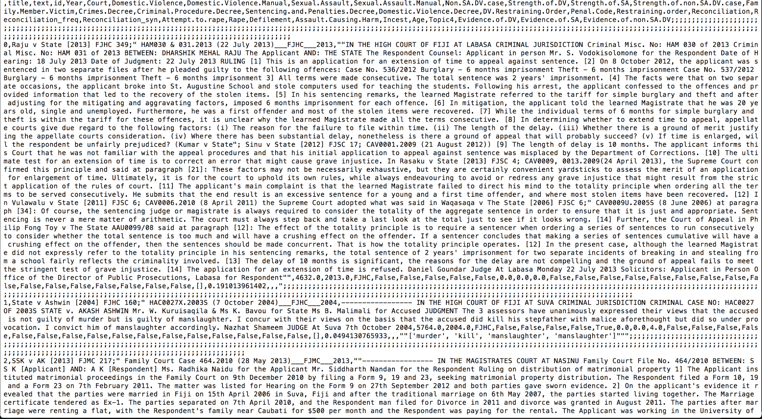
Notes:
Looking at the data.

Slide 6
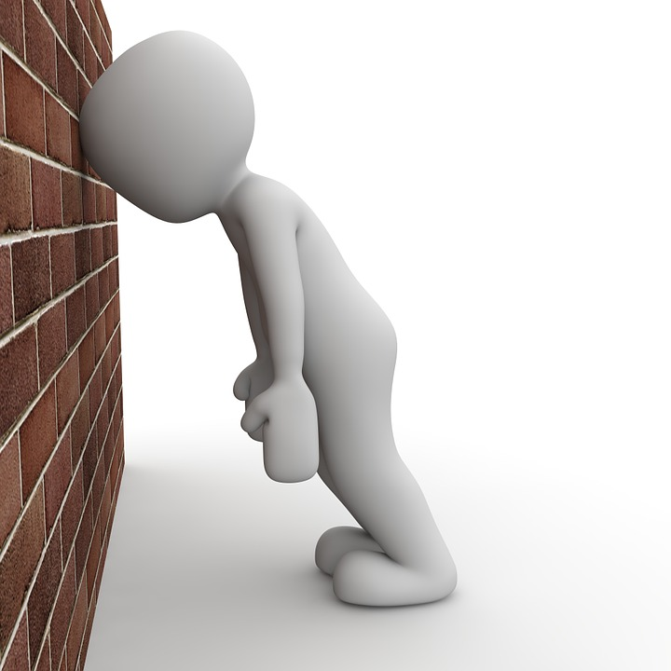
Notes:
It was hard and no obvious path going forward. Put much effort in exploration of the dataset and understanding the nuances of it. Structuring and cleaning was still needed.

Slide 7
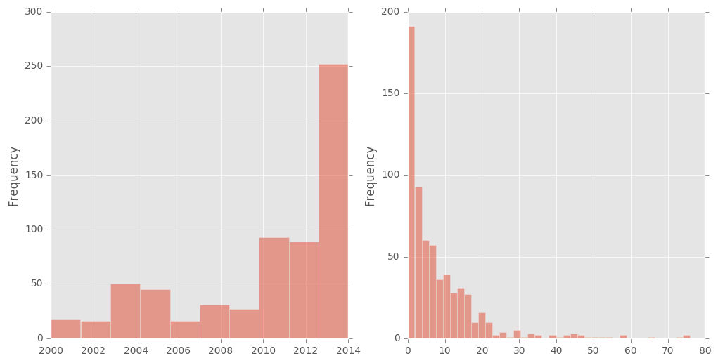
Histogram of court date and length of prison sentence

Slide 8
Our Contribution
Phrase matching on a discriminatory- and non-discriminatory-phraselist with weighted scores.
Giving each document a discriminatory score.
Notes:
The path we finally ended up on was based on Phrase matching on a discriminatory- and non-discriminatory-phraselist with weighted scores.
Giving each document a discriminatory score.

Slide 9
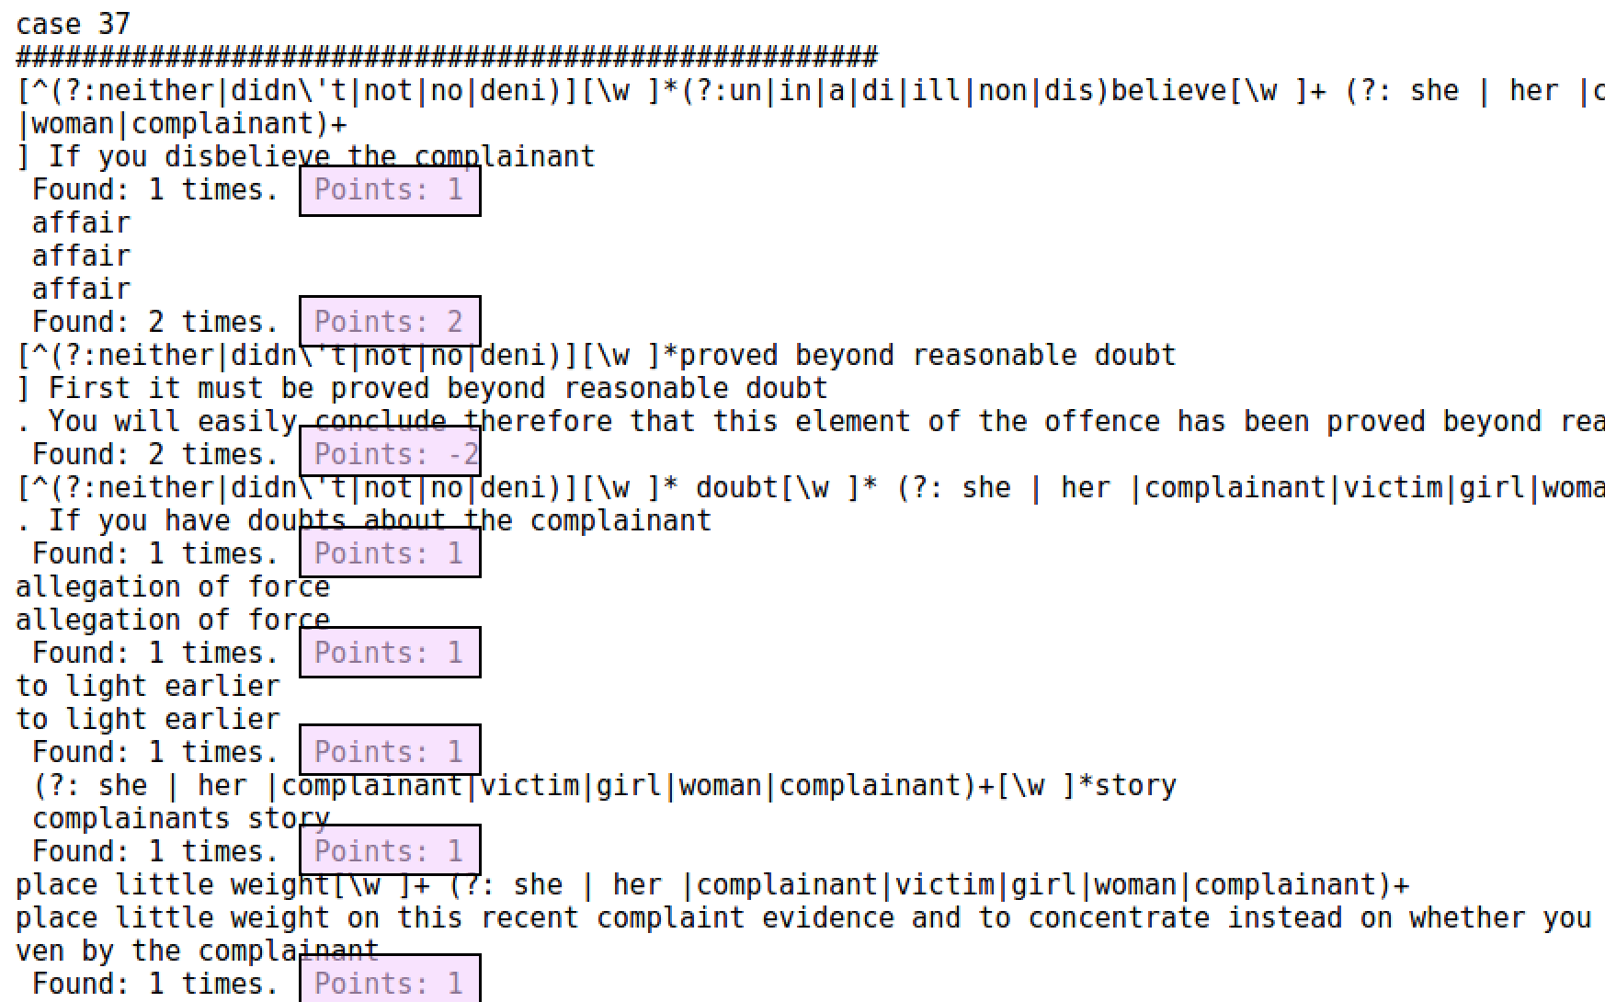

Slide 10
… But cool machine learning?
You need annotated data when the question is very specific. [1]
Citations: [1] Me, Now
Notes:
But what about the cool machine learning? Well, it depends a lot on the dataset. If you have a specific goal in mind, a very specific question you want answered. It is supervised learning you want and with supervised learning you need an annotated dataset.

Slide 11
So we built a data exploration- and annotation tool.

Slide 12
LIVE DEMO http://huridocs-openhack.azurewebsites.net/

Slide 13


LIVE DEMO http://huridocs-openhack.azurewebsites.net/

Slide 14
Thank you! Special thanks to Natalie from Huridocs

Slide 15
Thank you! Special thanks to Natalie from Huridocs And to the awesome OpenHack organizers!

