Slide 1
Multiplier effect in Humanitarian Aid
Cajsa-Lisa Ivarsson, Miriam Ahlberg, Josefin Lindström, Yang Zhao, Hampus Månefjord

Slide 2
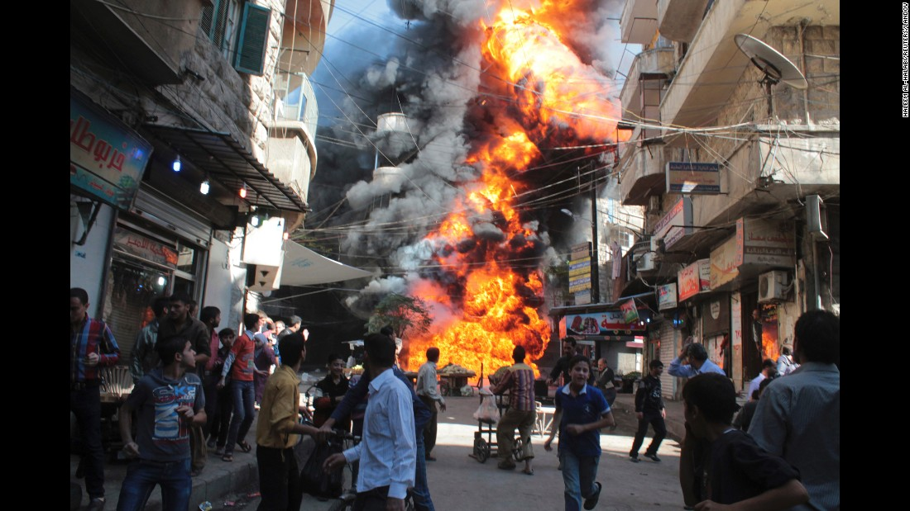
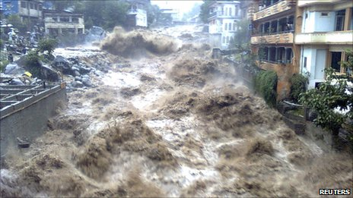
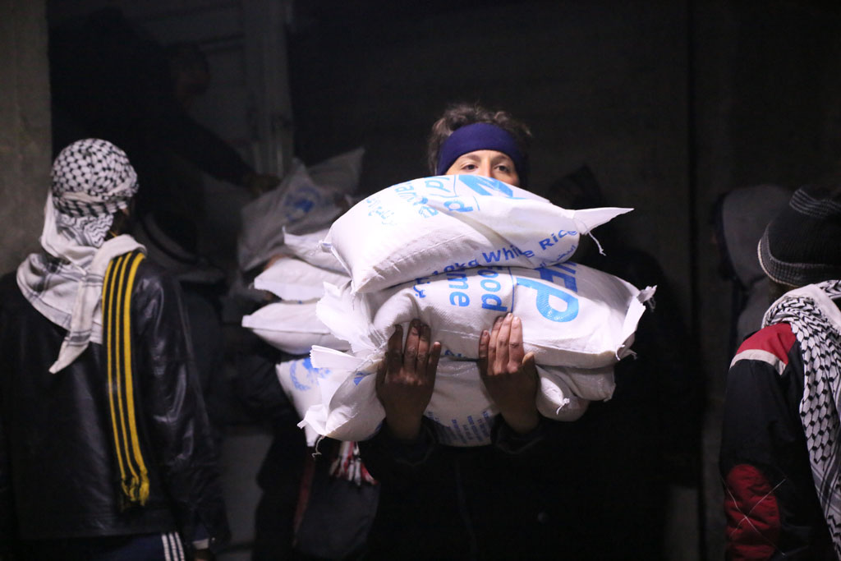
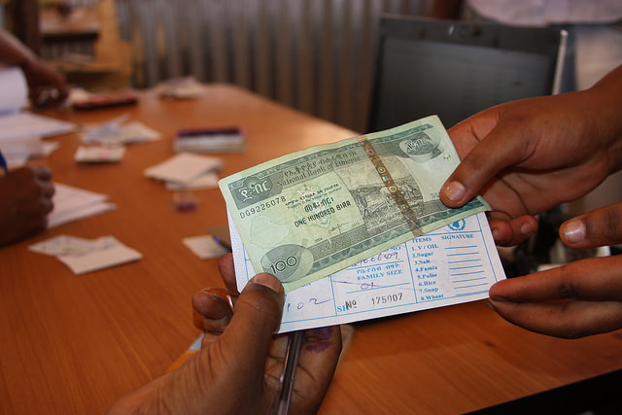
Calamity
20%
And
Aid Means
?
8%
VS

Slide 3
The Multiplier Effect
More jobs
Demand increases
f
Y=ME*A=(1/1-c)*A
(Y=economic benefit, c=propensity to consume locally-produced goods, A=amount of cash transfer)
Cash
Wage Increases
Supply Increases

Slide 4
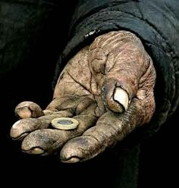
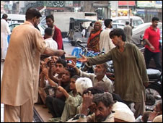
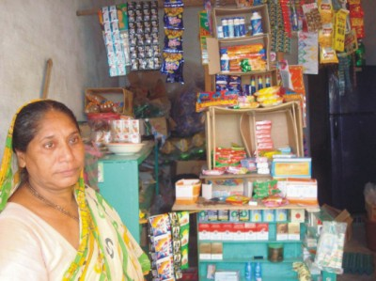
Behavior Profiles
Sa
The saver The spender The entrepreneur
Saves 60%
Spends 90% on the local market
Increases the local market functionality, especially in acute shock scenarios

Slide 5

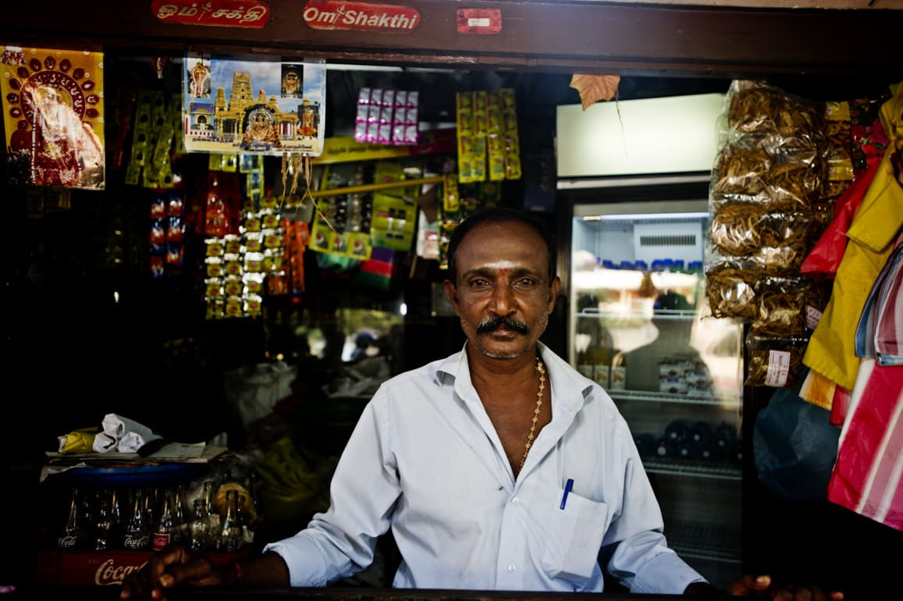
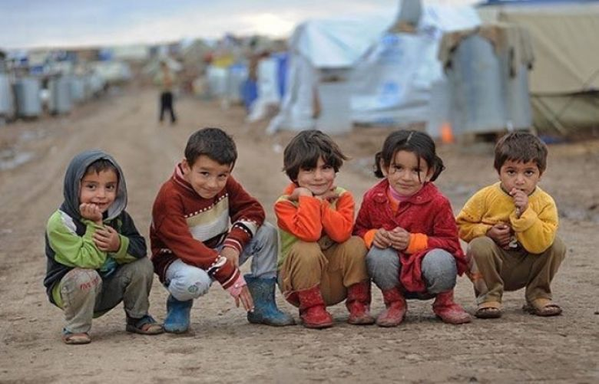
The importer The trader The non-contributor
Buys 90% from external market
Increases local market functionality
Need resources

Slide 6
Outcome
 | Scenarios | ME
Best case | Donation: large (> 100 $ per person) Community: large (> 50,000 people), stable Shock: not severe, not acute | 5.73
Most credible case | Donation: large Community: medium size, medium stable Shock: medium severe, not acute | 2.31
Worst case | Donation: small Community: small (< 2,000 people), unstable Shock: severe, acute | 1.34
Notes:
ME=2.31 <- this is close to literature value

Slide 7
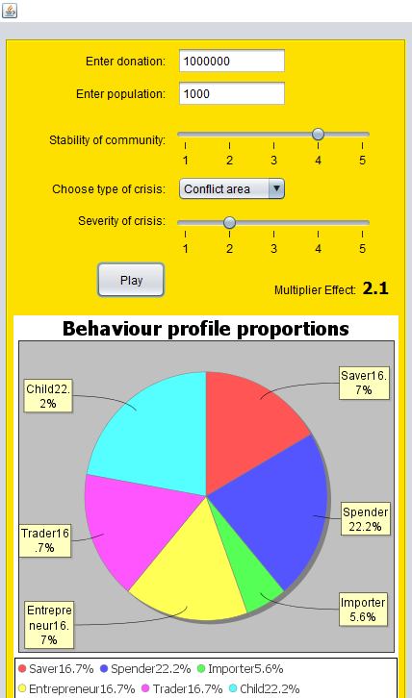
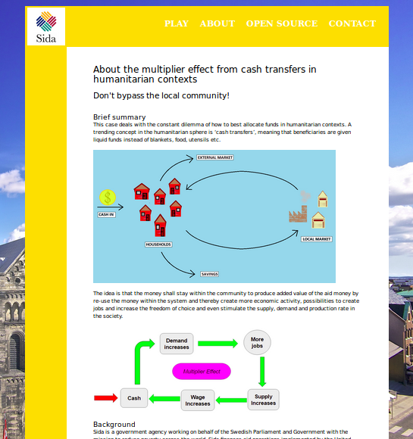
Tools created

Slide 8
Thanks for your attention!
We live in the world when we love it

