Slide 1

00. Introduction
BestFit
0
Notes:
Companies
Discrimination is prevalent even on the first layer of a recruitment process
Skill and experience centric assessment, not a value or unutilised strength
Job Seekers
Candidates may lack the knowledge of the “best fit” and may choose the companies based on reputation and perceived value

Slide 2
01. The Problem
Companies
Job Seekers
?
?
?
There is no clear method for companies to assess if a candidate is the
right fit…
BestFit
1
Notes:
Companies
Discrimination is prevalent even on the first layer of a recruitment process
Skill and experience centric assessment, not a value or unutilised strength
Job Seekers
Candidates may lack the knowledge of the “best fit” and may choose the companies based on reputation and perceived value

Slide 3


02. Existing Solutions
Traditional CVs
Interviews
Traditional CVs used as the first layer of filter for a recruitment process
Traditional Interviews are limited in their ability to assess their qualities
These are usually not indicative enough of whether you can work well in an organization for the long run.
BestFit
2
Notes:
Companies
Discrimination is prevalent even on the first layer of a recruitment process
Skill and experience centric assessment, not a value or unutilised strength
Job Seekers
Candidates may lack the knowledge of the “best fit” and may choose the companies based on reputation and perceived value

Slide 4
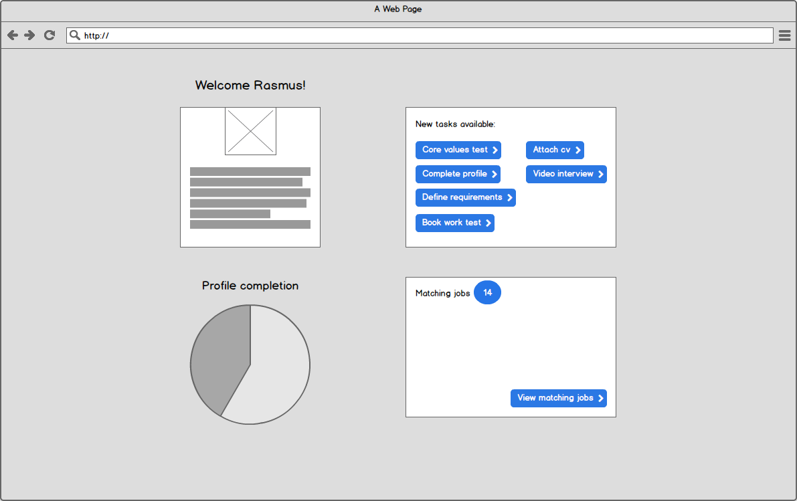
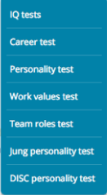
03. Our Solution
Summarize up here how you intend on making money.
Use the icons / sections below to provide additional detail.
SaaS
Ads
Affiliate
Traditional CVs used as the first layer of filter for a recruitment process
Traditional Interviews are limited in their ability to assess their qualities
These are usually not indicative enough of whether you can work well in an organization for the long run.
BestFit
3

Slide 5
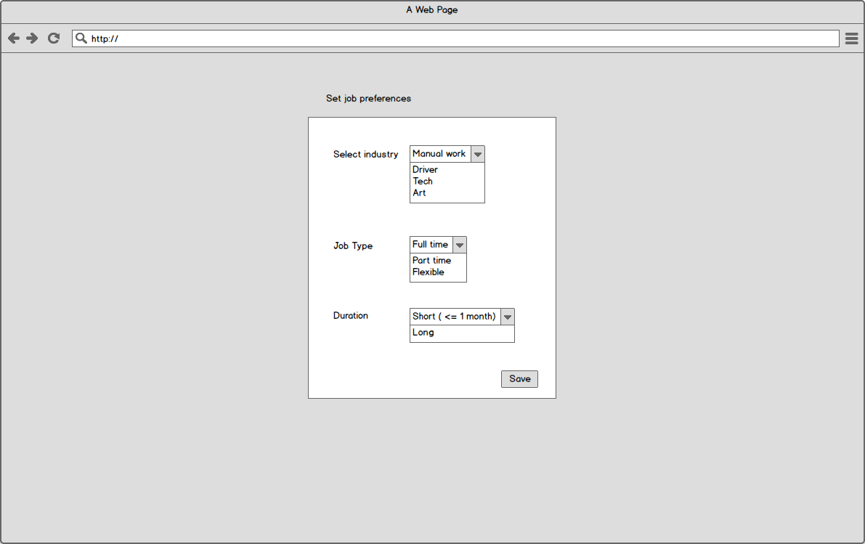
03. Our Solution
Summarize up here how you intend on making money.
Use the icons / sections below to provide additional detail.
SaaS
Ads
Affiliate
Traditional CVs used as the first layer of filter for a recruitment process
Traditional Interviews are limited in their ability to assess their qualities
These are usually not indicative enough of whether you can work well in an organization for the long run.
BestFit
4

Slide 6
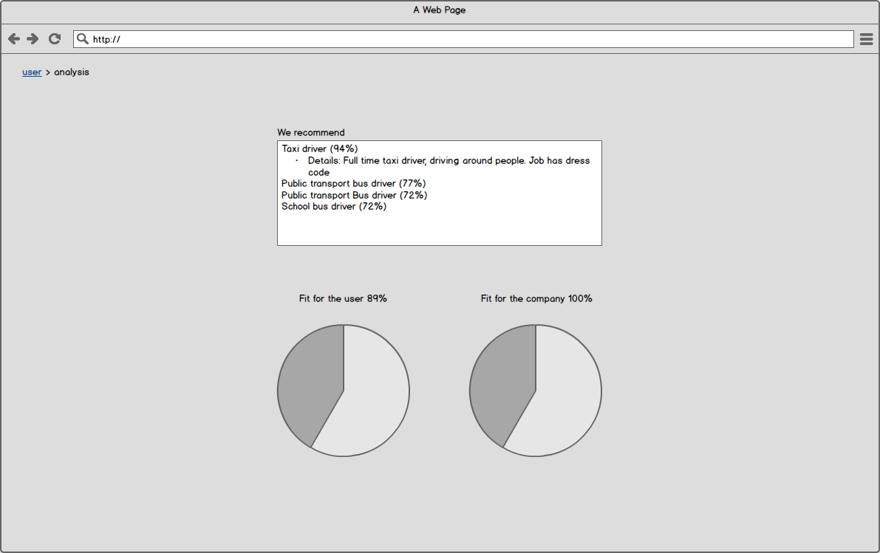
03. Our Solution
Summarize up here how you intend on making money.
Use the icons / sections below to provide additional detail.
SaaS
Ads
Affiliate
Traditional CVs used as the first layer of filter for a recruitment process
Traditional Interviews are limited in their ability to assess their qualities
These are usually not indicative enough of whether you can work well in an organization for the long run.
BestFit
5

Slide 7
04. Conclusion
Our solution aims to achieve the best organizational fit between companies and job seekers. It also steers the organizational mindset towards the direction of eradicating discrimination in recruitment.
BestFit
6

