Slide 1
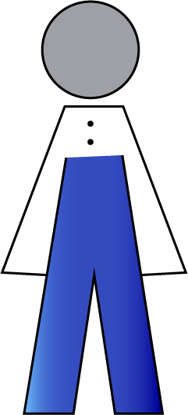
Wojciech
From Kosova
Degree in Chemistry
Recently arrived in Sweden

Slide 2



Slide 3

Which jobs in Sweden
match Wojciechs profile?
Does he need to
complement his degree?

Slide 4


Slide 5

Area
Chemistry

Slide 6
Area
Chemistry
Chemistry

Slide 7
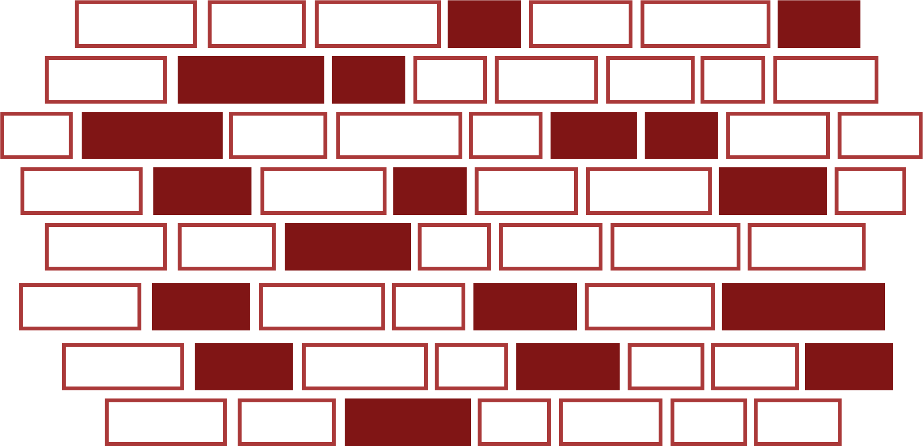

Skills

Slide 8


Top matches
97%
match
Analytical chemist
Skills you lack:
84%
Prognosis:
match
Lab technician
56%
match
Post doc

Slide 9




Job Ads
Field
Profession
Natural Language
Understanding
Keywords
{word: “Leadership”, occurrences: 3}

Slide 10
Notes:
http://ateam.eu-central-1.elasticbeanstalk.com/openHack/
<number>

