Slide 1

Anonymising the job seeking process

Slide 2
Discrimination
Hidden biases
Business insider
Harder to get jobs for foreign born applicants
SCB
Jobs are important for integration

Slide 3
Finding a solution
How to remove discrimination
Focus
Companies and applicants equally important

Slide 4
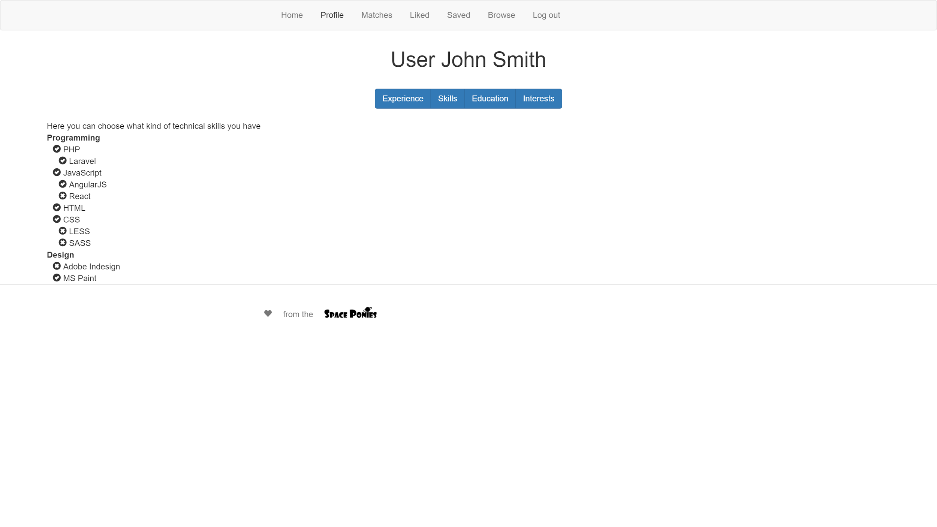

Slide 5
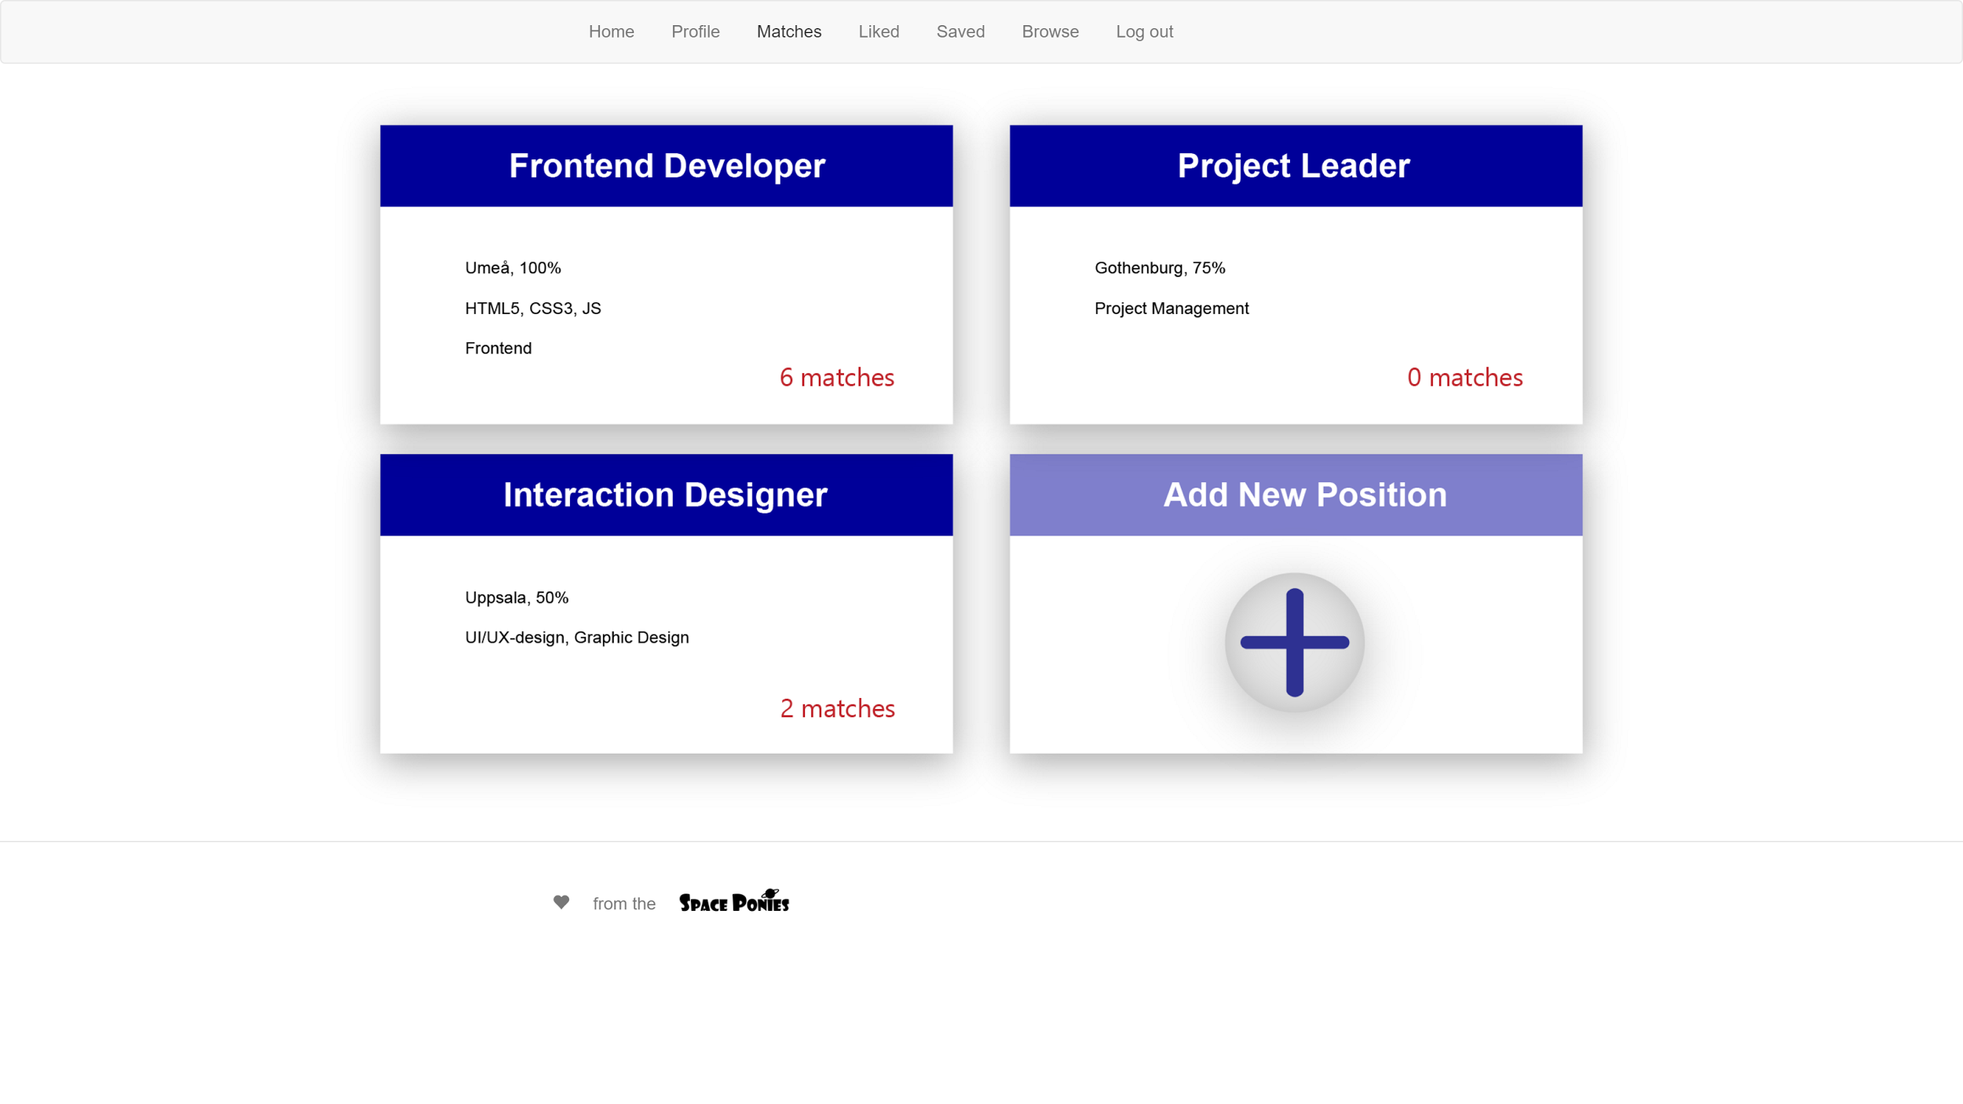

Slide 6
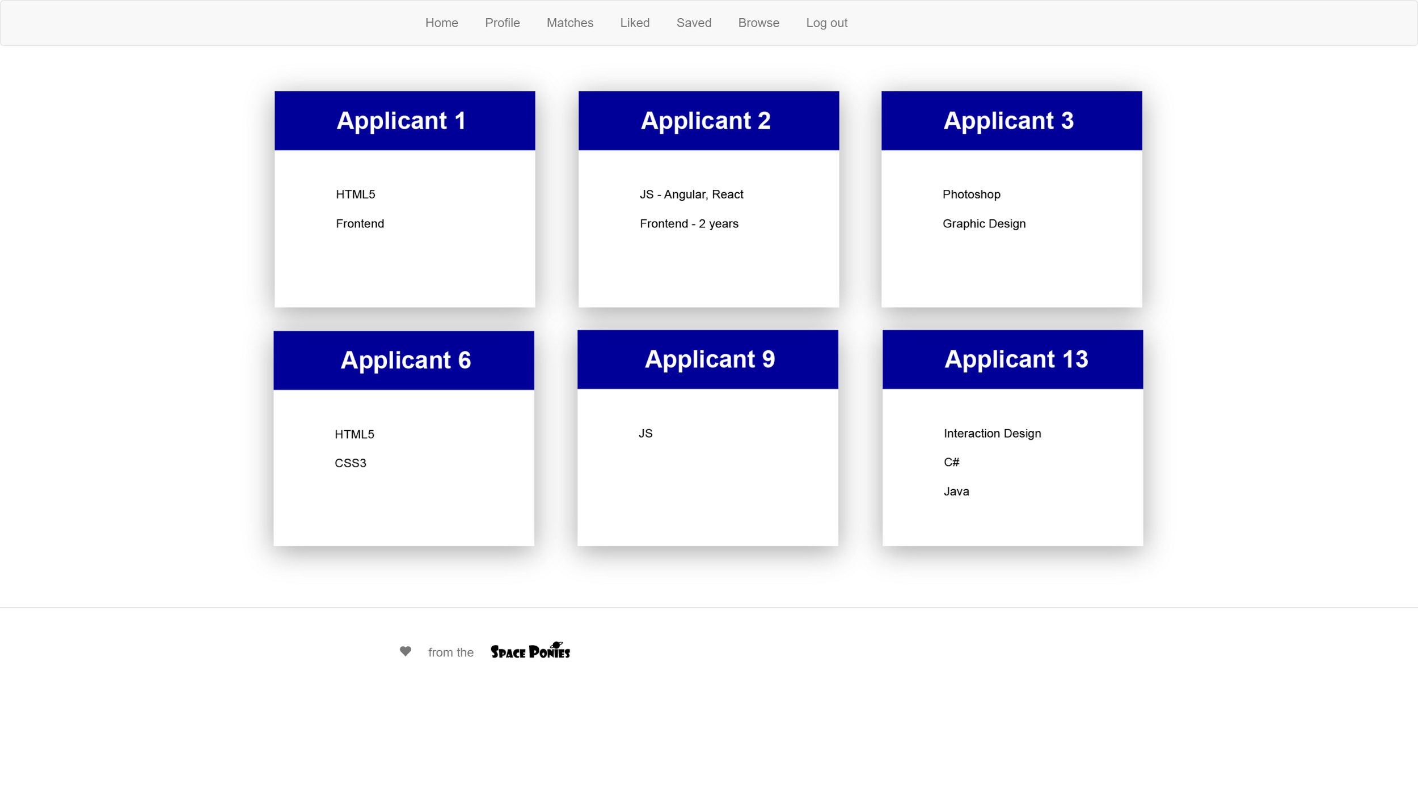

Slide 7
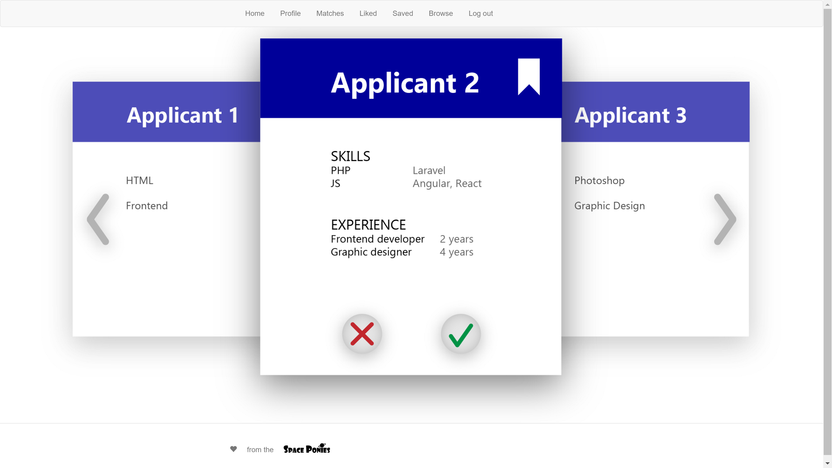

Slide 8


Slide 9
Thank you!

