Slide 1

Muscular Pain
Presented by Nikunj

Slide 2
Table of Contents
1. Introduction to Muscular Pain
2. Causes of Muscular Pain
3. Symptoms and Diagnosis
4. Treatment Options
5. Prevention and Management

Slide 3

Introduction to Muscular Pain
Muscular pain, also known as myalgia, is a common condition that affects many individuals at some point in their lives. It can range from mild discomfort to severe pain, impacting daily activities and quality of life. Muscular pain can be caused by various factors, including injury, overuse, tension, and certain medical conditions. Understanding the underlying causes and effective treatments is crucial for managing and alleviating muscular pain.

Slide 4
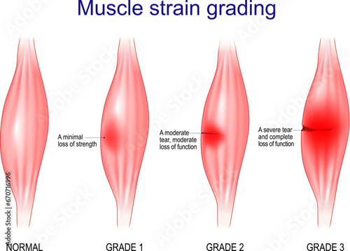
Causes of Muscular Pain
Muscular pain can be triggered by a variety of factors. Common causes include muscle strain or injury, which can occur during physical activities or accidents. Overuse of muscles, such as repetitive motions or prolonged exertion, can also lead to pain. Additionally, medical conditions like fibromyalgia, infections, and autoimmune disorders can cause widespread muscular pain. Identifying the specific cause is essential for appropriate treatment and management.

Slide 5
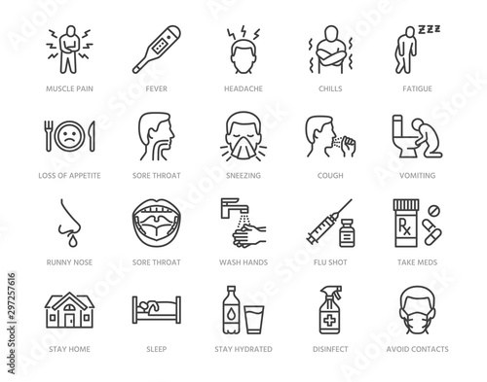
Symptoms and Diagnosis
The symptoms of muscular pain can vary depending on the cause and severity. Common symptoms include localized pain, stiffness, swelling, and tenderness in the affected muscle. In some cases, individuals may experience muscle spasms or cramps. Diagnosing the cause of muscular pain typically involves a physical examination, review of medical history, and possibly imaging tests such as X-rays or MRI scans. Blood tests may also be conducted to rule out underlying conditions.

Slide 6
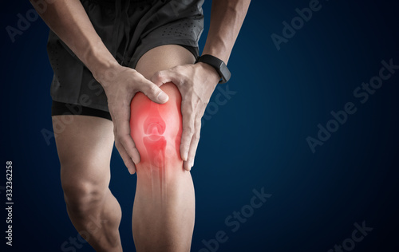
Treatment Options
Treatment for muscular pain depends on the underlying cause and severity of the pain. Mild to moderate pain can often be managed with rest, ice or heat application, and over-the-counter pain relievers such as ibuprofen or acetaminophen. Physical therapy and exercises to strengthen and stretch the muscles can also be beneficial. For more severe or chronic pain, a healthcare provider may recommend prescription medications, corticosteroid injections, or other interventions.

Slide 7

Prevention and Management
Preventing muscular pain involves adopting healthy lifestyle habits and practices. Regular exercise, proper warm-up and cool-down routines, and maintaining good posture can help prevent muscle strain and injury. Staying hydrated and ensuring adequate nutrition, including sufficient intake of vitamins and minerals, supports muscle health. For those experiencing chronic muscular pain, ongoing management strategies such as stress reduction techniques, ergonomic adjustments, and regular medical check-ups are important for maintaining overall well-being.

Slide 8
Thank You

