Slide 1

Diagnostic Tools of ICT
Ensuring Optimal Performance and Troubleshooting
Hildana Goyatom
12 of May 2024

Slide 2

Introduction to ICT Diagnostic Tools
What are ICT Diagnostic Tools?
• Tools, techniques, and software used to identify, analyze, and resolve problems within ICT systems.
Importance of ICT Diagnostic Tools:
• Minimize downtime and disruptions
• Improve system performance and reliability
• Enhance security by identifying vulnerabilities
• Facilitate efficient troubleshooting
• Enable proactive maintenance

Slide 3

Hardware Diagnostic Tools
Internal Hardware Tools:
• POST (Power-On Self-Test)
• Multimeters
• Logic Probes
External Hardware Tools:
• Cable testers
• Hard drive testers
• RAM testers

Slide 4

Software Diagnostic Tools
System Monitoring Tools:
• OS Utilities (Task Manager, Resource Monitor)
• Third-party system monitoring tools
Network Analysis Tools:
• ping
• traceroute/tracert
• Wireshark
• nslookup/dig

Slide 5
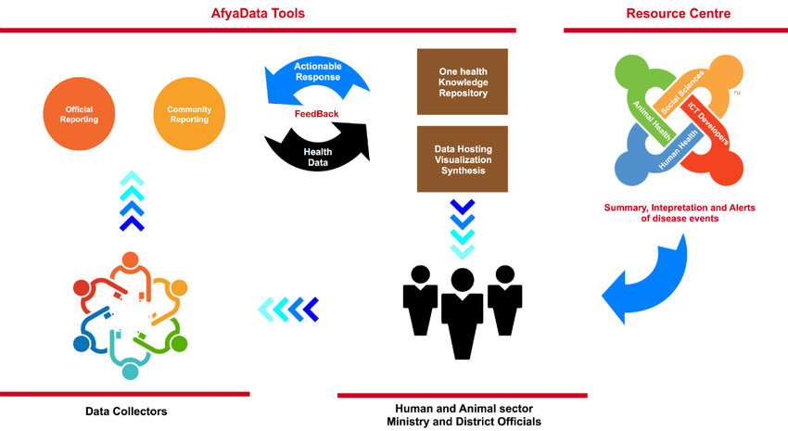
Examples and Applications of ICT Diagnostic Tools
Network Troubleshooting:
• ping, traceroute, Wireshark
System Performance Optimization:
• Monitor CPU, memory, disk I/O
Security Diagnostics:
• Vulnerability scanners, IDS/IPS
Hardware Diagnostics:
• Memtest86, SMART

Slide 6

Emerging Trends and Conclusion
Emerging Trends:
• AI and ML for predictive diagnostics
• Cloud-based remote diagnostics
• IoT monitoring and analysis
Conclusion:
• Diagnostic tools ensure proactive problem-solving
• Minimize downtime, enhance performance
• Stay current with emerging trends

