Slide 1
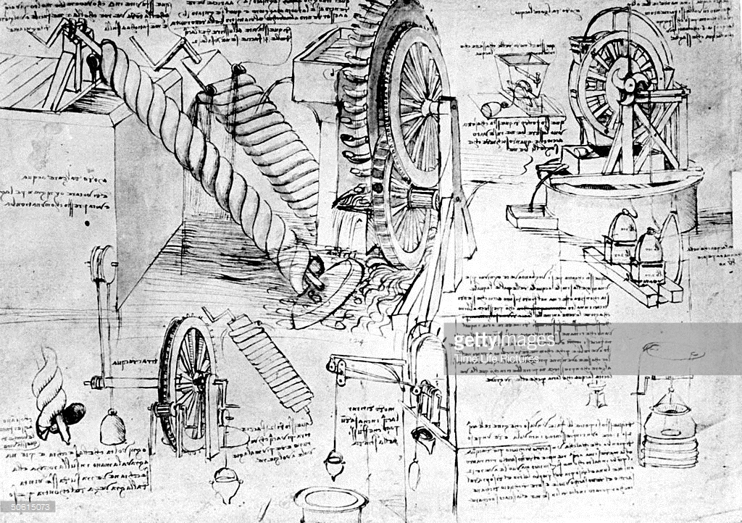


SCCore Architecture Integration platform
Last version of this document is available @:
https://spirit.sanofi.com/cs/sccore/Shared%20Documents/Architecture/ITS_Archi/SCCore-Architecture-ITS-Integration_Platform_GD.pptx

Slide 2
Executive summary
The purpose of this presentation is to describe SCCore integration platform.
It presents
Main decisions
Integration platform
Why we want to use it
principles, functionalities,
description of key components
RACI

Slide 3
Integration platform description

Slide 4
SCCore Architecture ITS – Integration Platform
What is an integration platform and why we want to use it?
An integration platform manage exchanges between applications …
Collect data from source systems in its own language
Translate messages/business objects to common data model
Stage information to manage different exchanges frequencies
Translate to target system language
Dispatch to target system (rooting and filtering)
… and act as a decoupling point between application …
Each application speaks and listen using its own language
Translation to common data model is managed by platform
Each application extract only once each business object
Target application requirements (filters, buisness rules, …) are not managed in source application
… to be able to add or replace an application with minimum impact on other application
Build one set of half interfaces to connect an application to the Hub …
… and benefits from information from other applications already connected.
Deploy multiple times or multiple application is only about routing information

Slide 5
SCCore Architecture ITS – Integration Platform
Illustration – Inventory report
Source Apps
Integration platform
Target App
Athena
Flat file
4 times a day
Only deployed countries & products
Target Planning Tool
iDoc - PROACT
2 times a day
Collect source message in standard application format
Translate to CDM
Enrich from MDM if necessary
Manage frequency differences
Translate to destination expected format
Filter according to destination needs
Transfer to destination
Flat file
1 time a day
Only deployed countries & products
Legacy
Planning Tool
SHIFT
iDoc - …
Event base
Legacy Format
Daily
GS1
According to supplier
Supplier Portal
CEP
GS1 -
Inventory report
Legacy Format
Daily
tbd
Daily
Wave
BI/Analytics

Slide 6
SCCore Architecture ITS – Integration Platform
Illustration – Delivery/ASN
Source Apps
Integration platform
Target App
Athena
Planning Tool
iDoc -
Every 5 min
Flat file
Daily
Only executed
Collect source message in standard application format
Translate to CDM
Enrich from MDM if necessary
Manage frequency differences
Translate to destination expected format
Filter according to destination needs
Transfer to destination
SHIFT
GS1
real-time
only Status change for kpi
BI / Analytics
iDoc - …
Real time
CEP
Legacy Format
2 times a day
tbd
Only Status done
CCM
GS1 -
Warehouse Outbound Instruction
GS1
According to 3PL
Legacy Format
Daily
3PL site 1
(Logistics service provider)
oEBS
3PL
(Logistics service provider)
3PL
(Logistics service provider)
3PL
(Logistics service provider)

Slide 7
SCCore Architecture ITS – Integration Platform
Integration platform benefits
From source application point of view:
Extract data only once, distribution and filtering to consumers is managed by platform
From target application point of view:
Define only once input interface
Modify interface with less developments from source
From transition point of view for legacy systems:
for legacy systems reuse existing interfaces to provide 1st set of information to target system, platform manages transformation to target model of target systems
Assess for each interface the benefits / cost to build new interface to common data model to

Slide 8
SCCore Architecture ITS – Integration Platform
key principles of integration platform
Collect data from source application
Using source application standards messages
With highest level of details
With highest update frequency and mechanism (delta, cancel and replace)
Only once for each shared business object
Translate and enrich to common data model
Using external referential (MDM, Business rules): No “hard coding” in Tibco
Stage information in common data model
To manage difference update frequency from source to target
Translate, enrich and filter to target data model
Using external referential (MDM, Business rules): No “hard coding” in Tibco
Dispatch to target application
Using target application standard messages
With required level of details (aggregation)
With required update frequency and mechanism

Slide 9
SCCore Architecture ITS – Integration Platform
Split of responsibilities between applications and platform
Source App 1
Target App 1
End to End functional monitoring of data flow
Translate
Enrich
Dispatch
Collect
stage
Translate & filter
Source App 2
Target App 2
Application
Work with its own language / data model
Implement business process / business logic
Extract only once data and transfer to integration platform for dispatch
Integration Platform
Orchestrate data exchange between Applications
Provides End to End data flow monitoring (objects flow not business process)
Maintains and exposes translation tables (X-referencing)
Maintains and exposes routing and filtering rules (if no source available)
Supports data quality (coherence in time, coherent data sets)
IT IS NOT a data repository for BI but can feed BI repositories

Slide 10
SCCore Architecture ITS – Integration Platform
Integration platform functionalities to be validated according to requirements collected in General Design
End to End functional monitoring of data flow
Translate
Enrich
Dispatch
With transmission acknowledgment and error management
Collect
Transfer data to integration platform
Extract from source application database
Manage technical transformation (ex: iDoc to XML or JMS, ….)
With transmission acknowledgment and error management
… to Common data language
Translate from source data language…
Add information
Stage
Calculate a value form 2 different values
Transfer message to all consumers
Translate & filter
Translate from common data language to target data language
Ex: SAP stock status to Business model status
SAP division code to GLN code
for flows synchronization
for flow replay in case of transmission error
Different push/pull mode between applications
Multiple sources needing to be synchronized to deliver a end to end consistent set
Filter data required by target
ex: EAN code
ex: GMID
Aggregate data
ex: Calculate stock in transit from previous stock and new stock mvts)
ex: calculate stock at product family level
Manage technical transformation (ex: iDoc to XML or JMS, or flat file)

Slide 11

SCCore Architecture ITS – Integration Platform
Integration platform high level architecture
GMID
Integration platform
Monitoring Tool
(Tbd)
MDM
(SAP/MDG)
B2B
Portal ?
Cross-Referencing & routing tables
(SEMARCHY)
Industrial Data Warehouse
CMO/Supplier Collaboration
tool
Data Hub
(TBD)
Tibco’s
Tibco Global l(5.x)
Tibco IA (5.x)
SHIFT / Back office
Supply Chain planning tool
Direct connections?
API Gateway
(Layer7)
ETL
(informatica)
Athena
TTM
Legacy Manuf ERP
CFT Gateway
(MFT)
Scheduler (Control M)
Direct connections?
SAP/EWM
TMS
Ad-hoc technical db
Legacy WMS
Key
3PL/WMS
Sol. Center Integration
Back office / Legacies ….
Integration platform component
Sol. Center BI/Analytics
Streams responsibilities

Slide 12
SCCore Architecture ITS – Integration Platform
Integration platform architecture components
Cross-Referencing & routing tables (SAMARCHY)
Provide Cross-referencing and routing tables to Tibco’s and ETL
Manage translation tables with functional user interface
Manage Routing tables with functional user interface
Data Hub
Buisines transformation
Tibco – for messages management
Manage extract
Manage technical transformation
Manage dispatch
Informatica (ETL) – for large files
Manage extract
Manage transformation
Manage dispatch
Scheduler (Control M)
Orchestrate flows
Monitoring tool (tbd)
Monitor End 2 End data flow
Reports transmission errors
Reports data quality errors
API Gateway (Layer7)
Manage security with Cloud
API management with Cloud
CFT Gateway (MFT)
Manage security for file exchanges with Cloud
Not recommended as no E2E monitoring possible
Ad-hoc databases
Technical databases to stage information
…

Slide 13
SCCore Architecture ITS – Integration Platform
Integration platform architecture key points
SAP 2 SAP data exchanges are managed by direct link without any transformation if no requirements for same data in any other application
Cross-Referencing & routing tables are manage in MDM tool
Target is to use MDM (MDG)tool
Transition can be managed SAMEARCHY
The Common Data Model acts as Pivot object to industrialize the exchanges
Exchange are orchestrated by TIBCO
TIBCO leads all inter-application exchanges except SAP 2 SAP exchanges
TIBCO monitors all inter-application exchanges except SAP 2 SAP exchanges
TIBCO orchestrates MFT & API gateway
TIBCO is responsible to collect data from several sources if required
TIBCO is responsible to collect the missing data to fit with the Common Data Model
Complex Business transformation rules are delegated by TIBCO to Data Hub

Slide 14
SCCore Architecture ITS – Integration Platform
Focus on Monitoring tool
The current middle ware infrastructures provides technical monitoring used by support teams
Business from multiple streams raised the need for a end to end business transaction monitoring tool
Business Transaction monitoring tool will be rolled out as part of SCCore program and extended to IA
Track transactions across applications, middleware infrastructures and regions.
The tool helps Business effectively track transactions and reduce dependency on support teams (ping-pong)

Slide 15
SCCore Architecture ITS – Integration Platform
Focus on Monitoring tool - Timing and validation
15/11
Dedicated team to study Business Transaction Monitoring tools in the market
01/02
Rollout RFP to shortlisted vendors.
Receive proposals, conduct RFP defense process and finalize the product vendor
15/06
Execute the contract and onboard the product vendor
Arrange demos and short List vendors
Infrastructure set up and rollout to development environment for first roadmap of SCCore.
Data Collection framework built separately and used during the interface development

Slide 16
SCCore Architecture ITS – Integration Platform
Focus on Data Hub
Rapid Response
Industrial Data Warehouse
Real time Event based data for transactional data and Scheduled batch data for master data collected based on the predefined frequency
The data is transformed, enriched and routed to subscriber systems
A copy of the data will be sent to Data Hub for consolidation(If separate Data Hub is created)
Business and transformation rules applied
Data consistency and master data checks applied
Treated data distributed to Rapid Response for Planning and to DW for KPI and reporting.
Data hub
Data bus (ESB/Tibco)
Plant ERP
(Athenas, oEBS, …)
Back Office ERP
(Shift, CEP, IS200…)

Slide 17
SCCore Architecture ITS – Integration Platform
Data Hub - Timing and validation
To be updated
15/11
Dedicated team to study Business Transaction Monitoring tools in the market
01/02
Rollout RFP to shortlisted vendors.
Receive proposals, conduct RFP defense process and finalize the product vendor
15/06
Execute the contract and onboard the product vendor
Infrastructure set up and rollout to development environment for first roadmap of SCCore.
Arrange demos and short List vendors

Slide 18
RACI

Slide 19
SCCore architecture - ITS Integration
For discussion
RACI between streams and architecture for interface up to GD
SCCore Stream
SCCore ITS Archi
SCCore MDM & BI
Requirements (data & interface) & design inside applications (source and target)
Rational: General design workshops are led by streams with different contributors
Integration Design – End Of GD
Data model design (transformation rules, formats, …)
Interface flow design (interfaces)
Provide full picture (map + interface list)
Rational: Optimization and harmonization of interfaces is centralized
A/R
C
I
C
A/R
C
R : Responsible
C : Contributor
A : Accountable
I : Informed
*: to be confirmed

Slide 20
SCCore architecture - ITS Integration
Split of responsibilities for interface build & validate
Source application
CoE &
Tibco SolCenter
Target application
Integration coordination
Make sur every think is on time (ITPL)
PTC
Integration design
A/R: Integration lead (Tibco)
Finance/SBS: Frederic DESSEAUVE
Industrial: Philippe JEANTET
SEMARCHY: Oliver MONROCHE
…
C: SCCore ITS Architecture
C: SCCore Stream Architecture
C
A/R
C
C
A/R
C
C
A/R
C
C
A/R
C
R : Responsible
C : Contributor
A : Accountable
I : Informed

Slide 21
SCCore architecture - ITS Integration
Split of responsibilities for interface build & validate
Source Application
Tibco SolCenter
Target application
URS: User RequirementS
Inbound flows for new requirement
Outbound flows for new requirement
Test strategy (SIT, UAT, Performance) - init
FS&DS: Functional Specification & Detailed Specification
Extract in source system
Integration platform
Integration in target system
Test strategy (SIT, UAT, Performance) - update
Dev, UT & CR: Unit testing & Code Review
Extract in source system
Integration platform
Integration in target system
C
A/R
C
C
C
A/R
A/R
C
C
C
A/R
C
C
A/R
C
A/R
C
C
C
A/R
C
C
C
A/R
C
A/R
C
C
A/R
C
A/R
A/R
A/R
R : Responsible
C : Contributor
A : Accountable
I : Informed

Slide 22
SCCore architecture - ITS Integration
Split of responsibilities for interface validation
Source Application
Tibco SolCenter
Target application
SIT: System Integration Test
Test coordination
Test data set
Test design
Test case
Test report
1 document per application + 1 per Tibco platform
UAT: User Acceptance Test - End 2 end functional validation
UAT coordination
UAT Design
Functional data set build
UAT Test Cases
UAT Test Cases Executed
UAT Report
1 document for all application managed by application with new requirement
C
A/R
C
C
A/R
C
A/R
C
C
C
A/R
C
C
A/R
C
C
A/R
C
Source/Target Application
Tibco SolCenter
Application with New requirments
C
C
A/R
C
C
A/R
C
C
A/R
C
C
A/R
C
C
A/R
C
C
A/R
C
C
A/R
R : Responsible
C : Contributor
A : Accountable
I : Informed

Slide 23
SCCore architecture - ITS Integration
Split of responsibilities for interface validation performance
Source Application
Tibco SolCenter
Target application
Performance / load testing
Design
Data set
Test Cases
Test Cases Executed
Report
TBD
R : Responsible
C : Contributor
A : Accountable
I : Informed

Slide 24
SCCore architecture - ITS Integration
Split of responsibilities for interface build
Architecture
Stream
ITPL: Jean-Christophe Boivinet
Stream
Cloud Application
Internal application
Layer 7
Informatica (ETL)
TIBCO’s (ESB)
MFT
TIBCO team
(Unique contact point: Corinne CAZOT)
Tibco IA
(5.x)
Tibco Group
(5.x)
Tibco NA
(5.x)
Tibco 6.x

