Slide 1
Sccore Planning & CCM SHIFT Interfaces in mvp
DRAFT
Version 1

Slide 2
Agenda
List of interfaces requirements Discuss on the support from SHIFT
SCPlanning Roadmap and list of interfaces
CCM Roadmap and list of interfaces
SCCore Roadmap

Slide 3
SCCORE Roadmap: SHIFT & SCCORE & ATHENA
2017
2018
2019
2020
2021
2022 -2023
Q1
Q2
Q3
Q4
Q1
Q2
Q3
Q4
Q1
Q2
Q3
Q4
Q1
Q2
Q3
Q4
Q3
Q4
Q3
Q4
GLOBAL
DESIGN
DETAILED
DESIGN & BUILD
DEPLOYMENT ACCELERATORS & TOOLKITS
HUB
EU1
MVP
VACCINES FR
Plants VACCINES
ATHENA
2022
TURKEY,
CZECH REPUBLIC, GREECE, NORWAY, ROMANIA, SLOVAKIA, SWEDEN,
ALGERIA, EGYPT, INDIA, ISRAEL, KAZAKHISTAN, NIGERIA, PAKISTAN, SENEGAL, SOUTH AFRICA, TUNISIA, TURKEY,
PILOT1
IBERIA
Spain +
Portugal
ATHENA
FRANCE
POLAND
ATHENA
ATHENA
ATHENA
SHIFT
SHIFT
SHIFT
MVP
MVP
RUSSIA
IRELAND
ATHENA
ATHENA
AUSTRIA, SWITZLND.
GERMANY
UK, IRELAND
SLOV, LITH
ATHENA
ITALY & MALTA
ATHENA
ATHENA
PILOT2
BENELUX
Belgium +
Netherland
ATHENA
ATHENA
HUB
EU2
SHIFT
SHIFT
SHIFT
SHIFT
SHIFT
SHIFT
2023
BULGARIA, DENMARK, FINLAND, BANGLADESH, LEBANON, SRI LANKA, UKRAINE, UNITED ARAB EMIRATES
HUNGARY
ATHENA
MOROCCO
ATHENA
SHIFT
SHIFT
ATHENA
2022
PUERTO RICO, ARGENTINA, CHILE, PARAGUAY, PERU, URUGAY
ATHENA
CHATTEM
USA &
CANADA
Vaccines
US VACCINES
HUB
NA
SHIFT
SHIFT
MVP
Plants VACCINES
US GNZ
CANADA
(ex Vacc)
All GNZ
Markets
ATHENA
2023
DOMINICAN REPUBLIC, ECUADOR, GUATEMALA
ATHENA
COLOMBIA
ATHENA
BRAZIL
MEXICO
ATHENA
PANAMA
SHIFT
SHIFT
SHIFT
SHIFT
SHIFT
SHIFT
VIETNAM
CHINA
ATHENA
2022
CAMBODIA, HONG KONG, MALAYSIA, NEW ZEALAND, PHILIPPINES
ATHENA
ATHENA
ATHENA
JAPAN
AUSTRALIA
Legend: Shift / Athena Dependency Integration
HUB
AP
Target Core model in place today
Core model not in place at SCCORE go-live
To be determined
SCCORE Plant Go Live
SCCORE Market Go Live
SHIFT
SHIFT
SHIFT
SHIFT
Plants VACCINES
ATHENA
SINGAPORE
INDONESIA
2023
SOUTH KOREA, TAIWAN, THAILAND, VIETNAM Plant
ATHENA
SHIFT
SHIFT

Slide 4
SCPlannning Overall Planning 2018, focus on MVP
MVP Minimum Viable Product
Kinaxis (KX)Functional Design (detail design)
Pilot Fit/GAP
KX configuration (build)
Pilot configuration (build)
Interfaces - Detailed Design
Kinaxis MVP 1 Build
KX/Tibco-Datahub interfaces (build 1,2)
Datahub ready
Tibco/Datahub transformations (build 3)
Tibco/Datahub
(mapping adj.)
Shift, Athena interfaces (detailed design, Build and FUT)
Transition interfaces (detailed design, Build and FUT)
Test Prep (data, plan, scenario, steps)
System Integration Tests (SIT) / UAT preparation
GO LIVE PILOTS
Unit Tests
Sprint 1
F. Unit Tests
Sprint 2
F. Unit Tests Sprint 3
SIT Data Load
Data Cleansing (Cycle 1)
Data Cleansing
Cycle 2
Data Cleansing
PROD
System Tests
Security / Perf
Data Template
preparation
SIT CORE
SIT CORE + Trans
SIT e2e
System Tests
Security / Perf
Go/NoGo
E2Open configuration (detail design & Build)
F. Unit Test
UAT
Cut-over
preparation
Pilot Fit/GAP
Go/NoGo
Pilot configuration (build)
Cut Over
Test Preparation & Data Load
SIT CORE
Cut-over
preparation
GO LIVE
CMO
Cut Over
Interface DD, Build, FUT (SAP CEP)
UAT
Supplier Deployment
Supplier Deployment
Supplier Deployment
Supplier Deployment
2
3
4
5
6
7
8
9
10
11
12
13
14
15
16
17
18
19
20
21
22
23
24
25
26
27
28
29
30
31
32
33
34
35
36
37
38
39
40
41
42
43
44

Slide 5
SC Planning - Shift Interfaces – MVP 20 from Shift to Kinaxis, 2 from Kinaxis to Shift SIT start May 2018
DRAFT
ID | Stream Owner | Interface Business Object | Master
IF-SCP-001 | SC Planning | Batch Master | Transactional Data
IF-SCP-003 | SC Planning | BOM | Master Data
IF-SCP-006 | SC Planning | Business partners | Master Data
IF-SCP-008 | SC Planning | Calendar | Master Data
IF-SCP-014 | SC Planning | Currency Exchange rate | Master Data
IF-SCP-023 | SC Planning | Inbound Delivery | Transactional Data
IF-SCP-026 | SC Planning | Inventory Report | Transactional Data
IF-SCP-029 | SC Planning | Management Center | Master Data
IF-SCP-031 | SC Planning | Material | Master Data
IF-SCP-034 | SC Planning | Minimum Remaining Shelf life | Master Data
IF-SCP-039 | SC Planning | Network segments / BOD | Master Data
IF-SCP-043 | SC Planning | Outbound delivery | Transactional Data
IF-SCP-052 | SC Planning | Purchase Order | Transactional Data
IF-SCP-059 | SC Planning | Sales orders | Transactional Data
IF-SCP-060 | SC Planning | Sell-in Actuals (customer req) | Transactional Data
IF-SCP-061 | SC Planning | Sell-out Actuals | Transactional Data
IF-SCP-062 | SC Planning | Site | Master Data
IF-SCP-070 | SC Planning | Sell-in Actuals (invoiced) | Transactional Data
IF-SCP-071 | SC Planning | Sell-in Actuals (shipped) | Transactional Data
IF-SCP-074 | SC Planning | Minimum Remaining Shelf life | Master Data
IF-SCP-016 | SC Planning | Deployment Plan | Transactional Data
IF-SCP-053 | SC Planning | Purchasing plan | Transactional Data
Deployment Plan and Purchasing plan are from SCP to Shift.

Slide 6
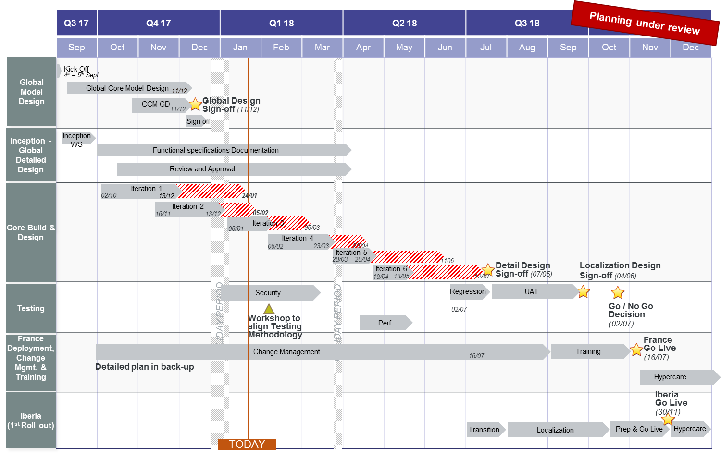
CCM Stream Detailed Planning
2018 Planning (DD, build, lead model & rollout)

Slide 7
CCM - Shift Interfaces – IBERIA SIT start May 2018
DRAFT
ID | Stream Owner | Interface Business Object | Master
TEMPO_022 | CCM | Business partners | Master Data
TEMPO_087 | CCM | Material | Master Data
TEMPO_112 | CCM | Sales orders | Transactional Data
TEMPO_154 | CCM | SAP document (invoice, sales orders, shipping orders) | Master Data
 | CCM | GetStatusUpdate | Transactional Data
 | CCM | Sales orders | Transactional Data
Web service
Web service
Web service?
Web service?

Slide 8
SCCore Roadmap

