Slide 1

SCCore Architecture Common Data Model
Last version of this document is available @:
https://spirit.sanofi.com/cs/sccore/Shared%20Documents/Architecture/ITS_Archi/SCCore-Architecture-ITS_Common_Data_Model.pptx

Slide 2
Open points CDM
A = Architecture (Bus+IS)
R = Architecture + MDM team
C = Streams
Common data model selection
GS1 / MESA / exiting pivot (Stradivarius) / Other
Governance
Design phase
Streams vs Architecture contributions
Budget / AED
Deliverables → MDM BI
Build phase
Streams vs Architecture contributions
Budget / AED
Deliverables
Run phase
Streams vs Architecture vs Solution Centers ?
Roadmap and priorities
Priorities driven by SCCore program

Slide 3
Decisions
Do we build a common data model ?
Go for Pilot to validate feasibility, governance and organization
Witch team owns the functional part of the common data model:
SCCore Buisiness/ITS Architecture team
Solution Center Integration
IA MDM & BI / Analytics
Comment: As SCCore Business/IT architecture team is a project team, recurring maintenance team needs to be identified (not blocking for pilot)
Recommandation
Recommandation

Slide 4
SCCore Architecture ITS - Common Data Model Workshops and Attendees March 7th 2017
Azzedine Allouache
Laurent Baudin
Yannick Bass
Conrad Behanzin x
Lionel Bossan
Jean-Pierre Cannizzo
Cyrille Causette x
Michelle Chanlon
Arnaud Chatelus x
Stephane Corrhions
Marc Dimouchy x
Pierre Dixon
Matteo Dubini x
Denis Fernandes
Frank Foerster x
Pierre Guitton x
Abraham Gurivindapalli x
Herve Henry
Laurence Hortig
Philippe Jeantet
Frederic Moigne x
Maxime Moreau x
Emmanuel Mouret x
Sergio Montenegro
Laurent Patte
David Robert

Slide 5
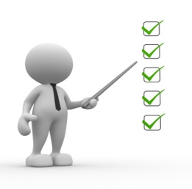
SCCore Architecture ITS - Common Data Model Agenda
Context and objective
What is a Common Data Model?
What are the Benefits?
What is it used for?
How to build it?
Integration team responsibilities … and roles
How does it works?

Slide 6
Context and objective Common data model open points
Owner = Abraham
Contribution: Arnaud
Contribution: Frederic
Do we build a common data model ?
In witch language (SAP, GS1, …) ?
Where is it build and maintened ?
In Industrial Data Warehouse ?
In other system ?
What governance ?
Which roadmap ?
Decision = March 31st
With Shift
SCCore
Business

Slide 7
SCCore Architecture ITS - Common Data Model Agenda
Context and objective
What is a Common Data Model?
What are the Benefits?
What is it used for?
How to build it?
Integration team responsibilities … and roles
How does it works?

Slide 8
What is a Common Data Model?
A Common Data Model is a standardized model to describe business information (Business Object)
It is business service object and independent of any application data model (agnostic)
It is also independent of data formats used by the applications like iDoc, File etc..
It proposes a common definition for each business object (dictionary) and associated business rules to manage data quality
It can be used for both transactional and master data interfaces
Common Data Model is not a Data store or Database.

Slide 9
What is a Common Data Model? Illustration – ASN
Source Apps
Integration platform
Target App
Athena
Planning Tool
GS1
Event based
tbd
5 min
Full coherent picture
Tibco
Collect source message in standard application format
Translate to CDM
Enrich from MDM if necessary
Manage frequency differences
Translate to destination expected format
Transfer to destination
SHIFT
iDoc
Event base
GS1
Event based
Supplier Portal
tbd
Daily
Legacy Format
Daily
GS1
Despatch Advice
CEP
BI/Analytics
Athena

Slide 10
What is a Common Data Model? Illustration – Inventory report
Source Apps
Integration platform
Target App
Athena
Planning Tool
iDoc - PROACT
Event based
tbd
5 min
Full coherent picture
Tibco
Collect source message in standard application format
Translate to CDM
Enrich from MDM if necessary
Manage frequency differences
Translate to destination expected format
Transfer to destination
SHIFT
iDoc - …
Event base
GS1
According to supplier
Supplier Portal
CEP
Legacy Format
Daily
GS1 -
Inventory report
tbd
Daily
BI/Analytics
Legacy Format
Daily
oEBS

Slide 11
SCCore Architecture ITS - Common Data Model Agenda
Context and objective
What is a Common Data Model?
What are the Benefits?
What is it used for?
How to implement it?
Integration team responsibilities … and roles
How does it works?

Slide 12
What are the benefits? (1/2)
Same language across transversal business process (data dictionary)
Every one share the same definition of a client …
Extendible architecture:
Not every think needs to be defined before starting implementing (incremental building)
It can be extended with minimal effort according to needs
The source and target applications interfaces changes are isolated by using Common data model
Adding a new application to landscape requires minimal interfaces developments and minimize non regression testing
only half interface specific to application needs to be set up without touching any other application
only conversion from source or target to CDM needs to be validated

Slide 13
What are the benefits? (2/2)
Common Data Model enables
Rapid interface development: specifications and non regression testing only for half interface in case of modification
Decoupled interface modifications (add data, modify update frequency, Push mode to Pull mode)
Simplify integration of new applications (Buy In, application replacement) and decommissioning (Carve out, application replacement)
parallel run of applications covering the same functional scope (M2, new supply chain planning tool) without bothering other applications
Simultaneous runs (to Dev / to QA / to Prod) without bothering other applications
Easily tied to Business Transaction monitoring using business object.

Slide 14
SCCore Architecture ITS - Common Data Model Agenda
Context and objective
What is a Common Data Model?
What are the Benefits?
What is it used for?
How to build it?
Integration team responsibilities … and roles
How does it works?

Slide 15
What is it used for?
The Common Data Model can be used in Integration as well as in Industrial Data warehouse
How do we use it for integration?
Source application sends information in its own language/data format
The integration team/platform manages translation to common data model (if needed)
The integration team/platform manages translation from common data model to target application language/data format
How do we use it for Industrial Data Warehouse?
The raw data into corporate layer is transformed into Common Data Model and inserted into Industrial Data Warehouse

Slide 16
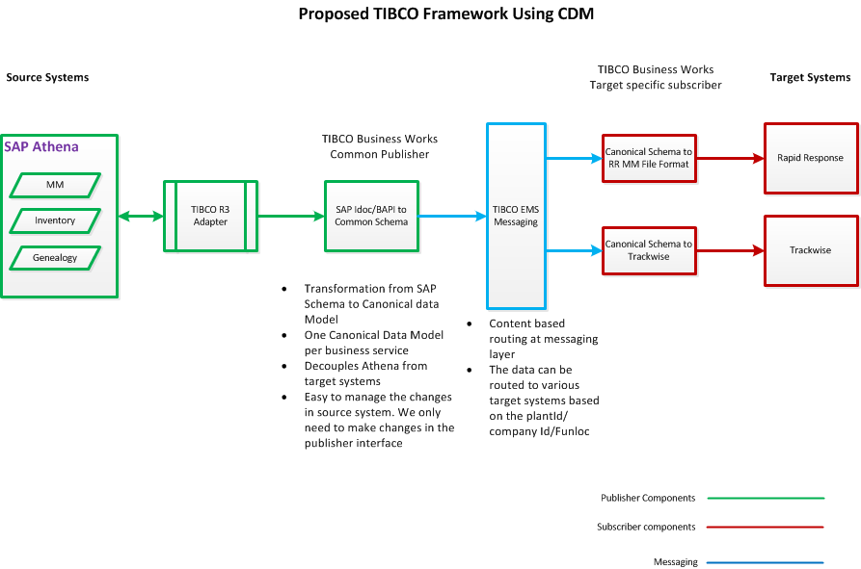
What is it used for? Integration example
Integration platform responsibility
Common data model use
Common data model use

Slide 17
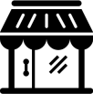
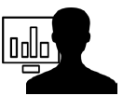
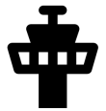
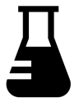
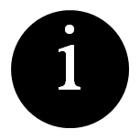
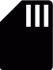
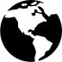
What is it used for? Industrial Data Warehouse
A three layers architecture to collect, store, harmonize and present information
BI
& Analytics
Third-part apps
Data Governance control tower
Data marts
Indicator modeling and data ready-to-use for tier apps
Enables semantic layer
One datamart dedicated to data governance monitoring
Data lab
Enables data-based proof of concepts and analytics upon defined scope of data
Industrial Data Warehouse
Provides the One single set of data
Business-oriented modeling
Detailed data keeping history
Source and usage free.
Querying
Data modeling & harmonization
Data quality checks
Corporate Memory
Collects & keeps history of raw data from all applications with no quality check.
Interfaces as simple as possible
No business transformation so far
Common data model use
Parameters
Transactions
Open data
Weather
Macro economic indicators…
Master data
External content
Raw data extracts only.
No transformation between source app and Corporate memory layer

Slide 18
SCCore Architecture ITS - Common Data Model Agenda
Context and objective
What is a Common Data Model?
What are the Benefits?
What is it used for?
How to build it?
Integration team responsibilities … and roles
How does it works?

Slide 19
How to build it?
Common data model can be build either from scratch or using Industry Standard Data Models as accelerators:
Life sciences Data model / Supply Chain from Terradata
B2MML: implementation of the ANSI/ISA-95 for manufacturing (http://www.mesa.org/en/B2MML.asp)
GS1 for logistics data exchanges (http://www.gs1.org/standards)
Stradivarius : CDM inside Sanofi
MDM/BI industry data model
Other …
It is the same model for integration and Industrial Data Warehouse
Open point:
Data model standards needs to be chosen

Slide 20
SCCore Architecture ITS - Common Data Model Agenda
Context and objective
What is a Common Data Model?
What are the Benefits?
What is it used for?
How to build it?
Who owns and maintain?
How does it works?

Slide 21
Who owns and maintain? What needs to be done?
Build and maintain Common data model components
Data dictionary
Business rules (trans codification / data quality)
Business data repository for consolidation/coherence purpose
Trans-codification tables
Interface/Integration catalogue
Deliver, maintain and monitor interfaces
Define and enforce integration best practices

Slide 22
Who owns and maintain? Core team and contributions
Updated after meeting
Core team
Business / functional analysts
Integration experts
DEVs / technical experts
Contributors
Business process owners for data objects
Master data owners for master data objects
Stream representatives (functional)
Integration / enterprise architects
To be defined
Existing team (Solution Center integration)
To be defined

Slide 23
Who owns and maintain? open point
Wish team is in charge of functional part:
SCCore Buisiness/ITS Architecture team
SCCore MDM & BI / Analytics?
Solution Center intergration
Solution Center Industrial Performance Analytics and MDM

Slide 24
Open discussion / Q&A

Slide 25
Q&A
Frederic: Does translation from each application to common data model in included in the common data model?
Abraham: usually, it is not included in the model, but, it definitely needs to be managed in the integration platform
Frank: if 2 systems are speaking the same language, do we need to use the common data language
Abraham: If there is no need to share with other systems and, than question can be razed to use the common data model. To be discussed on a case to case approach
Arnaud (slide9): Decoupled interface modifications (Push to Pull)?
Abraham: Once common data model is implemented, each half interface can be modified independently including retrieving mode (Pull or Pull). The all flow is not coupled any more
Arnaud (slide11): where translation is managed? And where translation rules are managed?
Abraham: translation is managed in integration platform as well as translation rules. They can be shared with other applications (ie: Industrial Data Warehouse)
Frederic (slide 12): can we manage different schedule if we have different target application?
Abraham: schedule and delivery modes (push pull) are managed in each half interface

Slide 26
Q&A and comments
Arnaud (slide 13): the common data model is mutualized, but the means to extract / collect data can be different (for BI / Analytics)
Abraham: Yes. Same common data model (Pivot description) is used but translation rules can be different (linked to the interface and not model)
Slide 15: witch model do we use ?
Standard models available in the market are used as accelerators.
For each business object described in the model, the “best standard” can be imported in the framework.
Frederic (slide 18):
Data/Master Data Business owners role to be added (Maxime team?)
Sponsorship is required?
Business ownership needs to be defined at common data object level

Slide 27
Thank you

