Slide 1
Sparse-Autoencoder Dissection of
Emotion Features in Frozen Speech Encoders
From decodability to mechanism
Nima Kelidari · Minoo Ahmadi · Chaitanya Parwatkar · Xiangxu (Henry) Lin
USC ICT — Intelligent Human Perception Lab

Slide 2
The question
Frozen speech encoders (HuBERT, WavLM, wav2vec2, w2v-BERT, MERT, Whisper) top SER benchmarks — but they were trained for ASR, so they encode a lot of TEXT.
Probing tells us WHERE emotion is readable. It can't tell us:
Which features encode emotion?
Is the signal ACOUSTIC (how it's said) or LEXICAL (what's said)?
Does the pattern hold across encoders and speakers?
Idea: use Sparse Autoencoders to go from decodability → mechanism.

Slide 3
Method in one slide
Train a TopK SAE (8×, k=32) on per-frame activations of each frozen encoder (~940k frames). Reconstruction: 93% variance, ~0 dead features.
Anchor on CREMA-D: 91 actors × 12 FIXED sentences × 6 emotions → text is constant, so any emotion signal is acoustic (built-in control).
Confound control: keep a feature only if its firing tells us more about EMOTION than about the SENTENCE (phonetics) or the SPEAKER.
Result: 394 naive features → 61 genuine emotion features (median monosemanticity 0.59); dominated by anger & sadness.
Without control, ~66% of ‘emotion’ features are really phonetic/speaker — the ‘SAE rediscovers phonemes’ trap.

Slide 4
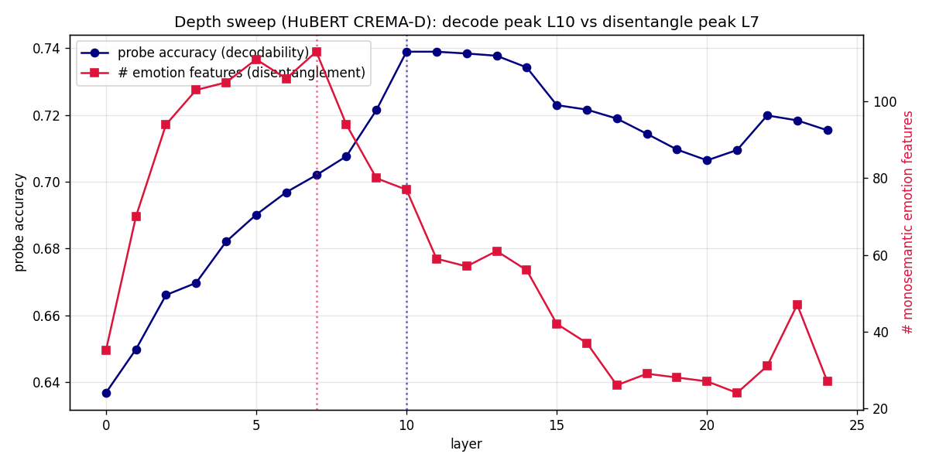
Q1 — Depth: decoding ≠ disentangling
Probe accuracy peaks DEEP (L10) and stays high.
But clean monosemantic emotion features peak EARLY (L7; monosemanticity L2).
Deep layers keep decodability but lose disentanglement (24–47 feats).
Takeaway: emotion is organised into clean features earlier than where a probe reads it best.

Slide 5
Q2 — Across encoders & speakers
All six encoders carry emotion features (61–145 each), all anger/sadness-dominated.
Cross-encoder overlap: Whisper→SSL 0.40 ≈ SSL→SSL 0.39 — on fixed-lexicon speech Whisper is NOT special; its difference is about TEXT.
Speaker-invariant: leave-one-speaker-out (91 actors) drop ≈ 0; each feature fires for ~95% of its emotion's actors.
→ the published MESD speaker-out collapse (~0.30) comes from the speaker-entangled features our control removes.

Slide 6
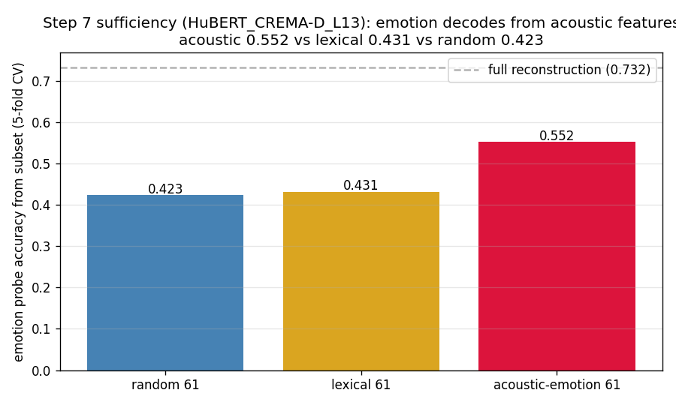
Q3 — The signal is acoustic, not lexical
Positive control: 60/61 features label acoustic (eGeMAPS AUC 0.83 vs sentence 0.66).
Causal sufficiency: emotion decodes at 0.55 from acoustic features vs 0.43 lexical vs 0.42 random (full 0.73).
Takeaway: what the probe exploits is paralinguistic delivery, not words.

Slide 7
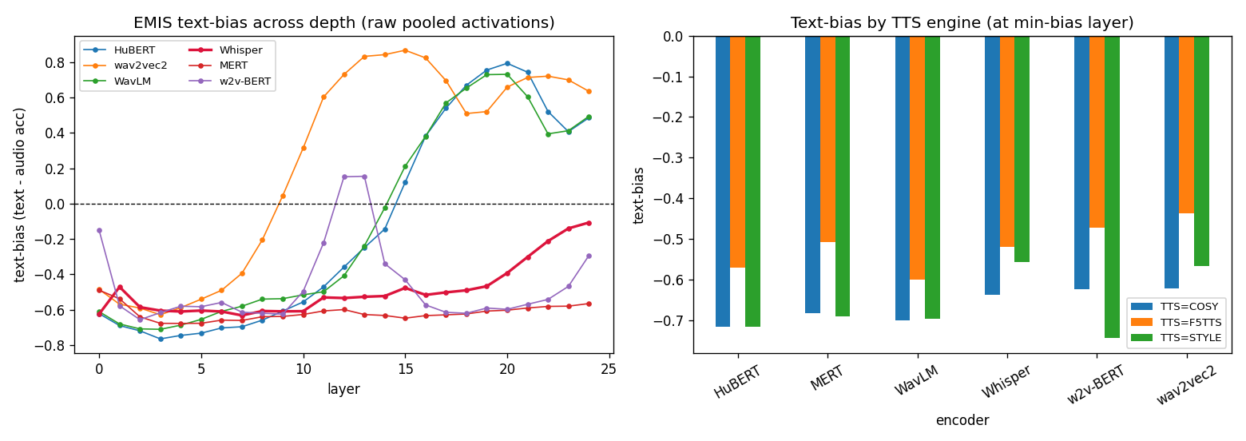
Q4 — EMIS: the lexical shortcut is a deep-layer thing
EMIS = synthetic speech where TEXT emotion ≠ VOICE emotion.
Train on congruent, test on incongruent; text-bias = text − audio accuracy.
Shortcut appears ONLY in deep layers of ASR-SSL (HuBERT/WavLM/wav2vec2, +0.7–0.9).
Whisper stays audio-grounded at EVERY layer (L24 −0.11); MERT/w2v-BERT never take it.
Reproduces the published text-bias — and localizes it to depth.

Slide 8
Where this sits in the literature
AudioSAE (EACL 2026): same SAE recipe on 2 encoders, but emotion is just one probe task — NO emotion-feature interpretation, confound control, factorial corpus, or acoustic/lexical split. Closest method neighbor.
ASR-SAE works (Pluth'26; Mariotte'26): SAEs on speech, but find phonetic/singing features — no affect, no depth sweep.
Ma et al.'25: mechanistic Whisper-SER — but via probing/CKA, NO SAEs.
Un-scooped core: confound-controlled SAE emotion features on a lexicon-controlled factorial corpus across 6 encoders + decode≠disentangle depth + EMIS-shortcut-by-depth.

Slide 9
Limitations & future work
Limitations:
Necessity-ablation is near-null (signal distributed) — we rely on sufficiency.
SAE reconstruction must NOT replace raw activations for the EMIS probe (it inverted Whisper).
Cross-encoder/EMIS arms use one layer per encoder, not full 25-layer grids.
Future work:
IEMOCAP real-transcript causal ablation (stub ready; needs transcripts).
SpeechCraft cross-lingual feature overlap → explain EN↔ZH collapse.
Feature steering; dimensional V/A/D targets; full per-encoder layer grids.

Slide 10
Takeaways
1. SAEs move SER analysis from decodability to mechanism; confound control is essential.
2. Decoding ≠ disentangling: emotion organises early (L2–L7), decodes best deep (L10).
3. Emotion features are acoustic and speaker-invariant, shared across all six encoders.
4. The lexical shortcut is a deep-layer ASR-SSL phenomenon; Whisper resists it everywhere.
All code (src/sae/), data pointers, artifacts (results/SAE/) and the report are on the SAE branch.

