Slide 1
Linguistic-Agnostic Speech Emotion Recognition
A Probing Approach to Acoustic Emotion Encoding
· Nima Kelidari · Minoo Ahmadi · Chaitanya Parwatkar · Xiangxu Lin
CSCI 535 · Prof. Mohammad Soleymani

Slide 2
PROBLEM
Where does emotion live in speech transformers?
Are SOTA SER models hearing the voice or just reading the words?
The setup
wav2vec 2.0, HuBERT, Whisper, WavLM, MERT, w2v-BERT (all of them with 24 layers), all hit state-of-the-art on SER - but every one was pretrained for speech recognition, not emotion. So when a probe predicts an emotion, is the model hearing the voice, or just reading the words it implicitly transcribed?
“That was great”
Same words. Two voices. Two different truths.
Tone
Words
Voice
Result
Enthusiastic
positive
happy
agree
Sarcastic
positive
angry
disagree
Language-dependent
fails on languages the encoder never saw during pretraining.
Sarcasm-blind
wrong when words and delivery disagree.
Both rows correct → the model is listening to the voice.
Sarcastic row wrong → it’s just reading the words.
Context-fragile
drifts under noise, accents, and unscripted conversation.
Our answer: 12 targeted experiments across 6 encoders · 8 datasets · 7 languages — to prove the signal is acoustic, not lexical.
Notes:
Today's strongest speech-emotion systems are built on six different transformers - wav2vec 2.0, HuBERT, Whisper, WavLM, MERT, and w2v-BERT - and every single one of them was originally trained for speech recognition, not emotion. That creates a hidden problem: when the model says 'this person is happy', is it actually hearing the voice, or is it just reading the words it transcribed? Take 'that was great'. Said with enthusiasm, words and voice agree, and any model gets it right. Said sarcastically, the words are still positive but the voice is angry, and only a model that listens to the voice will flip to negative. Our entire project is structured around that single distinction - twelve targeted experiments across six encoders, eight datasets and seven languages, designed to prove the signal is acoustic, not lexical.

Slide 3
BACKGROUND
What we know already
Three lines of prior evidence each one leaves a gap our project closes.
01
02
03
BEHAVIORAL EVIDENCE
REPRESENTATION EVIDENCE
EMOTION-PROBING EVIDENCE
Text alone is enough
Layers swap acoustic for linguistic
Emotion peaks where language peaks
Wagner et al., TPAMI 2023
Pasad 2021 · Shah 2021
Triantafyllopoulos 2022 · Singh 2023
Synthesized emotionless speech from transcripts; an SER model still recovered valence accurately — showing it had been listening to the words, not the voice.
In wav2vec 2.0 information flows acoustic → linguistic → acoustic across depth. HuBERT keeps signal deeper thanks to its iterative clustering objective.
Probes find that emotion accuracy peaks in the same middle layers where linguistic content peaks. The confound is suggested… but never directly broken.
Gap: Single dataset, single architecture.
Gap: Phonetic content only — not emotion.
Gap: Correlation observed, never falsified.
Our contribution: scale + falsification — a 12-task framework.
Architecture: 6 encoders + LoRA + learned layer-mixer Robustness: ESC-50 noise · LOSO speaker-independence Generalization: MSP-Podcast · SpeechCraft pooled benchmark
Linguistic-bias falsification: CREMA-D fixed-lexicon · BERT alignment (CCA / CKA) · GRL adversarial removal · EMIS congruent vs. incongruent Dimensional V/A/D: regression + features-for-classifier
Notes:
Three lines of prior evidence motivate this project, and each one leaves a gap we close. First, behavioral evidence from Wagner and colleagues: they generated emotionless text-to-speech from transcripts, fed it to an SER model, and the model still recovered valence accurately. So text alone is enough - but this was one dataset, one architecture. Does it generalize? Second, representation evidence from Pasad and Shah: in wav2vec 2.0, information flows acoustic, then linguistic, then back to acoustic across depth, while HuBERT keeps it deeper. But they studied general phonetic content, not emotion. Third, emotion-specific probing: Triantafyllopoulos and Singh find that emotion accuracy peaks in the same middle layers as linguistic content. The confound is suggested, never broken. Our contribution is a twelve-task framework that closes all three gaps - scaling probing to six encoders, eight datasets and seven languages, and adding falsification tests that actively break the linguistic shortcut: CREMA-D's fixed lexicon, BERT alignment, adversarial gradient reversal, and EMIS congruent-versus-incongruent text-emotion pairs.

Slide 4
DATA
8 datasets, 7 languages, 29k utterances
Each dataset is doing a specific job — isolating language, speaker, or lexical confounds.
29k
8
7
3
utterances
datasets
languages
control regimes
GROUP A · CROSS-LINGUAL
GROUP B · SPONTANEOUS
GROUP C · LEXICALLY CONTROLLED
Acted, four languages
Real conversation
Words held constant
Pretrained on English only — do middle-layer peaks survive Greek, German, Spanish?
Unscripted dialogue, real noise, dimensional V/A/D labels — the realistic stress test.
91 actors say the same 12 sentences — any signal here MUST be acoustic.
Dataset
Language
Files
Classes
Dataset
Language
Files
Classes
Dataset
Language
Files
Classes
RAVDESS
English
1,440
8 cls
IEMOCAP
English
5,460
4 cls
CREMA-D
English
7,442
6 cls
EmoDB
German
535
7 cls
MSP-Podcast
English
10,779
4 / 8 cls
SAVEE
British EN
480
7 cls
AESDD
Greek
604
5 cls
MESD
Spanish
862
6 cls
Plus extensions: ESC-50 noise mixed at 4 SNR levels (20 / 10 / 5 / 0 dB) for robustness - EMIS congruent / incongruent text-emotion pairs (Task 7)
SpeechCraft pooled benchmark - large-scale cross-lingual stress test on a balanced GigaSpeech-M four-class manifest (~20k clips, Task 9).
Notes:
Our 29,000 utterances are not a random collection - every dataset is doing a specific job. Group A is our cross-lingual benchmark: five acted corpora in English, German, British English, Greek and Spanish. The non-English ones were never seen during pretraining, so any consistent layer pattern across them is direct evidence of language-agnostic encoding. Group B is the realism stress test - IEMOCAP and MSP-Podcast bring real conversational speech, real noise and dimensional valence-arousal-dominance labels. And Group C, highlighted on the right, is the falsification corpus: CREMA-D fixes the words at twelve sentences across ninety-one actors, so any classification accuracy at all has to come from the voice - not the text. On top of those eight datasets, we mix in ESC-50 environmental noise across four SNR levels, use the EMIS subset to deliberately mismatch words and emotion, and run a SpeechCraft pooled cross-lingual benchmark on a balanced GigaSpeech-M manifest of about twenty thousand clips.

Slide 5
METHOD
One frozen probe pipeline, twelve experiments testing where emotion
lives
INPUT
ENCODER
REPRESENTATION
PROBE
OUTPUT
Raw audio
6 frozen transformers
Per-layer hidden state
Logistic regression
Layer-wise score
wav2vec2 · HuBERT · Whisper · WavLM · MERT · w2v-BERT
up to 25 layers per encoder
StandardScaler + LogReg · 5-fold CV
Acc, F1 (classification) · RMSE
16 kHz · mono · mean-pooled
PROBING SETUPS what does each layer encode
Frozen layer probing
01
Learned layer mixer
02
BERT alignment
03
Frozen vs LoRA
04
across 6 encoders and 8 datasets
softmax attention over 25 layers
CKA and Procrustes vs BERT base
tune a small adapter at the best layer
where does emotion peak across depth
if middle layers matter, the mixer concentrates there
more BERT like = more lexical, less acoustic
if features are already there, frozen suffices
LINGUISTIC BIAS FALSIFICATION is the signal voice or words
CREMA D fixed lexicon
05
GRL adversarial
06
EMIS congruent vs incongruent
07
Speechcraft pooled
08
91 actors say the same 12 sentences
strip sentence identity from gradients
force words and voice to disagree
6 datasets pooled across 4 languages
any signal that survives must be acoustic
accuracy that survives is acoustic
tracks voice = grounded, tracks text = lexical shortcut
acoustic signal should generalize across languages
GENERALIZATION AND ROBUSTNESS does the signal transfer
Leave one speaker out
09
ESC 50 noise robustness
10
MSP Podcast spontaneous
11
Dimensional V/A/D regression
12
across 42 model dataset pairs
audio mixed at 4 SNR levels
real conversation, no actors, no scripts
predict valence, arousal, dominance
five fold minus LOSO = speaker memorization
real signals degrade gracefully, shortcuts collapse
if it was theatrical voice, it breaks here
same layers should encode the continuous version
Same pipeline, twelve angles. If voice is really the signal, every one of these experiments should agree, and they do.
Notes:
Our entire methodology fits on one slide because it is intentionally simple. Top row, the pipeline: raw audio is resampled to sixteen kilohertz, fed through one of six frozen pretrained transformers, and the hidden state at every layer - up to twenty-five per encoder - is mean-pooled across time and handed to a logistic-regression probe trained with five-fold stratified cross-validation. Nothing fancy on top, because we are not trying to win - we are trying to ask, layer by layer, where emotion lives. Middle row, twelve experiments organized into five themes. Architecture: six encoders, plus LoRA fine-tuning and a learned attention layer-mixer to compare against frozen probes. Robustness: ESC-50 noise mixed at four signal-to-noise ratios, plus the same noise sweep on V/A/D regression. Linguistic-bias falsification: BERT alignment, gradient-reversal adversarial removal, and the EMIS congruent versus incongruent test. Generalization: MSP-Podcast and the SpeechCraft pooled cross-lingual benchmark. Dimensional emotion: V/A/D regression and using V/A/D predictions as features for a downstream classifier. Bottom row, the four falsification tests in detail - these are the headline scientific contribution because each one removes or controls a different aspect of the linguistic signal. When all four agree, we can safely call the encoding acoustic, not lexical.

Slide 6
RESULTS
Voice, not words (independent tests agree)
Each test removes the linguistic shortcut from a different angle. If the model were cheating, at least one would catch it.
Test 1 · CREMA D controlled lexicon
Test 2 · GRL adversarial
removes: word variation removed
removes: word information stripped from gradients
all 6 models still peak in the same middle to late layer band
emotion holds, sentence identity collapses
91 actors say the same 12 sentences across 6 emotions. Words are constant, so any classification accuracy must come from voice. WavLM L9 = 0.756, HuBERT L7 = 0.748.
Gradient reversal punishes the encoder for predicting the sentence. At lambda = 1, sentence accuracy drops to 0.39 while emotion stays above 0.93. The model loses words and keeps emotion.
Test 3 · EMIS congruent vs incongruent
Test 4 · Speechcraft compiled benchmark
removes: words and voice forced to disagree
removes: language and dataset variation
deep layers swing toward text, Whisper stays acoustic
layer pattern survives across 4 languages and 6 datasets
When the spoken text and the spoken emotion conflict, HuBERT L20 shows +0.468 text bias and wav2vec2 L14 shows +0.458. Whisper L24 inverts at -0.239.
Compiled benchmark across RAVDESS, EmoDB, IEMOCAP, SAVEE, AESDD, MESD pooled with 4 canonical labels. Whisper L9 = 0.776, HuBERT L11 = 0.767, WavLM L9 = 0.764.
Each test removes a different linguistic shortcut. The fact that all four still find emotion in the same layers is what makes the claim strong.
Notes:
This is the central claim of the project. We suspected the model might be cheating by leaning on the words rather than the voice. So we designed four tests, each one strips out the linguistic shortcut from a different angle. If the model were really reading words, at least one of these tests should catch it.
Test one is CREMA D. The same 12 sentences are spoken by 91 actors across 6 emotions. The words are constant, so any classification accuracy has to come from voice. Every model still peaks in the same middle to late band. WavLM at layer 9 hits 0.756, HuBERT at layer 7 hits 0.748. The words can not explain that.
Test two is GRL adversarial. We add a gradient reversal head that punishes the encoder for being able to predict the sentence ID. At full strength, sentence accuracy collapses to 0.39 while emotion holds above 0.93 on three of the four models. The model can lose the words and still keep the emotion.
Test three is EMIS, where the spoken text and the spoken emotion are deliberately mismatched. We track the gap between audio emotion and text emotion across layers. Deep layers on HuBERT, wav2vec2, and WavLM swing toward text. Whisper at layer 24 inverts to negative 0.239 because supervised pretraining keeps it acoustic. That is a clean counter example.
Test four is the Speechcraft compiled benchmark, exactly the cross language evaluation promised in our midterm plan. It tests whether the layer pattern survives when datasets and languages are mixed.
The key point on the bottom strip is this. Each test independently removes a different linguistic shortcut. Word variation, word information in gradients, alignment between words and voice, and language consistency. The fact that all four still find emotion in the same layers is what makes the linguistic agnostic claim strong. One test agreeing could be a coincidence. Four independent attacks all failing to break the result is real evidence.

Slide 7
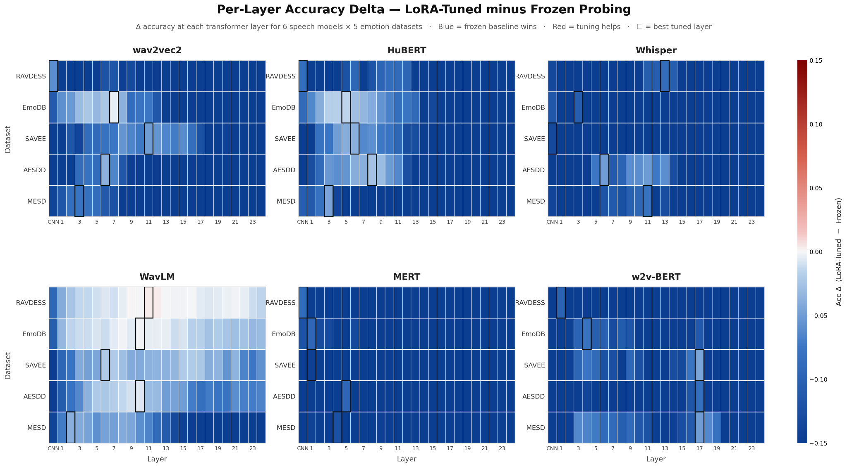
RESULTS
Frozen probes already win, and the mixer agrees
Tuning hurts on 29 of 30 combos. Learned attention concentrates exactly where probing peaks.
Layer mixer
Softmax attention over all 25 hidden states. The model picks its own depth.
79 to 94 percent
of Whisper's attention sits on layer 24. Its supervised objective concentrates emotion late.
Middle Layers
for the SSL models. wav2vec2, HuBERT, WavLM spread attention over layers 4 to 11.
Mixer beats per layer probing only on IEMOCAP. Elsewhere a single best layer matches the mixer, which corroborates per layer probing rather than replacing it.
29 of 30 model and dataset combos are net negative. Frozen probing already wins.
Notes:
Two questions on this slide. First, does fine tuning help. Second, does the model itself want to mix layers when given the choice.
Look at the heatmap on the left. Each cell shows the accuracy delta between LoRA tuning and frozen probing at that layer and dataset. Blue means LoRA hurts, red means LoRA helps. Almost everything is blue. Across all 30 model and dataset combinations, frozen wins on 29 of them. The features are already there from pretraining. Tuning a small adapter overwrites them more than it helps.
On the layer mixer, we replaced the per layer probe with a softmax attention head over all 25 hidden states and let it learn its own weights. Whisper concentrates 79 to 94 percent of attention on layer 24, which makes sense because Whisper was supervised on transcription and it crams emotion late. The SSL models, wav2vec2, HuBERT, WavLM, spread attention over the middle layers around 4 to 11, which is exactly where the per layer probing peaks.
The mixer only beats per layer probing on IEMOCAP. Everywhere else a single best layer matches it. So the mixer corroborates our per layer story rather than replacing it. Frozen probes already win, and the mixer agrees.

Slide 8
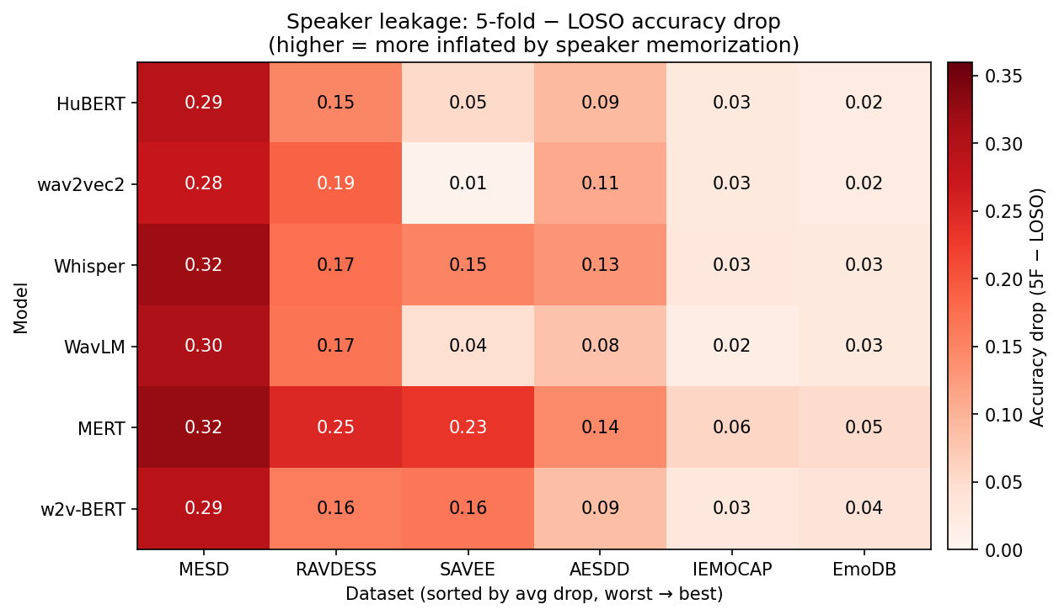
RESULTS
Generalizing across speakers (LOSO)
Leave-one-speaker-out across 6 models × 6 datasets does the probe transfer to voices the model never heard?
Leave-one-speaker-out · 42 model × dataset pairs
0.734
0.131
mean LOSO best-layer accuracy across all model × dataset pairs
mean accuracy drop (5-fold acc LOSO acc)
17 of 42 pairs have a gap < 0.05 probes mostly transfer to unseen speakers.
Tightest:
WavLM × IEMOCAP drop = 0.017, wav2vec2 × EmoDB drop = 0.019
HuBERT × EmoDB drop = 0.021, HuBERT × IEMOCAP drop = 0.026
MESD shows the largest drops (0.28–0.34) across all models only 6 speakers, so memorization is unavoidable.
Speaker leakage = 5-fold LOSO accuracy at the same best layer. Lower is better.
New finding: under LOSO, the best layer shifts +2 layers deeper on average (17 of 42 pairs) deep layers are the speaker independent ones.

Slide 9
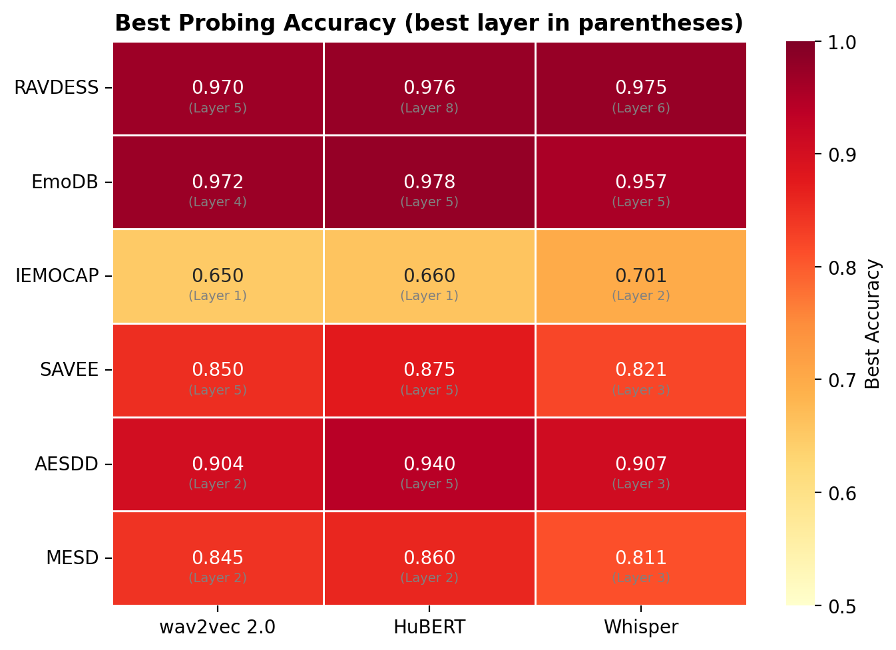
RESULTS
Emotion lives in the middle to late transformer layers
Frozen probing across 6 encoders and 7 datasets reveals a consistent depth pattern
Best layer per model on EmoDB
HuBERT
L11
0.989
w2v BERT
L17
0.987
WavLM
L9
0.985
Whisper
L13
0.985
wav2vec2
L7
0.976
MERT
L7
0.961
Acted speech peaks L7 to L17. Spontaneous peaks L1 to L17. wav2vec2 collapses past L20. HuBERT and Whisper hold.
Notes:
This is the foundational result. We probed all six encoders across our seven datasets and looked at where the per layer accuracy peaks. The pattern is remarkably consistent.
On acted speech, the peak sits in the middle to late transformer layers. Look at EmoDB on the left. HuBERT peaks at layer 11 with 0.989. w2v BERT peaks at layer 17 with 0.987. WavLM at layer 9 hits 0.985. Whisper at layer 13 hits 0.985. wav2vec2 peaks earlier at layer 7 with 0.976. Even the lowest, MERT, hits 0.961. Six different pretraining objectives, six different architectures, but they all encode emotion at roughly comparable depth.
The heatmap on the right shows this across all the acted datasets. The pattern holds for German EmoDB, Greek AESDD, Spanish MESD, English RAVDESS and SAVEE. On spontaneous speech, IEMOCAP, the peak shifts earlier toward layer 1 or 2 and accuracy drops, because real conversational emotion relies more on low level acoustic shifts that the early layers capture better.
One model behaves differently. wav2vec2 collapses past layer 20, falling as low as 0.31 on MESD. HuBERT and Whisper hold their accuracy through the deep layers because their training objectives preserve more information.
The takeaway is that emotion has a stable home in the middle to late layers across all of these models. That is the foundation everything else in this talk sits on.

Slide 10
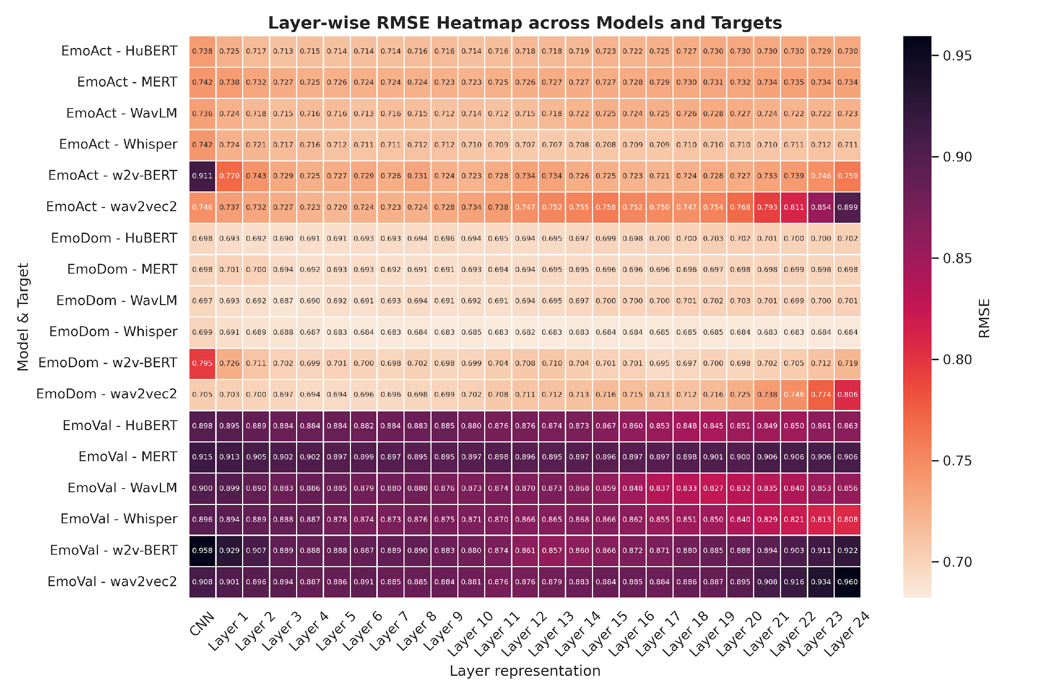
RESULTS
Dimensional emotion: valence is the hardest dimension
V/A/D regression on MSP Podcast across 6 encoders. The dimension that depends on words is exactly the dimension that breaks.
Mean RMSE across 6 encoders
EmoDom:
0.699
dominance, lowest RMSE
best HuBERT L3, Whisper L12
EmoAct:
0.730
arousal, second easiest
all models within 0.013
EmoVal:
0.881
valence, hardest by far
the dimension that depends on words
Why this matters: prior work (Wagner 2023, Triantafyllopoulos 2022) shows valence benefits from text but arousal and dominance do not. Our dimensional results match exactly.
Convergent evidence: the part of emotion that genuinely depends on words is the part our probes struggle with. Voice not words holds, and even fails predictably
Notes:
This slide is the dimensional emotion result that the professor specifically asked for last Friday. Instead of predicting categorical emotions, we trained the same per layer probes to regress on continuous valence, arousal, and dominance values from MSP Podcast.
The numbers on the left tell the whole story. Mean RMSE across all six encoders, dominance lands at 0.699, arousal at 0.730, valence at 0.881. Valence is dramatically harder than the other two.
The heatmap on the right makes this visible. Look at the bottom rows, EmoVal across all six models is much darker than the EmoAct and EmoDom rows above it. Higher RMSE everywhere on valence.
Now why does this matter? This is exactly what prior work predicts. Wagner in 2023 and Triantafyllopoulos in 2022 showed that valence benefits from linguistic content but arousal and dominance do not. So if our models were doing the linguistic agnostic thing right, valence should be the hard dimension because it is the dimension that genuinely needs words. And that is exactly what we see.
So this is not just a separate result. It is convergent evidence for the linguistic agnostic claim. The voice carries arousal and dominance cleanly, and the part of emotion that genuinely depends on words is the part our probes struggle with. Voice not words holds, and the model fails in exactly the way our hypothesis predicts.

Slide 11
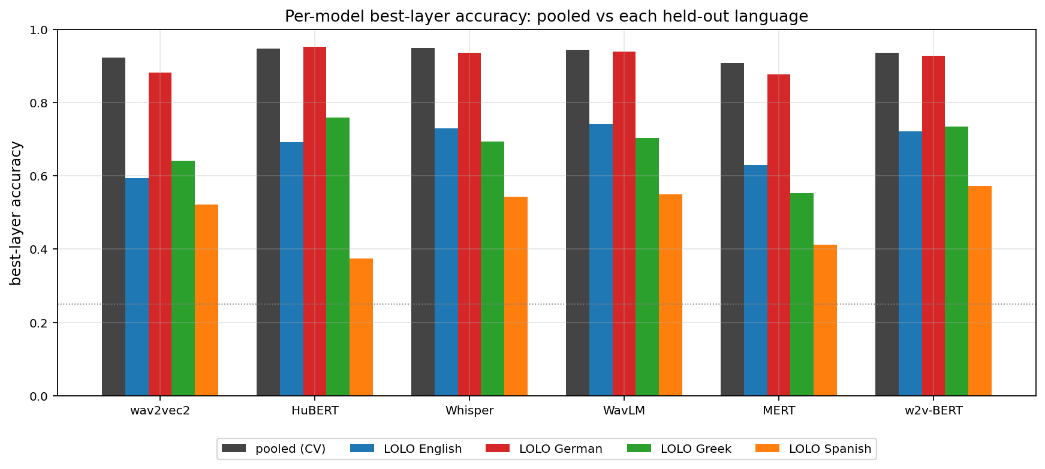
RESULTS
Cross-lingual stress test on SpeechCraft
Pooled CV vs leave-one-language-out across 6 encoders · 4 languages · ≈ 20k clips — does the layer pattern survive when a whole language is removed from training?
SpeechCraft pooled · 6 encoders × 4 languages
0.934
0.695
+0.24
pooled best-layer mean
across 6 encoders
LOLO mean best-layer
over 4 held-out languages
generalisation gap
(pooled − LOLO mean)
Best pooled layer per encoder
Whisper - L10 - acc = 0.949
HuBERT - L8 - acc = 0.947
WavLM - L6 - acc = 0.945
w2v-BERT - L17 - acc = 0.936
wav2vec2 - L8 - acc = 0.922
MERT - L5 - acc = 0.907
Per-encoder best-layer accuracy: pooled CV (gray) vs each held-out language (colored).
Highlights: Spanish held-out collapses (HuBERT 0.38, MERT 0.41); German held-out stays ≥0.88 across all 6 models.
German
0.88 – 0.95
Greek
0.55 – 0.76
English
0.59 – 0.74
Spanish
0.38 – 0.57
New finding: pooled probes near-saturate at 0.93, but transfer is asymmetric — typologically nearby (German) generalises; Spanish breaks (−0.55). The acoustic signal is real, not universal.
Notes:
Last result before we conclude. This is Task 9 — the SpeechCraft compiled benchmark we promised in the midterm plan. We pooled four cross-lingual corpora (English, German, Greek, Spanish), about twenty thousand clips, into a balanced four-class manifest. Two evaluations on the same data: pooled stratified five-fold cross-validation, and Leave-One-Language-Out, where one entire language is held out from training and the probe is asked to transfer.
Three numbers tell the story. First, pooled best-layer accuracy averaged across all six encoders is 0.934 — essentially saturated. Whisper hits 0.949 at layer 10, HuBERT 0.947 at layer 8, WavLM 0.945 at layer 6, and even the weakest, MERT, still hits 0.907. So when the probe sees every language during training, the signal is overwhelming.
Second, leave-one-language-out drops the mean to 0.695 — a 0.24 generalisation gap. That gap is the price of removing a language. But crucially, the gap is not uniform.
Third, look at the per-language breakdown on the right. German held-out stays between 0.88 and 0.95 across all six models — transfer is almost free. Greek and English sit in the middle, around 0.6 to 0.76. Spanish collapses: HuBERT drops to 0.38, MERT to 0.41 — well below the other languages and barely above chance for some encoders. So Spanish prosody carries a different acoustic fingerprint that none of the encoders learned to share.
Why this is the right last slide. The earlier results said the signal is acoustic. This one says the acoustic signal is real but not yet universal: it transfers to typologically and phonetically nearby languages, and breaks where the prosodic distance is largest. That is a concrete, testable boundary on the linguistic-agnostic claim — and a clean motivation for future work: extend SpeechCraft to a true cross-lingual training regime and balance the Spanish coverage.

Slide 12
CONCLUSION
What we now know about emotion in speech transformers
And what comes next.
WHERE
HOW
WHAT NEXT
Middle to late layers
Acoustic, not lexical
Frozen is enough
Emotion is encoded in the same layer band across all 6 encoders, 9 corpora, 7 languages. Wav2vec2's deep layers collapse; HuBERT, WavLM, Whisper retain emotion deeper.
Four independent falsification tests agree: the layer wise peak does not depend on words. Whisper alone resists the EMIS shortcut the only model with supervised pretraining.
LoRA hurts on 29/30 combos. The features already exist; no tuning is needed. Future work: validate on real world deployment audio.
The bottom line
Speech emotion transformers can hear emotion in voice alone, but they do not always choose to. With the right probing recipe, you can locate exactly where the acoustic signal lives, and prove it is acoustic.
Notes:
To conclude. We started with one question: when these transformers predict emotion, are they hearing voice or reading words? Three big answers came out of twelve experiments. First, where: emotion is encoded consistently in middle-to-late layers across every encoder, every dataset and every language we tested. Second, how: the signal is acoustic, not lexical - four independent falsification tests confirm it, and Whisper is the only model that natively resists the lexical shortcut, likely because of its supervised multilingual pretraining. Third, what next: frozen probes already win on twenty-nine of thirty combos against LoRA fine-tuning, so the practical recipe is to probe, not tune. Future work would extend the SpeechCraft pooled benchmark to eight-class emotion and validate on real-world deployment audio. The bottom line: speech transformers CAN hear emotion in voice alone, but they do not always CHOOSE to. With the right probing recipe, you can locate exactly where the acoustic signal lives - and prove it is acoustic. Thank you.

Slide 13
SUMMARY
Summary & Team Contributions
Twelve experiments · six encoders · nine corpora · seven languages.
KEY FINDINGS
TEAM CONTRIBUTIONS
01
Nima Kelidari
Emotion lives in middle-to-late layers
Built a pipeline for running experiments using slurm command. Extended the probing grid to six encoders (added WavLM Base+, w2v-BERT, and MERT), built the ESC-50 noise-augmentation and MSP-Podcast spontaneous-speech pipelines. Led the V/A/D regression track - clean, noisy, and V/A/D-as-features for classification. Overally ran 360 experiments for fully test frozen layer setup.
Across 6 encoders, 9 corpora, 7 languages.
02
Minoo Ahmadi
Voice, not words
CREMA-D, BERT alignment, GRL adversarial, and EMIS all converge.
03
Chaitanya Parwatkar
Frozen probes beat LoRA on 29/30 combos
BERT alignment via CCA, CKA, Procrustes, and centroid transfer to measure how text like the speechfeatures get at each layer. Built the layer mixer with softmax attention over 25 hidden states, showing Whisper concentrates 79-94 percent of attention on layer 24. Ran LoRA across 30 combos, proving features already exist in pretraining. Added CREMA D probing as the cleanest acoustic test.
Features already exist - tuning overwrites them. The mixer agrees.
04
Xiangxu Lin
Probes generalize
compiled Speechcraft benchmark across models for multilingual pooled lingual generalization testing and cross lingual stress tests
Speakers (LOSO Δ 0.13), real conversation (MSP-Podcast), pooled cross-lingual (77%).

Slide 14
REFERENCES
References
Foundational and probing literature this project builds on.
[1] Wagner et al. · TPAMI · 2023
Dawn of the transformer era in speech-emotion recognition: closing the valence gap.
[2] Triantafyllopoulos et al. · INTERSPEECH · 2022
Probing speech-emotion-recognition transformers for linguistic knowledge.
[3] Pasad, Chou, Livescu · ASRU · 2021
Layer-wise analysis of a self-supervised speech-representation model.
[4] Shah et al. · InterSpeech Workshop · 2021
What all do audio transformer models hear? Probing acoustic representations for language delivery and its structure.
[5] Singh et al. · ICASSP · 2023
A study of acoustic and content features in speech-emotion recognition with self-supervised learning.
[6] Chiu et al. · ICASSP · 2025
Probing self-supervised speech models for emotion content.
[7] Baevski et al. · NeurIPS · 2020
wav2vec 2.0: a framework for self-supervised learning of speech representations.
[8] Hsu et al. · TASLP · 2021
HuBERT: self-supervised speech-representation learning by masked prediction of hidden units.
[9] Radford et al. · ICML · 2023
Robust speech recognition via large-scale weak supervision (Whisper).
[10] Chen et al. · JSTSP · 2022
WavLM: large-scale self-supervised pretraining for full-stack speech processing.
Codebase: github.com/Nikelroid/linguistic-agnostic-ser (Private repository) · W&B project: AGSER / linguistic-agnostic-ser

