Slide 1

Smart Muscle Monitoring:
An ML-Driven IoT approach
Submitted by:
Nikesh Kumar – 21BLC1308
Sushruth – 21BLC1177
Akilesh – 21BLC1325
Sai dhanya – 21BEE1335
Kamal – 21BEE1286

Slide 2
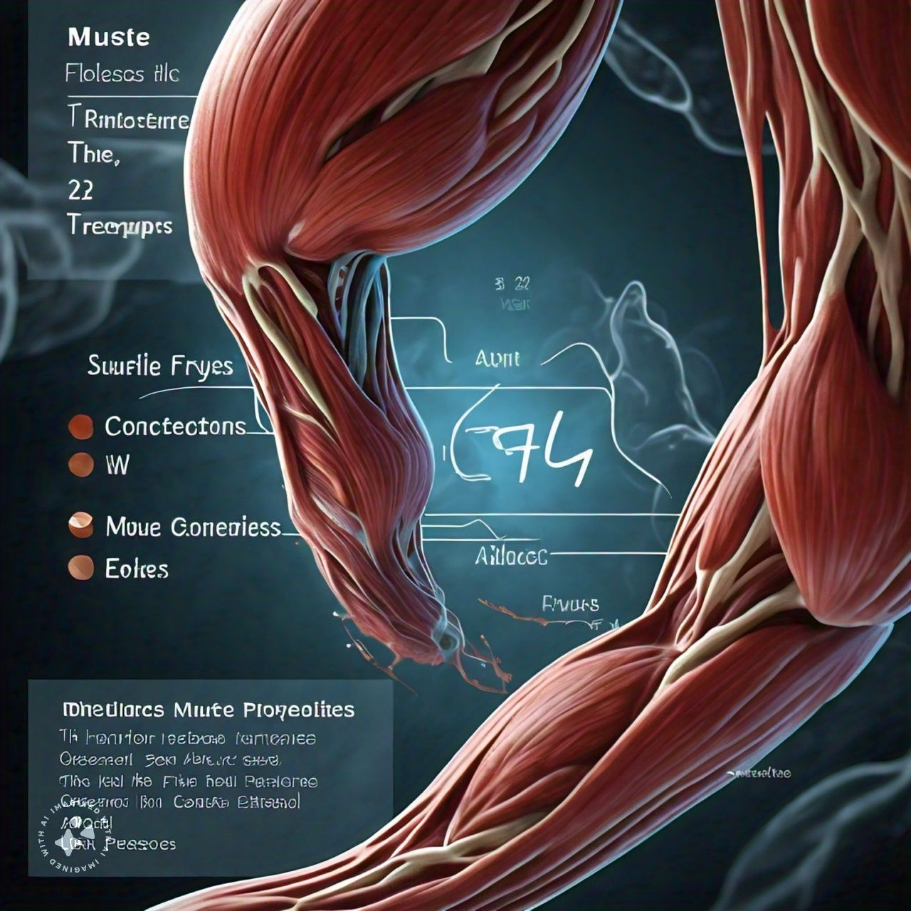
Introduction
To develop a wearable IoT device integrated with EMG, accelerometer, and gyroscope sensors to continuously capture muscle activity data and design a user-friendly interface to visualize and interpret muscle analysis results, providing real-time feedback and recommendations.
EMG sensor: Tracks muscle activity for fatigue detection.
Accelerometer & Gyroscope: Analyze movement patterns for efficiency.
Machine learning analyzes sensor data, providing:
Real-time feedback: Optimize workouts and prevent injuries.
Personalized recommendations: Maximize results and minimize risk.
A user-friendly interface displays insights, empowering you to achieve your fitness goals!

Slide 3
Features:
Real-time Muscle Activity Monitoring
User wears the device in the designated spot for different workouts and get a real time monitoring.
Performance Score
Performance scoring to ensure proper exercise form and maximize workout effectiveness.
Fatigue Score
Provides a real-time assessment of muscle fatigue based on EMG data analysis.
Alerting Overexertion Levels
When the Fatigue Score reaches a pre-defined level indicating potential overexertion, the system triggers an alert.
Rhythm Score
This feature analyzes movement patterns using data from the accelerometer and gyroscope. It evaluates how smoothly and consistently a user performs an exercise repetition, providing a score

Slide 4
Requirements:
Hardware:
Myoware 2.0 EMG Sensor
Myoware Cables
Myoware Power Shield
EMG electrodes
Accelerometer, Gyroscope, Magnetometer Sensor (ICM-20948)
ESP32
Miscellaneous
Software:
Eclipse - ESP IDF for Embedded Programming
MATLAB for Signal Processing
Python for Machine Learning
AWS IOT Core / EMQX
AWS Cloud
Processing

Slide 5
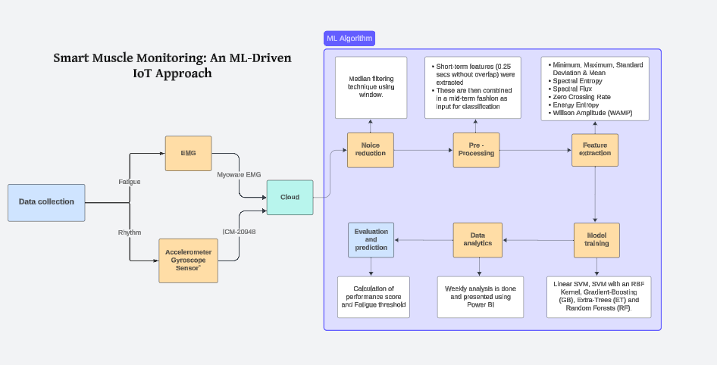
Approach:

Slide 6
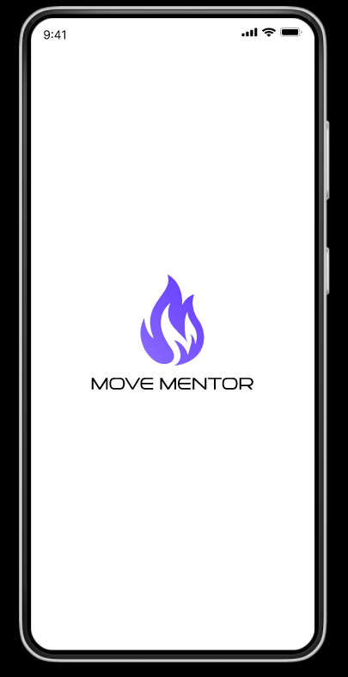
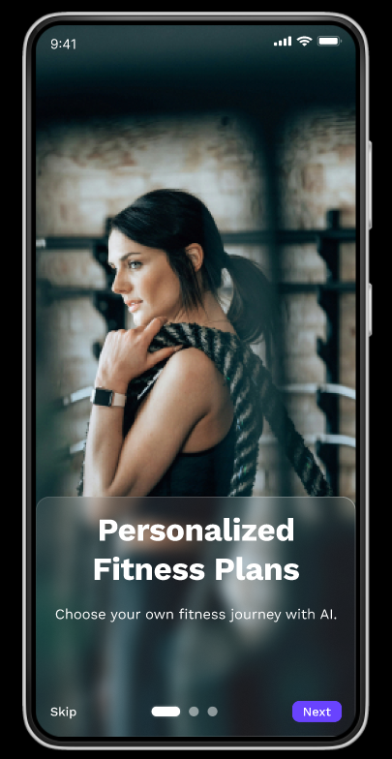
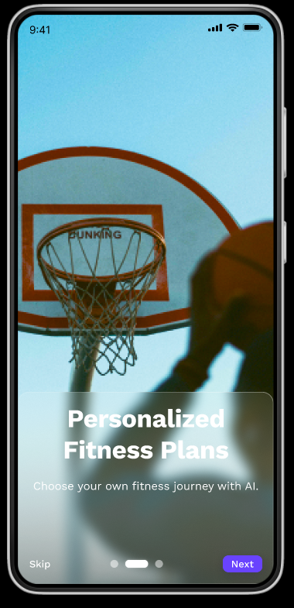
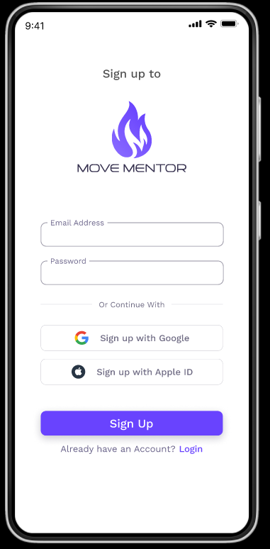
Design:

Slide 7
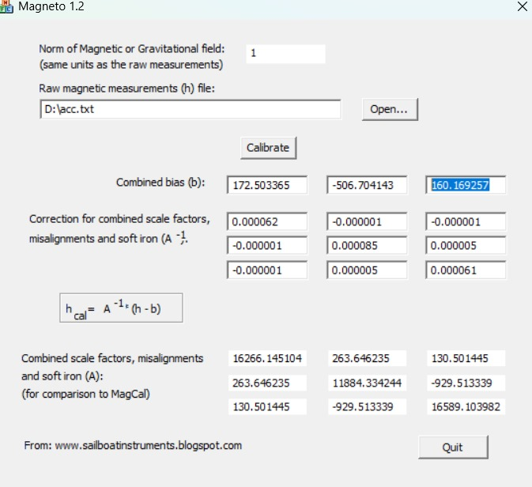
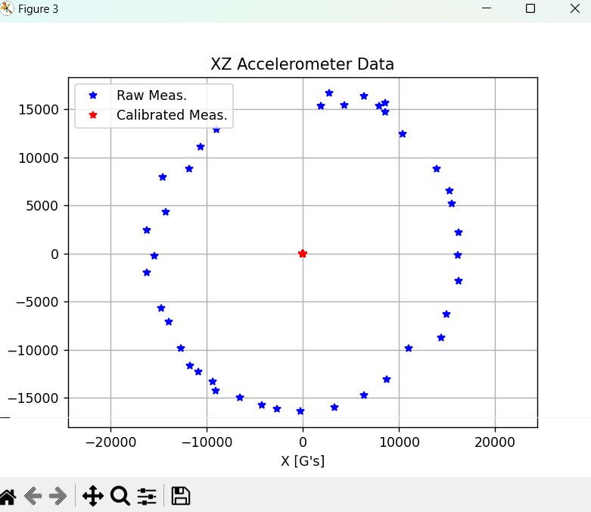
Calibrating ICM-20948 Sensor values
Experimental Results:

Slide 8
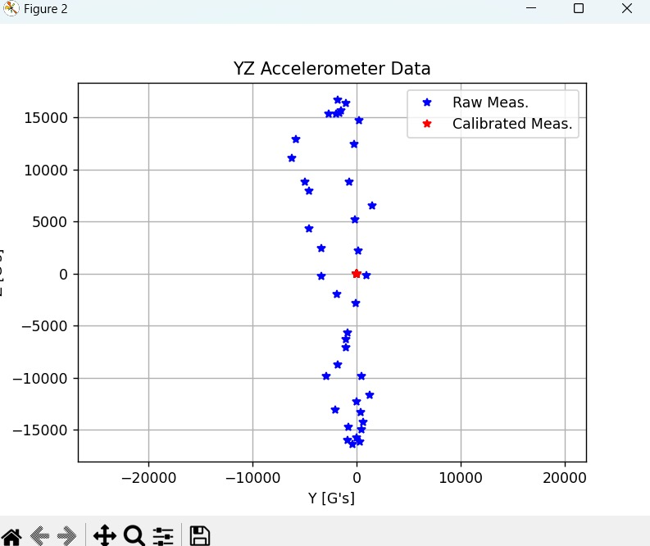
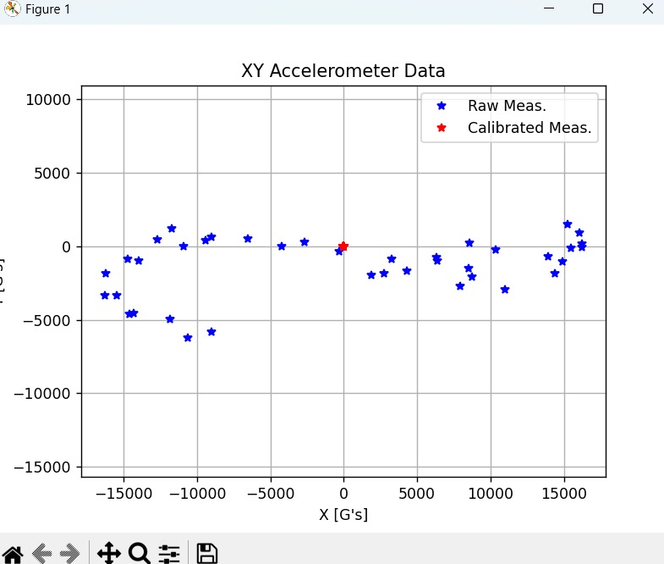

Slide 9
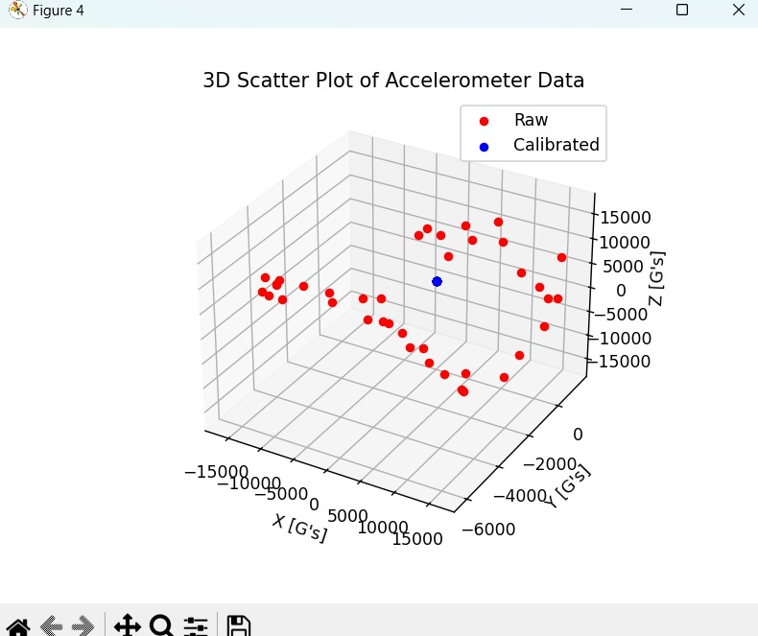

Slide 10
Thanks!

