Slide 1

Presented by:
Prabin Silwal
Nikesh Maharjan
Rasila Maharjan
Bijay Thapa

Slide 2
Topics of Presentation
Interpersonal communication
Organizational communication
Formal and informal communication
Communication process
Functions of communication

Slide 3
Interpersonal communication
an exchange of information between two or more people
often defined as the communication that takes place between people who are interdependent and have some knowledge of each other

Slide 4
Organizational communication
sending and receiving of messages among interrelated individuals within a particular environment or setting to achieve individual and common goals

Slide 5
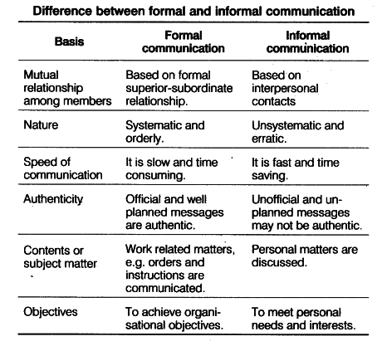
Formal and informal communication

Slide 6
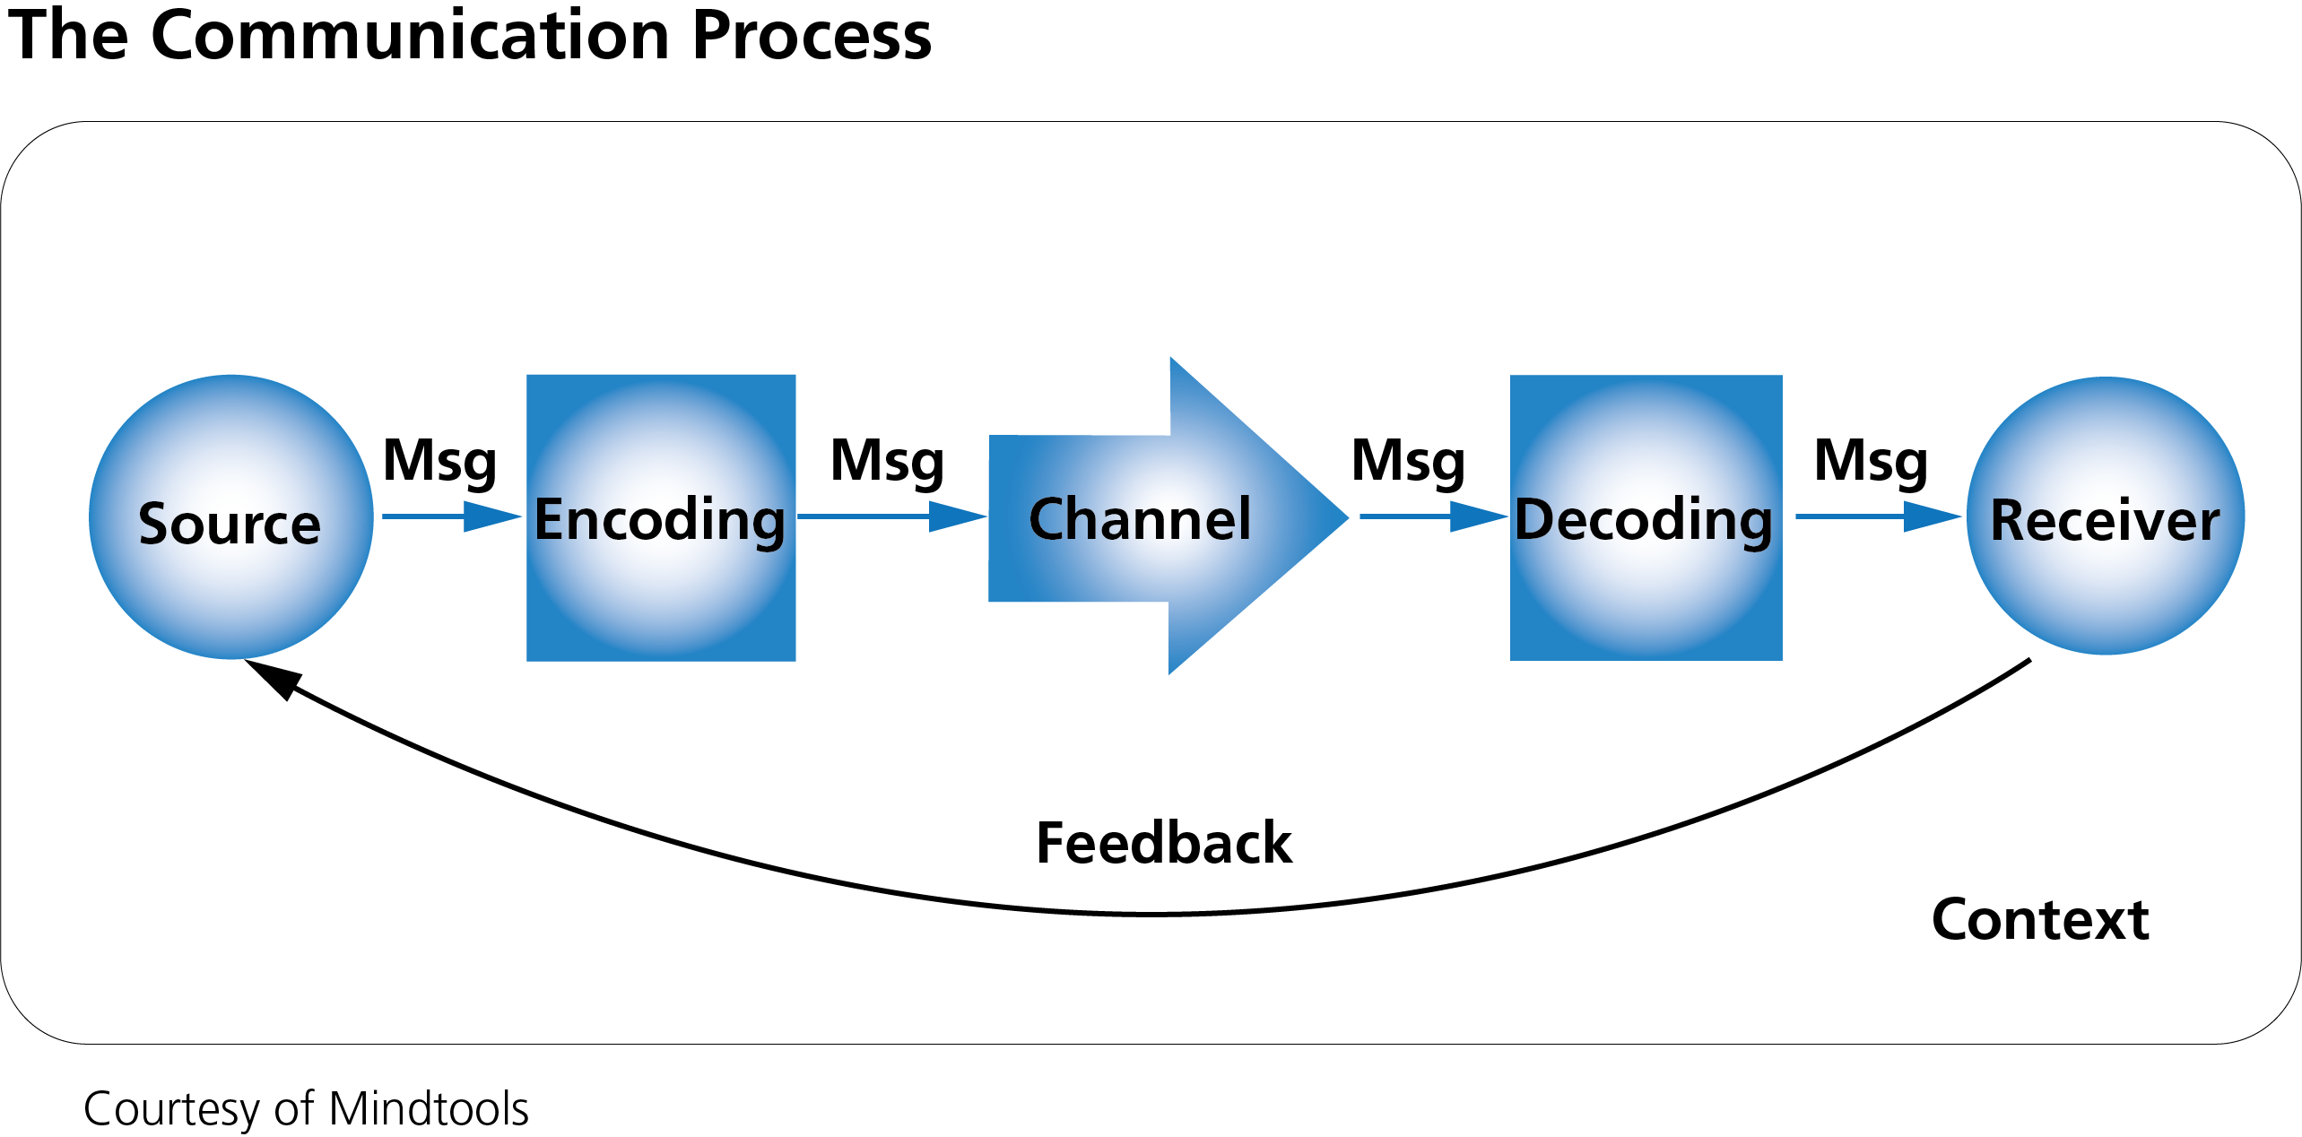
Communication process

Slide 7
Functions of communication
Control:
Communicate job related grievances.
To comply with company policy
To follow job description
Motivation:
Foster motivation by clarifying what needs to be done
How well employees are doing
What can be done to improve performance

Slide 8
Emotional Expression:
For many employees the work group is a primary source of social intraction. They share their feelings of frustration and satisfaction with each other.
Information:
Primary role relating to decision making by transmitting data and evaluating different choices

Slide 9
Any Question ?

Slide 10
Thank You!

