Slide 1
CAPSTONE PROJECT
Employee Attrition Analytics

Slide 2
HR Data Analysis Using Python
Project Submitted By :
Niket Chaudhari
Krishna Yadav
Mahesh Tamrakar
Madhubala JeyaMurugesan
Mentor : Prashant Sharma

Slide 3
Index
Introduction 4 Overview of the Problem 5
Problem Statement 6 Data Given 7
Merging Datasets 8 Identify factors influencing attrition 10
Missing value Interpretation 11 Tenure 12
Merged Dataset 13 Identification of Target Variable 14
Visualization of Target Variable 15 Theory of chi_square test, anova and correlation 16
Chi_Square Test 17 A nova Test 18
t-Test 19 2ND OBJECTIVE 21
Multi-collinearity 22 Min-Max Scaling 24
Encoding 26 Train Test Splitting 27
Model Building 28 Logistic Regression 29
Decision Tree Classifier 30 Random Forest Classifier 31
SVM 32 KNN 33
Model Building 34 Logistic Regression 35
Random Forest Classifier 36 ROC Graphs 37
Risk Category 38 3rd Objective 39
Strategic Retention Plan 40 Decision For this Particular Dataset 42
Suggestion to control attrition 43

Slide 4
INTRODUCTION
HR analytics enables HR professionals to make data-driven decisions to retain employees.
It helps leaders make decisions to create better work environments and maximize employee productivity, Control Attrition, Predict future attrition and how to retain high performer’s.

Slide 5
OVERVIEW OF THE PROBLEM
In other words, the cost of replacing employees for most employers remains significant.
This is due to the amount of time spent to interview and find a replacement, sign-on bonuses, and the loss of productivity for several months while the new employee gets accustomed to the new role.
In this project we will have to identify the factors contributing to attrition of the employees and recommend possible solutions.
The files contain complete staff utilization reports for all employees of the XYZ Corp. through 2016-2018.
The data contains details of employees as well as the details of the projects that they have worked on in the last two years.
The other file contains all the attrition in the organization for the years 2015-18 with details such as reason of attrition along with other employee details.

Slide 6
PROBLEM STATEMENT
Understanding why employees are most likely to leave can lead to actions to improve employee retention as well as possibly planning new hiring in advance.
In this study, we will attempt to solve the following problem statement is :
Factors influencing attrition
Predict possible attritions
Identify possible ways to retain high performers

Slide 7
DATASET GIVEN
staff utlz latest 16-17_masked.xlsx
It has 787 rows and 115 columns.
staff utlz latest 17-18_masked.xlsx
It has 971 rows and 115 columns.
Terminations 15-18.xlsx
It has 293 rows and 9 columns.
As this sheet contains only “Resigned” employees data.
Hence we have not considered this sheet for model building.

Slide 8
MERGING DATASETS
We have used “OUTER JOIN” to merge two datasets.
staff utlz latest 16-17_masked.xlsx
staff utlz latest 17-18_masked.xlsx
Employee No

Slide 9
MERGING DATASETS
staff utlz latest 16-17_masked.xlsx | staff utlz latest 17-18_masked.xlsx | Merged Dataset
Employee No_x | Employee No_y | Employee No
Profit Center_x | Profit Center_y | Latest Profit Center
Employee Position_x | Employee Position_y | Latest Employee Position
Employee Location_x | Employee Location_y | Latest Employee Location
People Group_x | People Group_y | Latest People Group
Employee Category_x | Employee Category_y | Latest Employee Category
Supervisor name_x | Supervisor name_y | Latest Supervisor name
Join Date_x | Join Date_y | Join Date
Current Status_x | Current Status_y | Latest Current Status
Termination Date_x | Termination Date_y | Termination Date
Total Hours_x | Total Hours_y | Overall Total Hours
Total Available Hours_x | Total Available Hours_y | Overall Total Available Hours
Work Hours_x | Work Hours_y | Overall Work Hours
Leave Hours_x | Leave Hours_y | Overall Leave Hours
Training Hours_x | Training Hours_y | Overall Training Hours
BD Hours_x | BD Hours_y | Overall BD Hours
NC Hours_x | NC Hours_y | Overall NC Hours
Utilization%_x | Utilization%_y | Overall Utilization%

Slide 10
1ST OBJECTIVE
IDENTIFY FACTORS INFLUENCING ATTRITION

Slide 11
MISSING VALUE INTERPRETATION
Merged Dataset | Missing Values | Missing value imputation method | No of missing values
Employee No
Latest Profit Center
Latest Employee Position | P | Mode Value | 9
Latest Employee Location
Latest People Group
Latest Employee Category
Latest Supervisor name | P | Decision Tree | 16
Join Date
Latest Current Status
Termination Date | P | Last Date (01-04-2018) | 834
Overall Total Hours
Overall Total Available Hours
Overall Work Hours
Overall Leave Hours
Overall Training Hours
Overall BD Hours
Overall NC Hours
Overall Utilization%

Slide 12
TENURE
As variables “Join Date” & “Termination Date” individually has no importance in dataset.
But using above variables, we have found out the new variable – “Tenure”.
And “Tenure” is calculated as :
Tenure = year of (Termination Date) – year of (Join Date)

Slide 13
MERGED DATASET
Column Name | Data-Type | Missing Values
Employee No | Numerical | 0
Latest Current Status | Categorical | 0
Latest Employee Position | Categorical | 0
Latest Profit Center | Categorical | 0
Latest Employee Location | Categorical | 0
Latest People Group | Categorical | 0
Latest Employee Category | Categorical | 0
Latest Supervisor name | Categorical | 0
Overall Total Hours | Numerical | 0
Overall Total Available Hours | Numerical | 0
Overall Total Work Hours | Numerical | 0
Overall Total Leave Hours | Numerical | 0
Overall Total Training Hours | Numerical | 0
Overall Total BD Hours | Numerical | 0
Overall Total NC Hours | Numerical | 0
Overall Total Utilization% | Numerical | 0
Tenure | Numerical | 0
No. of variables : 17 Nos.
No. of observations : 1111 Nos.

Slide 14
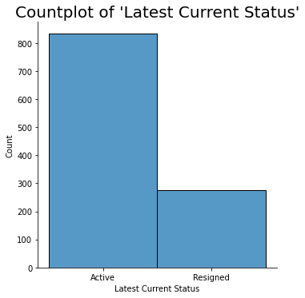
IDENTIFICATION OF TARGET VARIABLE
Variable “Latest Current Status” is the Target Variable.
As our target variable contains following types of employee status :
New Joiner
Secondment
Sabbatical
Active
Resigned
We have converted status of “New Joiner”, “Secondment”, “Sabbatical” as “Active”
No. of “Active” Employees : 834
No. of “Resigned” Employees : 277
Percentage of “Active” Employees : 75.07 %
Percentage of “Resigned” Employees : 24.93 %

Slide 15
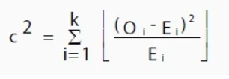
Chi_square test
A chi-square statistic is way to show a relationship between two categorical variables.
The chi-squared statistic is a single number that tells you how much difference exists between your observed counts and the counts you would expect if there were no relationship at all in the population.
Where
O = Observed value
E = Expected value.
Null Hypothesis : There is NO relationship between two variables.
Alternate Hypothesis : There is a relationship between two variables.

Slide 16
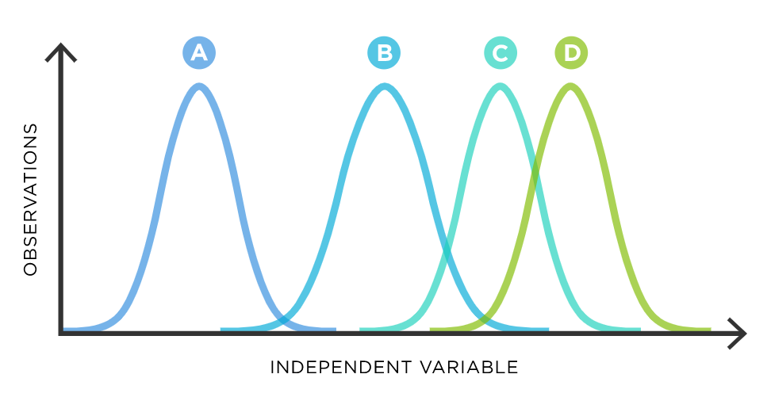
Anova test
ANOVA test is way to show a relationship between categorical variable & numerical variable..
ANOVA determines whether the groups created by the levels of the categorical variable are statistically different by calculating whether the means of the treatment levels are different from the overall mean of the numerical variable.
Null Hypothesis : True difference between these group means is zero.
Alternate Hypothesis : True difference between these group means is NOT zero.

Slide 17
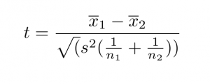
T-test
T-test is used to show a relationship between categorical variable & numerical variable..
A t-test is a statistical test that is used to compare the means of two groups.
It is often used in hypothesis testing to determine whether a process or treatment actually has an effect on the population of interest, or whether two groups are different from one another.
Where
t : t-value
x₁ , x₂ : means of the two groups being compared,
s₂ : pooled standard error of the two groups
n₁ , n₂ : the number of observations in each of the groups.
Null Hypothesis : True difference between these group means is zero.
Alternate Hypothesis : True difference between these group means is NOT zero.

Slide 18
RELATIONSHIP BETWEEN TARGET VARIABLE WITH OTHER VARIABLES
Column Name | Data-Type | Test | P-Value | Dependency
Latest Employee Position | Categorical | Chi-Square Test | 0.004354638 | Dependant
Latest Profit Center | Categorical | Chi-Square Test | 1.77E-28 | Dependant
Latest Employee Location | Categorical | Chi-Square Test | 0.174651655 | Independent
Latest People Group | Categorical | Chi-Square Test | 0.46581141 | Independent
Latest Employee Category | Categorical | Chi-Square Test | 6.6838E-200 | Dependant
Latest Supervisor name | Categorical | Chi-Square Test | 6.84349E-09 | Dependant
Overall Total Hours | Numerical | Anova / T-test | 7.10846E-32 | Dependant
Overall Total Available Hours | Numerical | Anova / T-test | 3.80729E-30 | Dependant
Overall Total Work Hours | Numerical | Anova / T-test | 1.55533E-23 | Dependant
Overall Total Leave Hours | Numerical | Anova / T-test | 4.12363E-23 | Dependant
Overall Total Training Hours | Numerical | Anova / T-test | 3.05104E-25 | Dependant
Overall Total BD Hours | Numerical | Anova / T-test | 0.009112316 | Dependant
Overall Total NC Hours | Numerical | Anova / T-test | 0.001310294 | Dependant
Overall Total Utilization% | Numerical | Anova / T-test | 3.21646E-05 | Dependant
Tenure | Numerical | Anova / T-test | 0.01074212 | Dependant
13 – Dependant Variable
2 - Independent Variable
No. of variables : 13 Nos.
No. of observations : 1111 Nos.

Slide 19
2ND OBJECTIVE
PREDICTION OF POSSIBLE ATTRITIONS

Slide 20

MULTI-COLINEARITY
R² value is determined to find out how well an independent variable is described by the other independent variables.
A high value of R² means that the variable is highly correlated with the other variables.
This is captured by the VIF which is denoted as :
Variables | VIF
Employee No | 6.91
Overall Total Hours | 417.23
Overall Total Available Hours | 342.02
Overall Total Work Hours | 46.07
Overall Total Leave Hours | 22.44
Overall Total Training Hours | 3.70
Overall Total BD Hours | 3.06
Overall Total NC Hours | 9.14
Overall Total Utilization% | 17.48
Tenure | 4.53
VIF starts at 1 and has no upper limit
VIF = 1, no correlation between the independent variable and the other variables
VIF exceeding 5 or 10 indicates high multi-colinearity between this independent variable and the others

Slide 21
Multicolinearity
“Overall Total Hours” , “Overall Total Available Hours” and “Overall Total Utilization%” has higher Multi-colinearity (Greater than 10 ).
Hence we remove such variables.
Variables | VIF
Employee No | 2.36
Overall Total Work Hours | 6.56
Overall Total Leave Hours | 9.29
Overall Total Training Hours | 3.57
Overall Total BD Hours | 1.50
Overall Total NC Hours | 3.00
Tenure | 3.40

Slide 22
MIN-MAX SCALING
Variables that are measured at different scales do not contribute equally to the model fitting & model learned function and might end up creating a bias.
Thus, to deal with this potential problem feature-wise normalization such as Min-Max Scaling is usually used prior to model fitting.
Min-Max scaling / Normalization is a scaling technique in which values are shifted and rescaled so that they end up ranging between 0 and 1.

Slide 23
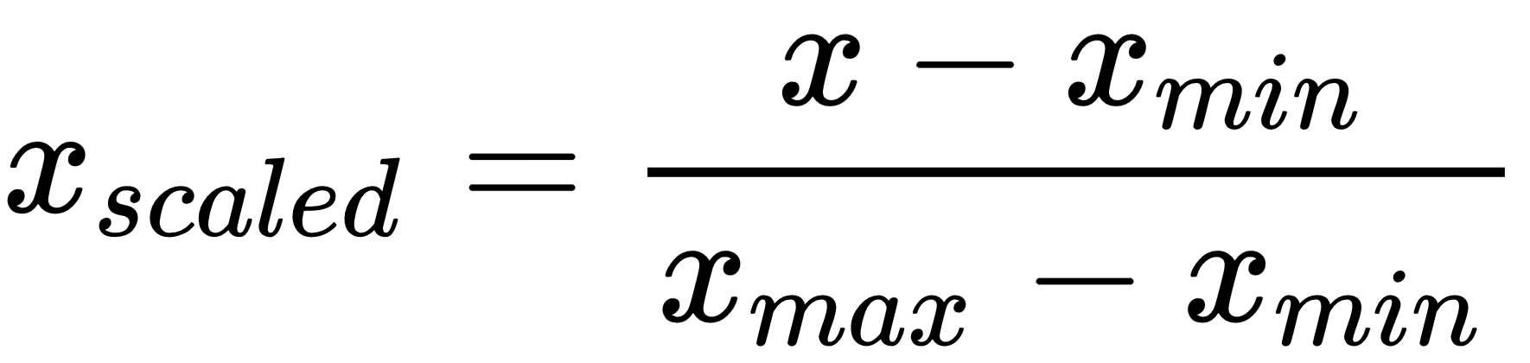
MIN-MAX SCALING
In this approach, the data is scaled to a fixed range - usually 0 to 1
Formula :
Tenure ( Before Scaling ) | Minimun Value | Maximum Value | Tenure ( After Scaling )
18 | 13 | 20 | 0.714
19 | 13 | 20 | 0.857
17 | 13 | 20 | 0.571
18 | 13 | 20 | 0.714
20 | 13 | 20 | 1.000
16 | 13 | 20 | 0.429
14 | 13 | 20 | 0.143
13 | 13 | 20 | 0.000
14 | 13 | 20 | 0.143
14 | 13 | 20 | 0.143
13 | 13 | 20 | 0.000

Slide 24
ENCODING
It usually happens that the variables represent vivid/ different types of categories.
Handling the huge number of groups in the data and feeding it to the model becomes a tedious and complex task as the size of the dataset increases and soon the ambiguity starts to increase.
It converts categorical data into dummy or indicator variables.
In statistics and econometrics, particularly in regression analysis, a dummy variable is one that takes only the value 0 or 1 to indicate the absence or presence of some categorical effect that may be expected to shift the outcome.
Profit Center | Profit Center_PC - 1 | Profit Center_PC - 2 | Profit Center_PC - 3 | Profit Center_PC - 4
PC – 1 | 1 | 0 | 0 | 0
PC – 2 | 0 | 1 | 0 | 0
PC – 4 | 0 | 0 | 0 | 1
PC – 1 | 1 | 0 | 0 | 0
PC – 3 | 0 | 0 | 1 | 0
PC – 3 | 0 | 0 | 1 | 0
PC – 1 | 1 | 0 | 0 | 0
PC – 2 | 0 | 1 | 0 | 0
PC - 4 | 0 | 0 | 0 | 1
After Encoding, Dataset contains
Nos. of Rows : 1111
Nos. of Columns : 191

Slide 25
TRAIN-TEST SPLITTING
Data
X
(Independent Variables)
Y
(Dependent Variables)
X_Train
( 75 % )
X_Test
( 25 %)
Y_Train
( 75 % )
Y_Test
( 25 % )
X_Train Dataset contains : 833 Nos. of Rows & 190 Nos. of Columns.
X_Test Dataset contains : 278 Nos. of Rows & 190 Nos. of Columns.
Y_train Dataset contains : 833 Nos. of Rows & 1 No. of Column.
Y_Test Dataset contains : 278 Nos. of Rows & 1 No. of Column.

Slide 26
MODEL BUILDING
As target variable ( Latest Current Status ) is Categorical in nature.
Hence we have following algorithms for model building :
Logistic Regression
Decision Tree Classifier
Random Forest
Support Vector Machine ( SVM )
K-Nearest Neighbor ( KNN)

Slide 27
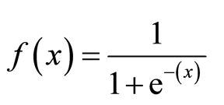
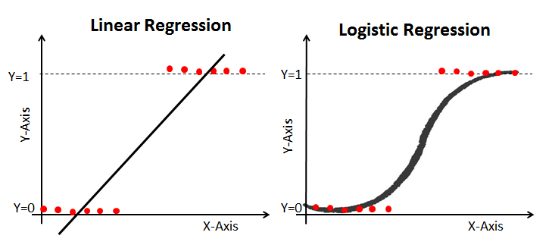
LOGISTIC REGRESSION
Logistic regression model uses the logistic function to squeeze the output of a linear equation between 0 and 1.
The logistic function is defined as :

Slide 28

DECISION TREE CLASSIFIER
It is a tree-structured classifier, where internal nodes represent the features of a dataset, branches represent the decision rules and each leaf node represents the outcome.
It is a graphical representation for getting all the possible solutions to a problem/decision based on given conditions.

Slide 29
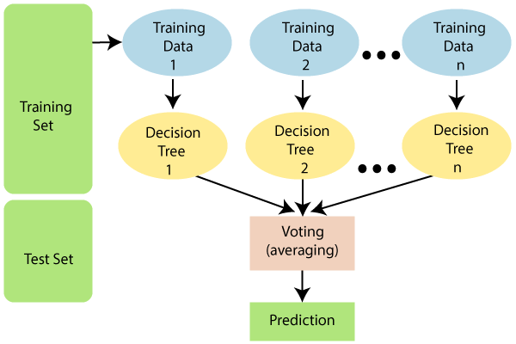
RANDOM FOREST
The random forest is a classification algorithm consisting of many decisions trees.
It uses bagging and feature randomness when building each individual tree to try to create an uncorrelated forest of trees whose prediction by committee is more accurate than that of any individual tree.
Instead of relying on one decision tree, the random forest takes the prediction from each tree and based on the majority votes of predictions, and it predicts the final output.

Slide 30
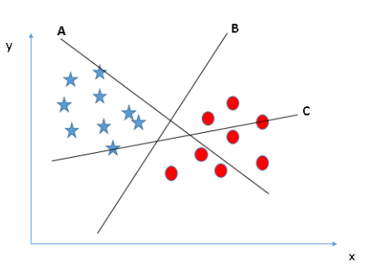
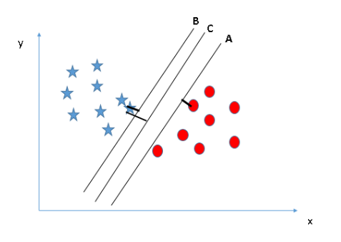
SUPPORT VECTOR MACHINE ( SVM )
In the SVM algorithm, we plot each data item as a point in n-dimensional space (where n is number of features) with the value of each feature being the value of a particular coordinate.
Then, we perform classification by finding the hyper-plane that differentiates the two classes very well.
Here, maximizing the distances between nearest data point (either class) and hyper-plane will help us to decide the right hyper-plane. This distance is called as Margin.

Slide 31
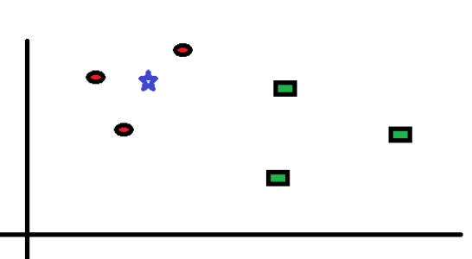
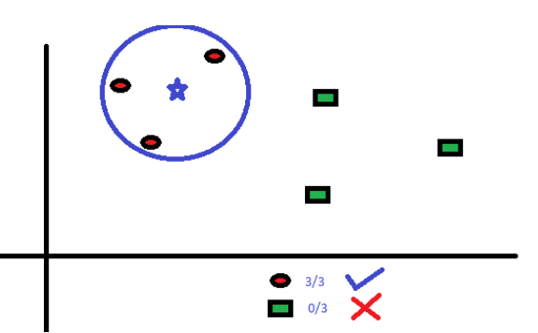
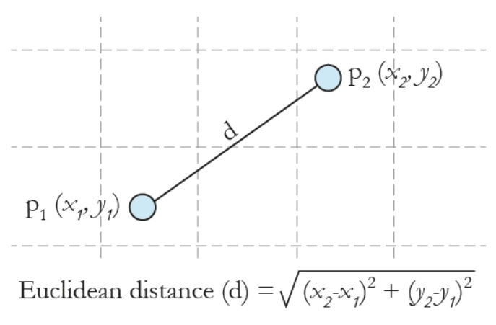
K-NEAREST NEIGHBOR ( KNN)
The KNN algorithm uses 'feature similarity' to predict the values of any new data points.
It stores all available cases and classifies new cases by majority vote of its K-neighbors.
This algorithm segregates unlabeled data points into well defined groups.
It classifies the data point on how its neighbor is classified.
It uses Distance Formula ( Euclidean Distance ) to calculate distance :

Slide 32
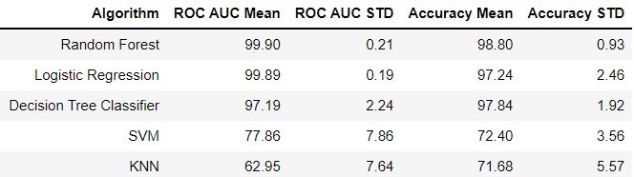
MODEL BUILDING
We first used a range of baseline algorithms (using out-of-the-box hyper-parameters) before we move on to more sophisticated solutions.
The algorithms considered in this section are :
Logistic Regression, Random Forest, SVM, KNN, Decision Tree Classifier.
We built the respective models with the help of training dataset.
Based on our ROC AUC comparison analysis, "Logistic Regression" and "Random Forest" show the highest mean AUC scores.
We shortlisted these two algorithms for further analysis.

Slide 33
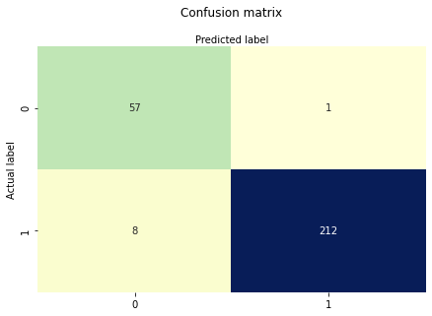
1) Logistic Regression
We used 10 fold Cross-Validation to train our Logistic Regression Model and estimate its AUC score.
The higher the AUC, the better the performance of the model at distinguishing between classes.
The Area Under the Curve (AUC) score (STD): 1.00
The Confusion matrix is telling us that we have :
212+57=269 correct predictions
8+1 = 9 incorrect predictions.
In other words, an accuracy of 96.76% on Test data

Slide 34
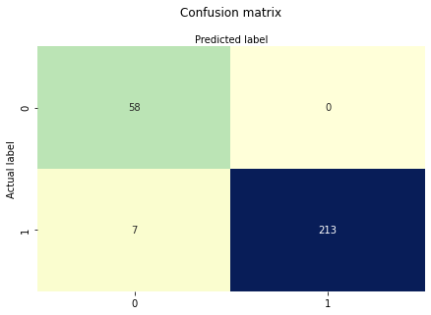
2) RANDOM FOREST CLASSIFIER
We used hyper-parameters tune by cross-validation to train our Random Forest Model.
The Confusion matrix is telling us that we have :
213+58 = 271 correct predictions
7+0 = 7 incorrect predictions.
In other words, an accuracy of 97.48% on Test data

Slide 35
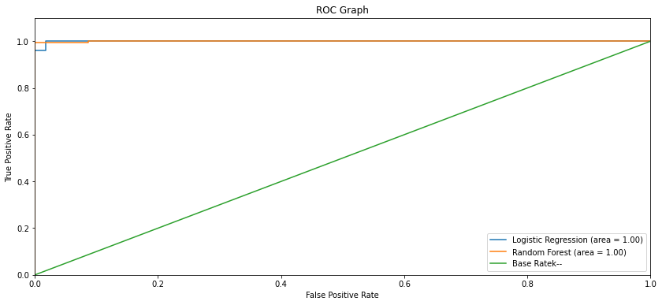
ROC Graphs
AUC - ROC curve is a performance measurement for classification problem at various thresholds settings.
ROC is a probability curve and AUC represents degree or measure of separability.
It tells how much model is capable of distinguishing between classes.
The green line represents the ROC curve of a purely random classifier.
A good classifier stays as far away from that line as possible (toward the top-left corner).
The Random Forest Classifier showed a higher AUC score compared to the Logistic Regression model.

Slide 36
Risk Category
Risk Category
As the company generates more data on its employees (on New Joiners and recent Leavers) the algorithm can be re-trained using the additional data and theoretically generate more accurate predictions to identify high-risk employees of leaving based on the probabilistic label assigned to each feature variable (i.e. employee) by the algorithm.
Employees can be assigned in 3 "Risk Categories" based on the predicted label such that :
Low-risk : For < 0.6
Medium-risk : Between 0.6 and 0.8
High-risk : For > 0.8
Employee No | Resigned Prob | Risk Category
900 | 0.803935 | High-risk
547 | 0.84985 | High-risk
187 | 0.139704 | Low-risk
847 | 0.148985 | Low-risk
419 | 0.937436 | High-risk
955 | 0.066818 | Low-risk
1059 | 0.081418 | Low-risk
689 | 0.087228 | Low-risk
407 | 0.920126 | High-risk
205 | 0.765383 | Medium-risk

Slide 37
3RD OBJECTIVE
IDENTIFY POSSIBLE WAYS TO RETAIN HIGH PERFORMERS

Slide 38
IMPORTANT VARIABLES BY
RANDOM FOREST
Latest Employee Category
Overall Total Work Hours
Overall Total Training Hours
Overall Total Leave Hours
Overall Total NC Hours
Tenure
Latest Profit Center

Slide 39
Visualization Based on Model
Latest Employee Category
People in “Confirmed Staff “ category have less chances to leave the company.
Overall Total Work Hours
People in category of 0-1500hr of Total work Hours have more chances to leave the company.
Overall Total Training Hours
People having Total Training Hours of “0-25” category have maximum number of attrition chances for the company.
As training hours increases proportion of attrition decreases.
Overall Total Leave Hours
People having Total Leave Hours of “0-200” category have maximum number of attrition chances for the company.
As Leave hours increases proportion of attrition decreases.
Overall Total NC Hours
People having Total NC Hours of “0-200” category have maximum number of attrition chances for the company.
As NC hours increases proportion of attrition decreases.
Tenure
People having Service Year of “0-2.5” shows maximum number of attrition.
As service year increases proportion of attrition decreases.
Latest Profit Centre
People Servicing Under profit center named “PC-1” ,“PC-2”, “PC-3” shows maximum number of attrition.
And People Servicing Under profit center named “PC- 4” ,“PC-5”, “PC-6” does not consist of active employees in it .Hence we can appoint special committee to investigate the reason behind the attrition.

Slide 40
Suggestion To Control Attrition
From having regular fun activities and team bonding sessions on quarterly basis in CEO’s townhall and leadership All-Hands event, everything counts when it comes to keeping your employees engaged at the workplace.
Trainings can be provided to people who are interested in other Technologies or Department .
Flexible work schedules helps the employees to manage their work-life balance. Offering remote work options, flexible timing, ability to choose day-offs, all help in offering flexibility. When employees can live their life outside work better, they are usually content and less distracted at work.
Whether it’s a top management policies, poor working conditions, or salary issues attrition is common in the field. Having said that if you think the number is alarmingly high, delve into the situation to figure out the root cause and take necessary actions before it starts affecting your reputation. Conducting an elaborate exit interview is one way to find the cause of the attrition.

Slide 41
Suggestion to control attrition
Show your employees they are valued and appreciated by offering them real-time recognition that celebrates their successes and their efforts. Make it specific, social and supported by tangible reward, and you, too, will be rewarded—with their loyalty.
A great boss knows how to challenge her people to accomplish tasks that may seem impossible. Be the boss that can push people out of their comfort zones and help them to achieve their goals. If you want your people to remain in your company, treat them well. You may have the most talented people but you may not be allowing them to develop professionally.
You can also give added perks like shares of company to employee who stays for more than 3 years. Introduce mandatory leave policy grade wise to control attrition to balance work and personal life. Rewards & Recognition award & certificate from head of department to top performers.
Company will publish the course which can help the employee development and career growth and if candidate clear the exam Company will pay the institute fee.
Staff who has reached the tenure of 3 years can be given Cashback by the company for confirmed staffs they can redeem that points in online shopping.

Slide 42
THANK YOU

