Slide 1


Git Branch
Presented By : NIket Mittal

Slide 2
Content
Introduction
Git and Github
Branch
Different types of commands
Implementation
Practical implementation in Github
Conclusion
Repository LInk

Slide 3
GIT
Git is the software to track changes in any set of files, usually used for the coordinating work among the programmers collaboratively developing source code during the development.
Goal
Open-Source
Repository
Speed, Data Integrity and support for distributed, non linear workflow.
Git is free and open source distributed version control system
Git also provide the support of github for the repository.

Slide 4


Branching in Git
Git branches are effectively a pointer to a snapshot of your changes. ... Instead of copying files from directory to directory, Git stores a branch as a reference to a commit. In this sense, a branch represents the tip of a series of commits—it's not a container for commits.
A branch represents an independent line of development. Branches serve as an abstraction for the edit/stage/commit process. You can think of them as a way to request a brand new working directory, staging area, and project history. New commits are recorded in the history for the current branch, which results in a fork in the history of the project.

Slide 5
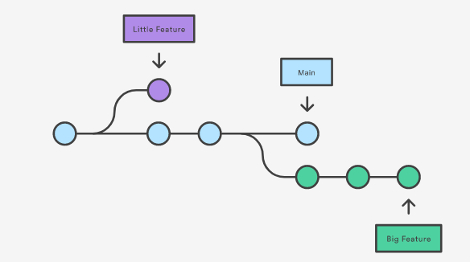

Slide 6
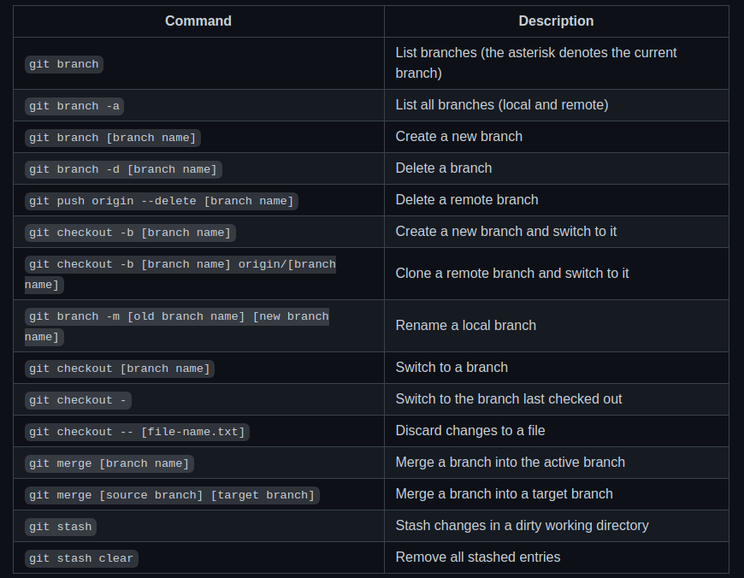
Commands

Slide 7
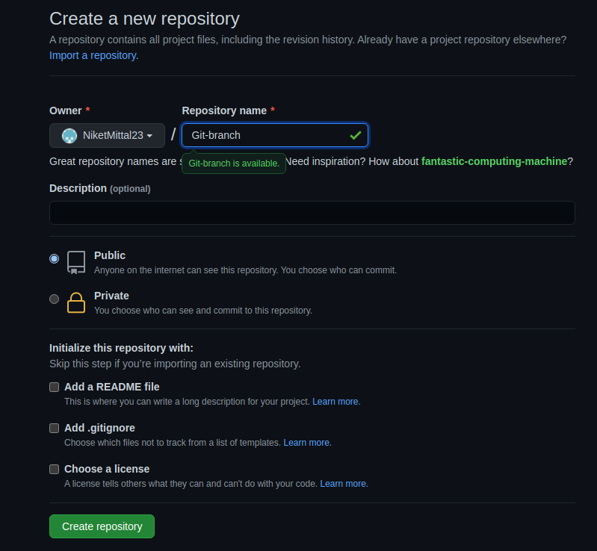
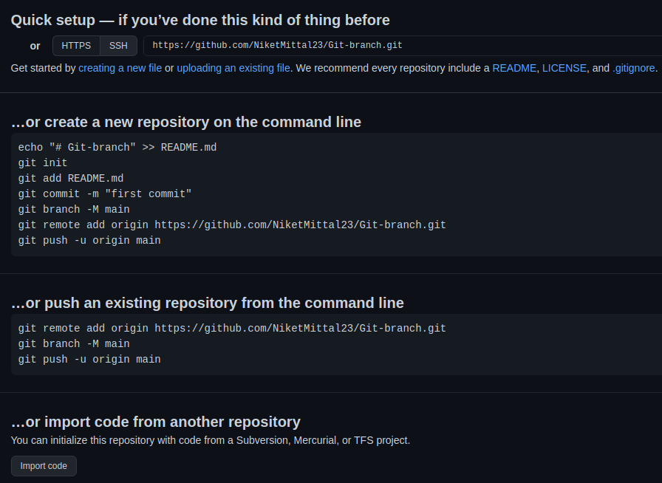
Creating a new Empty Repository in GitHub

Slide 8
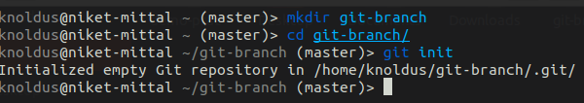
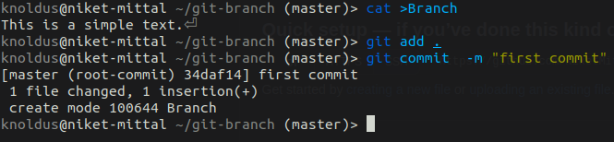
Making a new directory and initializing git on it
Making a new text file and committed that file

Slide 9
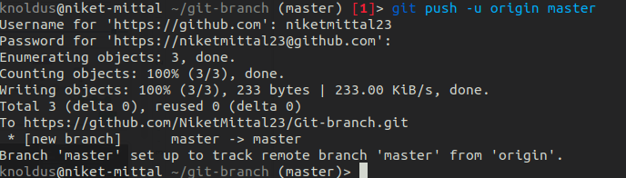
Pushing the file in the Repository

Slide 10

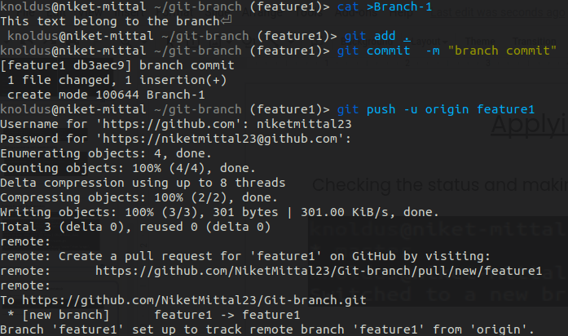
Applying Branch Commands
Checking the status and making a new branch
Creating a file in a branch and pushed in repo

Slide 11
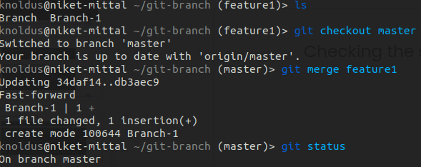
Checking the status and merged the feature branch in master branch

Slide 12
GitHub Link
https://github.com/NiketMittal23/Git-branch.git

Slide 13

Thank You!

