Slide 1
Transcript Intelligence
Insights from 100 AegisCloud Meeting Transcripts
Niket Sahai
niketsahai14@gmail.com

Slide 2
Executive Summary
Analysis of 100 meeting transcripts reveals key patterns in customer sentiment, feature requests, incident response, and churn risk.
Meetings span 3 call types: internal, support, external.
32 accounts assessed for churn risk.
51 unique feature gaps identified.
3 systemic issues flagged from internal discussions.
For: Product & Engineering Leadership

Slide 3
Methodology Overview
Pipeline uses VADER sentiment analysis (no API keys required).
Topic categorization via rule-based heuristics validated by TF-IDF clustering.
Churn risk scored on 0-10 scale using signal frequency, sentiment, and competitive mentions.
Feature gaps consolidated via fuzzy string matching and ranked by meeting frequency.
All processing runs locally with reproducible results.

Slide 4
Dataset Overview
100 meeting transcripts analyzed.
Call types: {'external': 43, 'internal': 30, 'support': 27}.
Total transcript sentences: 4,313.
Total key moments extracted: 402.

Slide 5
Topic Categorization: Key Findings
9 distinct topics identified.
Top topic: Comply (78 meetings).
Categorization methods: {'rule_based': 100}.
For: Product Managers

Slide 6
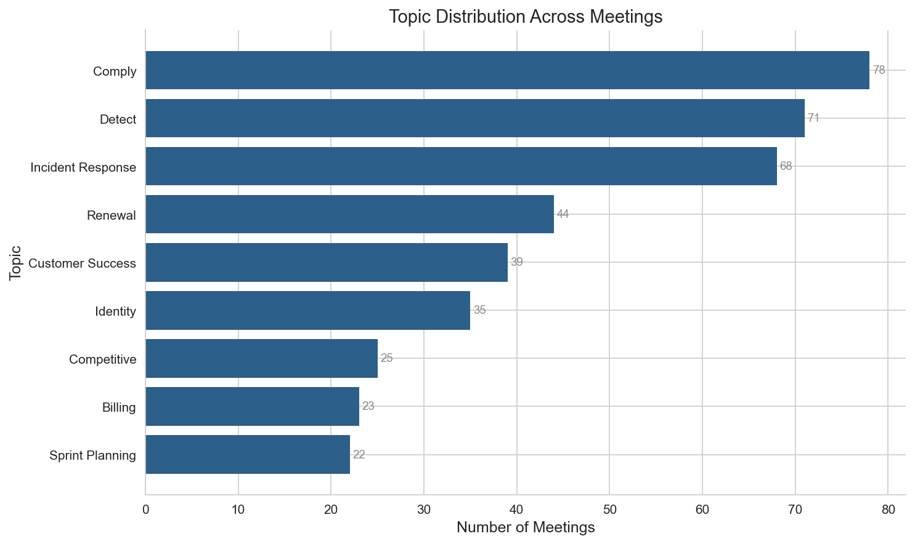
Topic Distribution
For: Product Managers

Slide 7
Sentiment Analysis: Key Findings
Sentiment Trend Summary:
- External calls: Sentiment remained stable over the period. Average sentiment is generally positive (3.95/5.0).
- Internal calls: Sentiment remained stable over the period. Average sentiment is generally positive (3.75/5.0).
- Support calls: Sentiment improved (+0.14) over the period. Average sentiment is generally positive (3.74/5.0).
For: Support Leaders

Slide 8
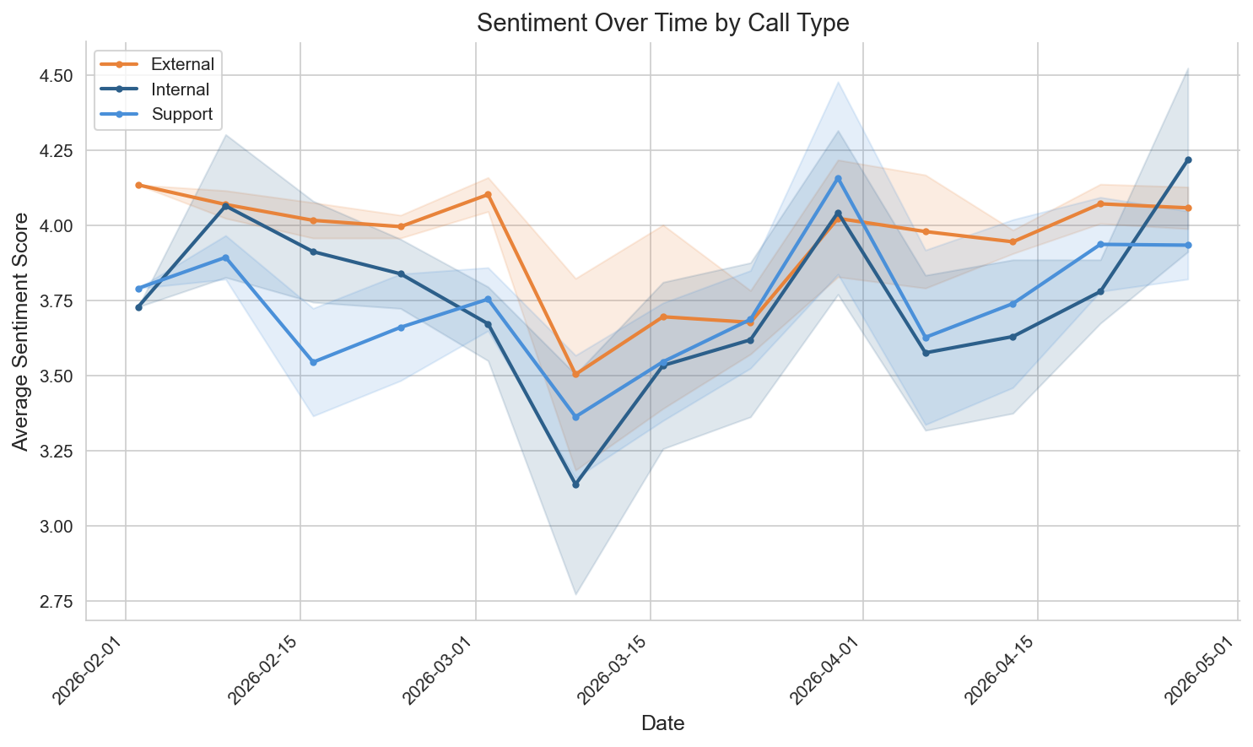
Sentiment Over Time by Call Type
For: Support Leaders

Slide 9
Churn Risk & Renewal Intelligence
29 accounts with non-zero churn risk.
Highest risk score: 10.0/10.
Risk factors: churn signals, negative sentiment, competitive mentions.
For: Sales Managers

Slide 10
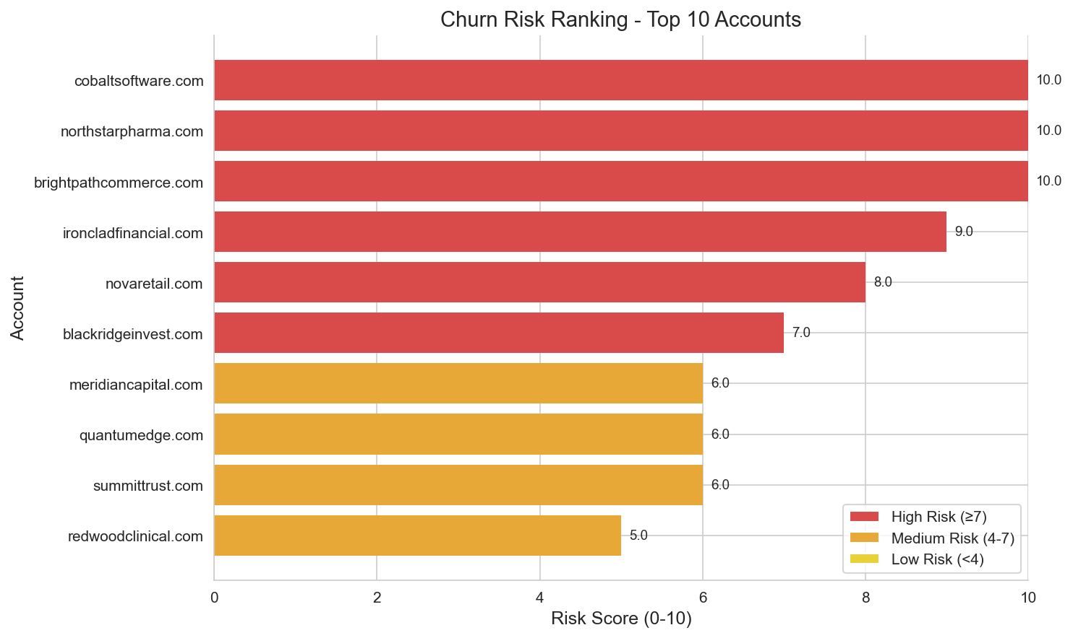
Churn Risk Ranking: Top At-Risk Accounts
For: Sales Managers

Slide 11
Feature Gap Analysis
51 unique feature gaps consolidated from 51 total mentions.
Product areas covered: ['Detect', 'Comply', 'Platform', 'Identity'].
For: Product Managers

Slide 12
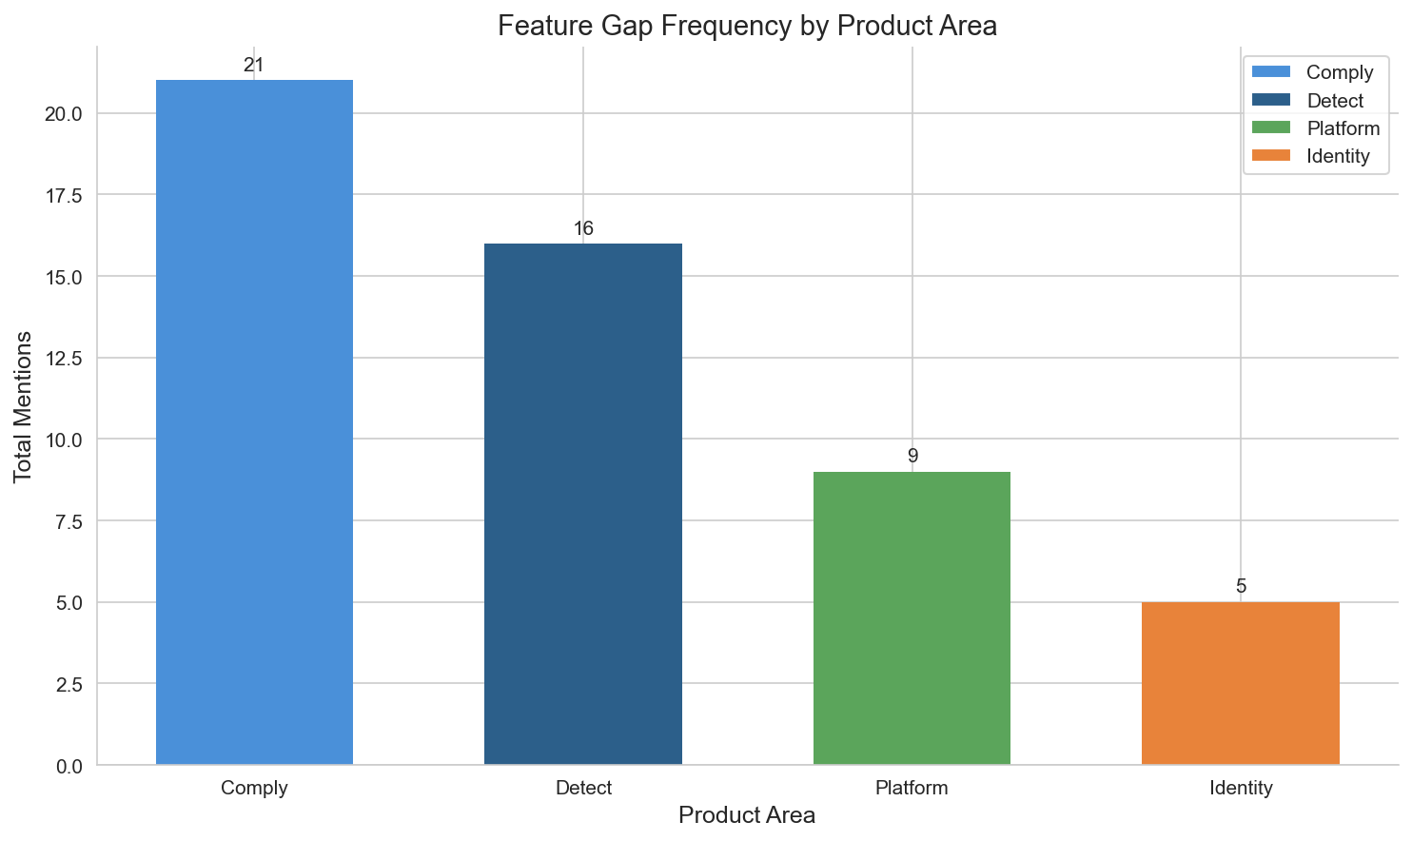
Feature Gap Frequency by Product Area
For: Product Managers

Slide 13
Incident Patterns & Team Health
3 systemic issues (3+ meeting mentions).
32 team health signals detected.
Components affected: ['event_processing', 'detect', 'other', 'comply', 'ui', 'infrastructure'].
For: Engineering Leads

Slide 14
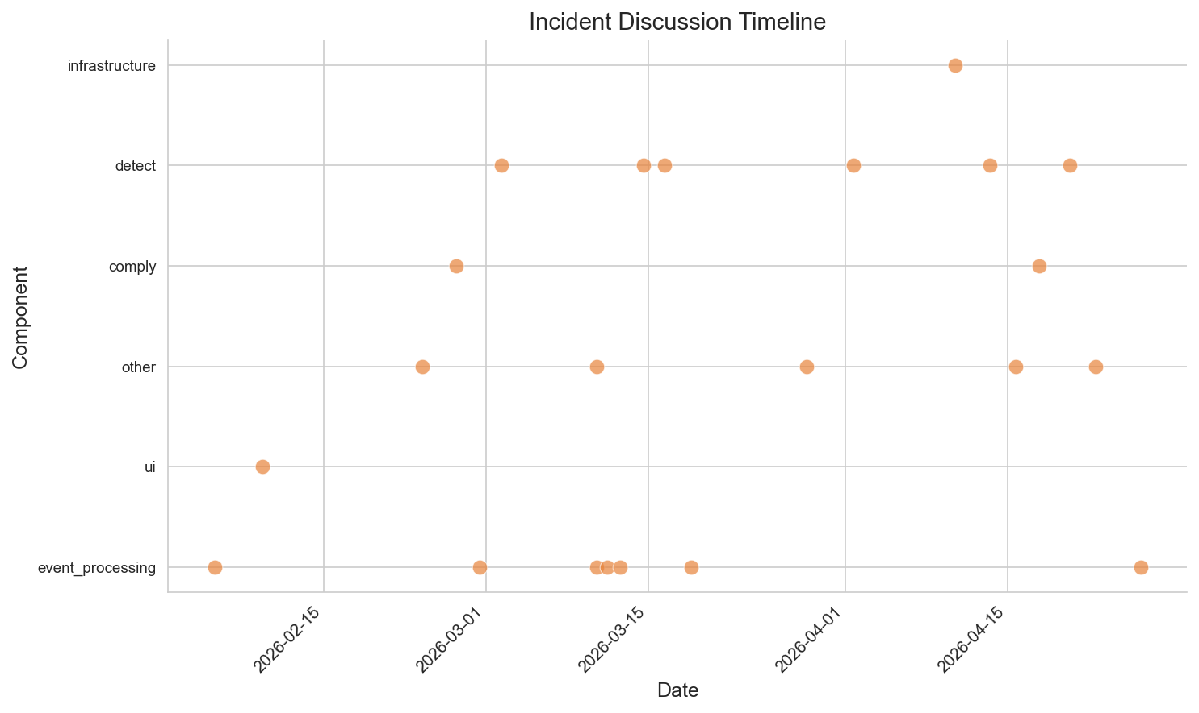
Incident Timeline
For: Engineering Leads

Slide 15
Support Issue Analysis
16 high-frustration support cases.
15 positive resolution patterns.
Top issue category: technical.
For: Support Leaders

Slide 16
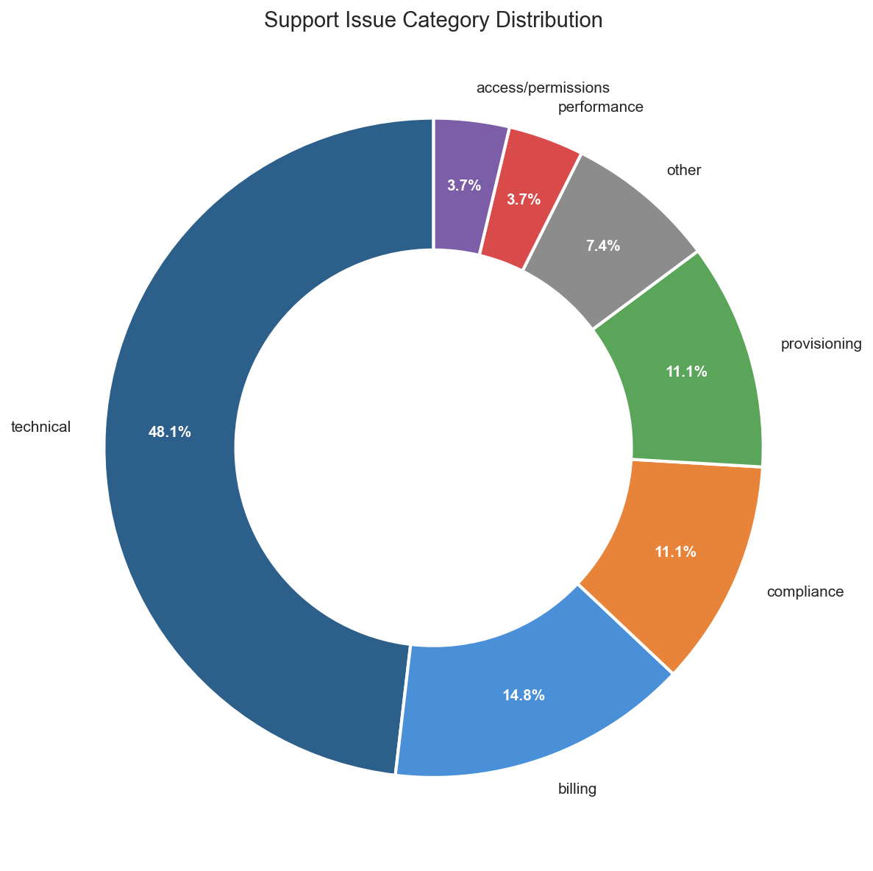
Support Issue Categories
For: Support Leaders

Slide 17
Recommendations
Prioritize retention outreach for high-risk accounts (see churn ranking).
Address top feature gaps in product roadmap planning.
Investigate systemic incidents for root cause resolution.
Optimize support workflows for high-frustration categories.
Continue monitoring sentiment trends across all call types.
For: Product & Engineering Leadership

Slide 18
Appendix: Methodology Details
Sentiment: VADER compound scores normalized to 1-5 scale
Topics: Rule-based heuristics validated by TF-IDF clustering
Churn Risk: Composite score from signals, sentiment, competitive mentions
Feature Gaps: Keyword-based product area assignment (Detect, Comply, Identity, Platform)
Incidents: Systemic threshold at 3+ meeting mentions
Support: Category assignment via title and summary keyword matching
All processing local — no external API dependencies

