Slide 1
Problem Statement: Binary Classification
To identify the risky customers for credit default dataset
To identify the characteristics and recommend suitable action
BY
NIKET SUNIL SHAH
Department of Business Economics

Slide 2
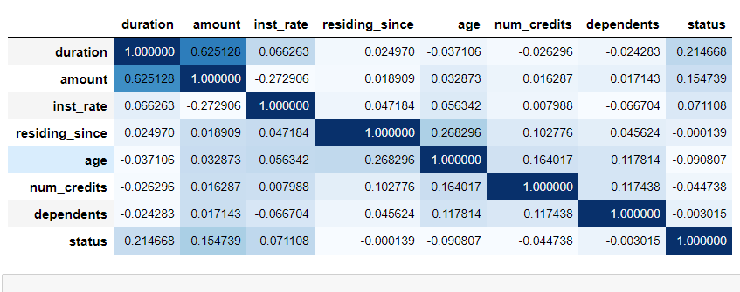
Correlation between existing features
There has been a positive correlation of default status with duration, amount and installment rate
formula
New Features created from the existing are: This news features showed great importance on status
Total_amount_with_int == amount * ((1 + rate / 100)^ duration/12))
Total_Int == Total_amount_with_int - amount
avg_amount_per_month == Total_amount_with_int/duration
intlmnt_per_depndnt == avg_amount_per_month/Dependents
Total_amount_with_int_deviation_from_mean == Total_amount_with_int – mean_Total_amount_with_int_per_purpose

Slide 3
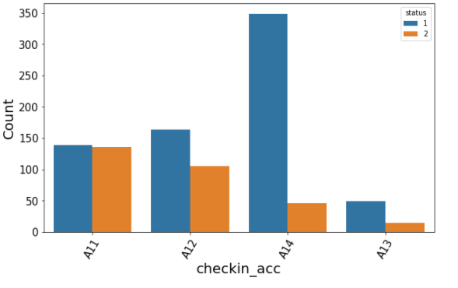
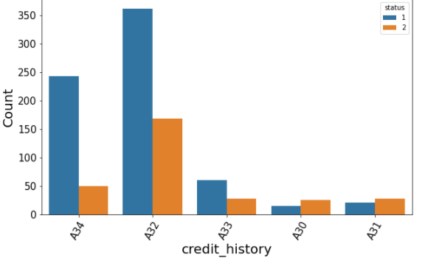
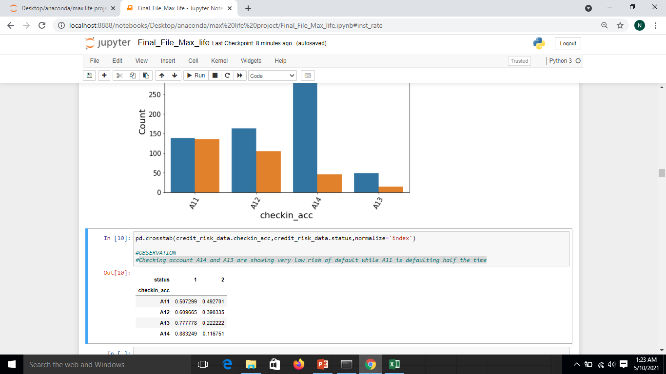
Characteristic features affecting default
Checking account A14 and A13 are showing very low risk of default while A11 is defaulting half the time
Credit history A30, A31 shows very high probability of default
Credit history of A34 shows the least probability of default.

Slide 4
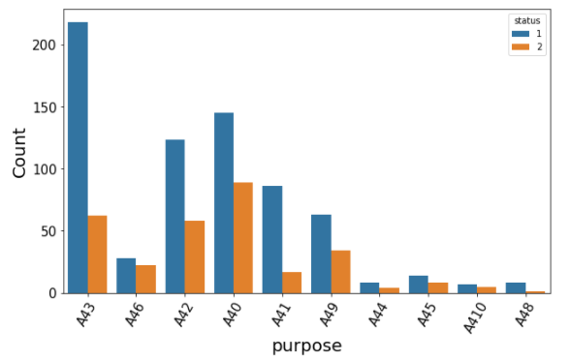
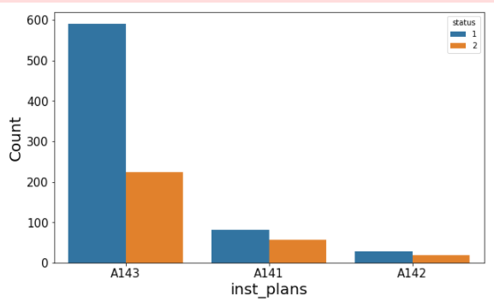
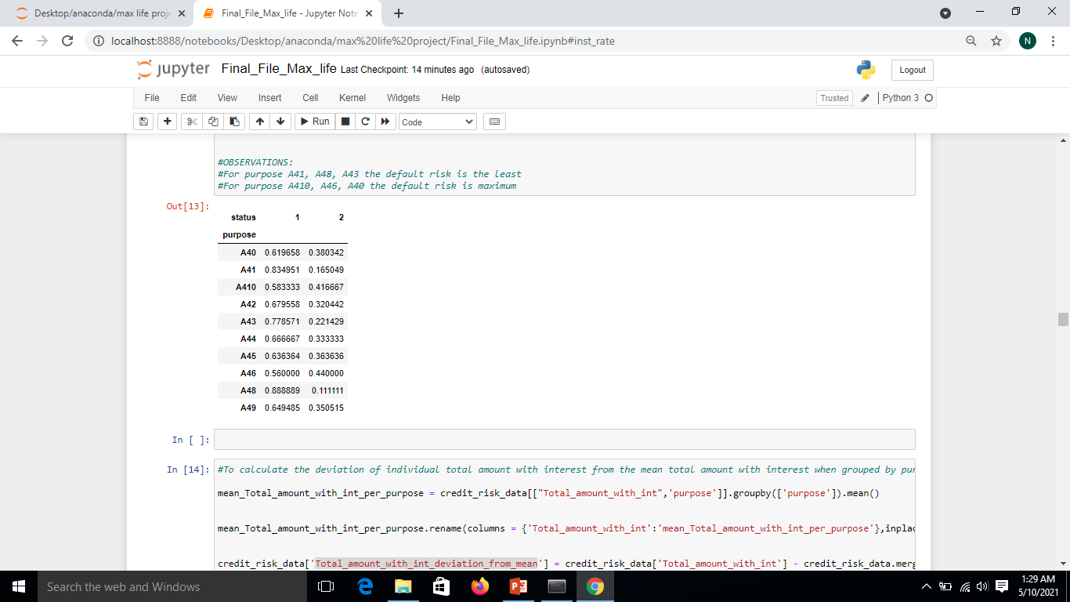
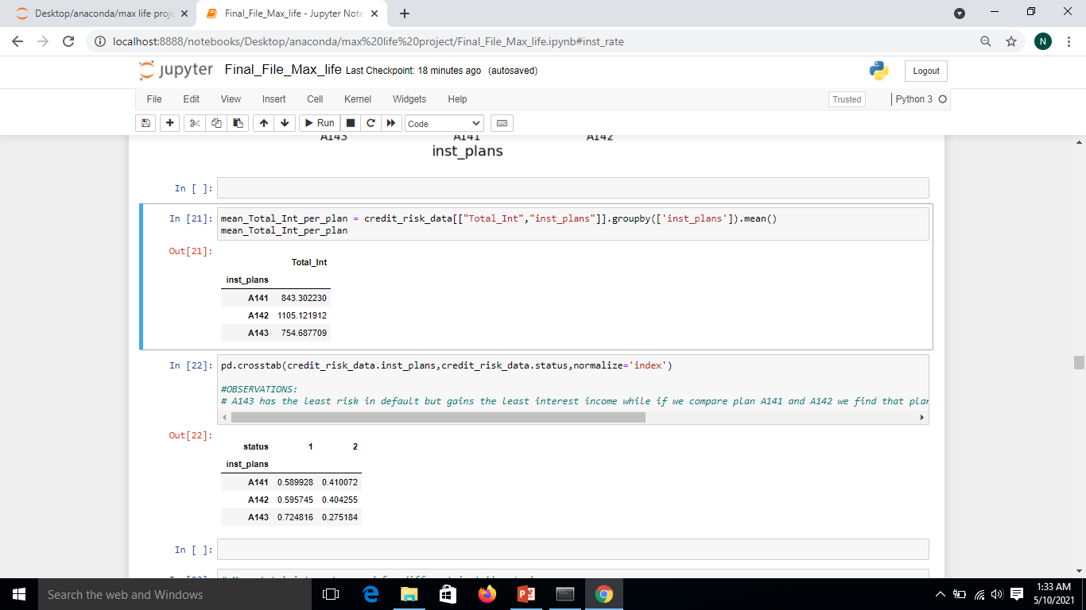
For purpose A41, A48, A43 the default risk is the least
For purpose A410, A46, A40 the default risk is maximum
A143 has the least risk in default but gains the least interest income while if we compare plan A141 and A142 we find that plan 142 earns higher interest and still the default risk is better compared to A141.

Slide 5
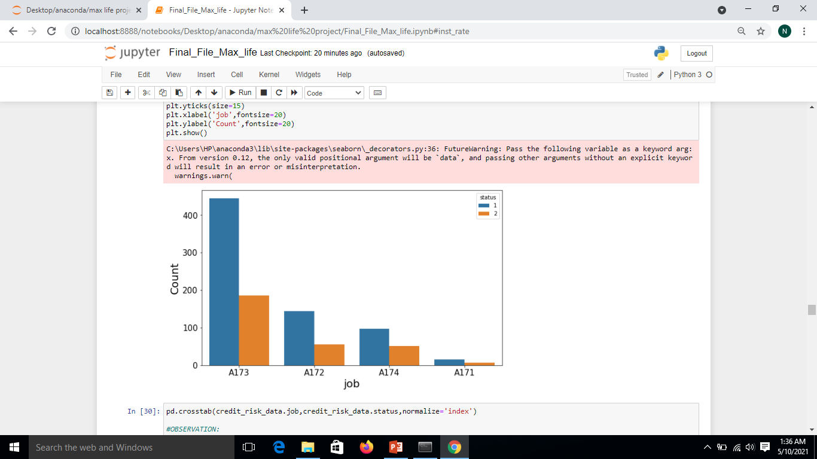
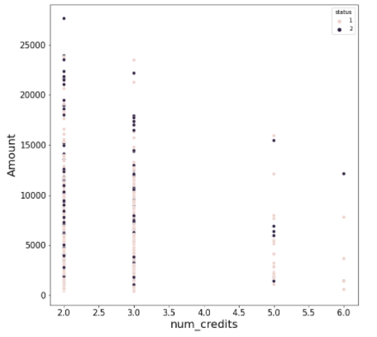
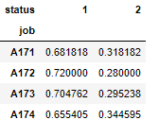
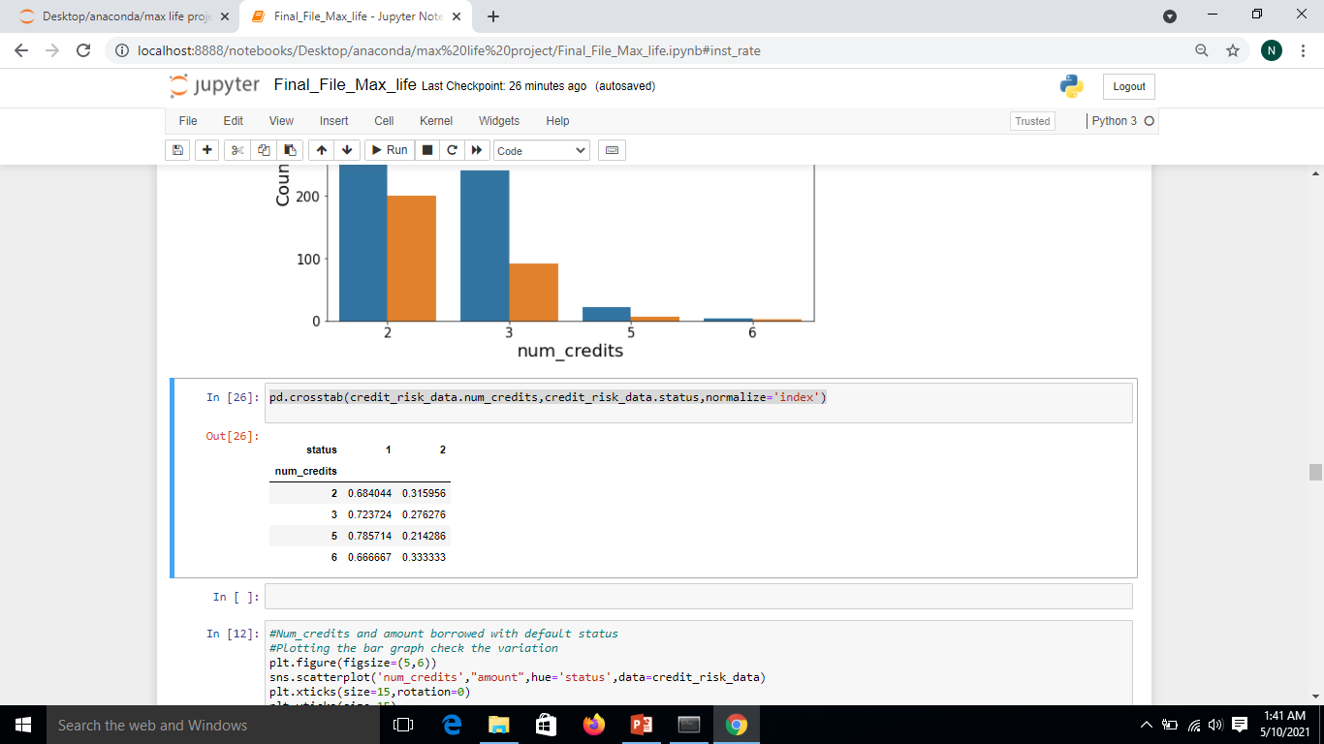
Person having Job A173 has the least default risk while person with job A174 has highest risk of default.

Slide 6
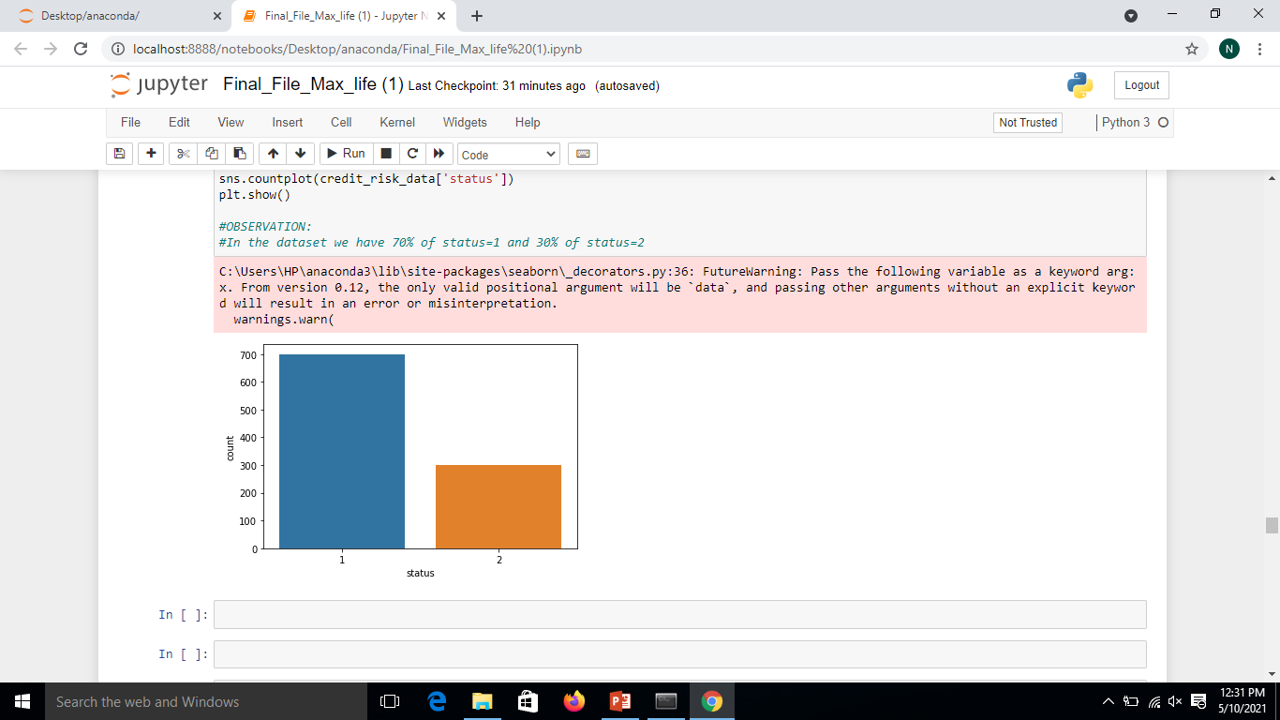
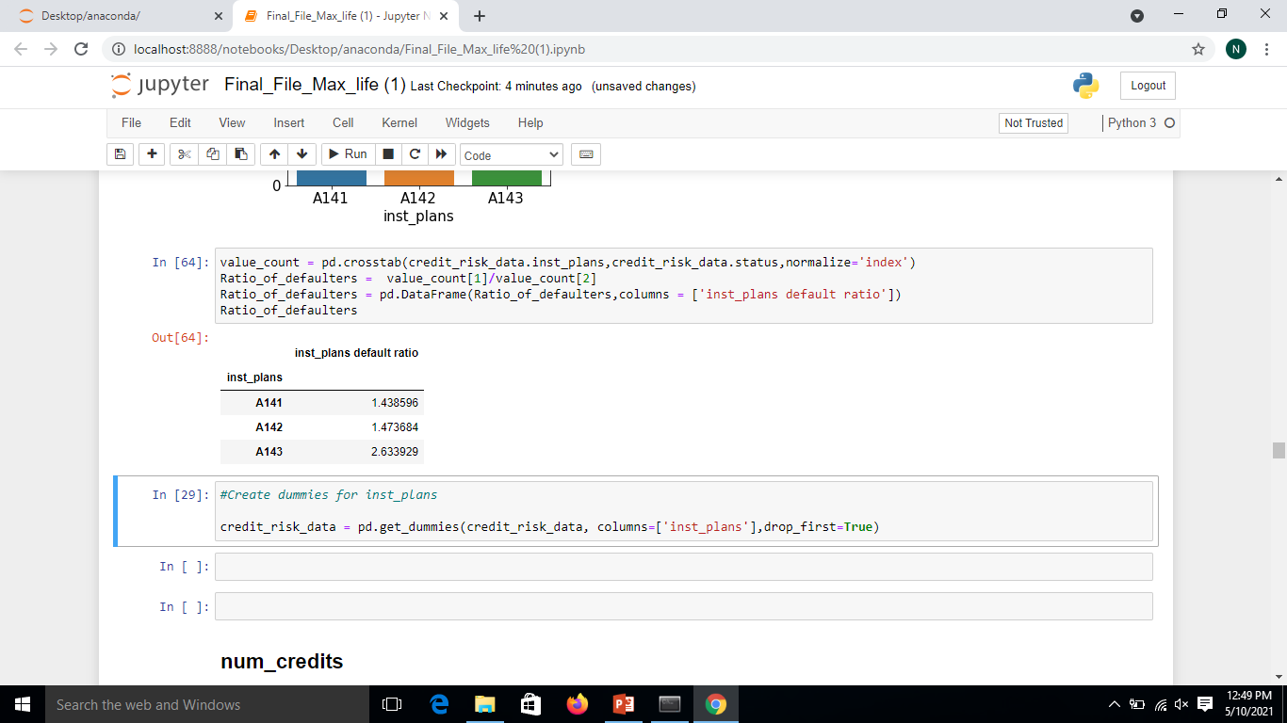
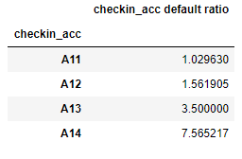
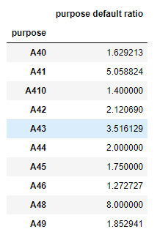
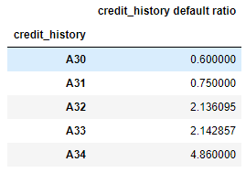
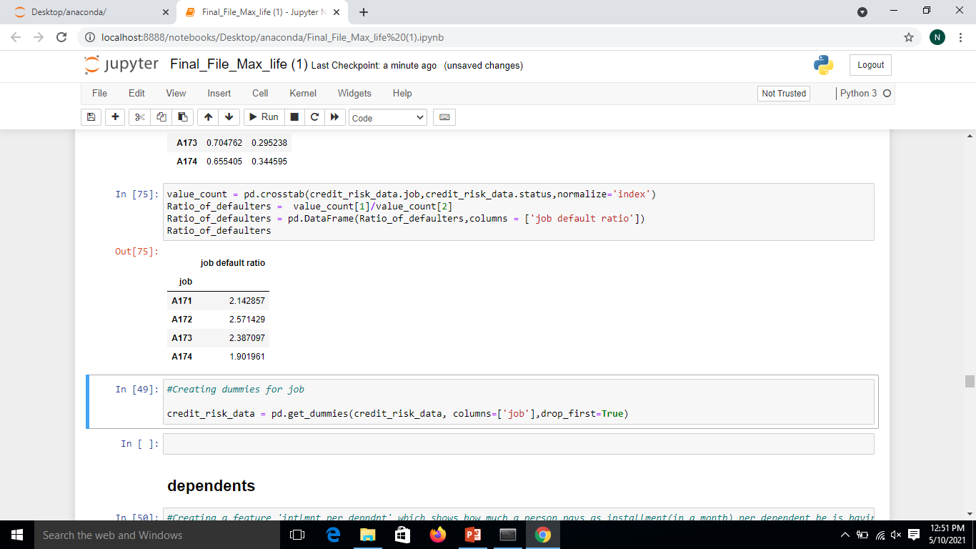
From the given dataset
700 datapoints where status=1
300 datapoints where status=2
Current default ratio= 700/300 =2.33
Characteristic with max risk to default
Characteristic with least risk to default

Slide 7
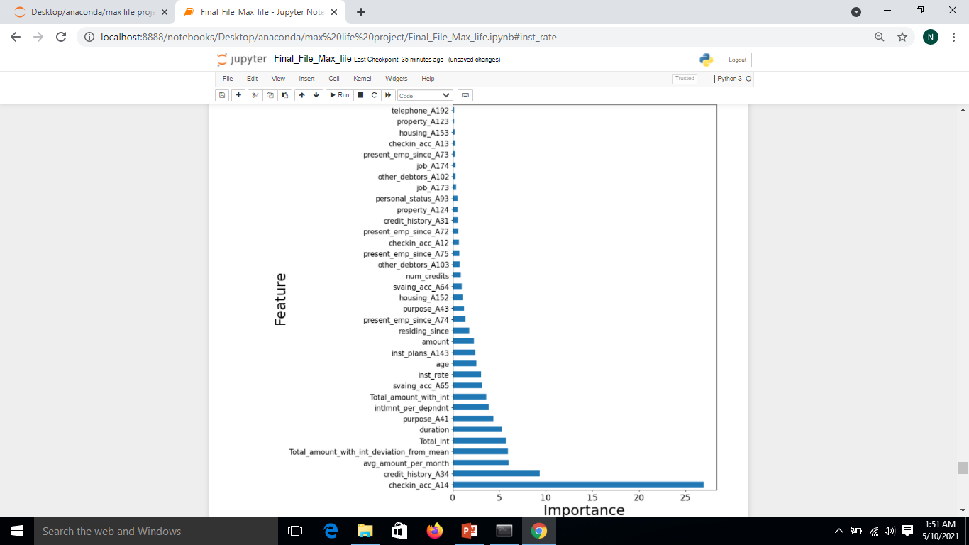

Slide 8
Results
Dividing into train(80%) and test data(20%)
Models/Parameter | Random Forest | Logistic Regression | Catboost
Train Accuracy | 0.84 | 0.76 | 0.82
Test Accuracy | 0.755 | 0.73 | 0.77
Train Log Loss | 0.44 | 0.47 | 0.46
Test Log loss | 0.53 | 0.55 | 0.53

